Slide 1
Adult Immunizations
Vinod Kurup, MD
vinod@kurup.com
August 23, 2004

Slide 2
Adult Immunizations
Tetanus, Diphtheria (Td)
Influenza
Pneumococcal
Hepatitis B
Hepatitis A
Measles, Mumps, Rubella
Varicella
Meningococcal

Slide 3
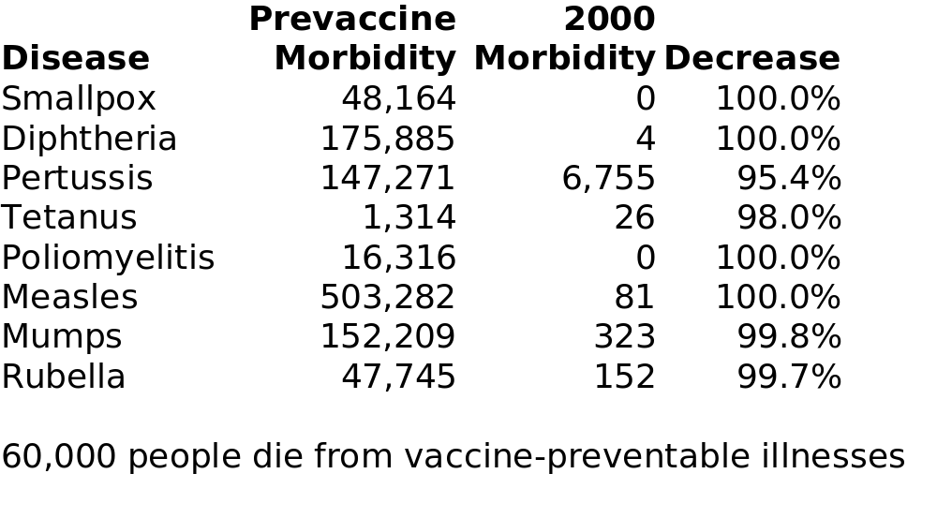
Why vaccinate?

Slide 4
Case 1
27 yo M presents for a routine physical. He has no significant PMH and you find him to be completely healthy.
What immunizations should he get?

Slide 5
Tetanus & diphtheria
40-60 cases per year in U.S.
30% mortality
Only 40% of elderly have protective levels of antibody
Vaccine is nearly 100% protective against tetanus, 95% against diphtheria

Slide 6
Td vaccine
If never immunized before, administer full series:
  2 doses at least 4 wks apart
  3rd dose at 6-12 months
Td booster required every 10 years

Slide 7
Case 2
52 F c/o cough and runny nose. She's asking if she should get the flu shot. What do you tell her?

Slide 8
Influenza
150,000 hospitalized, 36,000 die annually (from flu and complications)
Vaccine 70-90% protective in young adults, less so in elderly
Vaccine changes each year to match prevalent virus.

Slide 9
Who gets Influenza vaccine?
All adults over 50
Chronic liver, heart, kidney or lung disease
Diabetes, HIV, immunosuppression
Health care providers, long term care residents
Women who will be in 2nd or 3rd trimester during flu season

Slide 10
Influenza adverse reactions
80% will have no side effects
< 1% will have fever/chills
Vaccine is contraindicated in patients with egg allergy
Not contraindicated in mild illness

Slide 11
Case 3
65 yo M with DM brings in documentation of a pneumovax that he got last year. His MD told him he'd need another one. Does he?

Slide 12
Pneumococcal disease
40,000 die annually
pneumonia: 500,000 cases, 5-7% mortality
bacteremia: 50,000 cases, 20-60% mortality
meningitis: 3,300 cases, 30-80% mortality, high incidence of brain damage

Slide 13
Pneumococcal vaccine
Vaccine 60-70% effective
Contains 23 types of pneumococcus which account for 90% of infections
50% will have no side effects
< 1% will have fever/chills

Slide 14
Who gets pneumovax?
All adults > 65
Chronic illnesses (DM, heart, lung, kidney)
immunocompromised

Slide 15
Who needs pneumovax booster?
Only persons who received their initial shot before age 65
At least 5 years should elapse between injections.
Max # of injections = 2
Revaccination is associated with increased risk of local reaction

Slide 16
Case 4
36 F nurse got her 1st Hep B injection 2 years ago, but never followed up for her other doses. Should your restart the series? Should you measure her Hep B Surface antibody titer?

Slide 17
Hepatitis B
1980: 200,000 new cases per year
2001: 79,000 new cases
100 times more infectious than HIV
Infants are routinely immunized now
3 doses given over 6 months
No need to restart the series
70% get some protection from 1 dose

Slide 18
Who should get Hep B vaccine?
> 1 sexual partner in past 6 months
h/o STD, IVDU
Hemophilia
Healthcare and public safety workers
Household contact of pt with Hep B
Homosexual males
Hemodialysis patients (check titer annually)

Slide 19
Case 5
48 M comes in, wanting to travel to a Hep A endemic area. You give him his first injection and schedule a second injection for 6 months. When is it safe for him to begin his trip?

Slide 20
Hepatitis A
180,000 cases per year
Vaccine is given as 2 doses over 6-12 months
Protective levels 1 month after 1st dose in 94-100% of pts

Slide 21
Who gets Hepatitis A vaccine?
Childcare center employees
Household contact of pt with Hep A
Chronic liver disease
Hemophilia
Homosexual males
Illegal drug users

Slide 22
Case 6
A 30 yo F presents for a pre-employment physical. Someone ordered a Rubeola titer and it's negative. Her other titers were all positive. What should you do?

Slide 23
Measles, Mumps and Rubella
All 3 uncommon, but outbreaks occur
Adults born after 1956 should receive 1 dose unless:
  Medically contraindicated (pregnancy or immunocompromise)
  Documentation of 1 dose or immunity
Second dose:
  Recently exposed
  Healthcare workers

Slide 24
Case 7
22 M asks if he needs varicella vaccine. He's pretty sure he had chickenpox when he was 4. Does he need the vaccine? Do you need to check the titer?

Slide 25
Varicella
Highly contagious
Usually self-limited, but occasionally causes severe complications
No history of chickenpox:
  Administer 2 doses 4-8 wks apart
Hx of chickenpox is predictive of serologic immunity (97-99%)
Contraindicated: pregnancy, HIV

Slide 26
Case 8
28 F with ITP undergoes splenectomy. Should she get the meningococcal vaccine?

Slide 27
Meningococcal
3000 cases annually
10% mortality, 12% disability
Indications:
  Complement deficiency, asplenia
  Relative: college freshman in dorms
Consider revaccination at 3-5 years

Slide 28
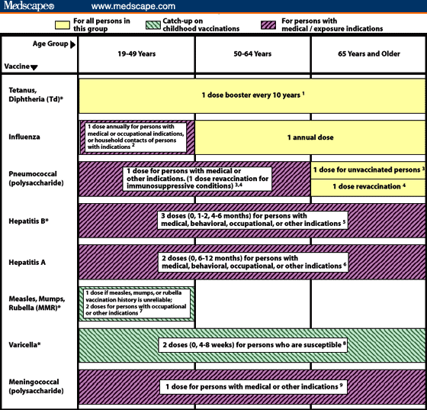

Slide 29
General issues
Only trust documented doses. When in doubt revaccinate!
  Reimmunization only increased risk of local reactions (3% -> 11%). None were severe
  Increased risk was even less in sicker patients
Flu and pneumovax MOST important

