Slide 1
Evaluation of Abnormal LFT's
  Vinod Kurup, MD
  vinod@kurup.com
  July 28, 2003

Slide 2
What are LFT's?
Misnomer
3 general categories
  Hepatocellular damage
  Cholestasis/obstruction
  Synthetic function
2.5% of Normal pts will have high LFT's

Slide 3
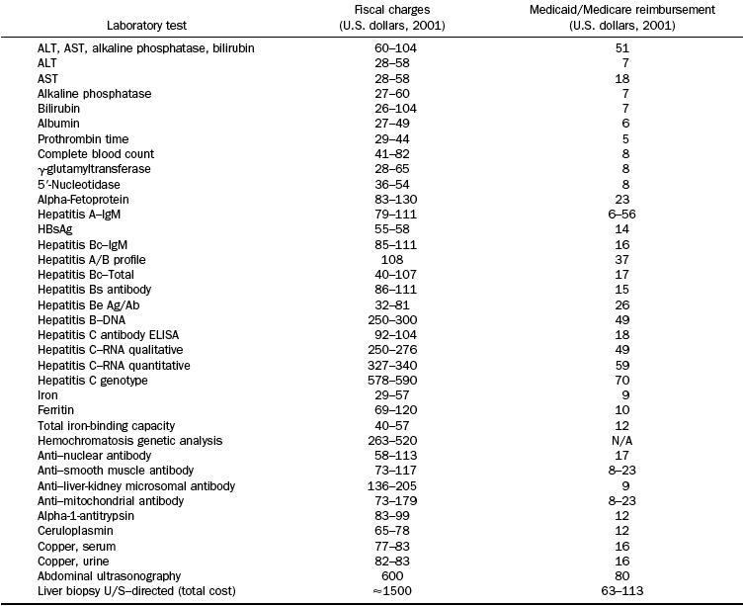

Slide 4
Hepatocellular Tests
ALT and AST
Elevation = hepatocellular damage
Other sources – muscle, heart
ALT more liver-specific than AST
Ratio of ALT:AST sometimes helpful

Slide 5
ALT elevations
A - Autoimmune Hepatitis
B – Hepatitis B
C – Hepatitis C
D – Drugs/Toxins
E – Ethanol
F – Fatty Liver (NASH)
G – Growths (Tumors)
H – Hemodynamic disorder (CHF)
I – Iron overload (hemochromatosis)
O – Other: Wilson's, Alpha-1 antitrypsin, Celiac sprue

Slide 6
Cholestasis Tests
Bilirubin and Alkaline Phosphatase
GGT and 5NT also
Elevation = biliary obstruction
Other sources
  Bilirubin: blood
  Alk phos: bone

Slide 7
Alk Phos elevations
Hepatic
  Bile duct obstruction
  Primary Biliary Cirrhosis
  Primary Sclerosing Cholangitis
  Granulomatous Disease
Nonhepatic
  Pregnancy
  Bone disorders
  Hyperthyroidism
  CHF
  Lymphoma

Slide 8
Bilirubin elevations
Direct (conjugated)
  Hepatocellular disease
  Intrahepatic cholestasis
  Benign postop jaundice
  Sepsis
  Congenital Hyperbilirubinemia
  Obstructive Jaundice
Indirect (unconjugated)
  Hemolysis
  Gilbert syndrome
  Crigler-Najjar
  Medications

Slide 9
ALT Algorithm
ALT > 2x normal
Group 1
Hep A IgM
Hep C Ab
Hep B SAb
Hep B Sag
Hep B Cab IgM
Fe/TIBC/Ferritin
Yes
Repeat
ALT > 2x normal
Observe
No
Group 2
Yes
Ultrasound
SPEP
Ceruloplasmin
Anti-gliadin
Anti-endomysial
HCV-RNA
HFE
Check Group 1 tests
Diagnosis?
Manage diagnosis
Yes
No
Repeat LFTs in 6 months
ALT > 2x normal
Observe
No
Yes
Check Group 2 tests
Liver Biopsy
Diagnosis?
Manage diagnosis
No
Yes

Slide 10
Alk Phos Algorithm
Repeat Alk Phos > 2x normal
No
Observe
Yes
GGT elevated
Pursue nonhepatic cause
No
Yes
RUQ Ultrasound
Ductal dilatation
AMA, liver biopsy
No
Yes
ERCP/MRCP

Slide 11
Bilirubin Algorithm
Repeat Bilirubin > 2x normal
Yes
Unconjugated
Retic count normal
Gilbert's
Yes
Yes
No
No
Hemolysis workup
RUQ Ultrasound
Ductal dilatation
Liver biopsy vs observation
No
Yes
ERCP/MRCP

Slide 12
Scenario 1
43 yo M has elevated ALT (3x normal) on routine lab test. History and physical exam are completely unrevealing. Which tests should he have next?
A. Full set of LFTs
B. Hep B S Ab
C. Hep B S Ag
D. Fe/TIBC/Ferritin
E. All of the above

Slide 13
Scenario 1
Answer: A – Full set of LFTs
In an asymptomatic patient with mild LFT elevation, always repeat the value before doing further evaluation.

Slide 14
Scenario 2
A patient has:
AST 183
ALT 75
Given no more information, what is the likeliest diagnosis?
A. Hepatitis C
B. Fatty liver disease (NASH)
C. Alcohol hepatitis
D. None of the above

Slide 15
Scenario 2
C. Alcoholic Hepatitis
An AST:ALT ratio of 2:1 or greater is suggestive of alcoholic hepatitis.

Slide 16
Scenario 3
34 yo F has had mild ALT elevation for 12 months. H&P unrevealing.
AST 67
ALT 73
Hep B SAb: Positive
Hep B SAg: Negative
Hep B Core IgM: Negative
Fe/TIBC ratio: 55%
Ferritin 1275
What is the most appropriate next test?
A) Repeat the LFTs
B) Hep B e Ag, Hep B e Ab and HBV-DNA
C) Liver Biopsy
D) Gene testing for hemochromatosis

Slide 17
Scenario 3
D. Gene testing for hemochromatosis
Testing for the HFE gene can confirm the diagnosis of hemochromatosis without a liver biopsy in some cases

Slide 18
Scenario 4
34 M asymptomatic.
Total bilirubin 1.8
Direct bilirubin 0.2
AST/ALT/Alk phos/Albumin WNL
Retic count WNL
What's the next test?
A. RUQ Ultrasound
B. Repeat LFTs
C. Haptoglobin
D. No further tests

Slide 19
Scenario 4
D. No further tests
This patient has unconjugated hyperbilirubinemia without evidence of liver disease or hemolysis. The diagnosis is Gilbert's syndrome and further testing is not needed.

Slide 20
Scenario 5
44 F c/o RUQ pain after meals for 6 months. Over the past few days her pain has been more frequent.
T.bili 2.3
D. bili 1.8
Alk phos 199
AST/ALT nl
Next step?
A. Repeat LFTs
B. RUQ Ultrasound
C. Hepatitis A,B and C studies, Fe/TIBC
D. AMA

Slide 21
Scenario 5
B. RUQ Ultrasound
This patient has symptoms consistent with biliary obstruction, so the algorithms should be ignored.

Slide 22
Summary
Which process predominates (obstructive versus hepatocellular)
Repeat abnormal test
Horses before zebras
H&P guides strategy

Slide 23
References
Pratt, Daniel S., Kaplan, Marshall M.
Evaluation of Abnormal Liver-Enzyme Results in Asymptomatic Patients
N Engl J Med 2000 342: 1266-1271
http://content.nejm.org/cgi/content/full/342/17/1266
AGA guidelineshttp://www2.gastrojournal.org/scripts/om.dll/serve?action=searchDB&searchDBfor=art&artType=fullfree&id=agast1231367
3 page summary and 18 page full article available

