Slide 1
Emacs for Python Programming
Vinod Kurup
@vkurup
October 20th, 2012

Slide 2
Hi Vinod!
Notes:
Addiction may be a strong word, but emacs is certainly a lifestyle choice.

Slide 3
Emacs users

Slide 4
Non-addicts (yet!)

Slide 5
Let's talk about...
Python-specific features
General programming features
Why I'm an addict for life

Slide 6
But first ...

Slide 7
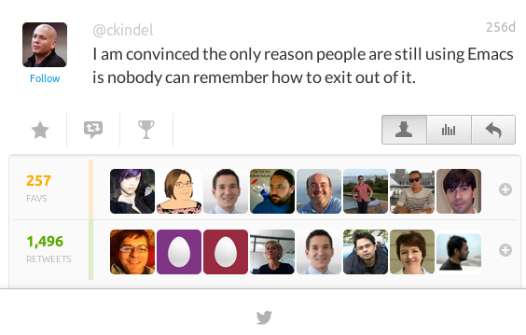

Slide 8
How to safely play with Emacs
Control-x Control-c quits (C-x C-c)
C-g is your friend
Plan to mess up
vinod:~$ rm -r .emacs.d .emacs
vinod:~$ emacs
You're good to go again!

Slide 9
Emacs Sucks!
but only if you use the default settings

Slide 10
Emacs Starter Kit
M-x package-install RET starter-kit RET

Slide 11
Other nice starting points
Emacs Prelude
http://batsov.com/prelude/
Emacs Live
https://github.com/overtone/emacs-live

Slide 12
Emacs Python IDE

Slide 13
Features
Syntax highlighting
Auto-Indentation
Code completion
Documentation lookup
Code lookup / navigation
Error highlighting (on-the-fly)
Code runner
Test runner
Debugging

Slide 14
Major mode
Python's is a bit of a mess

Slide 15
Use python-mode.el
https://launchpad.net/python-mode
M-x package-install RET python-mode RET

Slide 16
Syntax highlighting

Slide 17
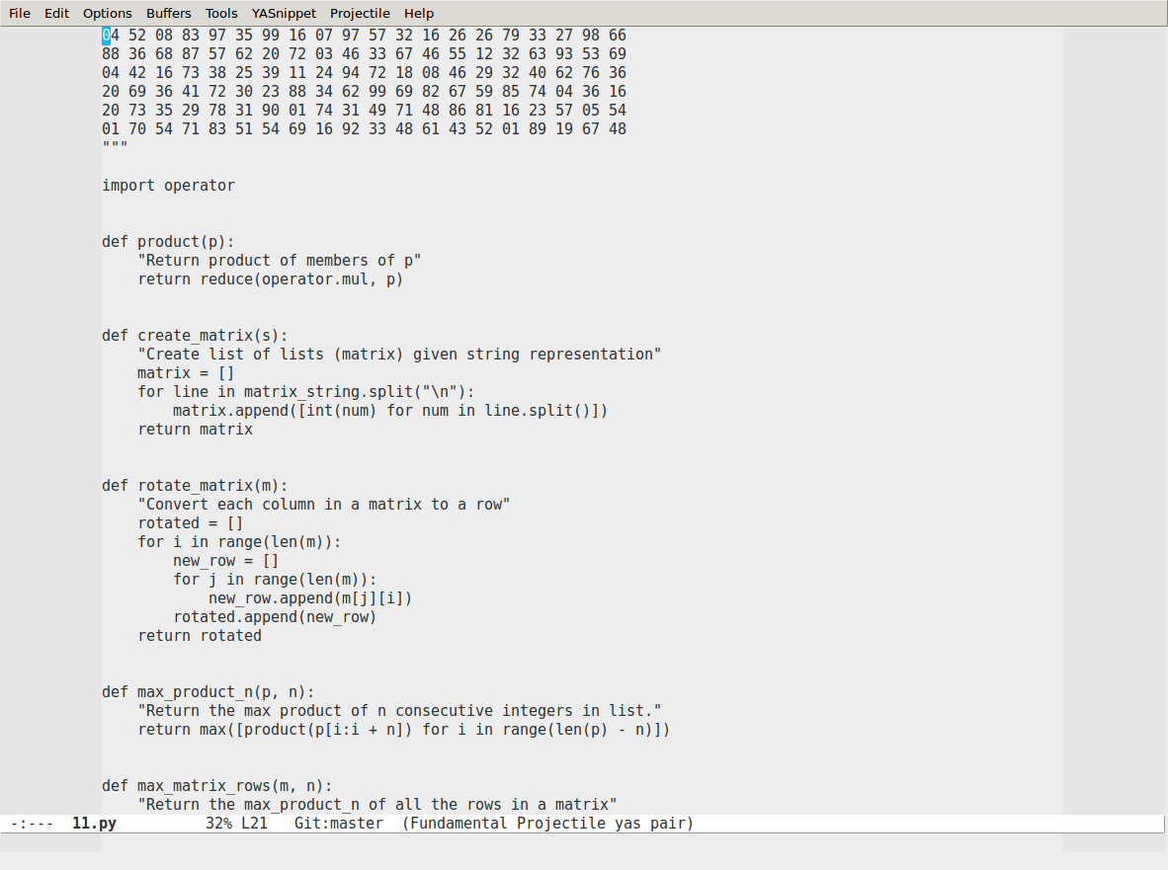

Slide 18
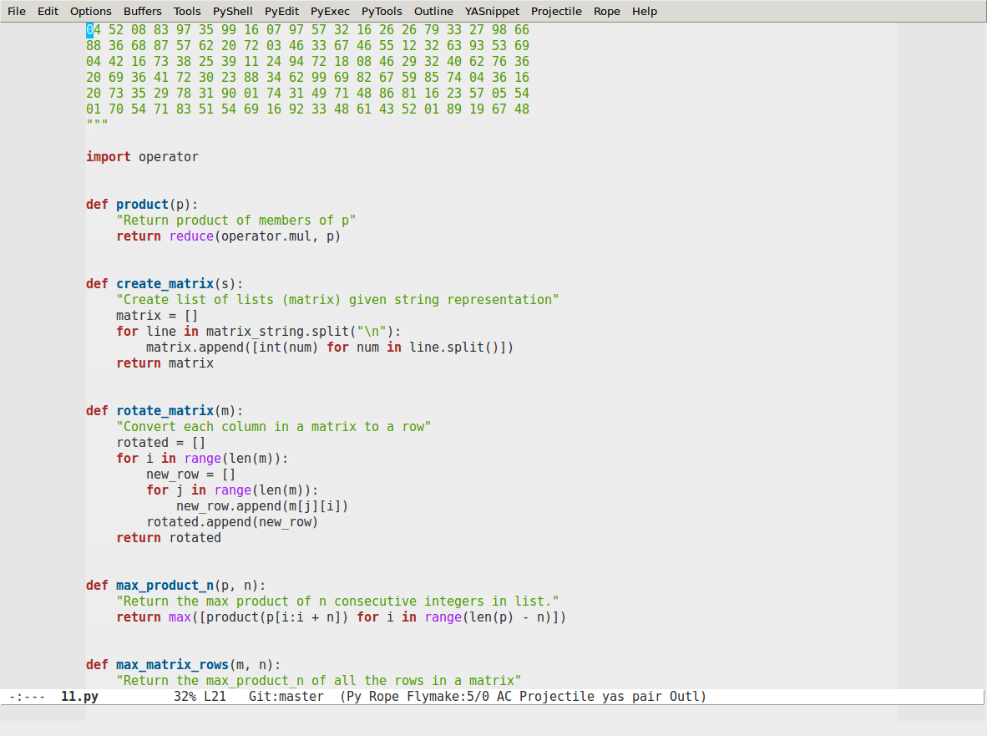

Slide 19
Automatic indentation

Slide 20
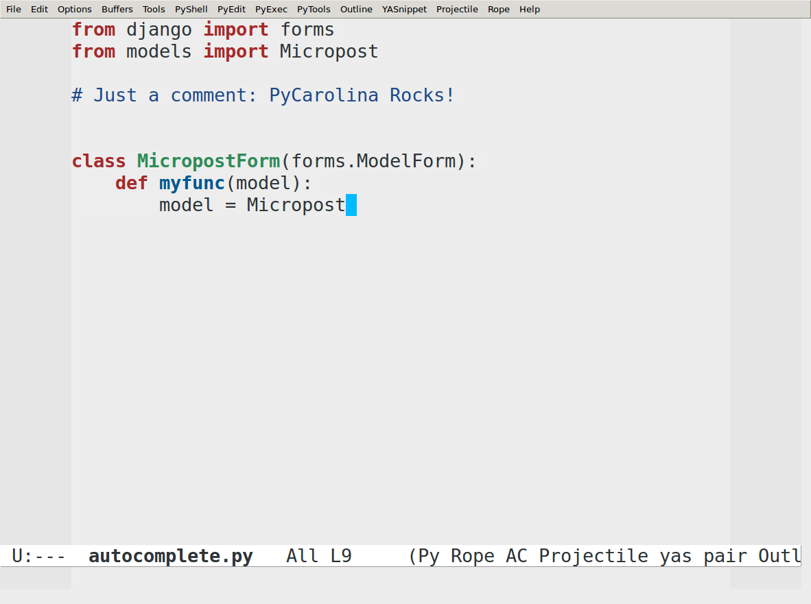

Slide 21
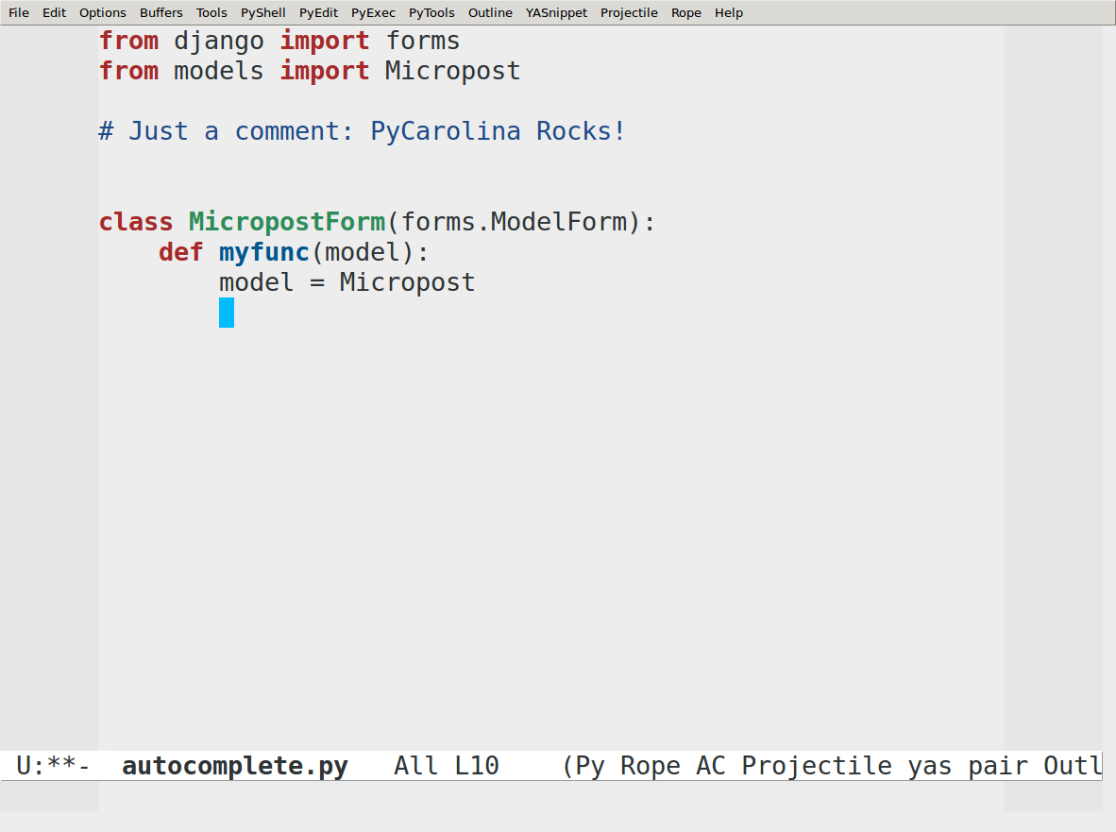

Slide 22
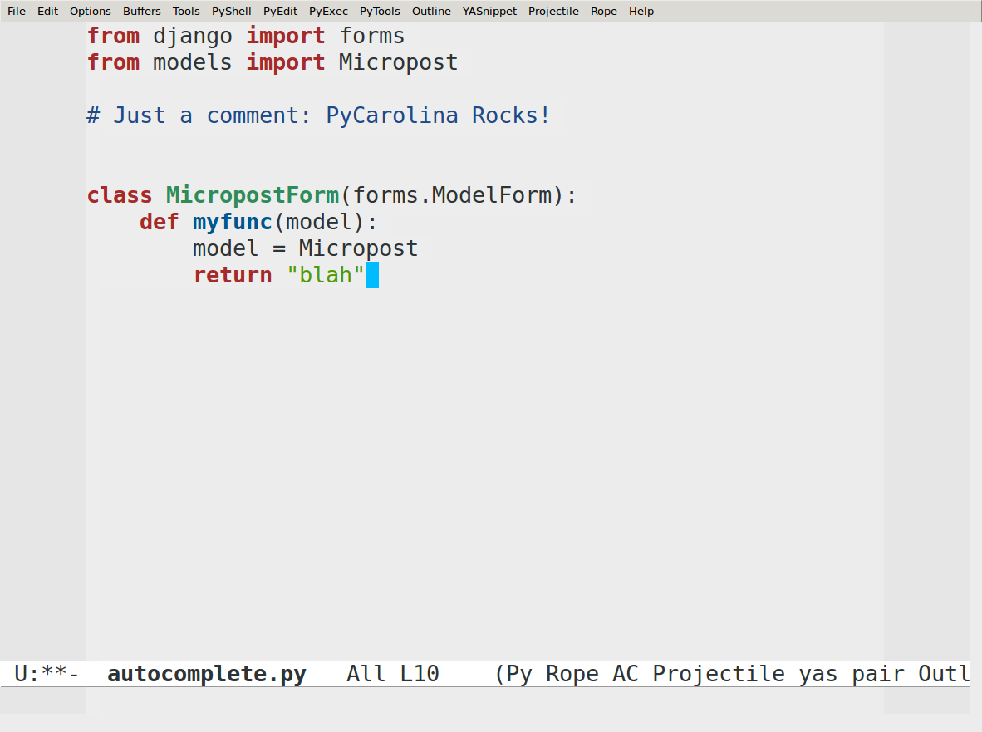

Slide 23
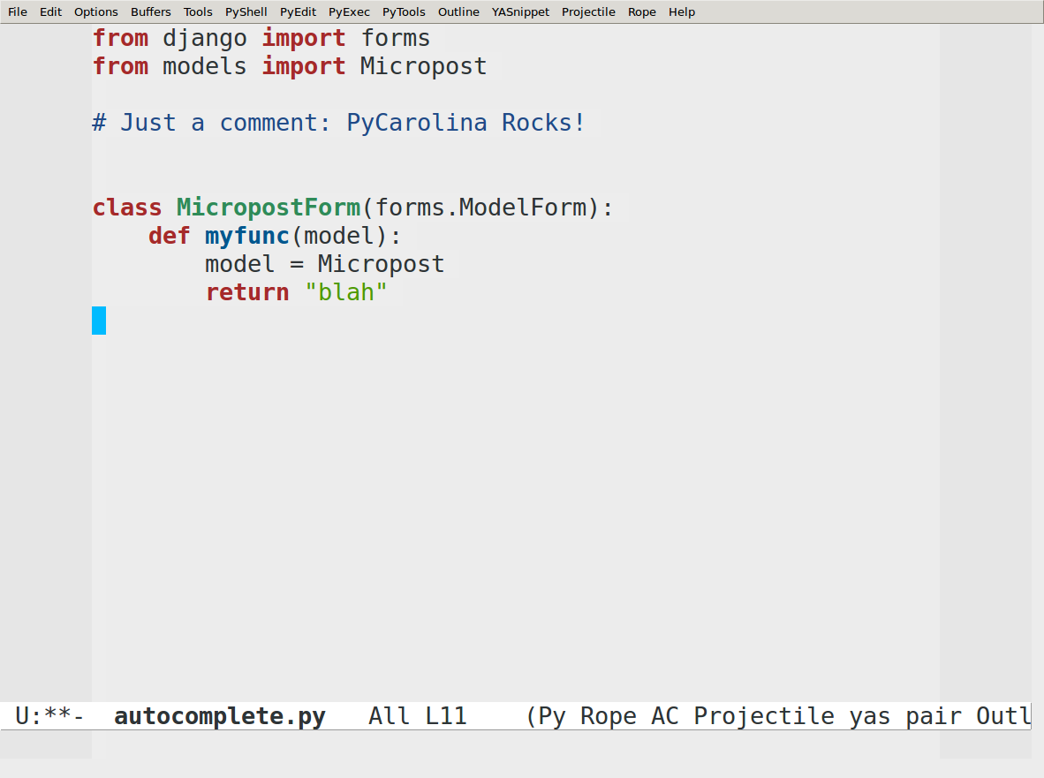

Slide 24
Code completion

Slide 25
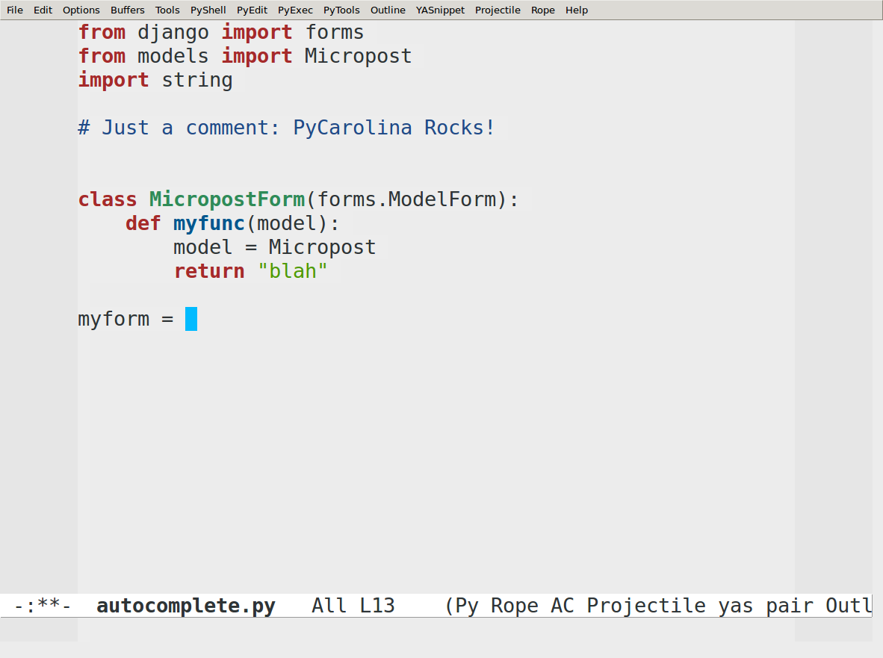

Slide 26
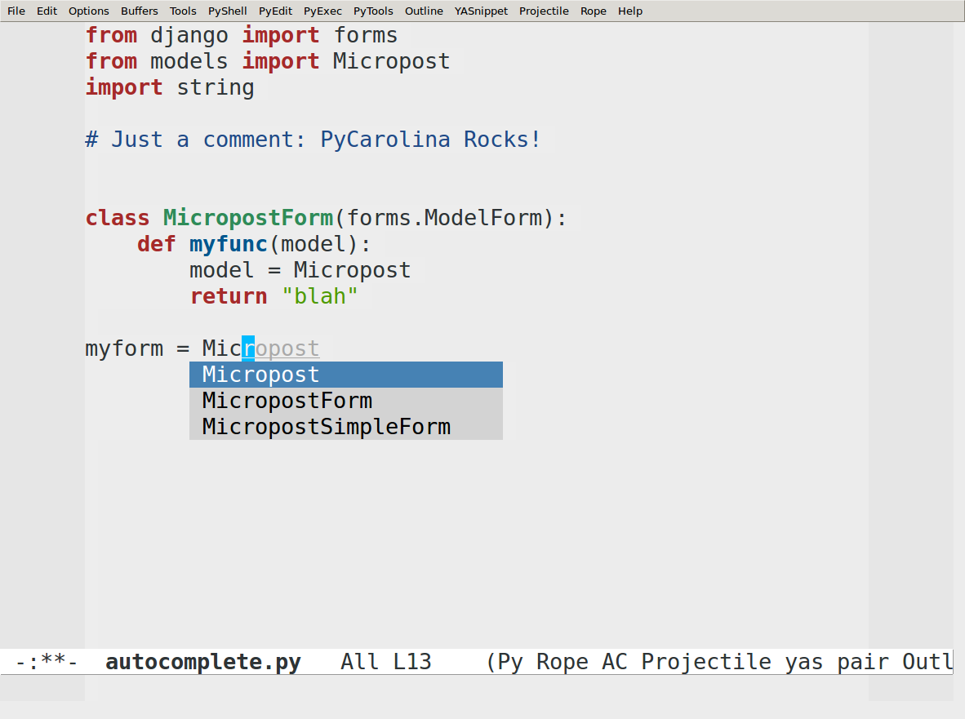

Slide 27
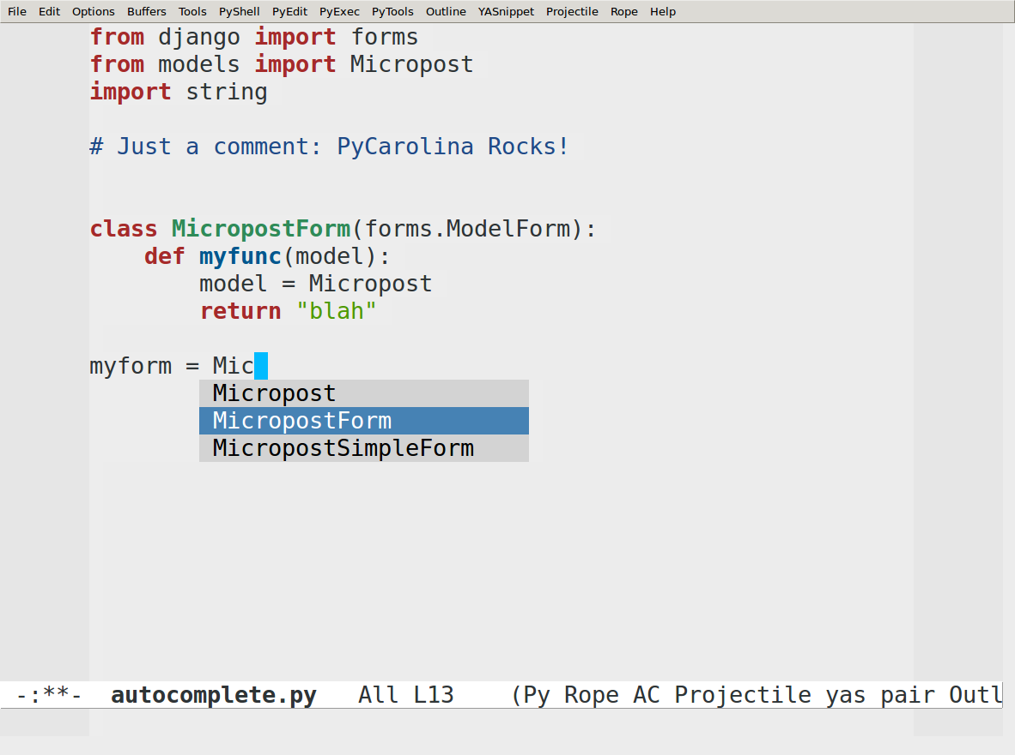

Slide 28
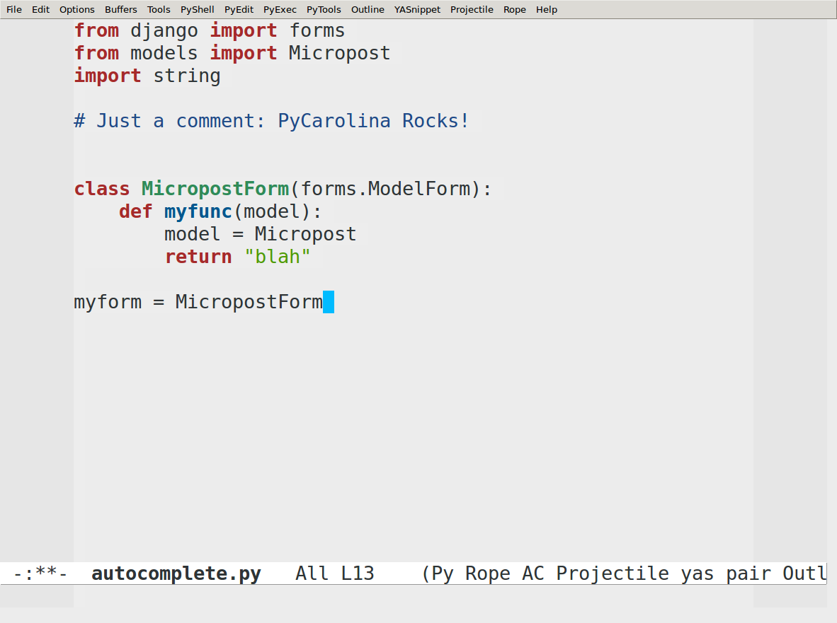

Slide 29
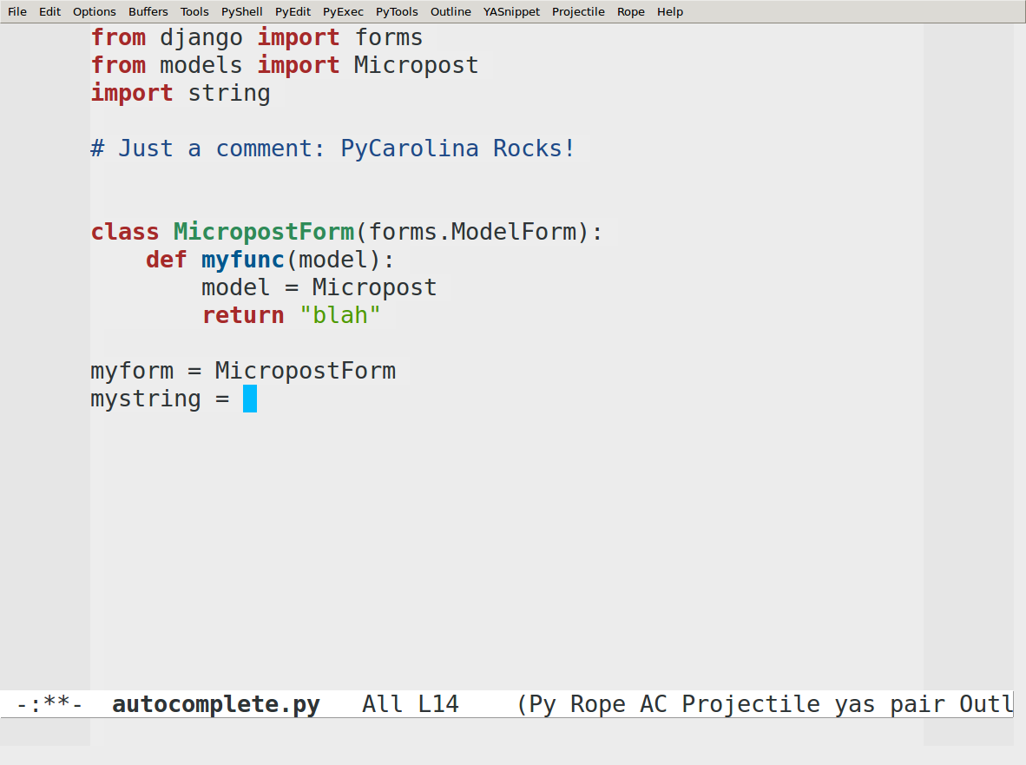

Slide 30
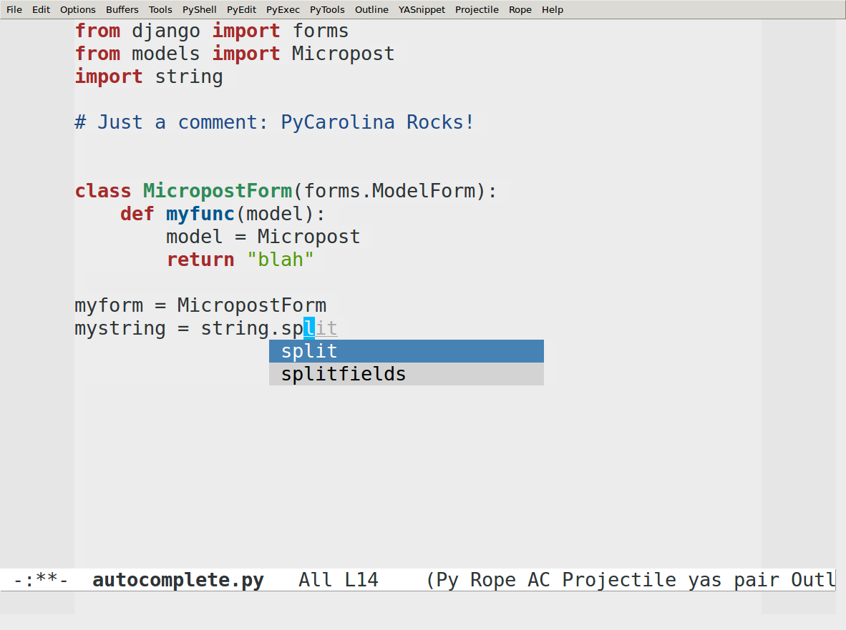

Slide 31
Documentation lookup

Slide 32
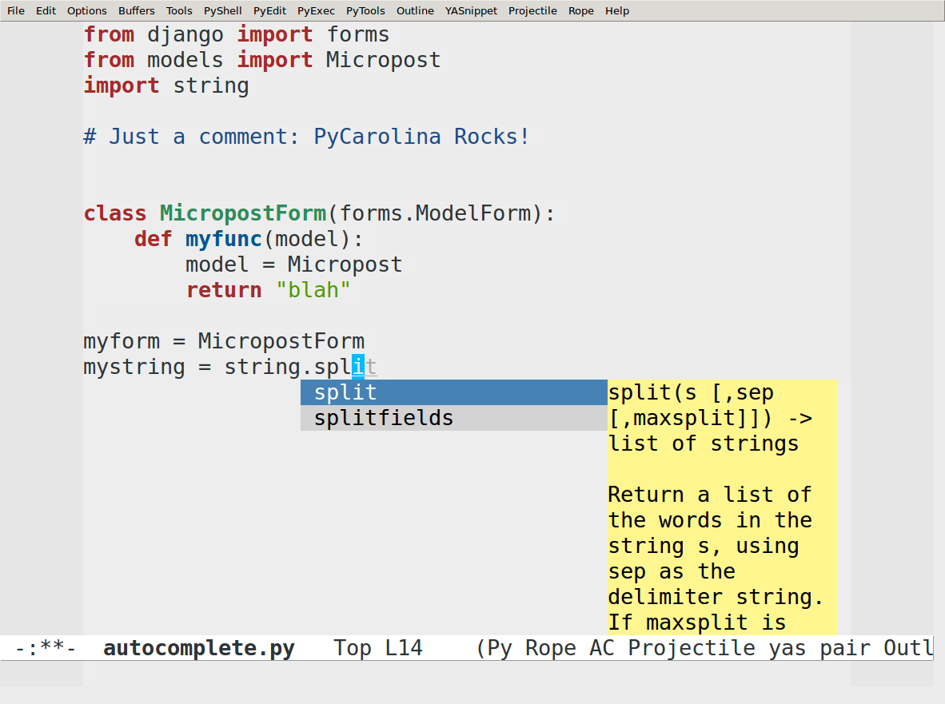

Slide 33
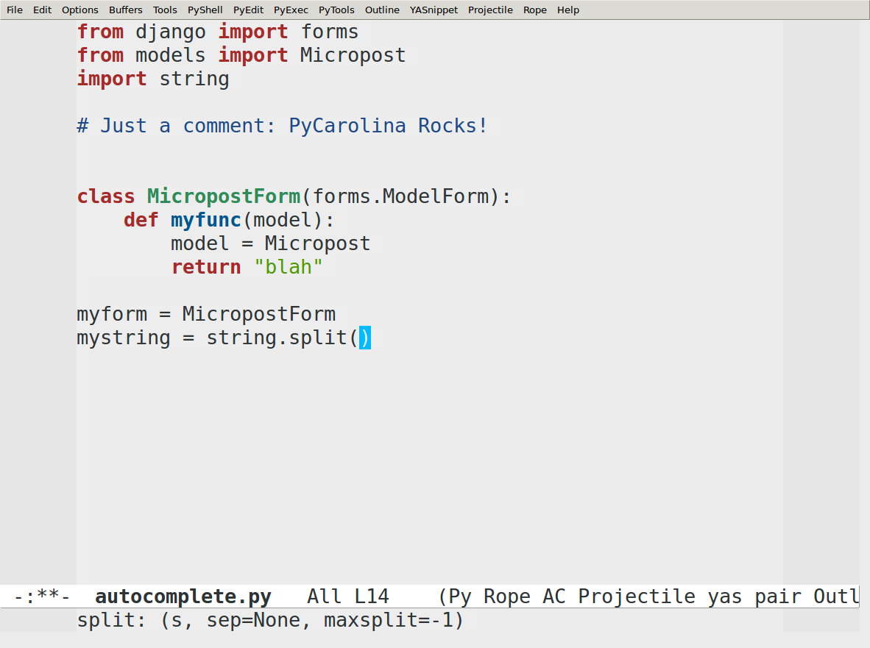

Slide 34
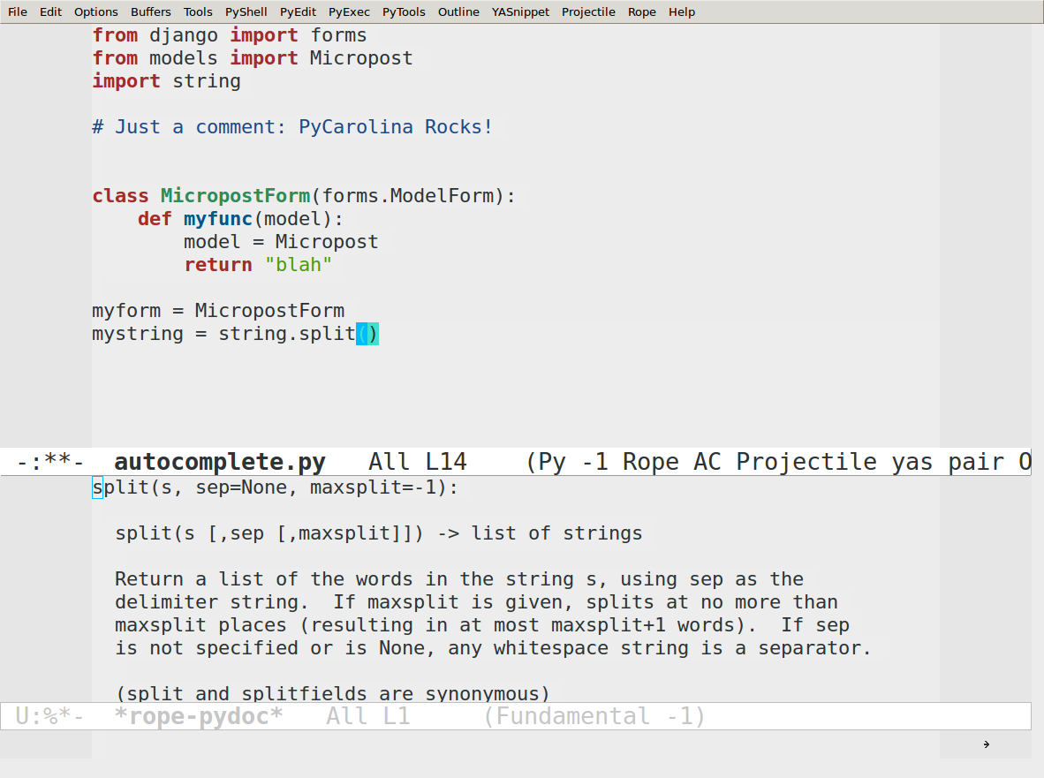

Slide 35
Code lookup

Slide 36
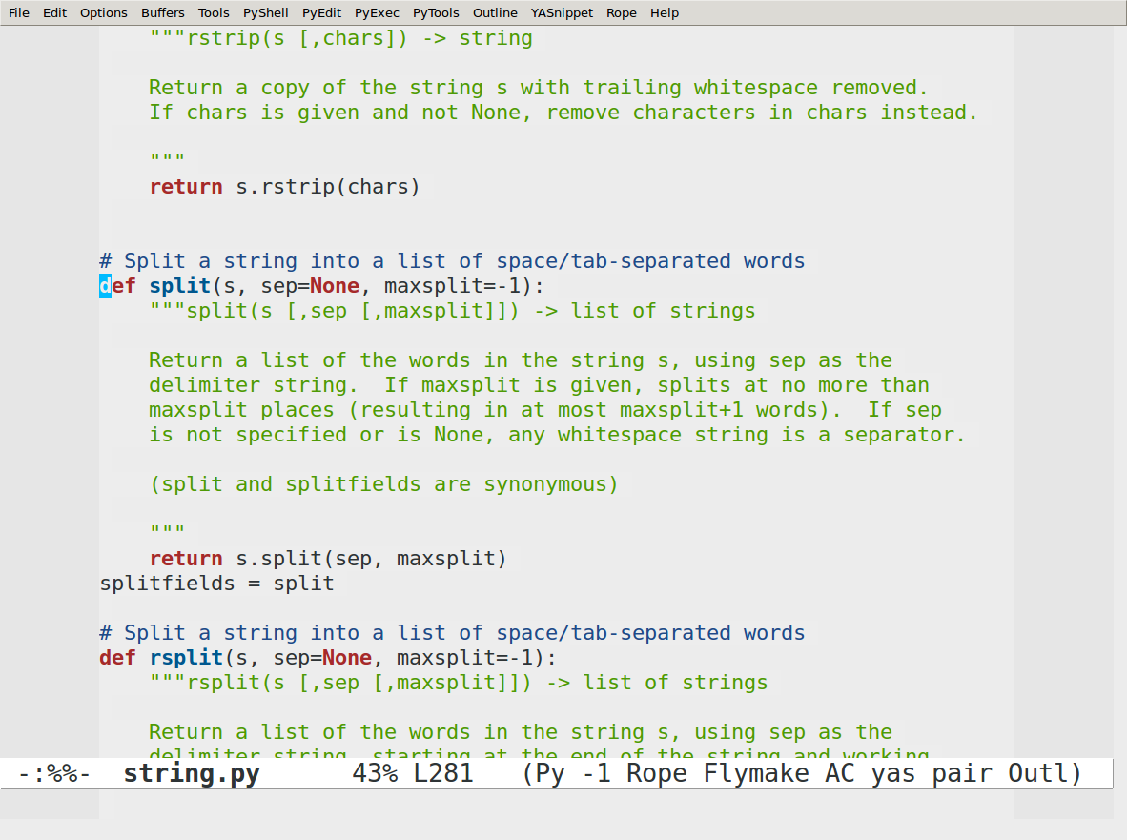

Slide 37
Error highlighting

Slide 38
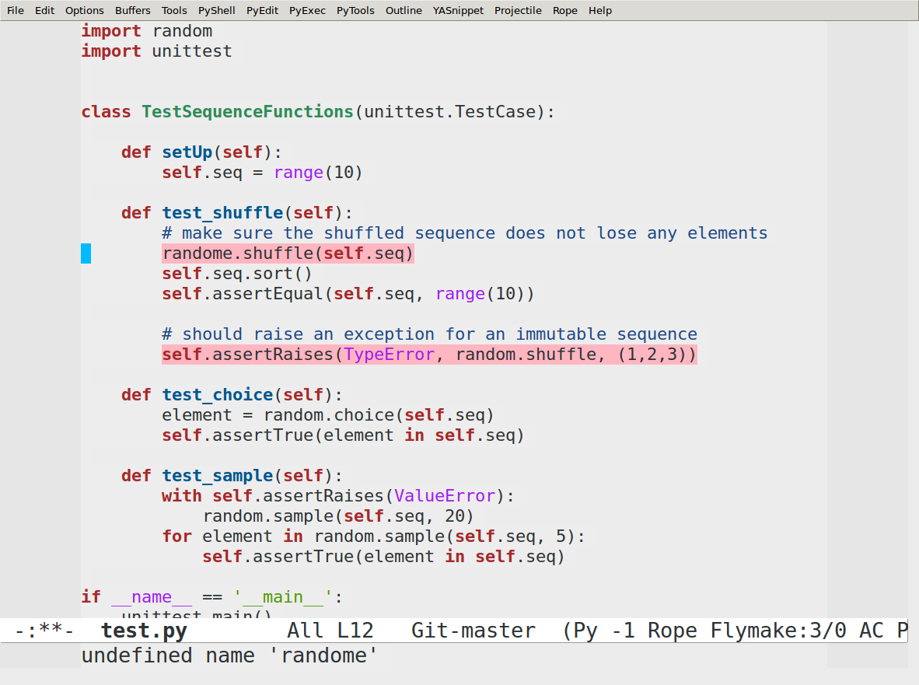

Slide 39
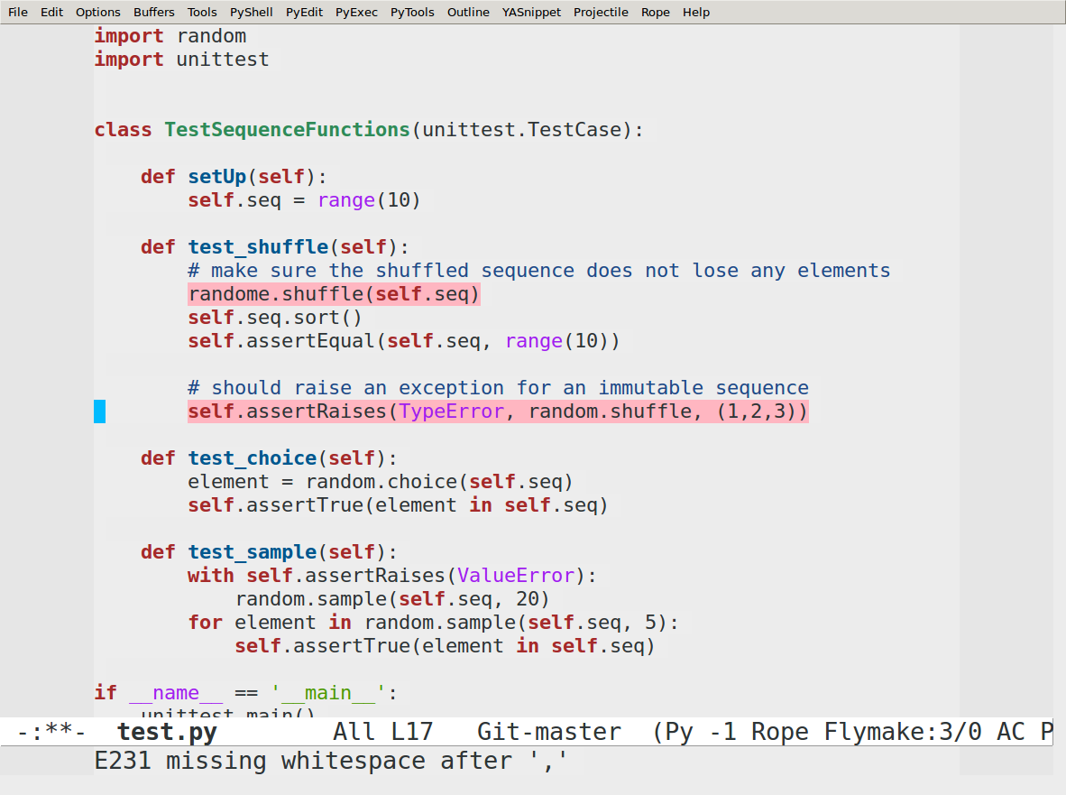

Slide 40
Code runner
Send the current buffer to Python
C-c C-c
Choose your interpreter
(setq python-python-command "ipython")
Choose your virtualenv
(virtualenv-workon "myproject")
or
M-x virtualenv-workon RET myproject RET

Slide 41
Test runner

Slide 42
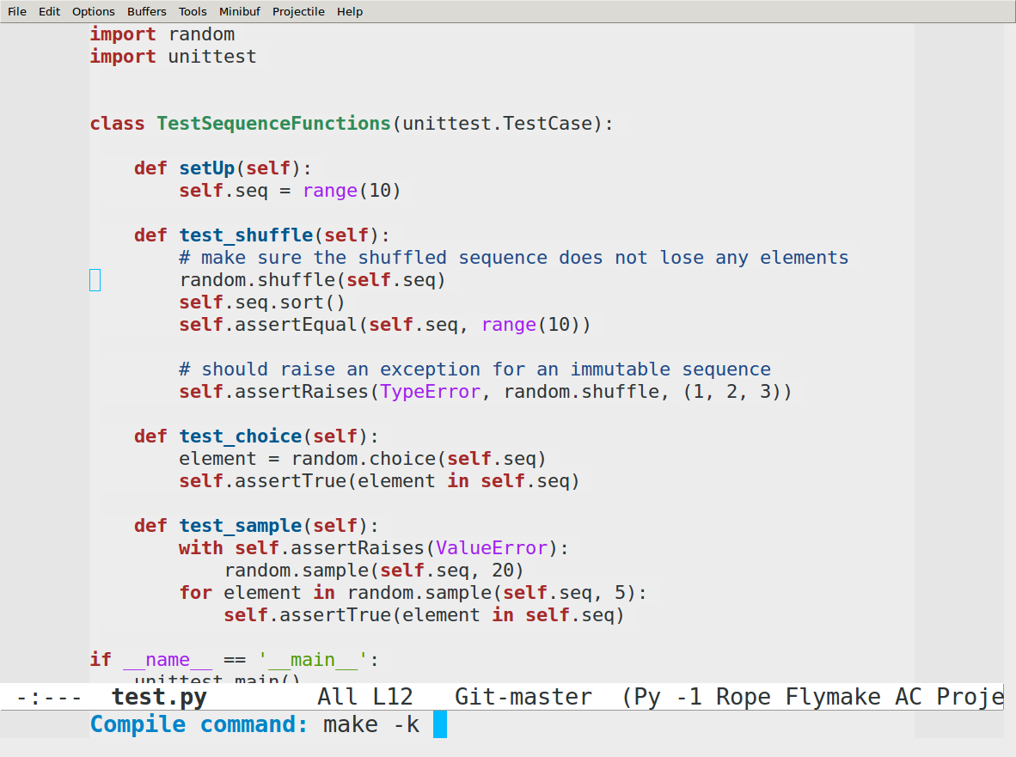

Slide 43
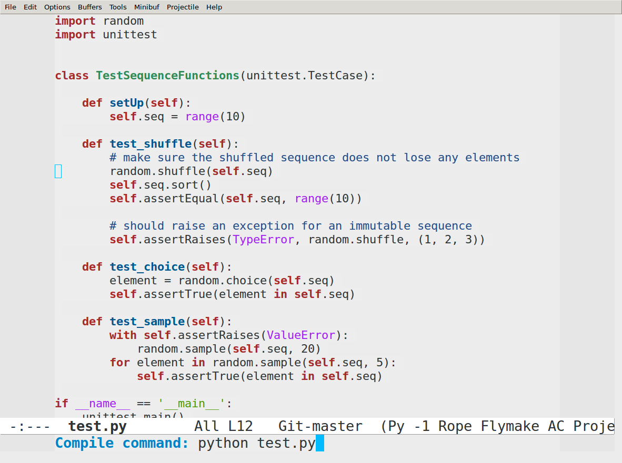

Slide 44
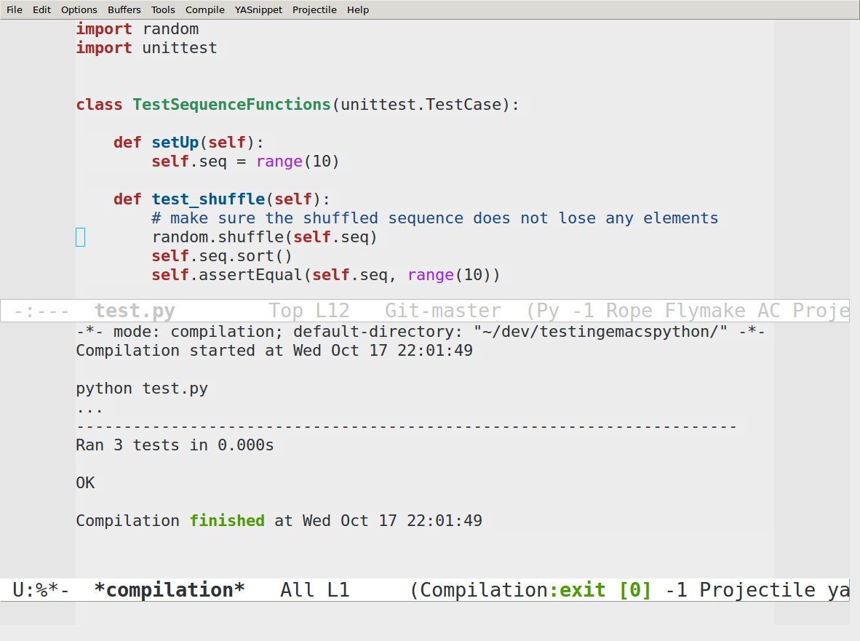

Slide 45
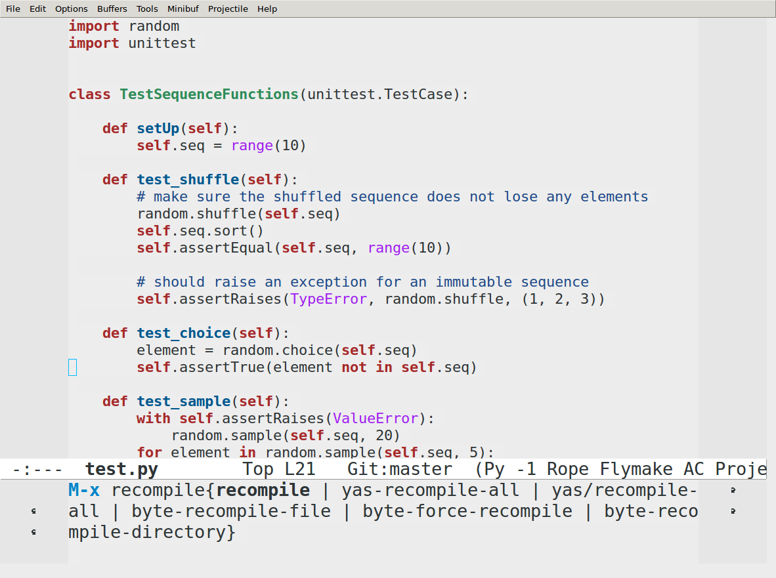

Slide 46
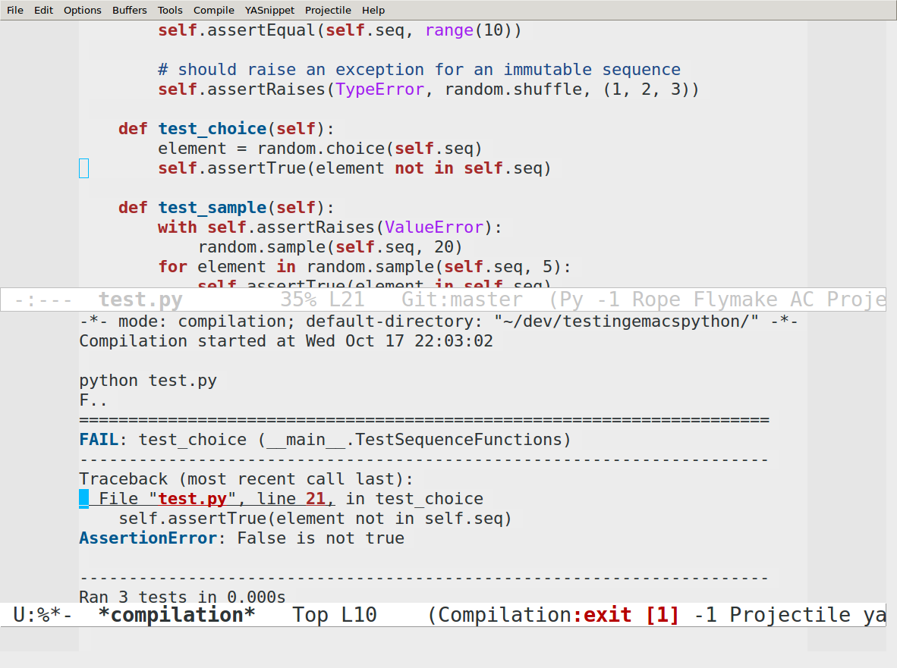

Slide 47
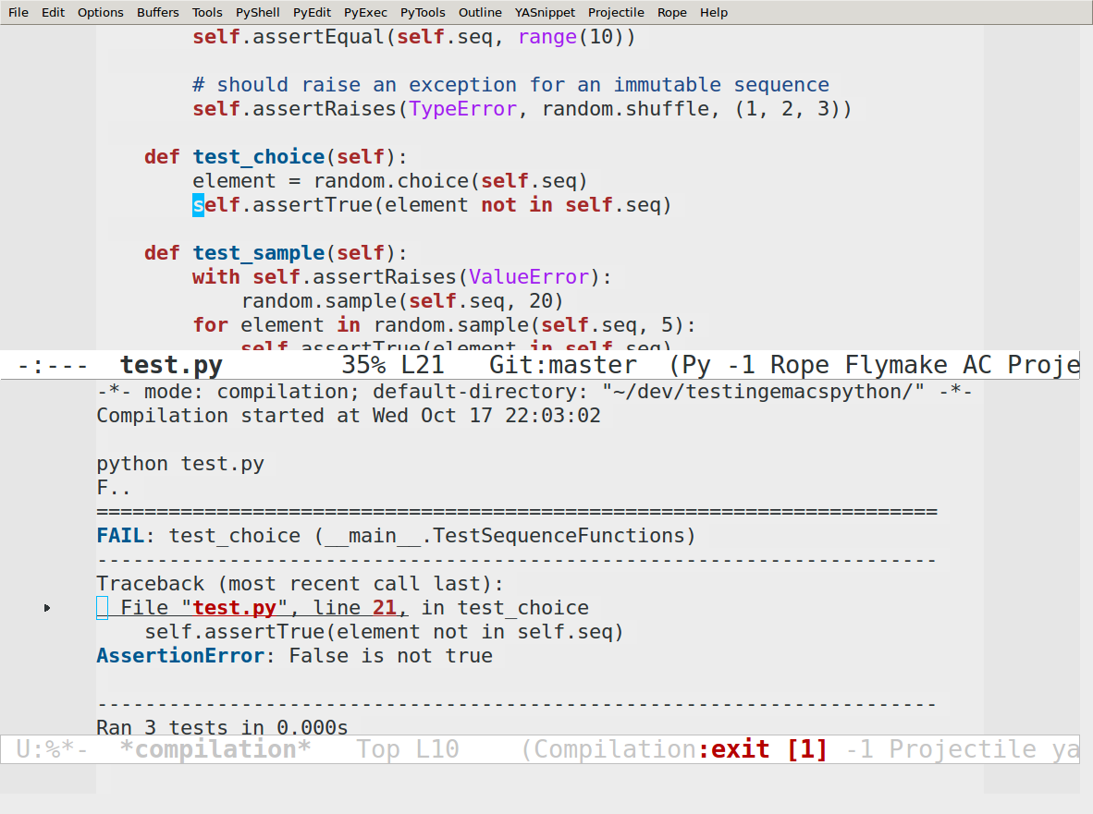

Slide 48
Debugging

Slide 49
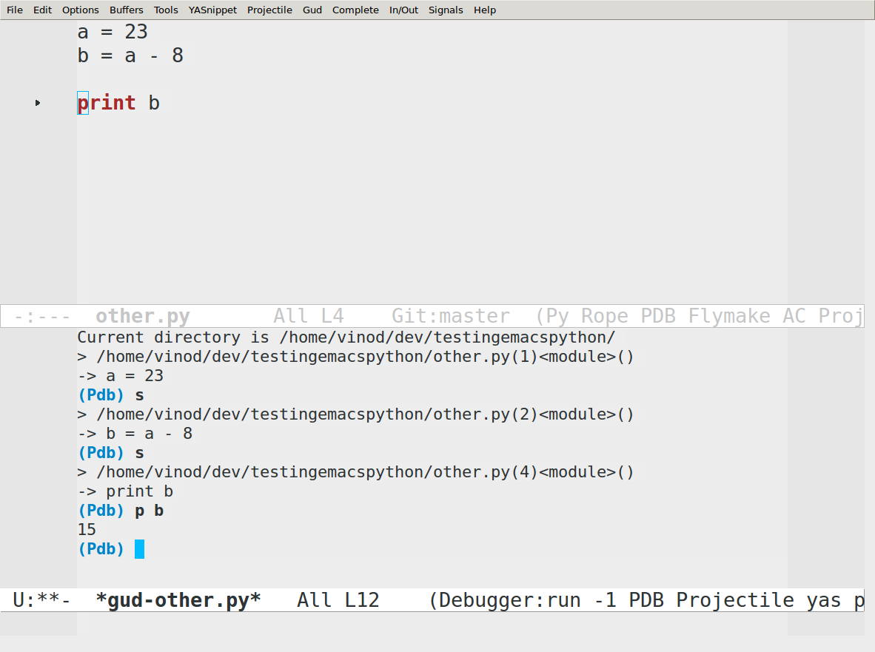

Slide 50
Brief HOWTO

Slide 51
Brief Howto
(emacs)vinod:~ $ pip freeze
Pymacs==0.25
pep8==1.3.3
pyflakes==0.5.0
pylint==0.25.2
rope==0.9.4
ropemacs==0.7
ropemode==0.2
wsgiref==0.1.2
(defvar my-packages '(starter-kit
starter-kit-bindings
yasnippet
pony-mode
markdown-mode
auto-complete
python-mode
autopair)
"A list of packages installed at launch.")
Python
Emacs

Slide 52
Brief Howto
(setq py-load-pymacs-p t)
(require 'python-mode)
(require 'auto-complete-config)
(ac-config-default)
(require 'autopair)
(autopair-global-mode)
(shell)
(add-to-list 'load-path "~/.emacs.d/vendor/")
(virtualenv-workon "emacs/")
(require 'pymacs)
(pymacs-load "ropemacs" "rope-")
(setq ropemacs-enable-autoimport t)
;; pyflakes flymake integration
;; http://stackoverflow.com/a/1257306/347942
(when (load "flymake" t)
(defun flymake-pyflakes-init ()
(let* ((temp-file (flymake-init-create-temp-buffer-copy
'flymake-create-temp-inplace))
(local-file (file-relative-name
temp-file
(file-name-directory buffer-file-name))))
(list "pycheckers" (list local-file))))
(add-to-list 'flymake-allowed-file-name-masks
'("\\.py\\'" flymake-pyflakes-init)))
(add-hook 'python-mode-hook 'flymake-mode)

Slide 53
Non-python stuff

Slide 54
Magit mode

Slide 55
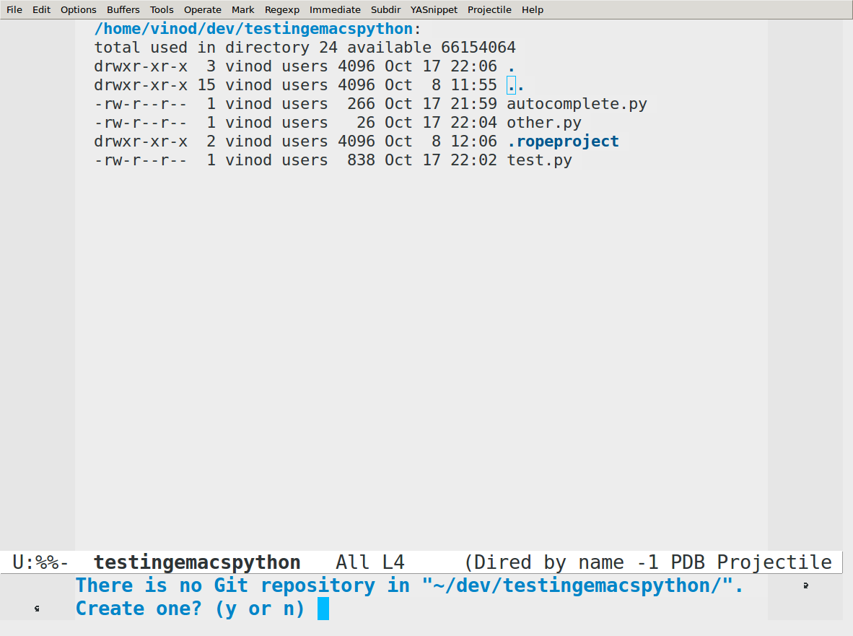

Slide 56
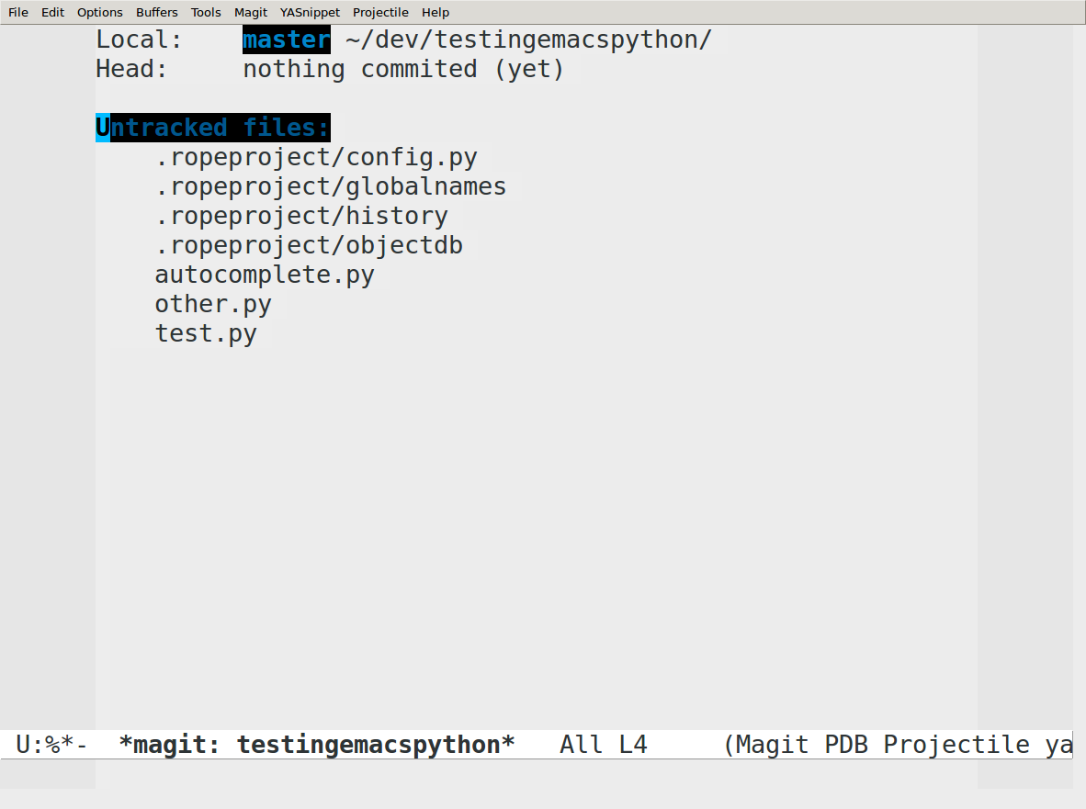

Slide 57
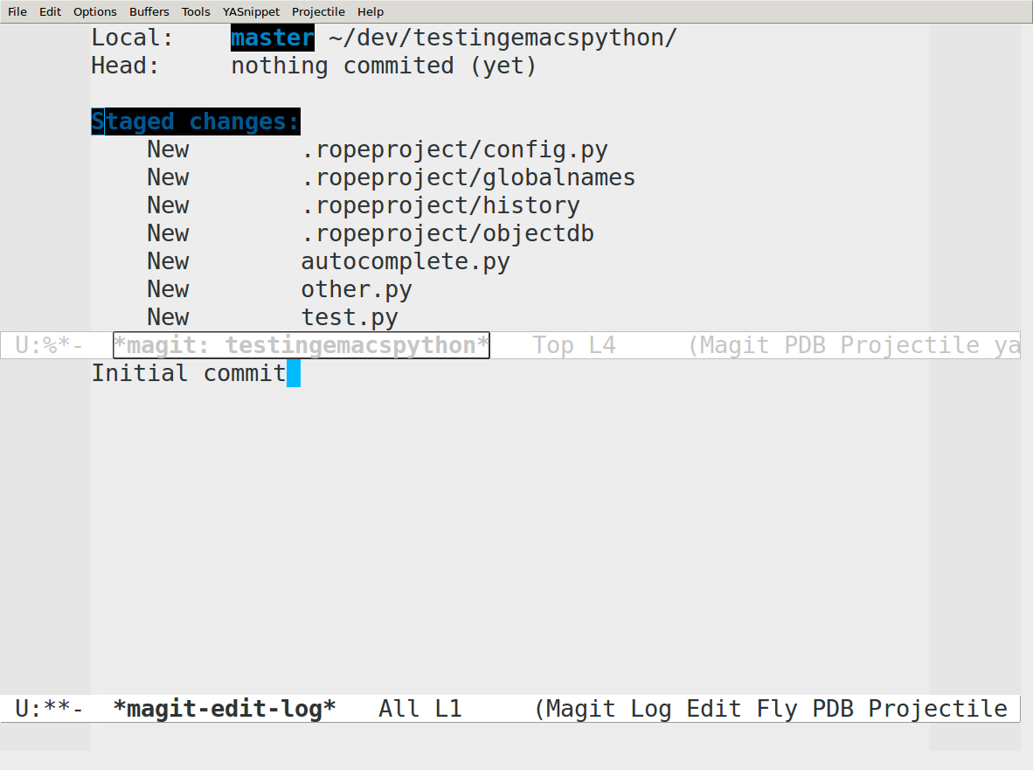

Slide 58
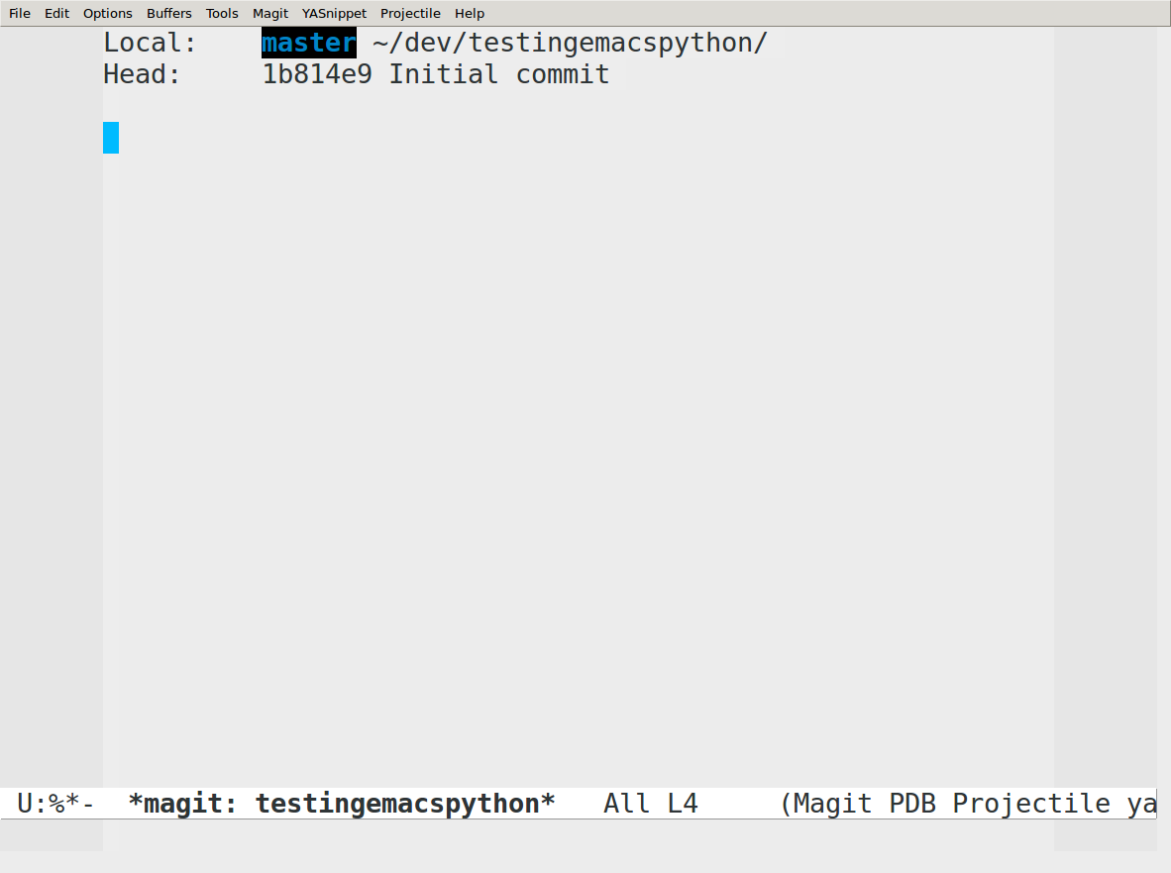

Slide 59
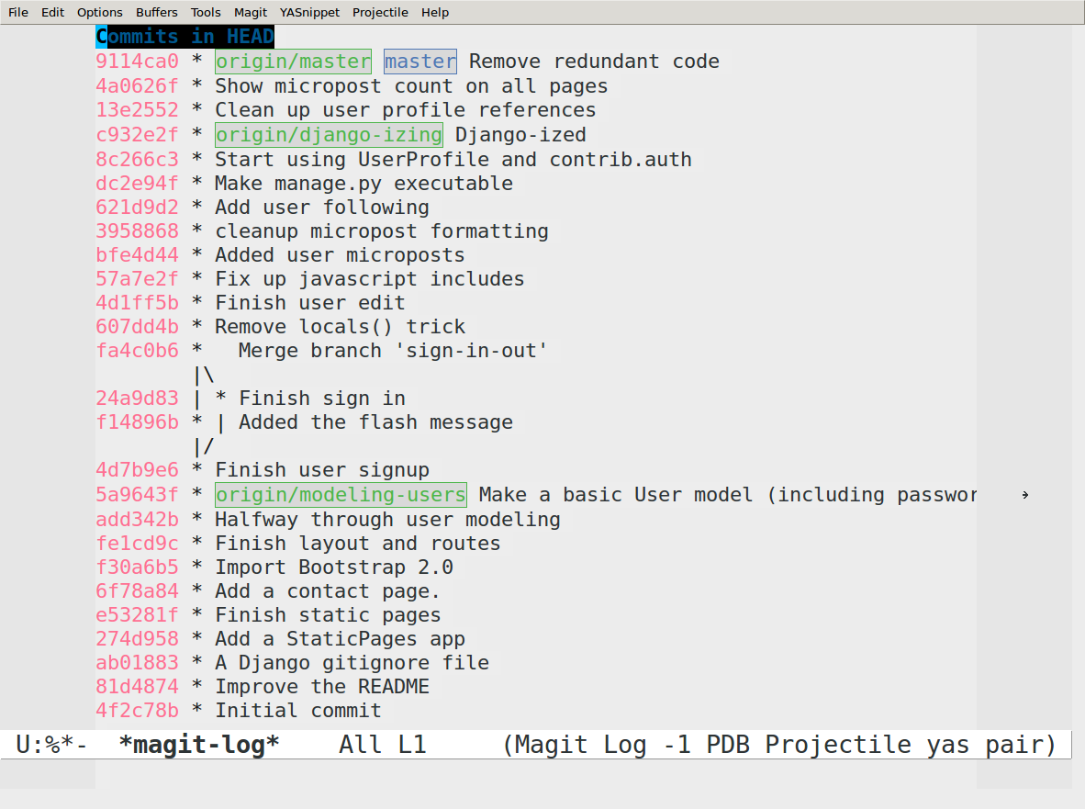

Slide 60
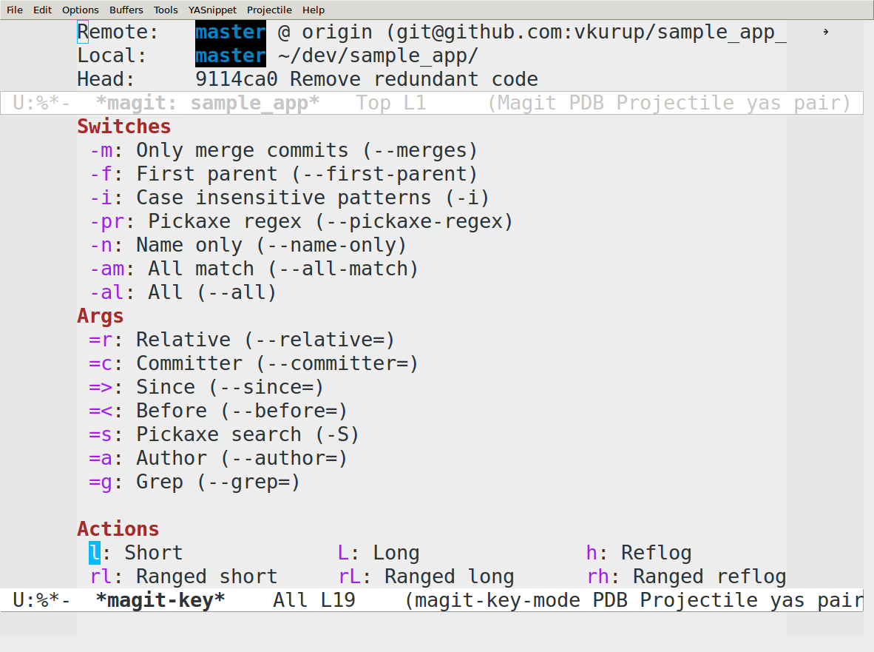

Slide 61
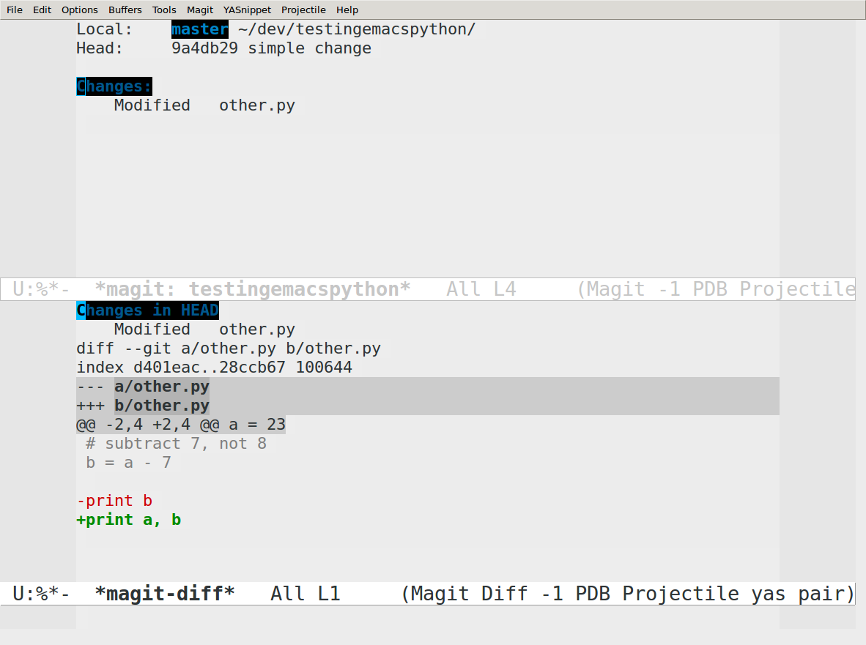

Slide 62
Help in emacs
C-h t => tutorial
C-h f => function docs
C-h v => variable docs
C-h k => keybindings
Emacs can teach you emacs

Slide 63
Dired mode

Slide 64
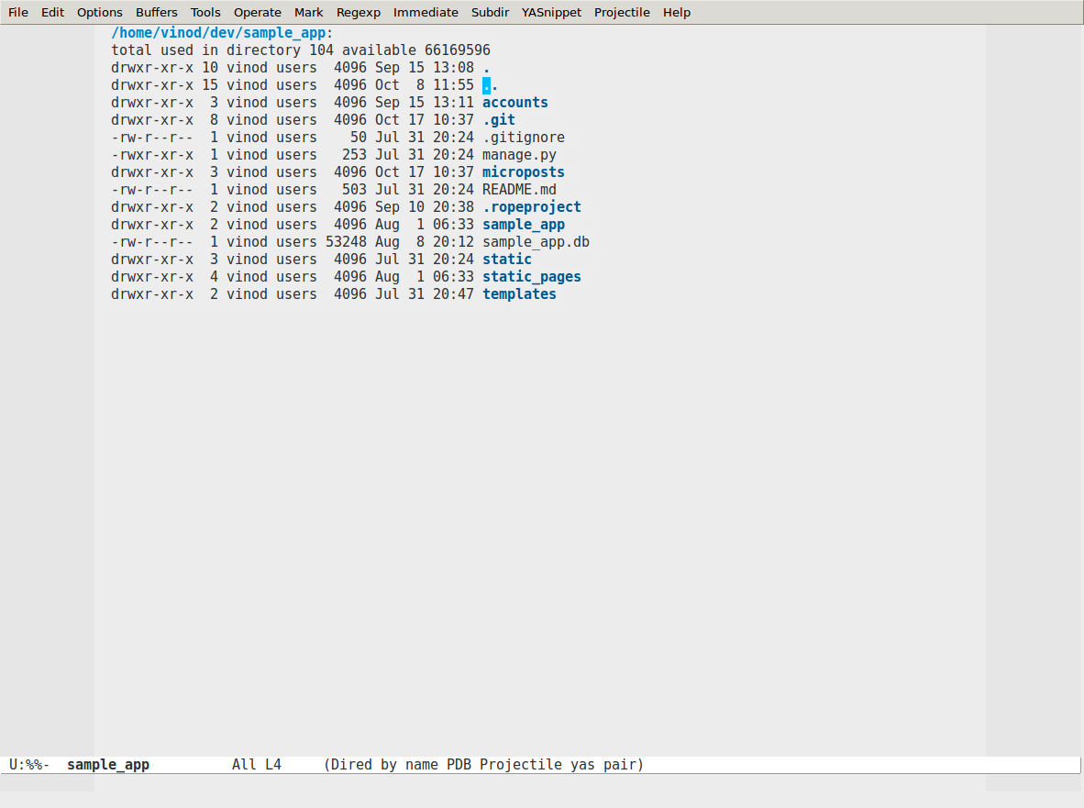

Slide 65
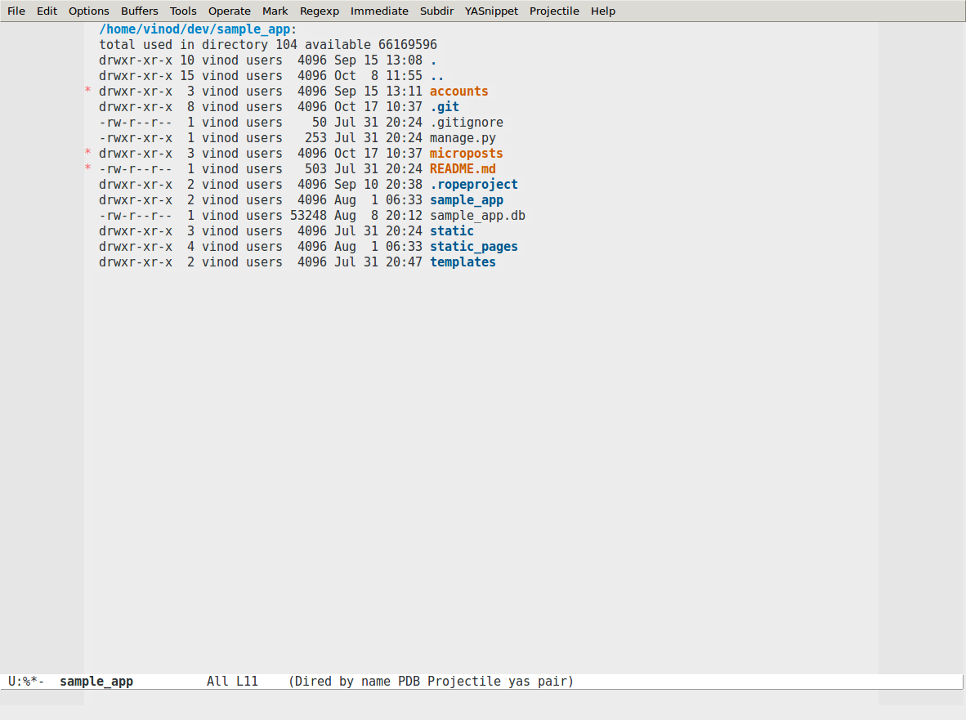

Slide 66
Keyboard Macros

Slide 67
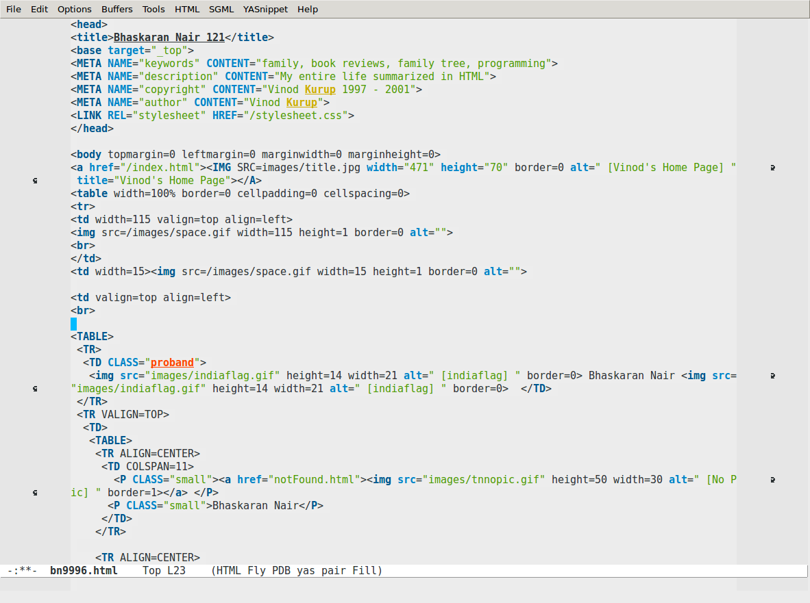

Slide 68
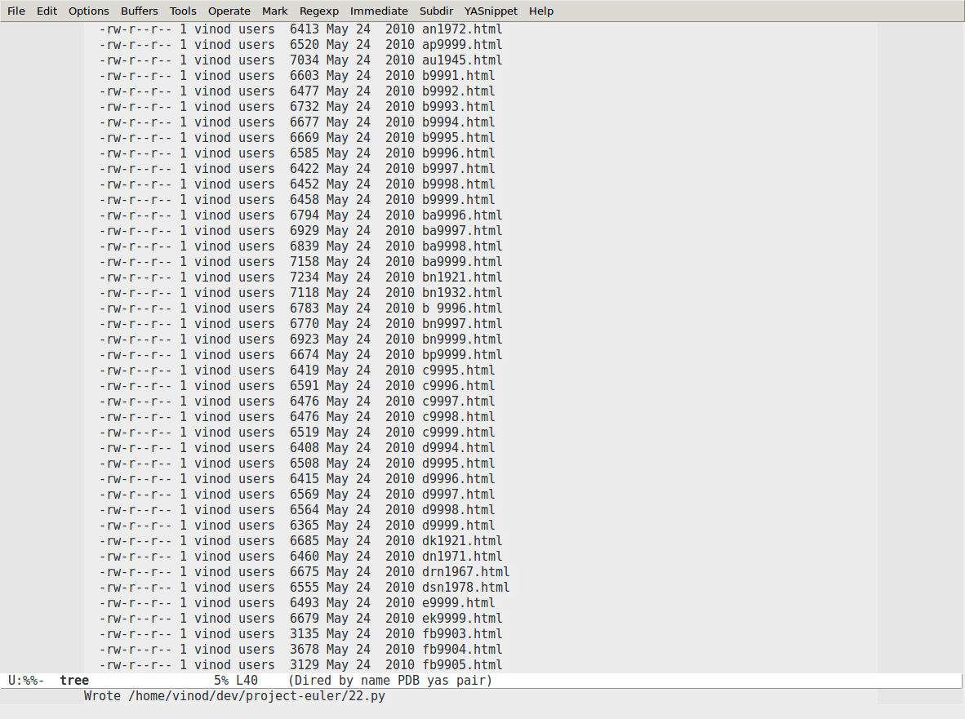

Slide 69
Pretty Themes

Slide 70
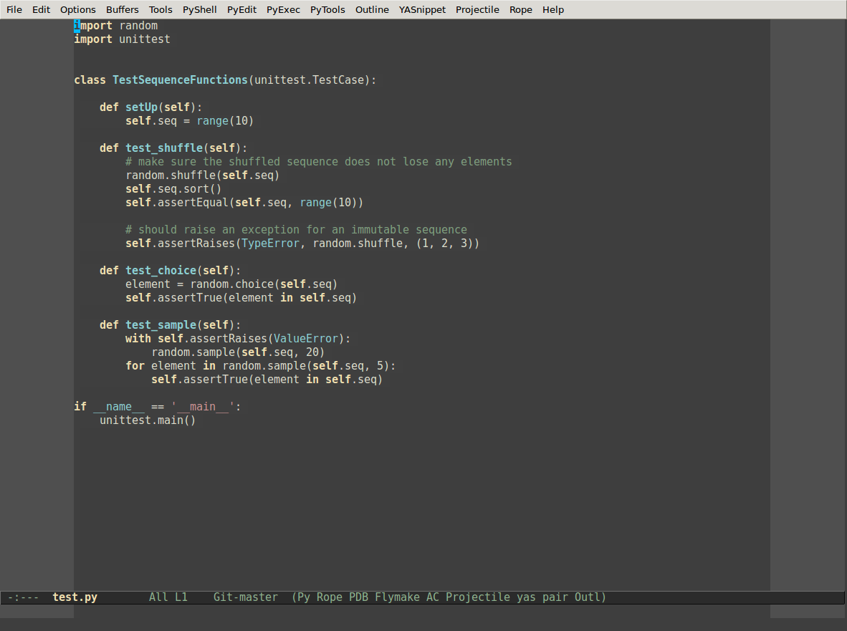

Slide 71
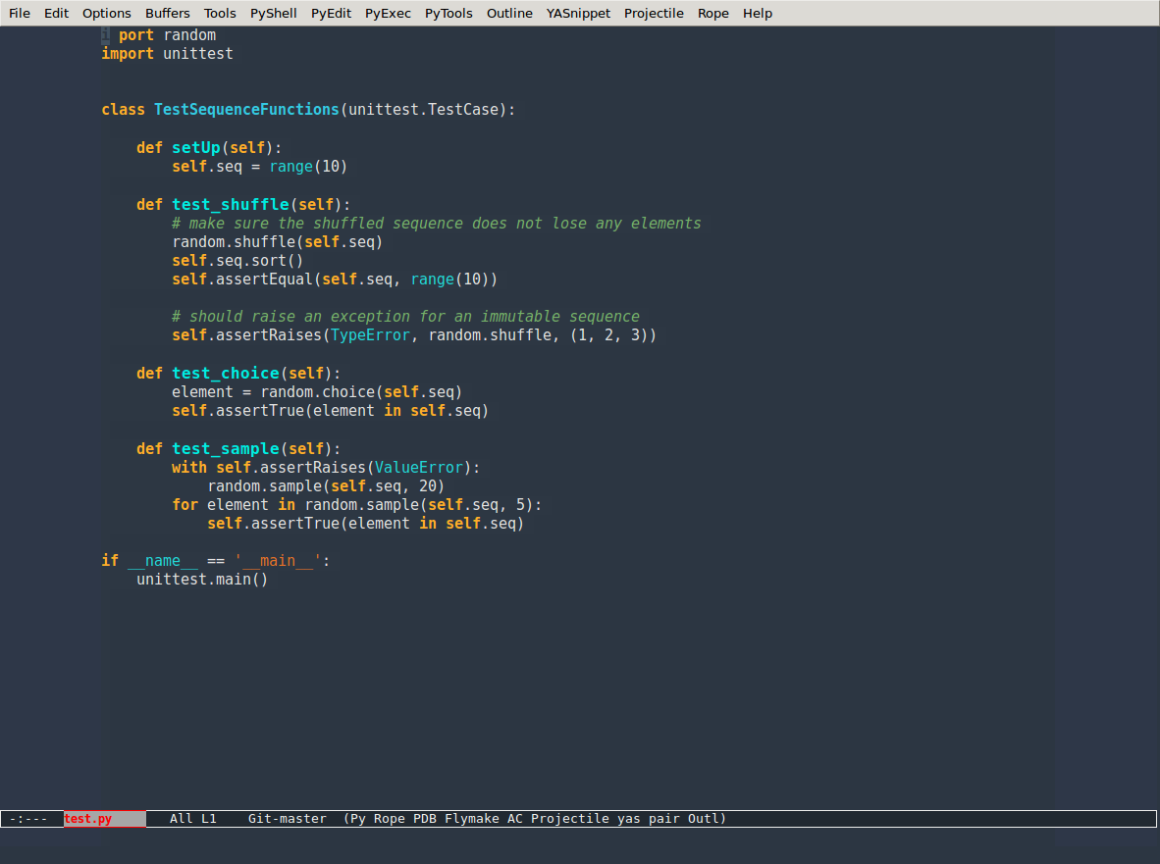

Slide 72
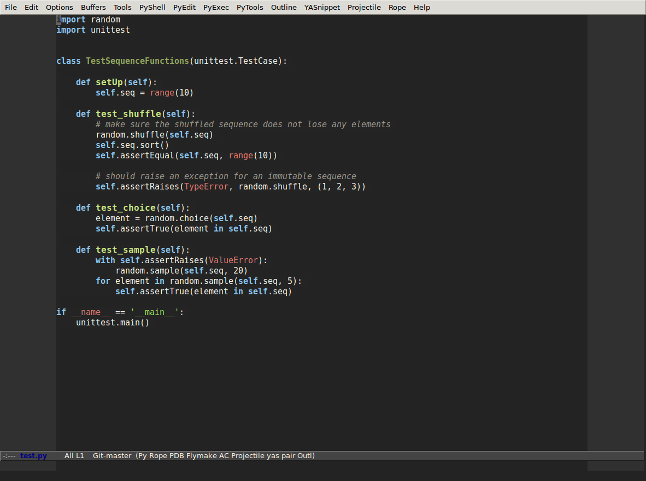

Slide 73
Shell modes

Slide 74
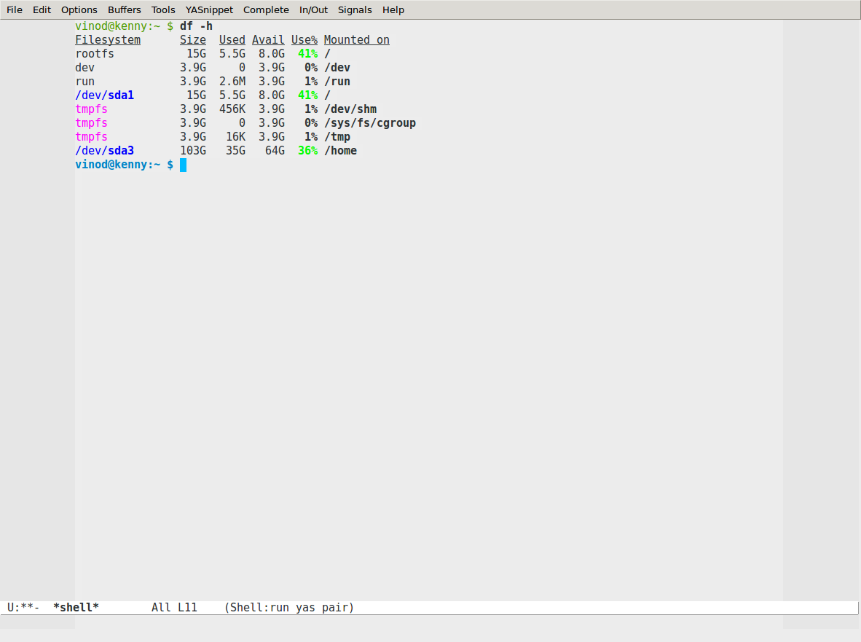

Slide 75
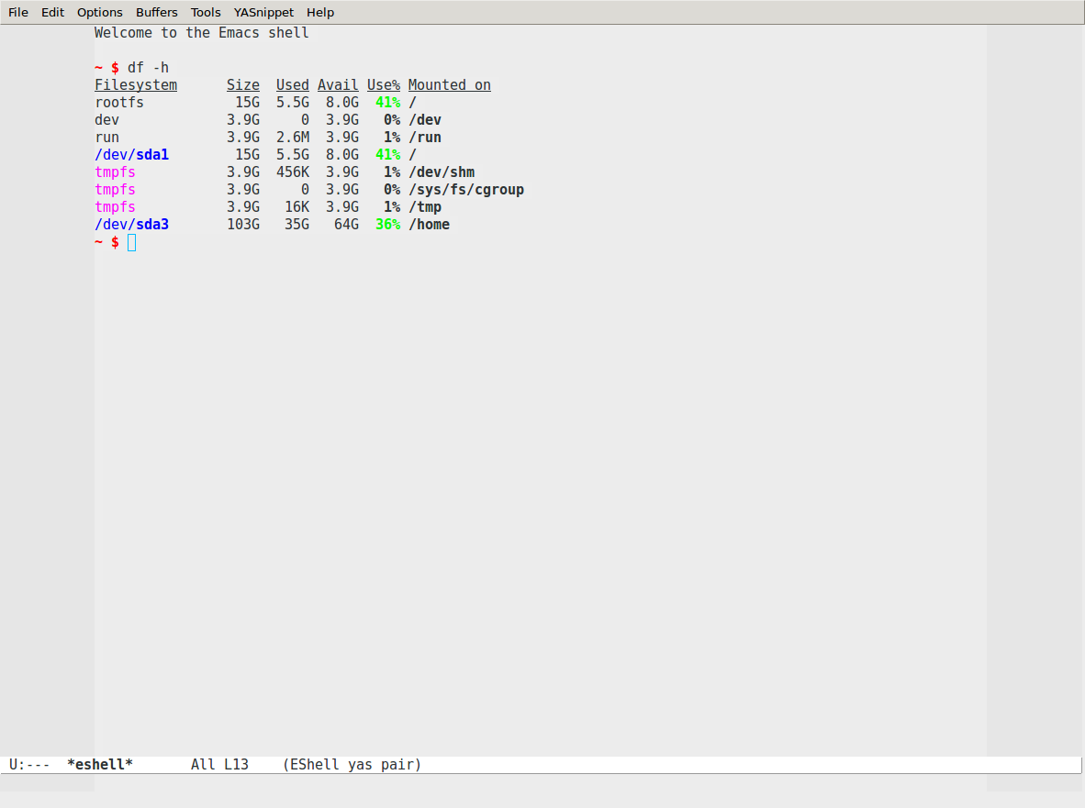

Slide 76
And more!!
Kill ring
yasnippet
org-mode
ace-jump

Slide 77
Emacs for life!

Slide 78
One interface
to rule them all

Slide 79
Infinitely customizable

Slide 80
Stands the test of time

Slide 81
Eight
Megs
And
Constantly
Swapping
(Mine takes 41M now, though)

