Slide 1
Osteoporosis
Vinod Kurup, MD
vinod@kurup.com
December 22nd, 2006
CC-BY-SA

Slide 2
Definition
Which of the following patients have a clinical diagnosis of osteoporosis?
    A) 65 F with nl bone density, but frequent falls
    B) 70 M very low bone density, asymptomatic
    C) 58 F with a hip fx after minor fall, no BMD
    D) 39 M with hip fx after major MVA, no BMD

Slide 3
Definition
Which of the following patients have a clinical diagnosis of osteoporosis?
    A) 65 F with nl bone density, but frequent falls
    B) 70 M very low bone density, asymptomatic
    C) 58 F with a hip fx after minor fall, no BMD
    D) 39 M with hip fx after major MVA, no BMD

Slide 4
Definition
Reduction in bone mass
Presence of a fragility fracture

Slide 5
Key Points
Don't treat the T-score, treat the fracture risk
Nonpharmacologic measures are very effective

Slide 6
Epidemiology
What percent of white women will have osteoporosis by the age of 80?
        A) 10 %
        B) 30 %
        C) 50 %
        D) 70%
Which type of fractures are associated with the most mortality?
        A) Vertebral
        B) Hip
        C) Colles' fractures

Slide 7
Epidemiology
What percent of white women will have osteoporosis by the age of 80?
        A) 10 %
        B) 30 %
        C) 50 %
        D) 70 %
Which type of fractures are associated with the most mortality?
        A) Vertebral
        B) Hip
        C) Colles' fractures

Slide 8
Epidemiology
8 million women, 2 million men in U.S.
Another 18-30 million with osteopenia
70% of white women at age 80
1.5 million fractures per year (300K hip)
Hip Fx – 5-20% mortality within 1 year

Slide 9
Pathophysiology
Bone resorption / Bone formation balance
Favors formation until age 30-45
Type I – postmenopausal (ages 50-70)
Type II – senile (ages 70+)
Type III - secondary

Slide 10
Pathophysiology
2 factors dictate the development of OP
  Peak bone mass achieved
  Rate of bone loss
Attack one of these factors to prevent OP

Slide 11
Diagnosis
Which is the correct criteria to diagnose osteoporosis?
    A) Z score of -2.5 or lower
    B) T score of -2.5 or lower
    C) T score of -1.5 to -2.5
    D) combination of B and C

Slide 12
Diagnosis
Which is the correct criteria to diagnose osteoporosis?
    A) Z score of -2.5 or lower
    B) T score of -2.5 or lower
    C) T score of -1.5 to -2.5
    D) combination of B and C

Slide 13
Diagnosis
DeXA is gold standard
Bone density is compared on a bell curve to give:
  T score – comparison to young adults
  Z score – comparison to age-matched adults
Both are race & gender matched
Osteoporosis: T score < -2.5
Osteopenia: T score -1.5 to -2.5

Slide 14
Other diagnostic tests
CT – more expensive, more radiation, less reproducibility
US – lower cost, not widely used yet. Less accurate.

Slide 15
Who to screen
Which of the following patients should be screened for osteoporosis?
    A) 70 F with no medical problems
    B) 57 F thin postmenopausal smoker
    C) 50 F with Colles fracture after minor fall
    D) 37 F premenopausal with bone pain
    E) 58 M with incidental vertebral fx noted on CXR

Slide 16
Who to screen
Which of the following patients should be screened for osteoporosis?
    A) 70 F with no medical problems
    B) 57 F thin postmenopausal smoker
    C) 50 F with Colles fracture after minor fall
    D) 37 F premenopausal with bone pain
    E) 58 M with incidental vertebral fx noted on CXR

Slide 17
Who to screen
All males and females over the age of 65
Younger patients if they have fracture risk factors
  *** Low body weight (< 70 kg)
  Prior fracture
  FH osteoporotic fracture
  Chronic diseases which increase fall risk
  smoking, physical inactivity, alcohol, caffeine

Slide 18
Who to screen for secondary causes
Search for secondary causes of OP:
  T score < -2.0
  History of minimal trauma fracture
  Physical evidence of vertebral fracture:
    Loss of height > 2 inches
    Wall-occiput distance > 0 inches
    Rib-pelvis distance < 2 fingerbreadths
    Fewer than 20 teeth

Slide 19
Secondary causes of OP
Which of the following is not a secondary cause of osteoporosis?
    A) Hyperthyrodisim
    B) Hypogonadism
    C) Hypertension
    D) Steroid use

Slide 20
Secondary causes of OP
Which of the following is not a secondary cause of osteoporosis?
    A) Hyperthyrodisim
    B) Hypogonadism
    C) Hypertension
    D) Steroid use

Slide 21
Secondary causes of OP
Endocrine
  Hypogonadism, hyperthyroidism, DM type I, cushings, hyperparathyroidism
Nutritional
  Malabsorption, vit D deficiency, Ca deficiency, EtOH
Meds
  STEROIDS, thyroxine, anticonvulsants, loop diuretic
Other
  COPD, RA, Multiple myeloma, CKD

Slide 22
Secondary search
Ca, Phos, Protein/Albumin, Alk Phos, creatinine
CBC
TSH
25-hydroxyvitamin D
Testosterone (men)
Consider: PTH, Urinary calcium, Urinary cortisol

Slide 23
Nonpharmacologic measures
Stop smoking
Treat fall risks: EtOH use, nocturia, vision, safety issues
Exercise – mostly by increasing coordination
Protective pads

Slide 24
Calcium
We prefer calcium intake to be from diet rather than supplements:
    A) True
    B) False

Slide 25
Calcium
We prefer calcium intake to be from diet rather than supplements:
    A) True
    B) False

Slide 26
Calcium
RDA is 1000-1200 mg
Average intake is 600-800 mg
Preferred from dietary sources
Take CaCO₃ with food (needs acid to absorb)

Slide 27
Vitamin D
Deficiency is prevalent
Recommendations 200 to 600 IU daily
MVI has 400 IU
Safe and effective
Vit D + Calcium decrease fracture risk by 30%

Slide 28
Meds
After Calcium and Vitamin D, the first line treatment for osteoporosis is:
    A) Bisphosphonates
    B) HRT
    C) Raloxifene
    D) Calcitonin
    E) A or C

Slide 29
Meds
After Calcium and Vitamin D, the first line treatment for osteoporosis is:
    A) Bisphosphonates
    B) HRT
    C) Raloxifene
    D) Calcitonin
    E) A or C

Slide 30
Bisphosphonates
Decrease fracture risk by 50%
Administration instructions
Overall GI side effects equal to placebo
Alendronate 70 mg weekly
Risedronate 35 mg weekly
Safe long term, but do they remain effective?
Osteonecrosis of jaw

Slide 31
Others
Estrogen: WHI study makes this less attractive
Raloxifene: doesn't decrease hip fx rate
  Side effects similar to estrogen
Calcitonin: little proven benefit
  May have analgesic effect on bone pain

Slide 32
NNT to prevent Vertebral Fx
(over 2 years)

Slide 33
Treatment Guidelines
Age < 75, treat if T-score < -2.5
Age > 75, treat if T-score < -2.0
If T-scores don't dictate treatment, still treat if:
  Low impact or vertebral fx by history, exam
  Other significant risks
    Steroid use
    Smoker
    Conditions creating a fall risk

Slide 34
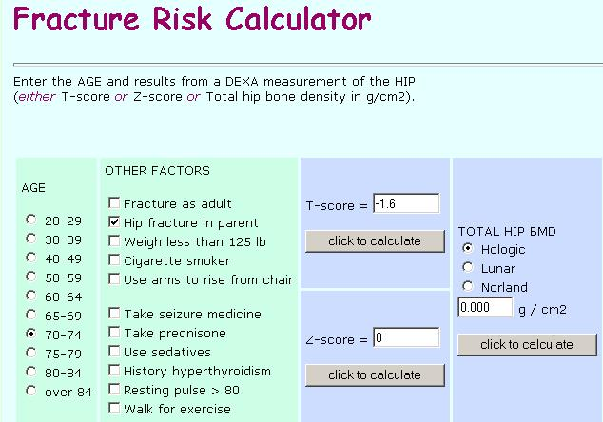
http://courses.washington.edu/bonephys/opTZconvert.html

Slide 35
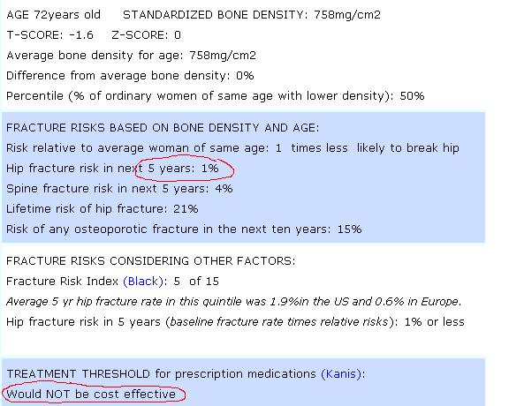
Results

Slide 36
Monitoring
You've diagnosed a patient with osteoporosis. How should you follow this patient?
      A) Repeat DeXA in 1 year
      B) Repeat DeXA in 2-3 years
      C) Measure N-telopeptide at baseline and repeat q 6 months
      D) Just monitor for medication tolerance, side effects
      E) Any of the above

Slide 37
Monitoring
You've diagnosed a patient with osteoporosis. How should you follow this patient?
      A) Repeat DeXA in 1 year
      B) Repeat DeXA in 2-3 years
      C) Measure N-telopeptide at baseline and repeat q 6 months
      D) Just monitor for medication tolerance, side effects
      E) Any of the above

Slide 38
Monitoring
Monitor treatment with repeat DeXA
  1 year in high risk patients
  2-3 years in lower risk patients
Remodeling markers not useful clinically
  Urinary N-telopeptide, Bone alkaline phosphatase
  Check at initiation of treatment and 4-6 months later

Slide 39
Questions to be answered
Relatively young patients with osteopenia – treat?
When to stop treatment?
Long term risks of bisphosphonates
What to do if patient has a fracture while on bisphosphonates?
What to do if BMD decreases while on treatment?

Slide 40
Key points
Don't treat the T-score, treat the fracture risk
Nonpharmacologic measures are very effective

