Slide 1
Heart Disease Prediction
By
Kushaal Reddy Vadde

Slide 2
Outline
Introduction to the problem
Data description
Exploratory analysis
Data preparation
Modeling
Results
Conclusion

Slide 3
Introduction to the problem
Precise classification of cardiovascular disease is essential for efficient therapy, underscoring the importance of exact diagnosis and prognosis in medicine.
By identifying patterns in data and addressing important risk factors like smoking, high blood pressure, and high cholesterol, using machine learning to classify heart disease occurrences can help doctors minimize misdiagnosis and ultimately improve patient outcomes and reduce mortality.

Slide 4
Data description
The dataset has 319,796 observations of 18 variables/features including BMI, Smoking, Alcohol Drinking, Stroke, Physical Health, Mental Health, Diff Walking, Sex, Age Category, Race, Diabetic, Physical Activity etc;
18 features, - 4 numerical variables and 14 categorical variables.
The target variable - “Heart Disease” column
Prediction: “Yes” or “No”

Slide 5
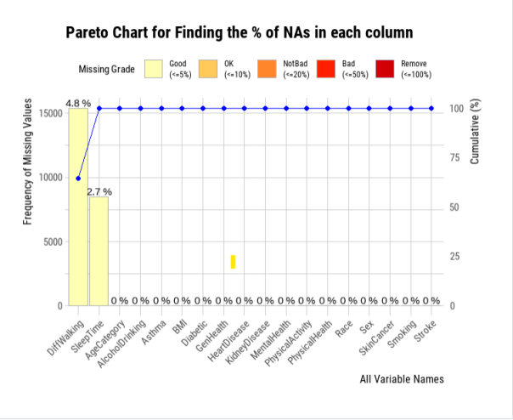
Exploratory analysis
Missing/NaN values:
This chart is specifically designed to illustrate the percentage of missing values (notated as NAs) across various variables in a dataset. The vertical bars represent the frequency of missing values for each variable, with the left vertical axis quantifying this frequency. The line with dots indicates the cumulative percentage of missing values, corresponding to the right vertical axis. Variables are categorized by the severity of missing data into grades: Good (<5%), OK (<10%), Not Bad (~20%), Bad (~50%), and Remove (~100%), which is color-coded at the top. For instance, ‘Diff waking' has the highest frequency of missing values, around 4.8%, classified as 'Good', while other variables like 'Race', 'Sex', and 'Smoking' have 0% missing values, indicating no missing data. This chart helps in deciding which variables may need data imputation or could be removed from the analysis due to a high percentage of missing values.

Slide 6
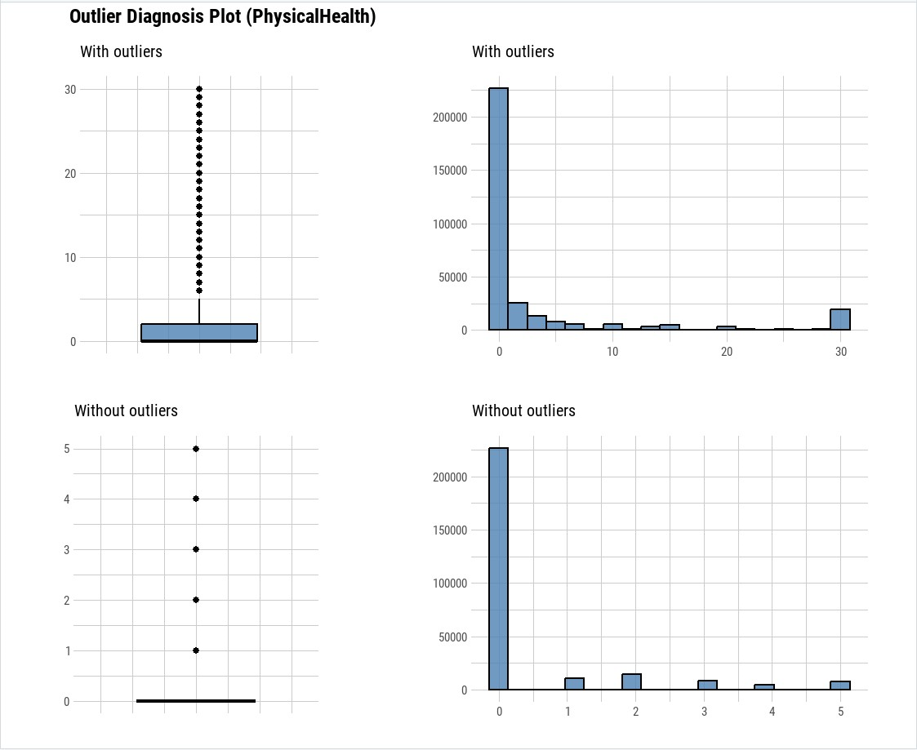
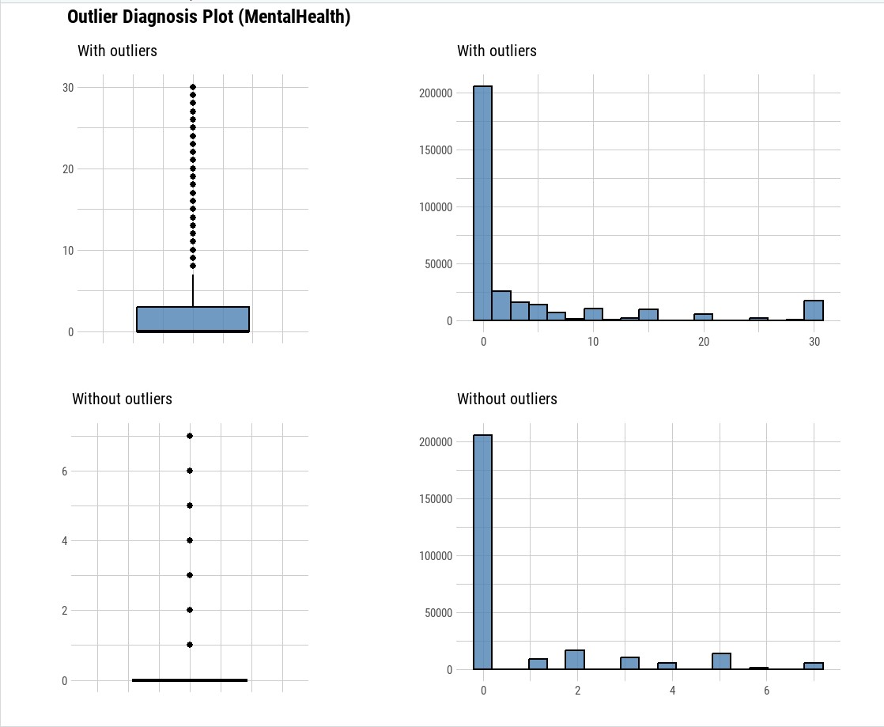
Exploratory analysis
Outliers:
For Physical Health, the boxplot with outliers shows a large number of outlier points above the upper whisker, indicating a significant number of days with reported poor physical health. The histogram with outliers shows a heavily right-skewed distribution, with most of the data concentrated at lower values and a long tail towards higher values. After removing outliers, the data points in the boxplot are fewer and the scale is reduced, suggesting that outliers were indeed affecting the scale of the plot. The histogram without outliers becomes more uniform, with fewer instances of extreme values.
For Mental Health, a similar pattern is observed. The boxplot with outliers indicates numerous days with poor mental health being reported as outliers. The histogram with outliers is also right-skewed, with a peak at the lower end of the scale. Once outliers are removed, the boxplot indicates a much smaller range of values, and the histogram shows a more even distribution, with a slight right skew but without extreme values.

Slide 7
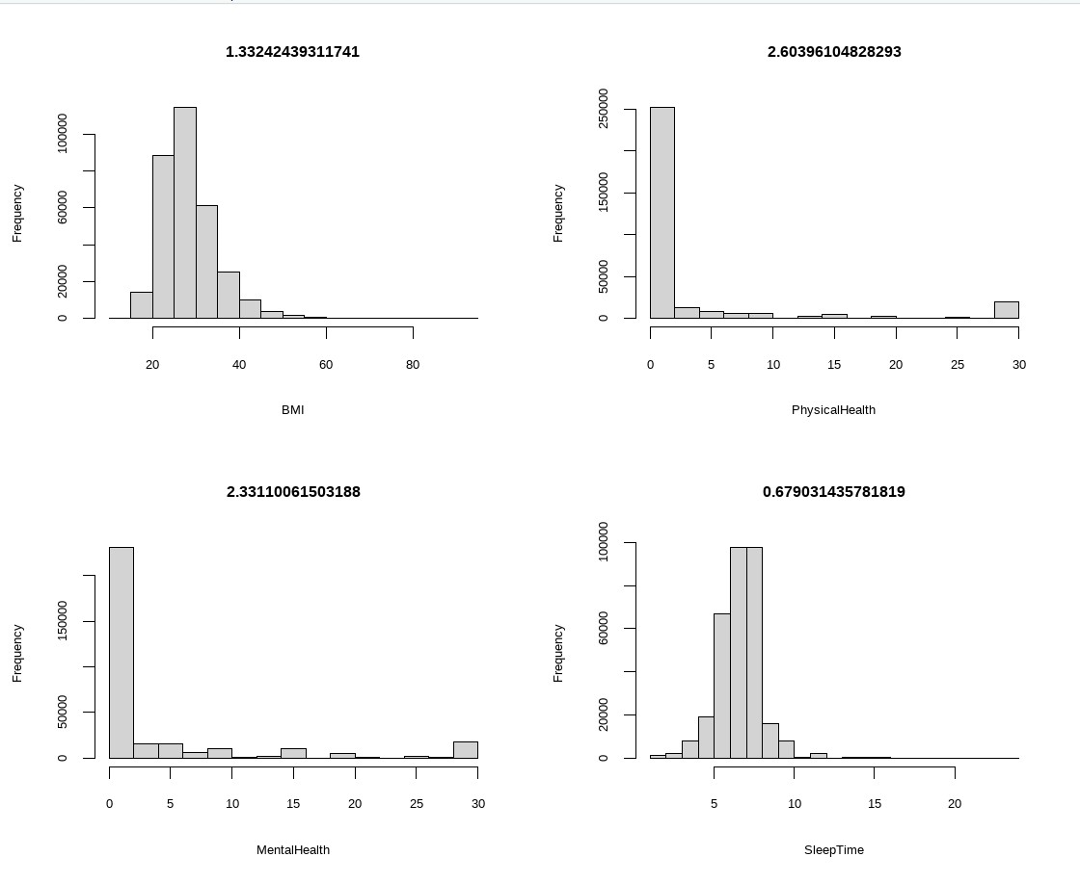
Exploratory analysis
Skewness:
A skewness value near zero indicates a symmetrical distribution, while a positive value indicates a right skew (tail to the right), and a negative value indicates a left skew (tail to the left).
BMI: The histogram shows a right-skewed distribution, as indicated by the skewness value of 1.33. This means that there is a tail towards higher BMI values with most individuals having a lower BMI.
Physical Health: With a skewness of 2.60, this histogram is also right-skewed, suggesting that most individuals reported fewer physical health problems, with fewer individuals reporting a high number of problems.
Mental Health: This histogram has a skewness value of 2.33, similar to Physical Health, indicating a right-skewed distribution with most individuals reporting fewer mental health issues.
Sleep Time: The distribution of Sleep Time has a skewness value of 0.67, which is closer to zero, suggesting it is relatively more symmetrical than the other variables but still slightly right-skewed.

Slide 8
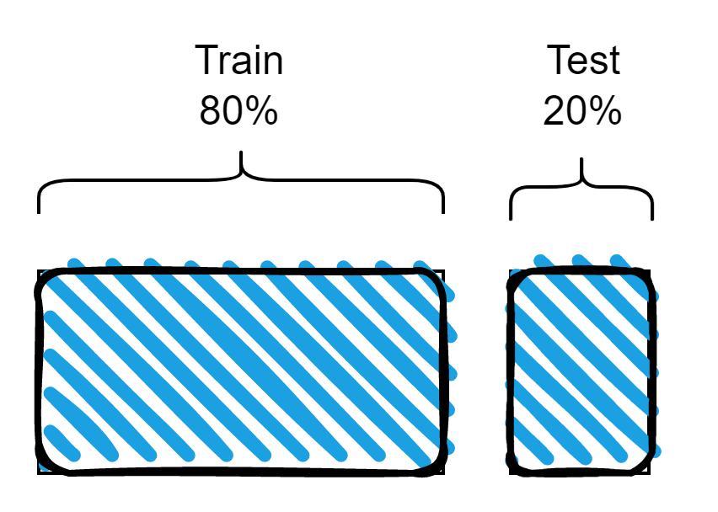
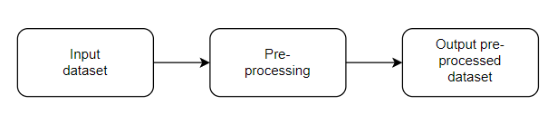
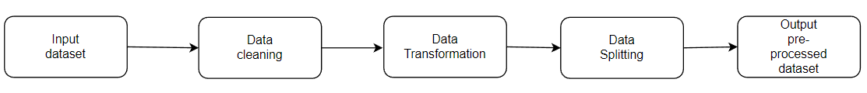
Data Preparation

Slide 9
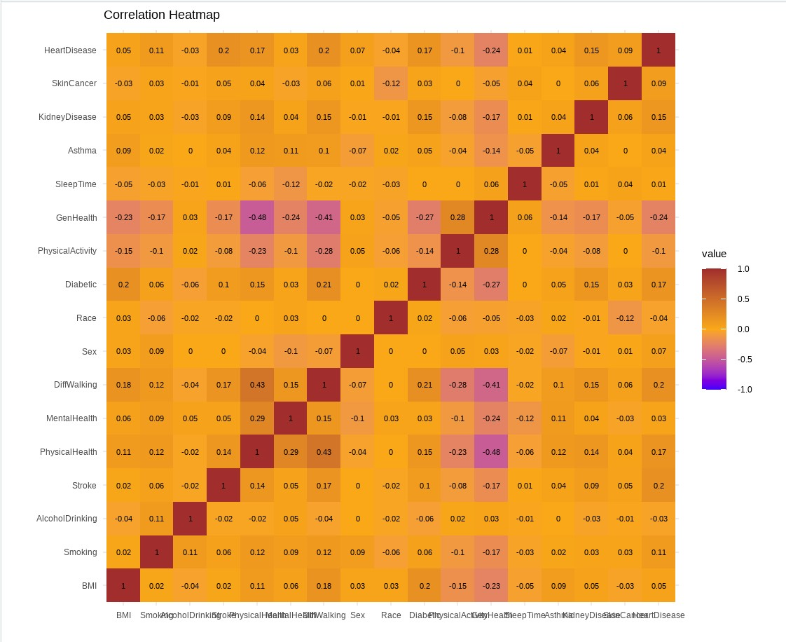
Visualization
Correlation heatmap:
The correlation heatmap presented offers a visual summary of the strength and direction of the relationships between various health indicators and heart disease. The colors range from dark purple (negative correlation, -1) to bright yellow (positive correlation, +1), with neutral correlations in white (0). A positive correlation means that as one variable increases, so does the other, and vice versa for negative correlations.
Key observations include:
General Health has a strong negative correlation with Heart Disease, Physical Health, and DiffWalking, indicating better general health is associated with lower instances of these conditions.
Physical Health shows a notable positive correlation with DiffWalking and Mental Health, suggesting that challenges in physical health are linked with difficulties in walking and mental health concerns.
Sleep Time has a weak to negligible correlation with most variables, implying little direct association with other health indicators.
Race and Sex exhibit very low correlations with other variables, indicating a minimal direct relationship with health conditions in this dataset.

Slide 10
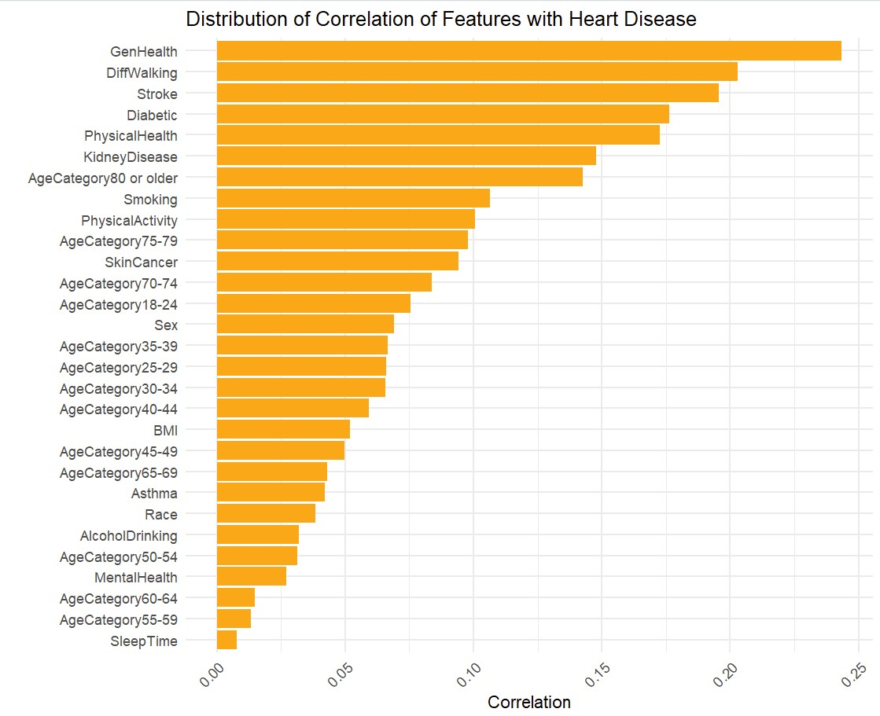
Visualization
Distribution of Data based on Various Parameters:
The bar graph depicts the correlation of various health and demographic factors with heart disease. The length of the bar represents the strength of the correlation with heart disease.
General Health and Difficulty Walking are the most positively correlated with heart disease, indicating a strong association where declines in these areas may predict an increased risk of heart disease.
Stroke, Diabetes, Physical Health, and Kidney Disease also show significant positive correlations, underscoring their importance as potential comorbidities or indicators of heart disease.
Age categories show a gradient of correlation, with older age groups generally presenting a higher correlation, reflecting the increased risk of heart disease with aging.
BMI shows a moderate positive correlation, suggesting its role as a risk factor, albeit less significant than some other health factors.
Mental Health, Sleep Time, and Alcohol Drinking show the least correlation, implying that in this dataset, they have a minor direct association with heart disease compared to other factors.

Slide 11
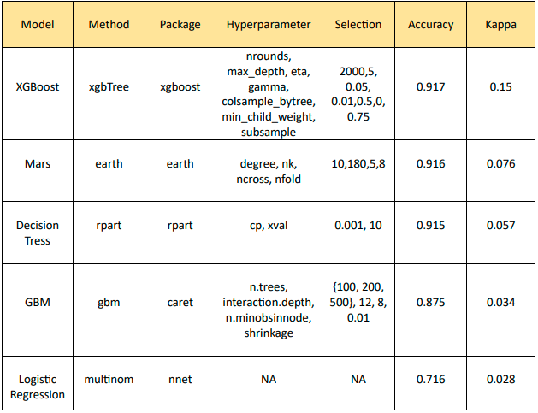
Modeling

Slide 12
Conclusion
The confusion matrix comparing the five models demonstrates that the XGBoost Classifier has the best accuracy. Thus, in order to forecast the incidence of heart disease based on numerous factors like BMI, age, smoking, diabetes, and so forth, we have selected the XGBoost Classifier model. The target variable "Heart Disease" column is predicted by this model to be either "Yes" or "No".

Slide 13
Thank you !

