Slide 1
🀄
🀇
🀙
SportBook
Slot Booking for Mahjong Clubs
🀐
🀄
Your club sets the slots. Members book their seat. Tables confirm themselves.
sportbook.in

Slide 2
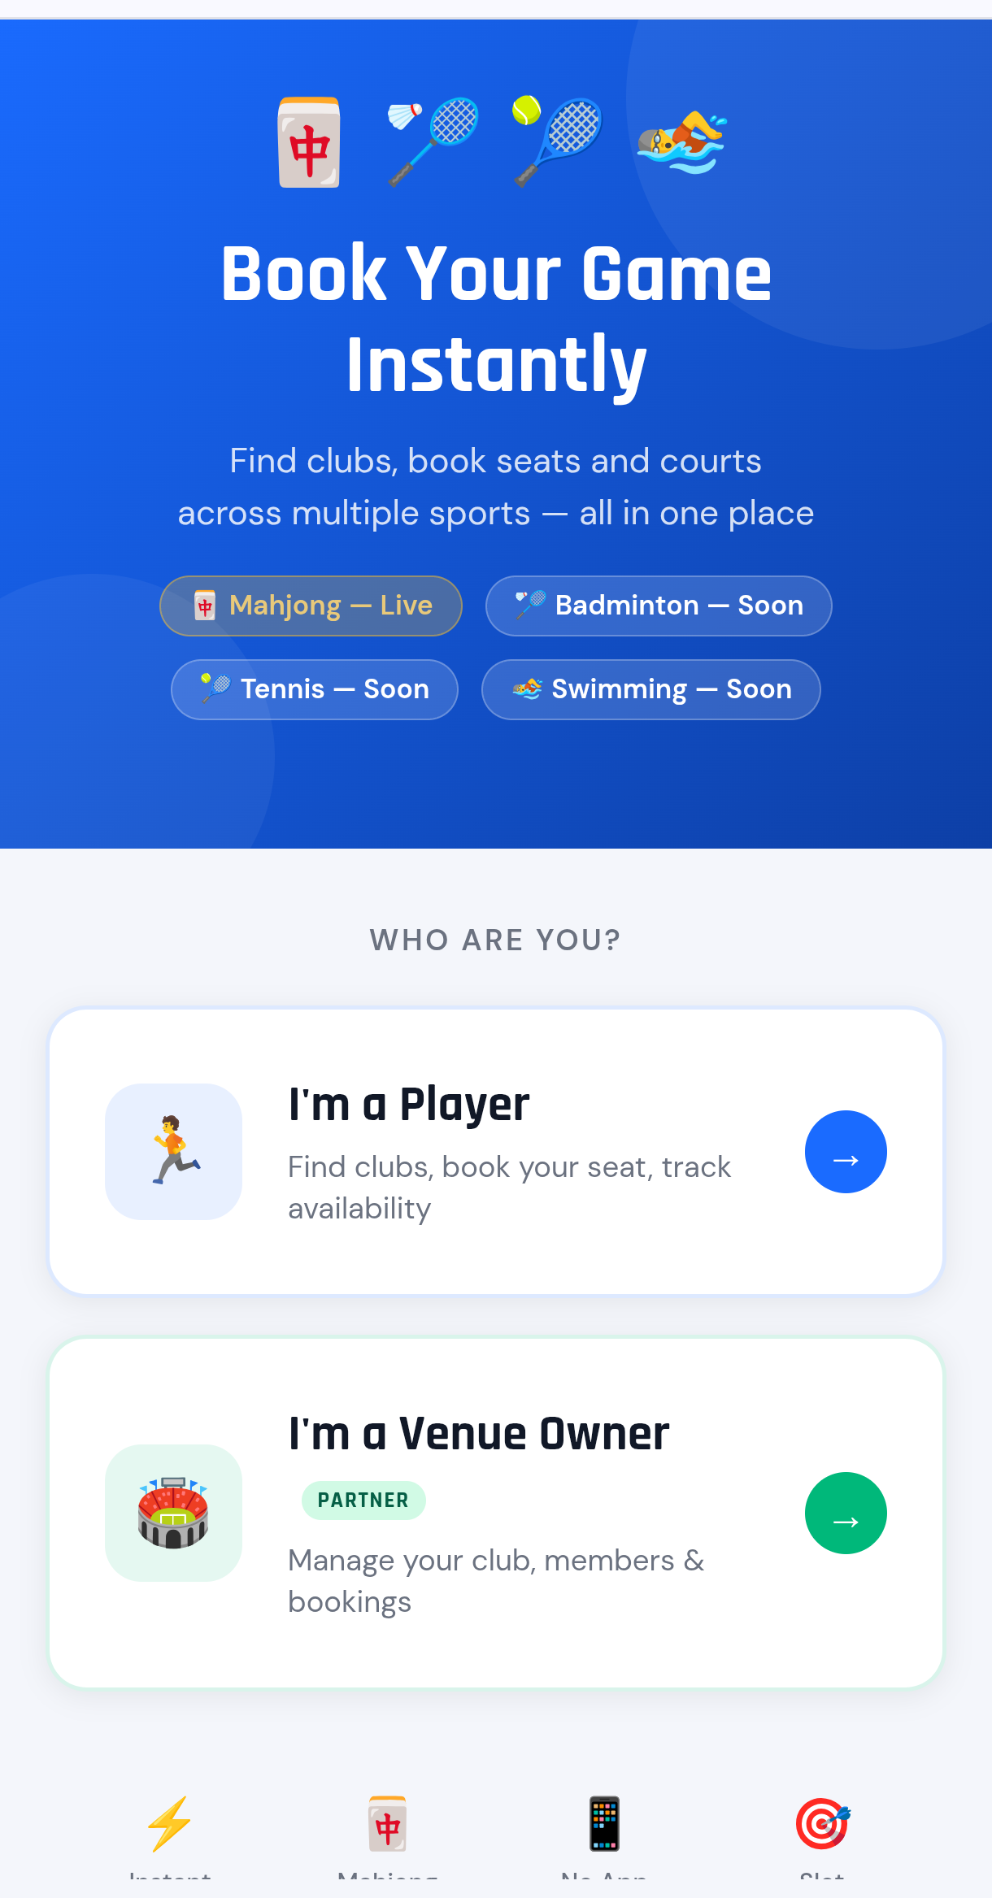
THE LINK
One Link for Your Club
One link for your club — players and owners, no app to download.
1
sportbook.in

Slide 3
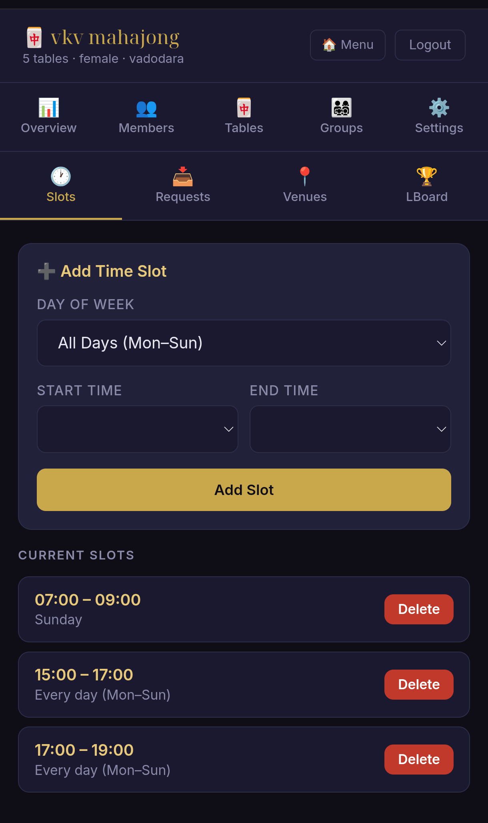
STEP 1 · CLUB
You Set the Slots
You set the playing slots — daily or specific days, in seconds.
2
sportbook.in

Slide 4
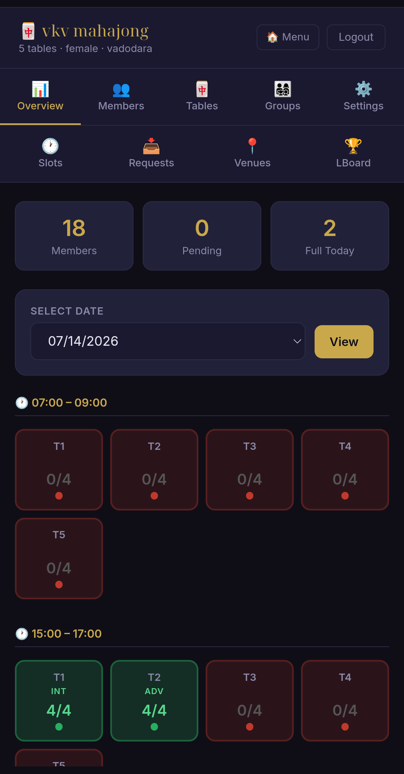
STEP 2 · LIVE VIEW
Every Table at a Glance
See every table's status at a glance, category-wise — who's full, who's still open.
3
sportbook.in

Slide 5
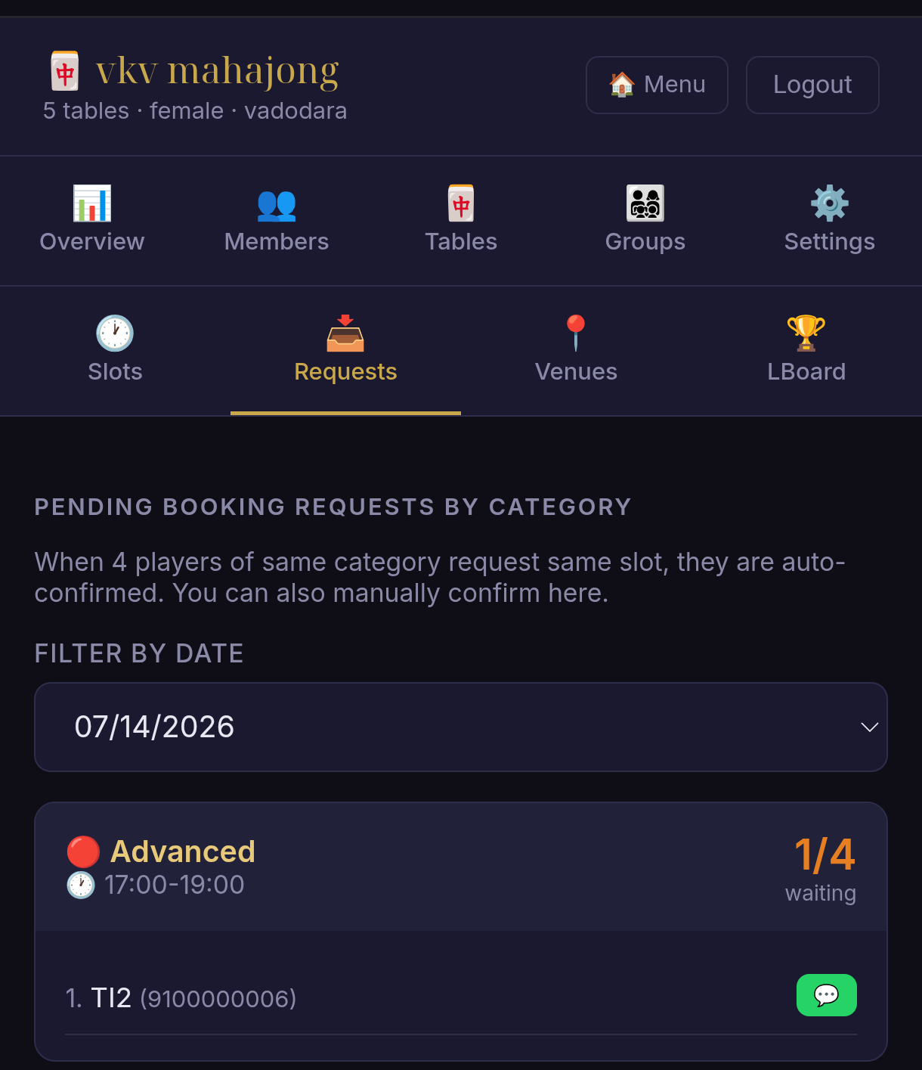
STEP 3 · AUTO
Tables Confirm Themselves
4 players of same category book the same slot → table auto-confirmed.
4
sportbook.in

Slide 6
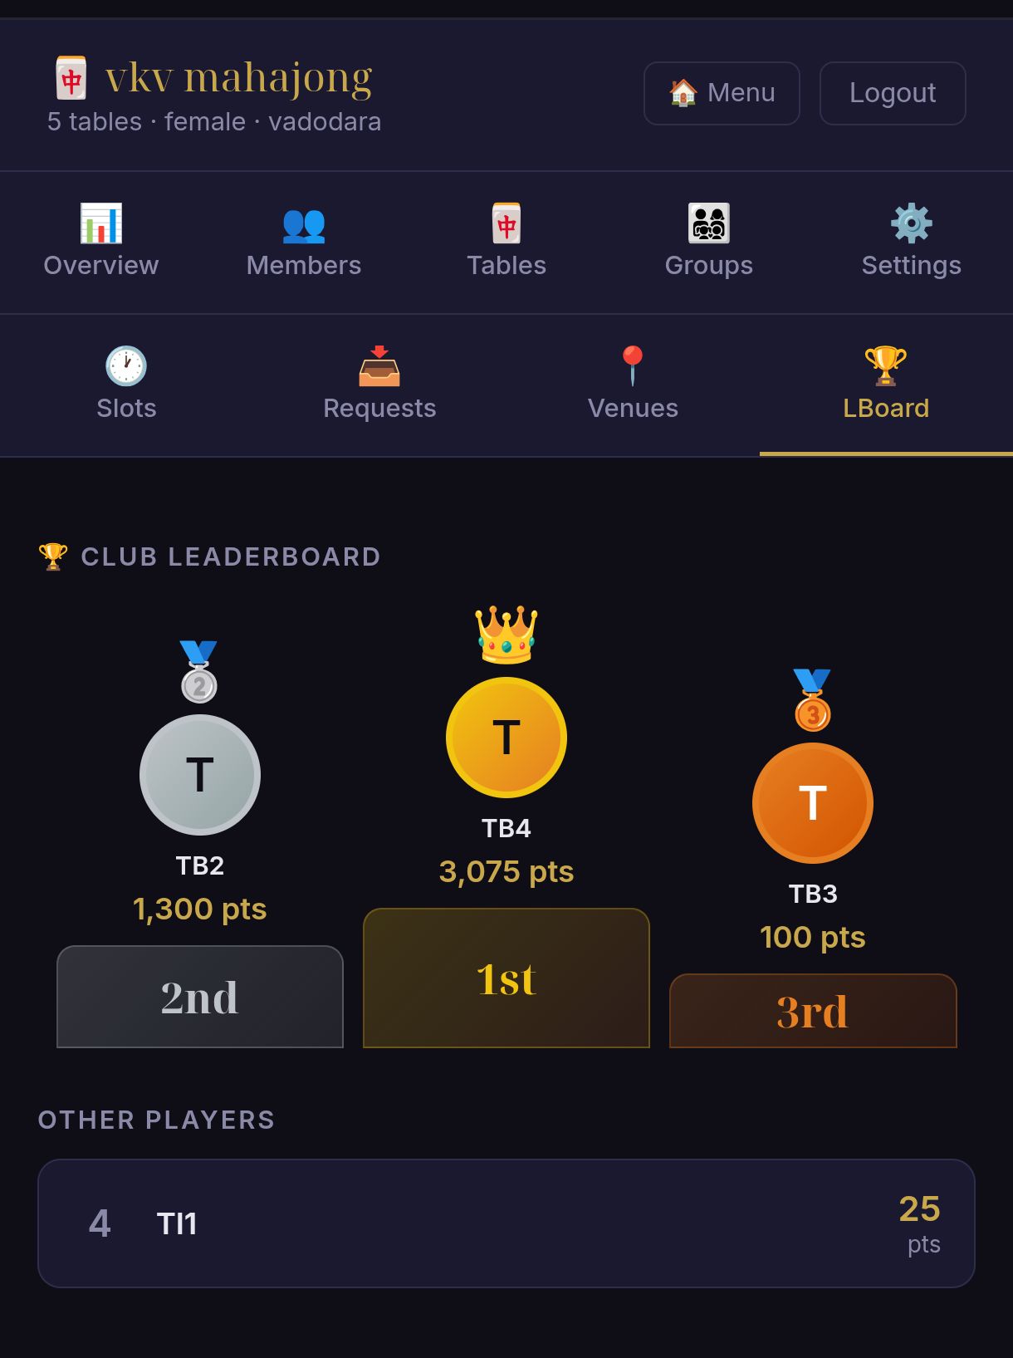
STEP 4 · ENGAGE
Rank Points & Leaderboard
Automatic rank points and club leaderboard — keeps members coming back.
5
sportbook.in

