Slide 1

CITY ENGINEERING COLLEGE DEPARTMENT OF COMPUTER SCIENCE AND ENGINEERING
PowerPi: Measuring and Modelling the Power Consumption of the Raspberry Pi
Presented by:
VINAY KARTHIK M B (1CE13CS124)
Under the guidance of :
Mrs. RASHMI GANGADHAR
Assistant professor,
Dept. of CSE,
City Engineering College

Slide 2

CONTENTS
INTRODUCTION
LITERATURE SURVEY
PROBLEM STATEMENT
METHODOLOGY
RESULTS AND DISCUSSION
CONCLUSION

Slide 3

INTRODUCTION
PowerPi considers the world’s population of 7.1 billion people. With a power consumption of around 10 W each, their power draw alone results in approximately 6.7T Wh of electrical energy per year.
The Raspberry Pi is a popular platform for low-power and low-cost computational tasks, suitable for a large range of applications.

Slide 4
INTRODUCTION(cont..)
The method proposed in tries to accurately estimate the power consumption and possible improvements to each application, But to achieve this, accurate power models of the devices are necessary.
To this end, this paper presents PowerPi, a power model focusing on the power consumption of the Raspberry Pi to derive possible power saving strategies.

Slide 5
INTRODUCTION(cont..)
The hypotheses of the paper are:
An accurate estimation of the Raspberry Pi’s power consumption can be obtained using the system utilization only.
Knowing the power model, it is possible to reduce the power consumption by optimizing the software running on the platform.

Slide 6
LITERATURE SURVEY
SL NO | AUTHOR | TOPIC | YEAR | METHODOLOGY
1. | Fabián Astudillo-Salinas, Daniela Barrera-Salamea, Andrés Vázquez-Rodas, Lizandro Solano-Quinde | Minimizing Power Consumption in Raspberry Pi to use as remote WSN Gateway | 2016 | This paper presents a comparative analysis of Raspberry Pi power consumption profile under multiple settings.

Slide 7
LITERATURE SURVEY
SL NO | AUTHOR | TOPIC | YEAR | METHODOLOGY
2. | Kerry Hinton, Jayant Baliga, Michael Feng, Robert Ayre, and Rodney S. Tucker, University of Melbourne | Power Consumption and Energy Efficiency in the Internet. | 2011 | This article provides an overview of a network-based model of power consumption in Internet infrastructure and insight into how different parts of the Internet will contribute to network power as Internet access increase over time.

Slide 8
LITERATURE SURVEY
SL NO | AUTHOR | TOPIC | YEAR | METHODOLOGY
3. | Girish Bekaroo, Bonne Terre | Power Consumption of the Raspberry Pi: A Comparative Analysis. | 2016 | This paper investigates how power consumption of the Raspberry Pi is affected by the key functionalities that could be performed by end-users on the platform.

Slide 9
LITERATURE SURVEY
SL NO | AUTHOR | TOPIC | YEAR | METHODOLOGY
4. | M. Anwar Hossain, Pradeep K. Atrey and Abdulmotaleb El Saddik | Smart mirror for ambient home environment. | 2013 | This paper describes the design and development of a futuristic smart mirror that represents an unobtrusive interface for the ambient home environment.

Slide 10
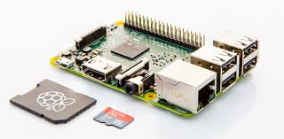
PROBLEM STATEMENT
There are several related works which focus on the high performance, networking models for the Raspberry Pi. But there exists no power model for the Raspberry Pi or for any other ARM boards.

Slide 11

PROBLEM STATEMENT(cont..) .....
PROPOSED SYSTEM
This power model focuses on the power consumption of the Raspberry Pi to derive possible power saving strategies. The hypotheses of the paper are:
An accurate estimation of the Raspberry Pi’s power consumption can be obtained using the system utilization only.
Knowing the power model, it is possible to reduce the power consumption by optimizing the software running on the platform.

Slide 12
PROBLEM STATEMENT(cont..)
Advantages of proposed system
Using the PowerPi model, and similar models of other devices connected to the network, it becomes possible to estimate the power consumption of the full network for a given load.
Energy efficiency improvements of the full network infrastructure are possible based on the power models and the system utilization only.

Slide 13
METHODOLOGY
Power Measurement
The Raspberry Pi is a low-power device, its power consumption is measured by interrupting the power lines of the USB connection and inserting a measurement shunt in the 5 V line.
Measurement PC Setup
These measurements are run from a conventional laptop.
The measurements are best run from a Linux PC, as most software required for the measurements is readily available for this platform.

Slide 14
METHODOLOGY(cont..)
Setup of Raspberry Pi
The measured platform is a Raspberry Pi Model B running a software image based on Raspbian4. It is a Debian-based Linux distribution specifically designed for the Raspberry Pi.
System State Monitoring
During the tests, only required services run, minimizing side effects.
The system is monitored using custom scripts tracking state and utilization of the platform.

Slide 15
METHODOLOGY(cont..)
Load Generation
To measure the different operating points of the CPU and the network interfaces, it is required to generate a configurable load.
The load is generated by running an infinite loop adding numbers, filling up the CPU load to the desired limit.

Slide 16
RESULTS AND DISCUSSIONS
Measurements
The measurements were conducted in a home environment during the night to reduce potential interference of the WiFi measurements.
All measurement values between two system or network utilization samples are averaged and then mapped to the second value.
The time difference between the utilization and bandwidth measurement points is always below 80 ms.

Slide 17
RESULTS AND DISCUSSIONS(cont..)
Model Generation
The power model for the different measurements is generated by fitting a linear function to the measured data, minimizing the remaining Root Mean Square Error[RMSE].
Matlab’s TM robust-fit function is used for this purpose. This function is based on an iterative process fitting the linear function to the data, minimizing the RMSE.

Slide 18
RESULTS AND DISCUSSIONS(cont..)
Description of the Power Model
The measurements of the CPU utilization in Figure 2 show a clear linear dependency. This observation is confirmed, by calculating the 1st order regression.

Slide 19
RESULTS AND DISCUSSIONS(cont..)
Description of the Power Model(cont..)
The measurements of the CPU utilization in Figure 2 show a clear linear dependency. This observation is confirmed, by calculating the 1st order regression.
The measurements below 10% CPU utilization represent the idle state of the Raspberry Pi without additional load.
Combined Power Model and Usage
Table I shows the approximations of the power consumption of the Raspberry Pi for different utilization.

Slide 20
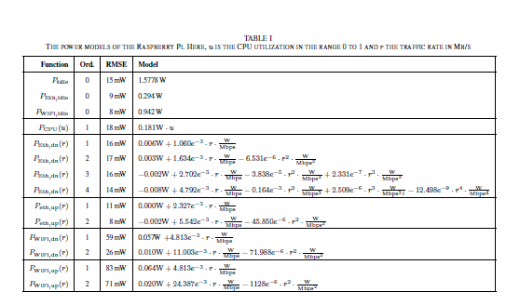
RESULTS AND DISCUSSIONS(cont..)
The table is grouped to distinguish the different measurement categories.

Slide 21
CONCLUSION AND OUTLOOK
Presented here was PowerPi, a power model for the Raspberry Pi, which includes the CPU and Ethernet power consumption as well as the power consumption of an external USB WiFi dongle. The power model is modular to incorporate all measured components.
Using the PowerPi model, and similar models of other devices connected to the network, it becomes possible to estimate the power consumption of the full network for a given load.

Slide 22
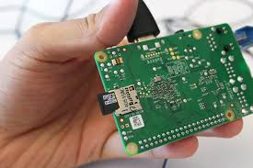
THANK YOU

