Slide 1

introduction
Simple voting management system
introduction
Title

Slide 2

Title
introduction
introduction
Introduction
introduction

Slide 3
Introduction
Members

Slide 4

Introduction
Members
01.
V. Kamal Vaarshneya Reddy
24kb1a05mk
02.
V. Aishwarya
24kb1a05mr
03.
V. Kamal Vaarshneya Reddy
24kb1a05nu
04.
V. Kamal Vaarshneya Reddy
24kb1a05ph

Slide 5
Introduction
Members
01.
V. Kamal Vaarshneya Reddy
24kb1a05mk
02.
V. Aishwarya
24kb1a05mr
03.
V. Kamal Vaarshneya Reddy
24kb1a05nu
04.
V. Kamal Vaarshneya Reddy
24kb1a05ph

Slide 6
Introduction
Members
01.
V. Kamal Vaarshneya Reddy
24kb1a05mk
02.
V. Aishwarya
24kb1a05mr
03.
V. Lasya
24kb1a05nu
04.
V. Kamal Vaarshneya Reddy
24kb1a05ph

Slide 7
Introduction
Members
01.
V. Kamal Vaarshneya Reddy
24kb1a05mk
02.
V. Aishwarya
24kb1a05mr
03.
V. Kamal Vaarshneya Reddy
24kb1a05nu
04.
Y. Meghana
24kb1a05ph

Slide 8
Introduction
Members
Project

Slide 9
What is a Voting System?
A voting system is a method by which voters make a choice between options.
Used in: Governments, schools, organizations.
Voter Registration: Each eligible voter is registered with a unique ID to ensure one-person-one-vote.
Authentication: Before voting, the system verifies the voter's identity (e.g., ID check, login, token).
Vote Casting: Voters select their preferred candidate/option via a simple interface (ballot form or button).
Vote Recording: The vote is stored securely in a database or tallying system to prevent tampering.
Counting & Result: The system automatically counts votes and displays the results transparently.

Slide 10
Why Voting Systems Matter
FOUNDATION OF DEMOCRACY
ENSURES FAIR REPRESENTATION
BUILDS TRUST IN OUTCOMES

Slide 11
Components of a Simple Voting System
Register candidates
Vote
Show results
Show voter and candidate info

Slide 12
Title
introduction
introduction
Introduction
Project

Slide 13

Introduction
Title
Project
Project
Refences

Slide 14
Project
01.
Objective
Scope
02.
V. Aishwarya
24kb1a05mr
03.
V. Kamal Vaarshneya Reddy
24kb1a05nu
04.
V. Kamal Vaarshneya Reddy
24kb1a05ph

Slide 15
Objectives
Develop a command-line-based voting system.
Use Array for managing candidate list.
Use Linked List for storing voter details.
Practice file handling for data persistence.

Slide 16
Scope
CLI-based interface
No GUI
Local execution only

Slide 17
Project
01.
Objective
Scope
02.
V. Aishwarya
24kb1a05mr
03.
V. Kamal Vaarshneya Reddy
24kb1a05nu
04.
V. Kamal Vaarshneya Reddy
24kb1a05ph

Slide 18
Project
01.
V. Kamal Vaarshneya Reddy
24kb1a05mk
02.
Technologies used
03.
V. Kamal Vaarshneya Reddy
24kb1a05nu
04.
V. Kamal Vaarshneya Reddy
24kb1a05ph

Slide 19
Technologies Used
Programming Language: C
Platform: Online C compiler
Data Structures: Array, Linked List
File Handling for storing data securely.

Slide 20
System Design – Modules
Candidate Management: Add, display, and search candidates using an array.
Voter Management: Record voter details using linked list.
Voting: Vote casting with validation.
Result Display: Show vote counts and declare winner.

Slide 21
Array – Candidate List
Candidates stored in a structure array.
Each element includes: Candidate ID, Name, Party, Vote Count.
Ensures quick access and update.
Candidates stored in a structure array.
Each element includes: Candidate ID, Name, Party, Vote Count.
Ensures quick access and update.

Slide 22
Linked List – Voter Details
Each node represents a voter: Name, Voter ID, Candidate Voted.
Linked to the candidate they voted for.
Prevents double voting and enables vote traceability.

Slide 23
Project
01.
V. Kamal Vaarshneya Reddy
24kb1a05mk
02.
Technologies used
03.
V. Kamal Vaarshneya Reddy
24kb1a05nu
04.
V. Kamal Vaarshneya Reddy
24kb1a05ph

Slide 24
Project
01.
V. Kamal Vaarshneya Reddy
24kb1a05mk
02.
V. Aishwarya
24kb1a05mr
03.
Project
04.
V. Kamal Vaarshneya Reddy
24kb1a05ph

Slide 25
Code

Slide 26
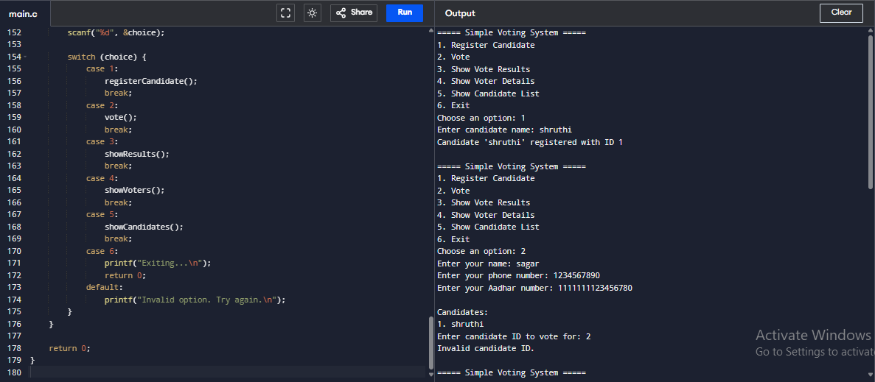
Output

Slide 27
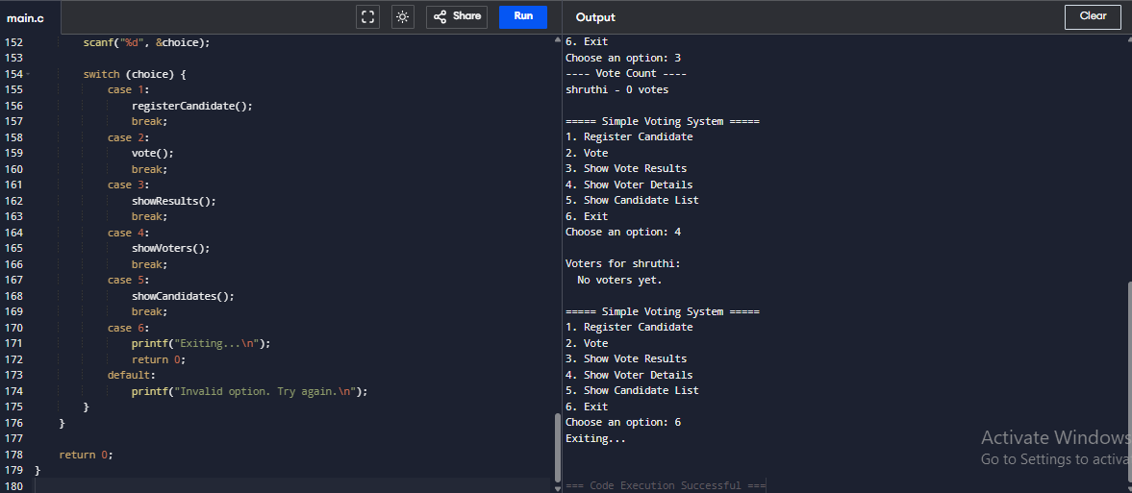
Output

Slide 28
Project
01.
V. Kamal Vaarshneya Reddy
24kb1a05mk
02.
V. Aishwarya
24kb1a05mr
03.
Project
04.
V. Kamal Vaarshneya Reddy
24kb1a05ph

Slide 29
Project
01.
V. Kamal Vaarshneya Reddy
24kb1a05mk
02.
V. Aishwarya
24kb1a05mr
03.
V. Kamal Vaarshneya Reddy
24kb1a05nu
04.
Conclusion

Slide 30
Conclusion
We successfully built a basic voting system using C. This project reinforces the importance and application of arrays and linked lists. Future upgrades include GUI, duplicate vote checks, file storage, and result analytics.

Slide 31
Project
01.
V. Kamal Vaarshneya Reddy
24kb1a05mk
02.
V. Aishwarya
24kb1a05mr
03.
V. Kamal Vaarshneya Reddy
24kb1a05nu
04.
Conclusion

Slide 32
Introduction
Title
Project
Project
Refences

Slide 33

Introduction
Title
Conclusion
Project
Conclusion

Slide 34
References
The C Programming Language by Dennis Ritchie
GeeksforGeeks.org
Lecture notes & documentation
Gramarlly
Links
https://github.com/vkvr-2007/simple_voting_system

Slide 35
How Our Project Reflects Real-World Digital Voting
Uses linked list to ensure each voter is recorded uniquely.
Arrays help in quick access and result processing.
Simulates how a secure system prevents multiple voting.
File storage mimics a backend database for recordkeeping.
If We Had More Time – Future Improvements
Authentication System: Add OTP or biometric login for voter verification.
GUI Implementation: Develop a web or mobile app for better user experience.
Database Integration: Use MySQL or MongoDB instead of file handling.
Blockchain Concept: Implement a transparent, tamper-proof voting ledger.
Analytics Module: Real-time vote tracking, heatmaps, and participation trends.
If any further queries please ask us

Slide 36
Conclusion
Thank you for the entire faculty for giving us this opurtunity to prove ourselves and enhance our skills not only in the aspect of coding but also in presentation skills.
THANK YOU

