Slide 1

PRESENTATION ON RETAIL STORE MANAGEMENT

Slide 2
RETAIL STORE MANAGEMENT
*retail Store is the point of contact between the customer of the retailer. It is the place where moment of truth occurs.
*The primary area of responsibility within the environment of a retail store lies with the store manager.
*Store manager plays a critical role in retail business.Due to their daily contact with customers, they have the best knowledge of customer needs and play an important role in formulating and executing retail strategies.
* They must make sure that the merchandise is presented effectiviely and sales associates offer services that stimulate and facilitate customer buying decisions.

Slide 3
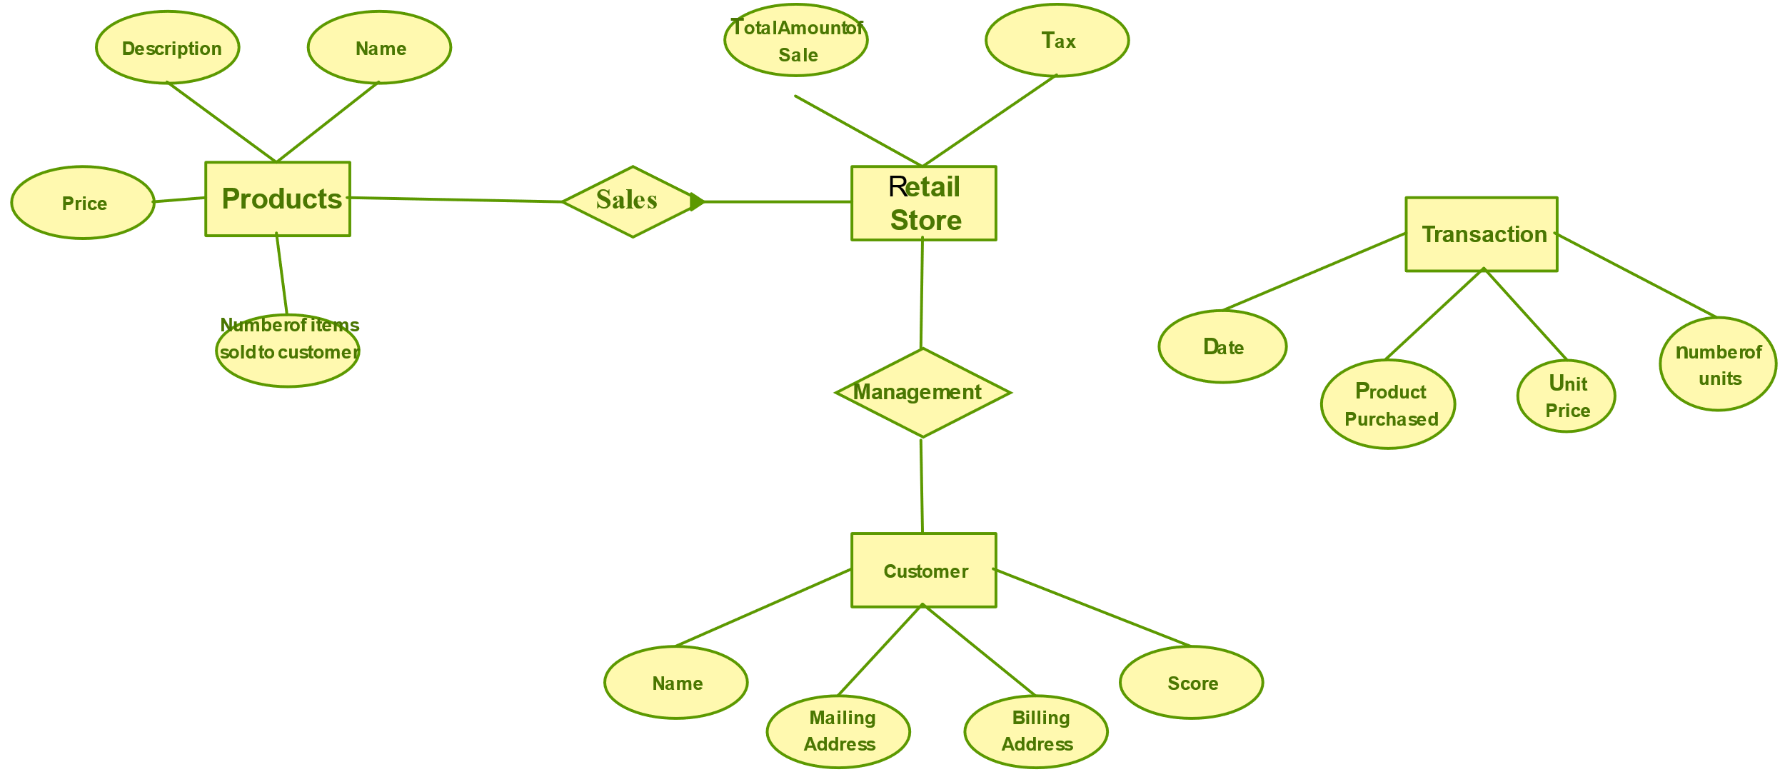
ER DIAGRAM OF RETAIL STORE

Slide 4
Functions / Responsibilities of Store Manager. The functions of store managers are divided into four major categories: 1. Managing Employees. 2. Controlling costs. 3. Managing Merchandise Presentation. 4. Providing Customer Service

Slide 5
Importance of Retail .
Retailing has mirrored the increasing prominence of the retail industry.
Retailing provides necessary service and a positive contribution to the economy. The importance of retailing is given below.
*Retailing shapes the lifestyle of people.
*Retailing contributes to the economy.
*Retailing dominates the supply chain.
*Retailers have status as employers.

Slide 6
THANK YOU

