Slide 1
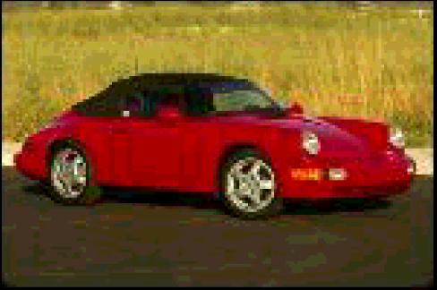
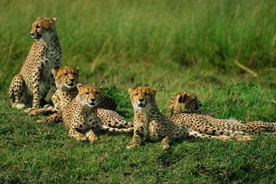
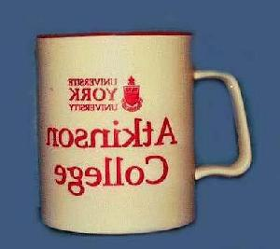

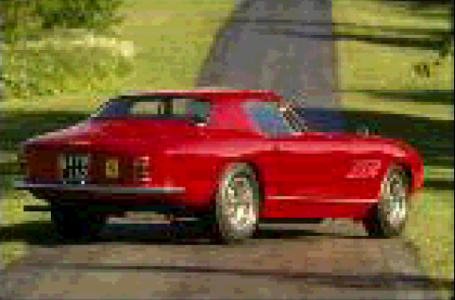
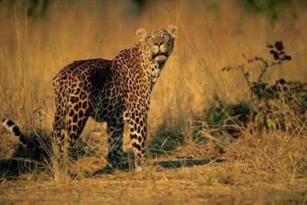
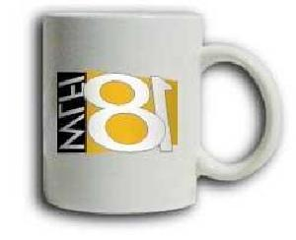
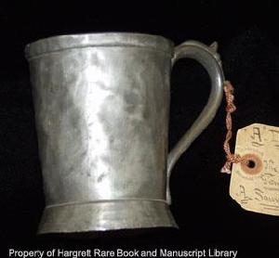
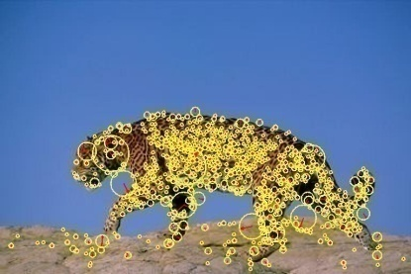
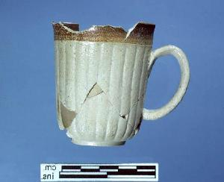
Multiple Kernel Learning for Object Recognition
Motivation of using multiple features in object recognition
red car
jaguar
cup
color
shape
texture

Slide 2
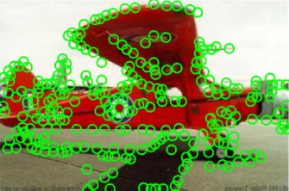
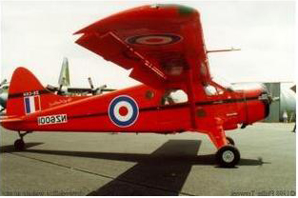
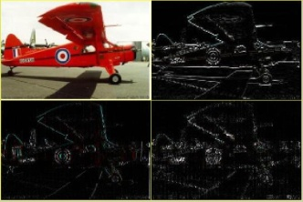
Motivation
bag of features
histogram
a unified space of lower dimensions
2D matrix
1. diverse forms
2. high dimensions

Slide 3
Multiple Kernel Learning for Dimensionality Reduction
Multiple kernel learning (MKL) for dimensionality reduction
  Multiple kernel learning for heterogeneous feature fusion
  Generalize a set of dimensionality reduction methods to consider multiple kernels
  Extend MKL from supervised learning to unsupervised and semi-supervised learning
  NIPS 2008 and TPAMI 2011

