Slide 1
Cross Camera People Counting with Perspective Estimation and Occlusion Handling (WIFS 2011)
Yen-Yu Lin
Research Center for IT Innovation, Academia Sinica

Slide 2
Introduction
Cross camera people counting
Learning a counting model that adapt itself to a new environment without manual inspection
Our model: a pair of collaborative Gaussian processes
First-pass GP
Taking the visual parts of pedestrians into account
Complement multiple features to boost prediction accuracy
Second-pass GP
Taking the occluded parts in account
Investigate the extent of disagreement among different features to recover the underestimate by occlusions

Slide 3
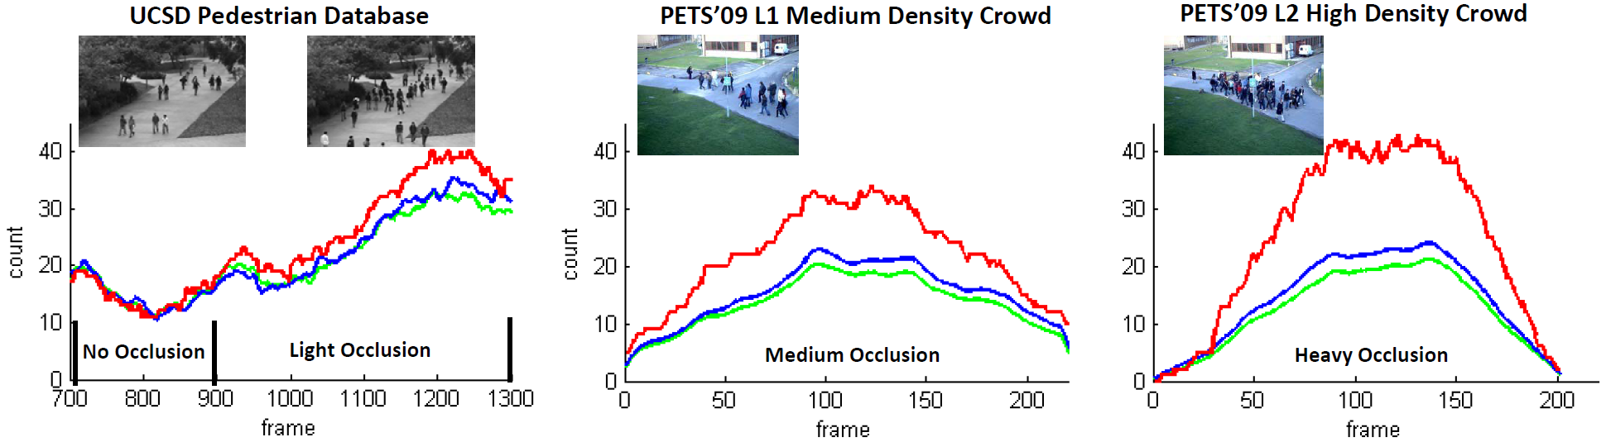
Motivation of the Second-pass GP
Ground truth
Prediction by the feature of horizontal gradients
Prediction by the feature of vertical gradients

Slide 4
Cross Camera People Counting
Blob representation
Feature extraction
Perspective modeling
Online training data acquisition

Slide 5
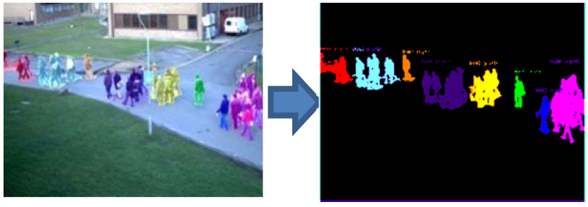
Blob Representation
Blob: a natural unit for people counting
Each pedestrian typically appears in one blob
A pedestrian can be occluded only by other pedestrians within the same blob

Slide 6
Feature Extraction
Feature: characterize blobs for counting
Area
Canny edge pixels
Gradient orientations
Properties of the adopted features
Applying to each pixel in a blob and summing over the responses on all the pixels
Feature values grow linearly w.r.t. the number of people in the blob if no occlusions occur

Slide 7
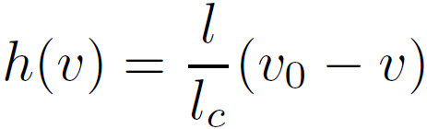




Perspective Modeling
Goal: construct the perspective normalization map
Adopt the perspective model by [Hoiem et al. CVPR’06]
where and : pedestrian height and camera height
: bottom position in image
: pedestrian height in image with
: horizon position

Slide 8

Online Training Data Acquisition
Why online acquisition?
The appearances of pedestrians taken by different cameras span a wide spectrum
Apply off-the-shelf pedestrian detector [Dalal & Triggs, CVPR’05] for training data collection
A special case of the blob representation
Each blob contains exactly one pedestrian

Slide 9



The TPGP Algorithm
TPGP = Two-pass Gaussian Processes
The estimated number of pedestrians in blob
The first-pass GP
Visible parts
Pedestrian appearances are camera-dependent
The second-pass GP
Occluded parts
Assume abilities of features against occlusions are fixed -->
is feature-dependent

Slide 10



The First-pass GP
Counting the visual parts:
Multiple visual features
Complement these features to boost accuracy
Camera-dependent:
Online single-person blob collection
Gaussian processes
Linear kernel: for any constant

Slide 11

The Second-pass GP
Counting the occluded parts
Assume abilities of features against occlusions are fixed
An extrapolation method
Investigate the extent of disagreement among different features to measure the underestimate by occlusions
Feature-dependent
Offline blob collection

Slide 12

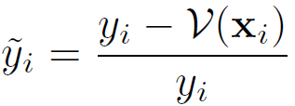
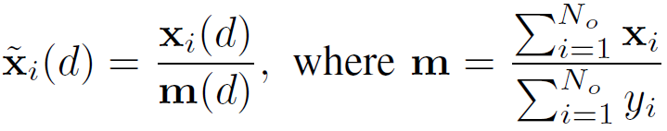

The Second-pass GP
The occlusion rate for each blob
Feature value normalization for comparison
Feature vector transformation
Learning the second-pass GP by the transformed data

Slide 13
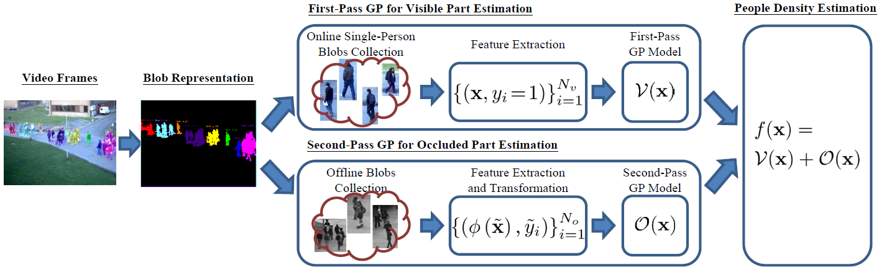
System Flowchart

Slide 14
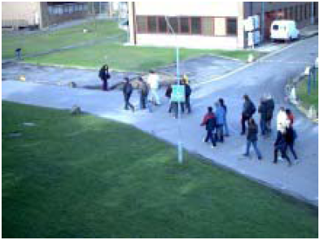
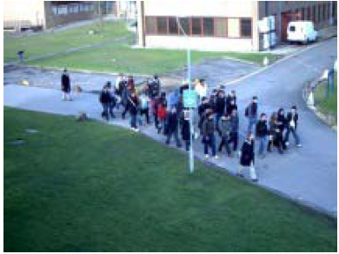
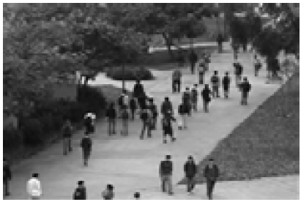
Experimental Results - Dataset
Datasets
PETS’09 S1 (light occlusions)
PETS’09 S2 (medium occlusions)
PETS’09 S3 (heavy occlusions)
UCSD (no/light occlusions)

Slide 15
Experimental Results – Comparison
The proposed method: TPGP
Baselines
MAGP (manually annotated GP): for cross-camera evaluation
FPGP (the first-pass GP): for occlusion evaluation
Public systems
[Kong et al. BMVC’05] - [Chan et al. ICCV’09]
[Ryan et al. DICTA’09] - [Lempitsky & Zisserman, NIPS’10]

Slide 16
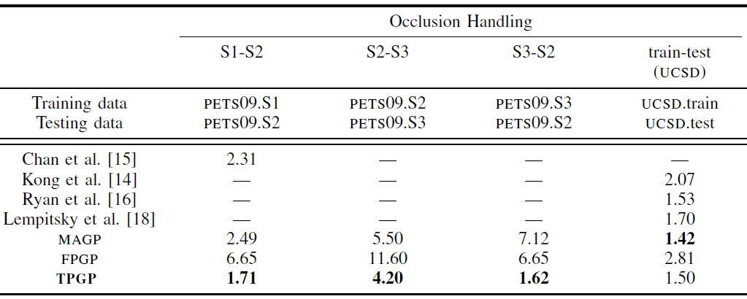
Quantitative Results
For occlusions handling, [mean absolute error]

Slide 17
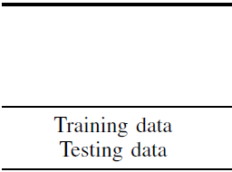
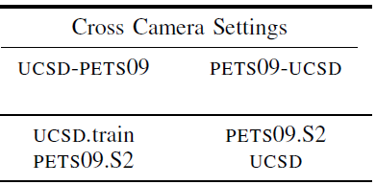


Quantitative Results
For cross camera setting

Slide 18
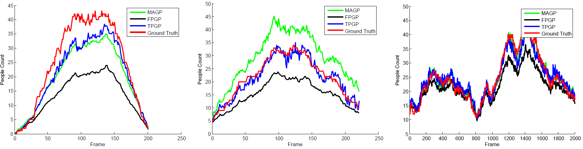



Experimental Results
Occlusion handling

Slide 19
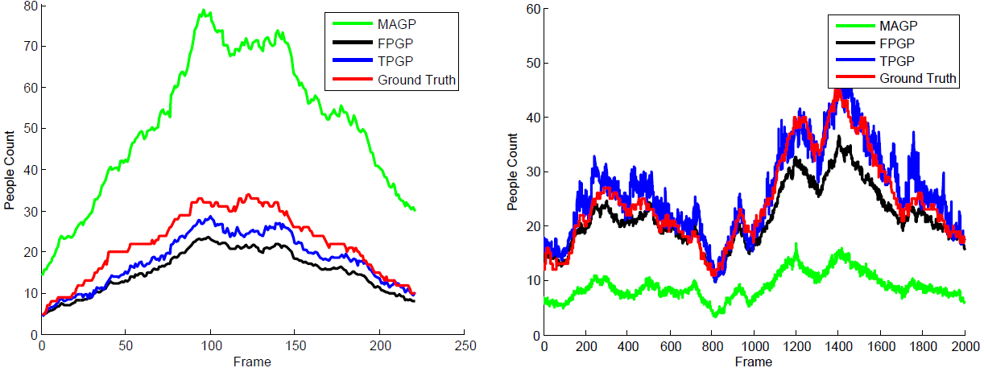


Experimental Results
Cross camera setting

Slide 20
Future Work
Perspective modeling and online data acquisition at the same time
New features, especially for second-pass GP
New datasets, such as UCF
More experiments

Slide 21
Thank You
Yen-Yu Lin (林彥宇)
Tel: (02) 2787-2392
Email: yylin@citi.sinica.edu.tw

