Slide 1
NeuralNet 101
6. CNN

Slide 2
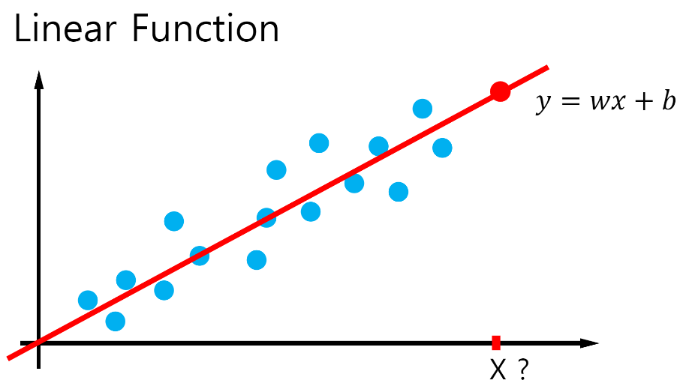
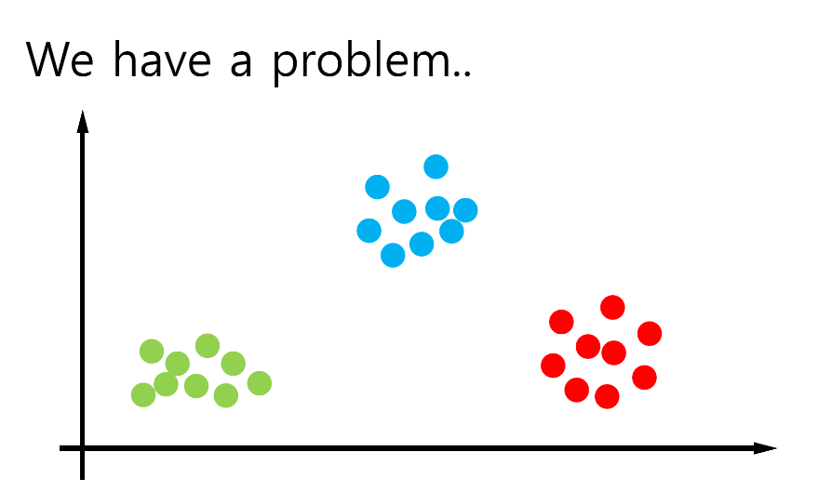
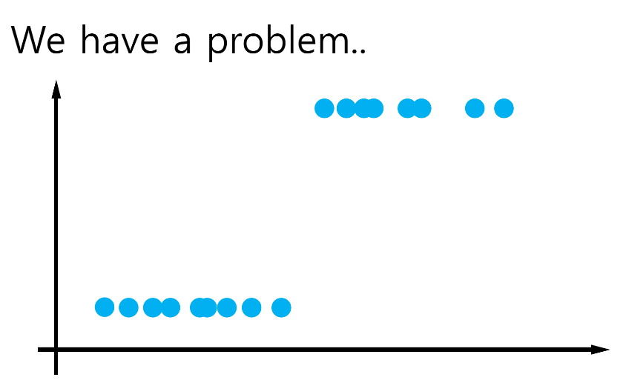
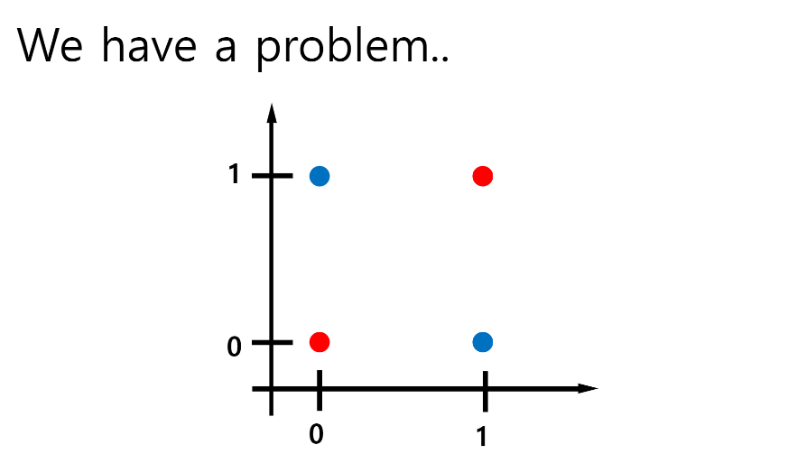
We have a problem.. (again)

Slide 3
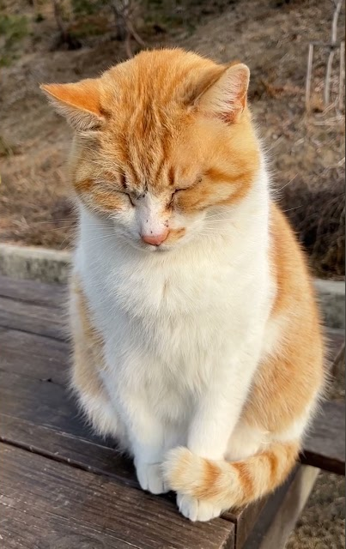
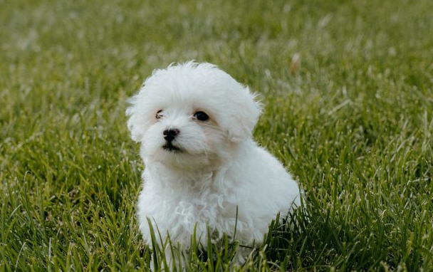
How to train for image data?
Cat
Dog

Slide 4

CNN (step-by-step)

Slide 5
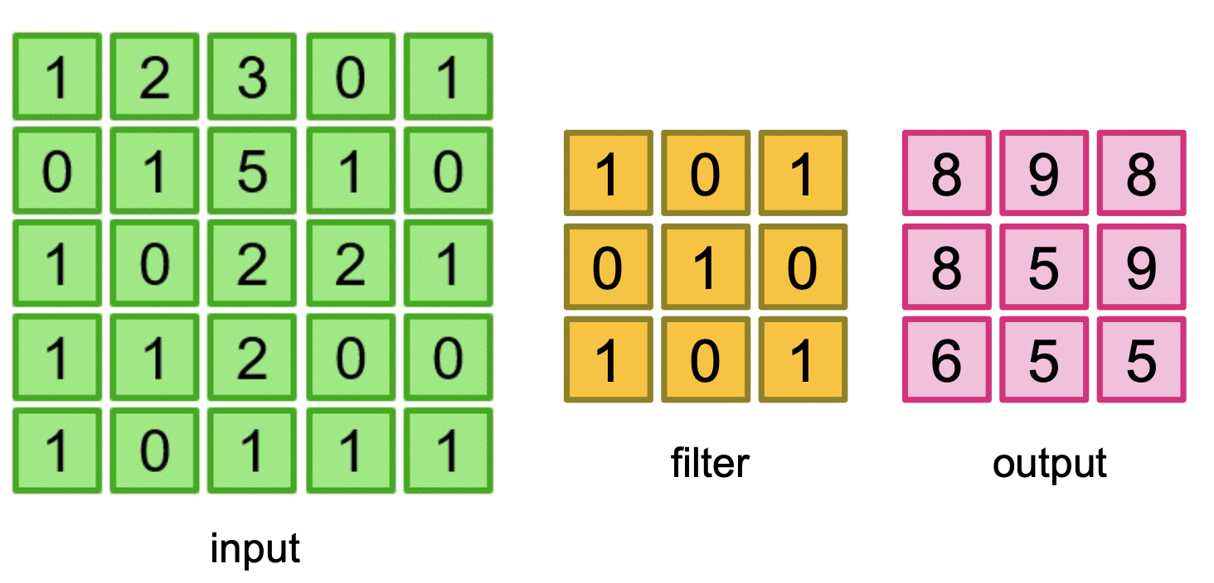
Convolution
Stride(step) ->

Slide 6
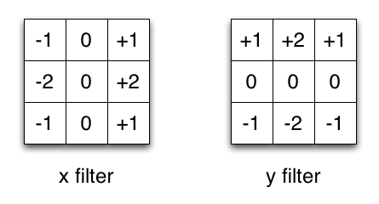
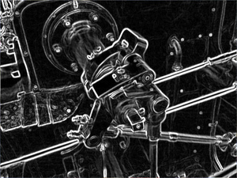
Convolution Filter (Kernel)
ex) Sobel X/Y: Edge Filter
Appropriate filters automatically trained in CNN,
to extract feature

Slide 7
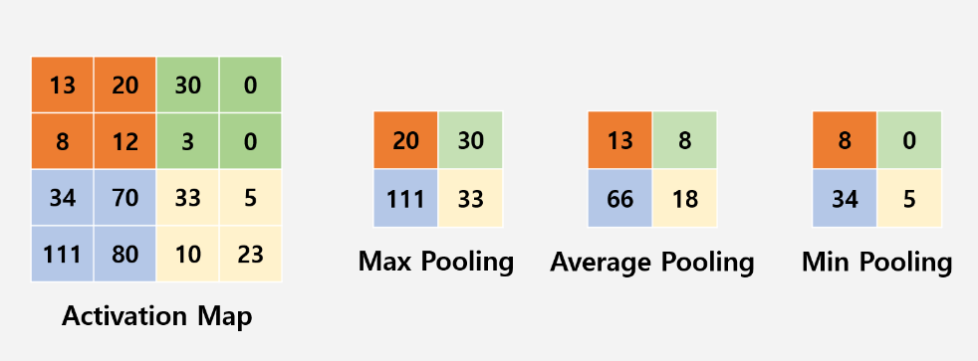
Pooling (sub sampling)
Reduce data size for less calculation and less overfitting

Slide 8
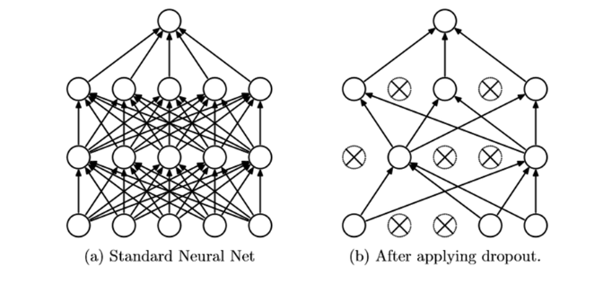
Dropout
Random dropout prevents overfitting and co-adaptation
-> better feature!

Slide 9
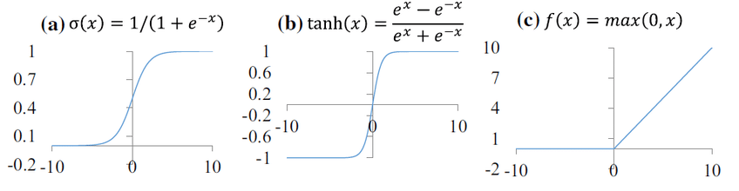
Activation Function
tanh: better slope, back-prop direction not biased
ReLU: faster training, no saturation for extreme values

Slide 10
CNN Architecture Overview
LeNet -> AlexNet/ZFNet ->
VGG/GoogLeNet -> ResNet -> …

Slide 11
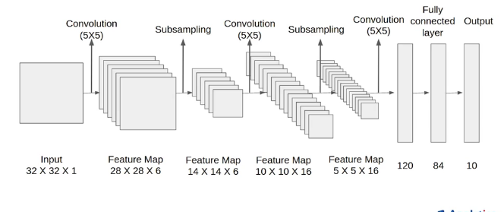
LeNet-5

Slide 12
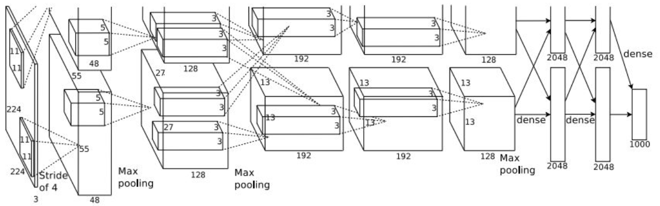
AlexNet

Slide 13
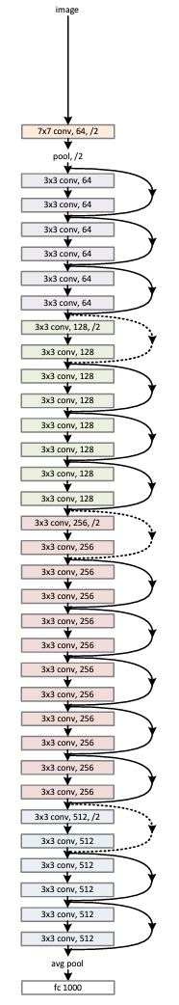
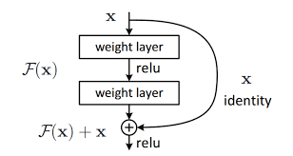
ResNet
skip connection:
residual mapping
-> deep layer performance!

