Slide 1
Numerical modelling of coated 3D printed implant for various loading conditions
10-11-2019

Slide 2
FEM Analysis
For preliminary testing modelled implant is simulate for normal loading and realistic loading condition. Both coated and uncoated modelled implant is used for simulation work.
For normal loading normal walking and fast walking is considered and for realistic loading condition, only slow walking condition is used for determining total deformation and von-misses stress.
Walking Method | Slow | Fast
Force (N) | -2000 N | -6000 N
Walking methods with magnitudes of force
Type of Loads | Normal | Realistic
Magnitude | Fz= -1944N | Fx= -370 N, Fy= -292 N, Fz= -1944 N, F= -2000N, Mz= -13.7 Nm
Types of load with their magnitudes
11-11-2019

Slide 3
Results:-
a) Effect of normal walking load on the implant
Walking Style | Load (N) | Coating | Stress (MPa) | Deformation (mm)
Slow | -2000 | No | 216 MPa | 0.065
Slow | -2000 | Yes | 318 | 0.072
Fast | -6000 | No | 649 MPa | 0.19
Fast | -6000 | Yes | 788 MPa | 0.21
The effect of normal static load for slow and fast walking condition on coated or without implant are calculated. Calculated results show the percentage increment in the stress value for slow walking is much higher for fast walking. But the percentage of deformation increment is almost constant (approx. 10%) for both slow and fast walking.
04-11-2019
Design and Functionality Improvement of 3D Printed Ti6Al4V Hip Implant using Powder Bed Fusion Approach

Slide 4
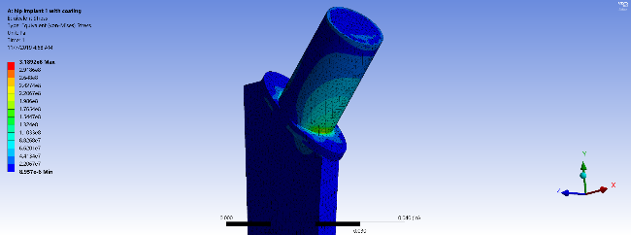
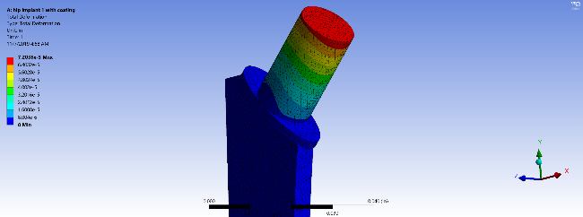
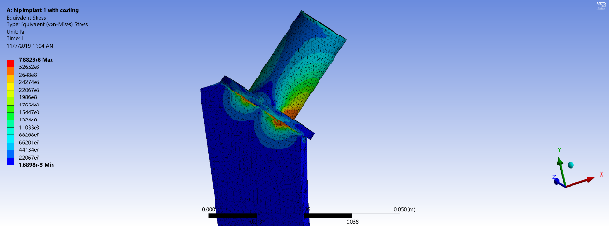
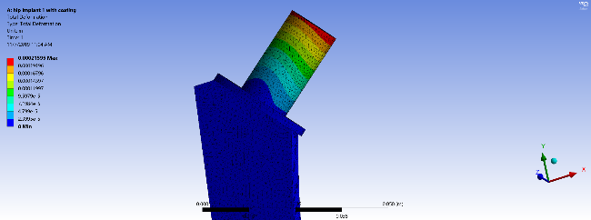
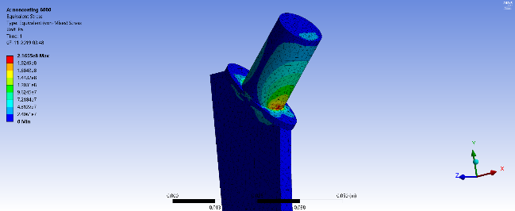

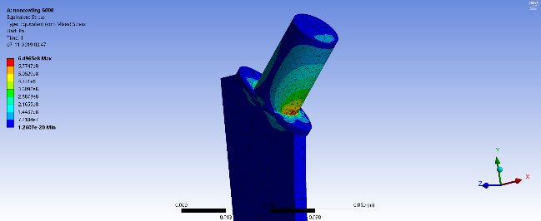
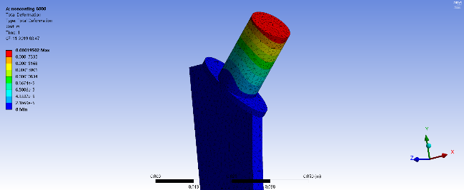
(a) Stress
(b) Deformation
(a) Stress
(b) Deformation
For normal walking with coating
For fast walking with coating
(a) Stress
(b) Deformation
(a) Stress
(b) Deformation
For normal walking without coating
For fast walking without coating
04-11-2019

Slide 5
b) Effect of type of load on the implant
Type of Loading | Coating | Stress (MPa) | Deformation (mm)
Normal | No | 210 MPa | 0.063 mm
Realistic | No | 190 MPa | 0.056 mm
Normal | Yes | 301 MPa | 0.07 mm
Realistic | Yes | 269 MPa | 0.062 mm
The effect of different load for slow-walking condition on coated or without implant are calculated. Calculated results show decrease in the stress value 9.5% and deformation by 14% for implant without coating. With the coating percentage increment in stress is remain constant (9.5% to 10%) but the percentage increment in deformation is decreased (14% to 11%).
04-11-2019
Design and Functionality Improvement of 3D Printed Ti6Al4V Hip Implant using Powder Bed Fusion Approach

Slide 6


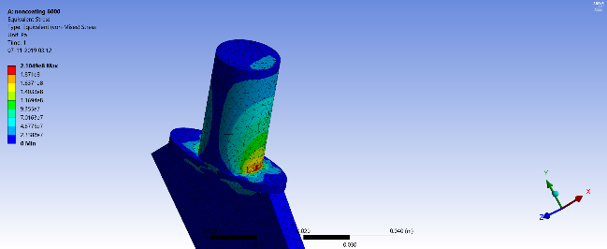
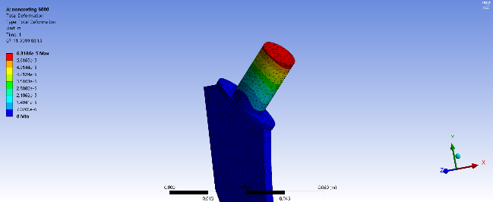
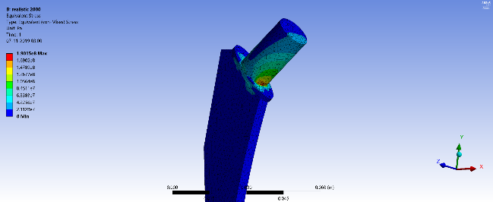
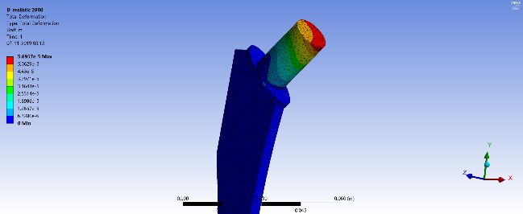
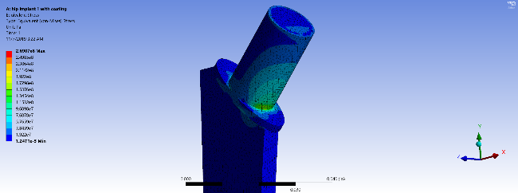
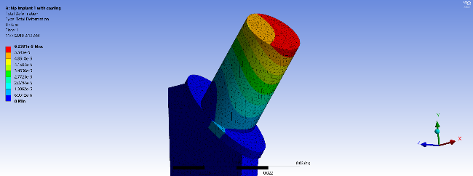
(a) Stress
(b) Deformation
(a) Stress
(b) Deformation
For normal walking load with coating
For normal walking load without coating
(a) Stress
(b) Deformation
(a) Stress
(b) Deformation
For realistic walking load without coating
For realistic walking load with coating
04-11-2019

