Slide 1
Residual stress measurement of additive manufactured support-less metal parts

Slide 2
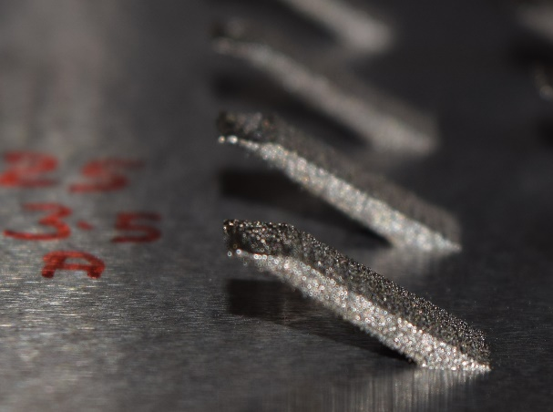
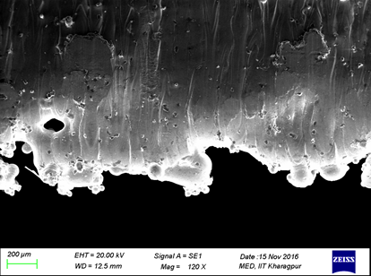
Challenges and Impact
Challenges
To reduce the dross and wrap.
Accumulation of residual stress.
Impact
Distort the dimensional accuracy of part, which may damage recoter.
Forming failure of part surfaces.
Warp
Dross

Slide 3

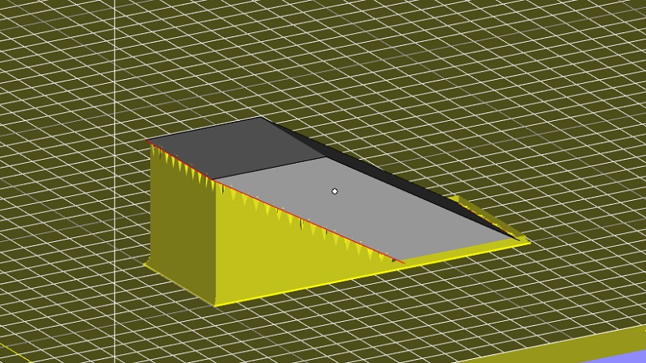
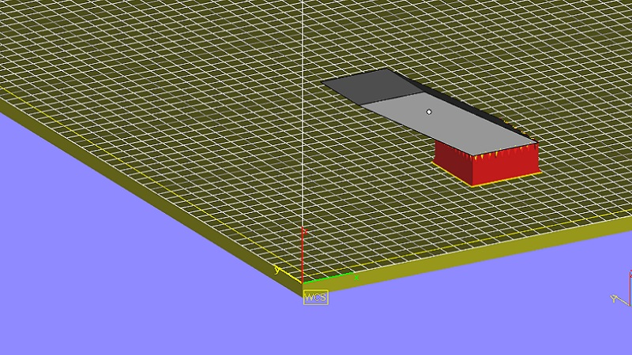
Design Sample
Support recommended by Magics
Actual Support

Slide 4
XRD Analysis :-
Radiation | Wavelength | Current | Tension | Psi (Ψ) | Phi (ø) | Lattice Parameter [hkl]
Co Kα | 1.79Å | 30 mA | 40 KV | -45 to 45 | 90 | 211
Nanoindentation Analysis :-
Indenter | Acquisition Rate | Maximum Load | Loading Time | Holding Time | Unloading Time | Approach Speed | Retract Speed
Spherical Diamond | 10 Hz | 200 mN | 30 sec | 10 sec | 30 sec | 2000 mm/min | 2000 mm/min

Slide 5
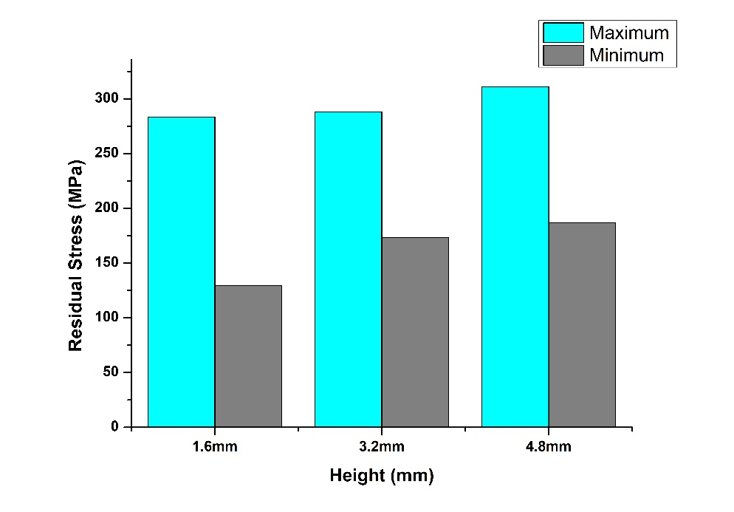
X-Ray Diffraction Analysis
Effect of Height
Height (mm) | 1.6 | 3.2 | 4.8
Normal Stress (Mpa) | 206±76.9 | 230.6±57.3 | 248.9±62

Slide 6
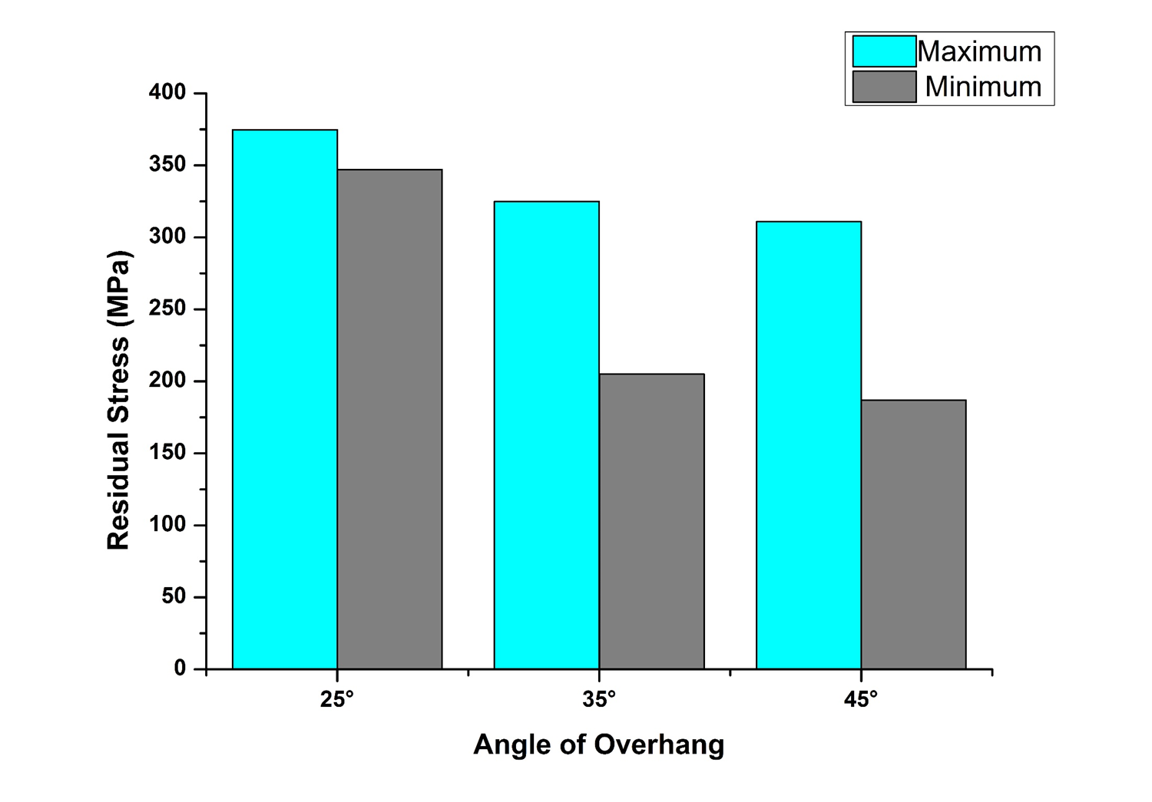
Effect of Overhang Angle
Angle | 25 | 35 | 45
Normal Stress (Mpa) | 360±13.8 | 265±60 | 248.9±62

Slide 7
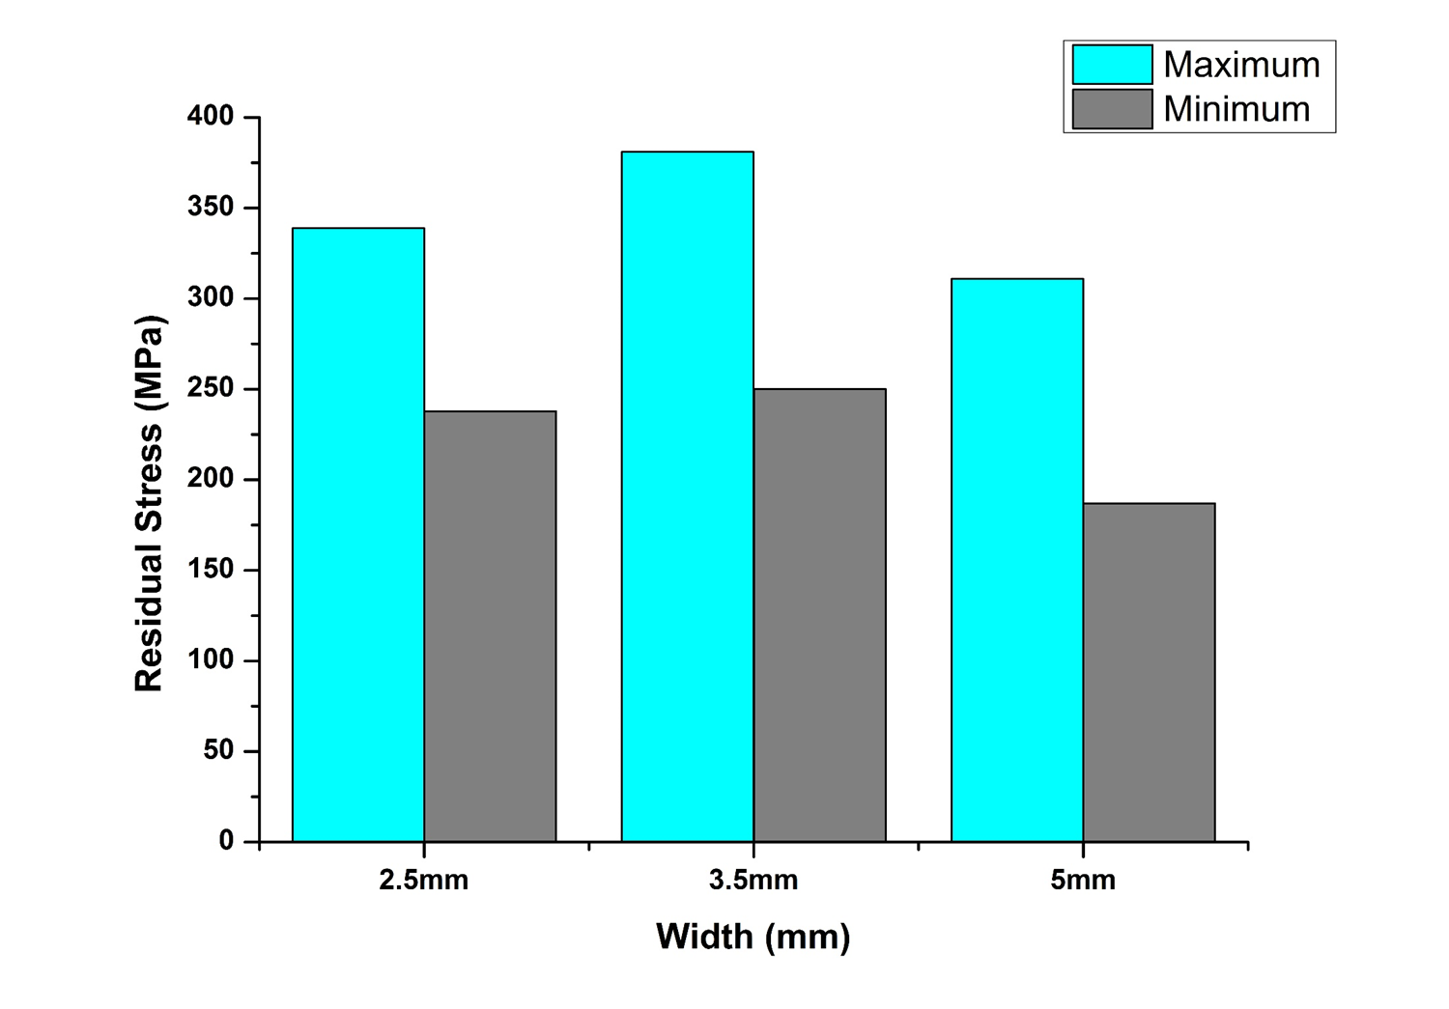
Effect of Width
Width (mm) | 2.5 | 3.5 | 5
Normal Stress (Mpa) | 221.3±28.3 | 315±65.4 | 248.9±62
04 May 2017
Fabrication and Characterization of Different Supportless Overhang Structures Using DMLS

Slide 8
Nano Indentation Analysis
Effect of Height
Height (mm) | 1.6 | 3.2 | 4.8
Indentation (nm) | 1366.80 | 1376.20 | 1392.35
Effect of Overhang Angle
Angle | 25 | 35 | 45
Indentation (nm) | 1418.31 | 1414.59 | 1392.35
Effect of Width
Width (mm) | 2.5 | 3.5 | 5
Indentation (nm) | 1379.07 | 1447.22 | 1392.35

Slide 9
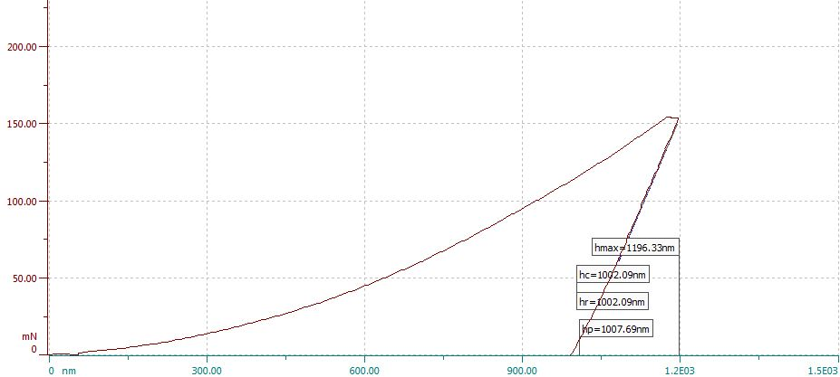
For Stress Free Sample:-
Average indentation depth obtain for the stress free sample is 1074.42nm

Slide 10
Conclusion
•We successful built the overhang angle below the critical angle, although the surface quality is poor.
•The value of residual stress increases with increase of height. Although it is not above the yield stress of used material but if we increase height more there us chance of crack generation is there.
•Residual stress also increases as we lower the overhang angle, so for small angle the height of sample needs to be small.
•For the scan length (width), residual stress is also depend on the rate of cooling.
•The result of nanoindentation also matches with the result proﬁle of XRD method.
04 May 2017

Slide 11
Conference Paper
Study on the Effect of Different Process Parameters on the Quality of Overhang Surface Produced by Direct Metal Laser Sintering Process by Sagar Sarkar, Ankit Porwal, Cheruvu Siva Kumar and Ashish Kumar Nath, Proceedings of National Conference on Advanced Functional Materials Processing Manufacturing (NCAFMPM-2017), Excel India Publishers ,New Delhi, 96-100 (2017).

