Slide 1
Additive manufacturing of composite materials

Slide 2
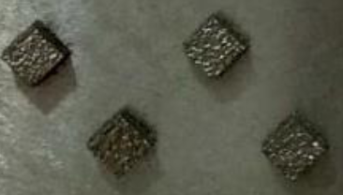
15_5ph stainless steel is mixed with Graphene nano particle (GNP)
Manufactured part are tested for micro scratch and micro hardness to find out change in surface property of composite
Additive manufactured SS-15-5ph
and GNP composite samples

Slide 3
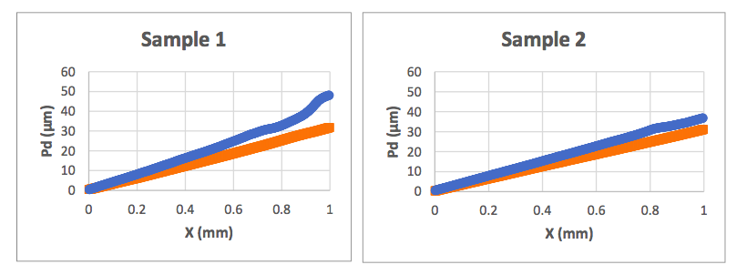
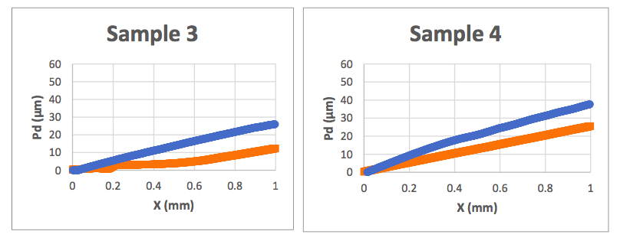
MICROSCRATCH
Blue indicate the composite material and orange indicate base base ss 15-5 ph

Slide 4
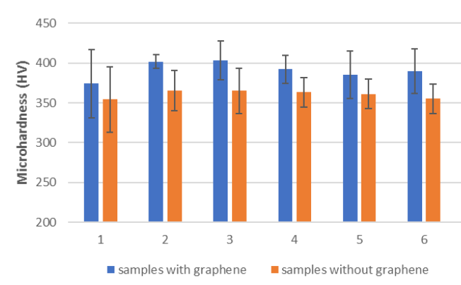
MICROHARDNESS

Slide 5
Results
Results shows increment in the surface mechanical property of the composite material in compare to the base material

