Slide 1

HY454 : ΑΝΑΠΤΥΞΗ ΕΞΥΠΝΩΝ ΔΙΕΠΑΦΩΝ ΚΑΙ ΠΑΙΧΝΙΔΙΩΝ
ΠΑΝΕΠΙΣΤΗΜΙΟ ΚΡΗΤΗΣ,
ΣΧΟΛΗ ΘΕΤΙΚΩΝ ΕΠΙΣΤΗΜΩΝ,
ΤΜΗΜΑ ΕΠΙΣΤΗΜΗΣ ΥΠΟΛΟΓΙΣΤΩΝ
ΔΙΔΑΣΚΩΝ
Αντώνιος Σαββίδης

Slide 2

ΕΞΥΠΝΕΣ ΔΙΕΠΑΦΕΣ,
Σύνολο διαλέξεων 7, Διάλεξη 3η

Slide 3
Table of contents
Motivation and objectives
Software refactoring
Main idea
Adaptive composition
Process overview
Process elaboration
Some wishful thinking
Conclusions
 | Anthony Savidis, Constantine Stephanidis: Software refactoring process for adaptive user-interface composition. ACM EICS 2010: 19-28

Slide 4
Motivation (1/2)
Adaptive behavior
  is a key requirement for industrial-level applications
Current applications
  are too big (hundreds of thousands to millions LOC)
And their architectures
  are custom designs optimally fitting their domain
We may have good architectures
  to engineer adaptive interactive systems
But we lack software processes
  to blend architectures together (in general)

Slide 5
Motivation (2/2)
We cannot suggest that application vendors
  should rebuild using our proposed UI architecture
The obvious reason relates to development cost
  as it takes huge efforts to radically reengineer a system
An equally critical factor concerns software quality
  since UI architectures may be suboptimal for the app domain
Mostly expected as adaptivity is not a governing feature
  since it concerns small parts of the global source code base
But then to remake existing applications as adaptive
  we essentially lack software engineering methodologies

Slide 6
Objectives
Define a software update process for adaptivity
Preserve the domain-specific architecture
May even turn applications to “adaptivity ready”
Allow adaptivity behavior to be easily hooked
Explore adaptivity as a cross-cutting concern
Shift adaptivity from macro to micro architecture
Prescribe updates of certified software quality

Slide 7
About software refactoring
Specialized software update process
Incremental small-scale source transformations
Enhances the software design of a system
Does not affect the original functionality
Neither its externally-observed behavior
Applies architecture-preserving refinements
Well-defined conduct via stepwise changes
Certified refactoring catalogues exist

Slide 8
Main idea (1/2)
?
+
=
domain architecture
interface architecture

Slide 9
Main idea (2/2)
interface architecture
Shift interface features from macro to micro architecture level and define incremental updates for all features
Interface features remain microscopically, via differing patterns, but always inside the original domain architecture
+
=
domain architecture
refactoring process
domain architecture

Slide 10
Adaptive composition (1/4)
The UI design has alternative versions of some UI components, the latter matching particular aspects of a user / context model
The UI implementation encompasses all such alternatives
The UI system drives the adaptive selection and activation of those alternatives optimally matching the current user / context profile

Slide 11
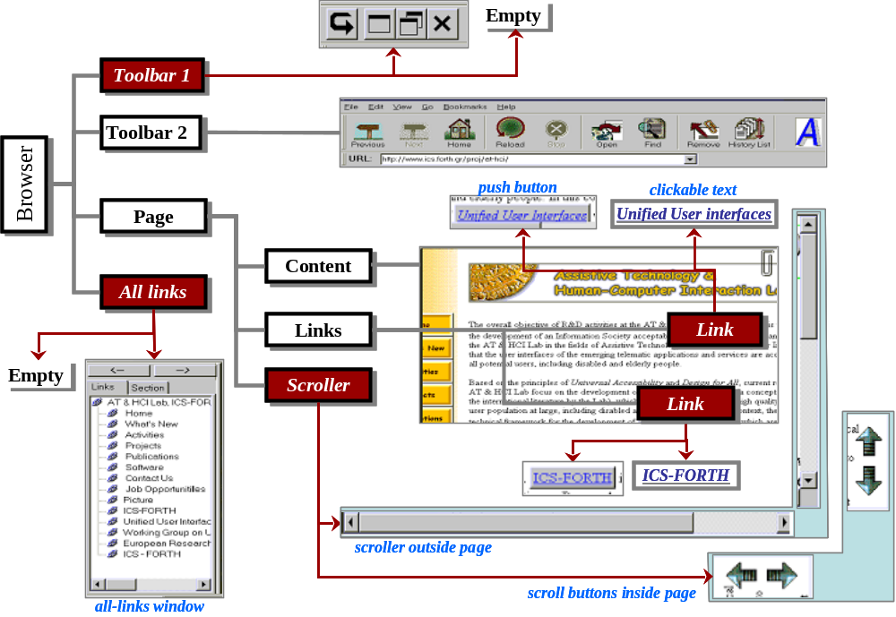
Adaptive composition (2/4)

Slide 12
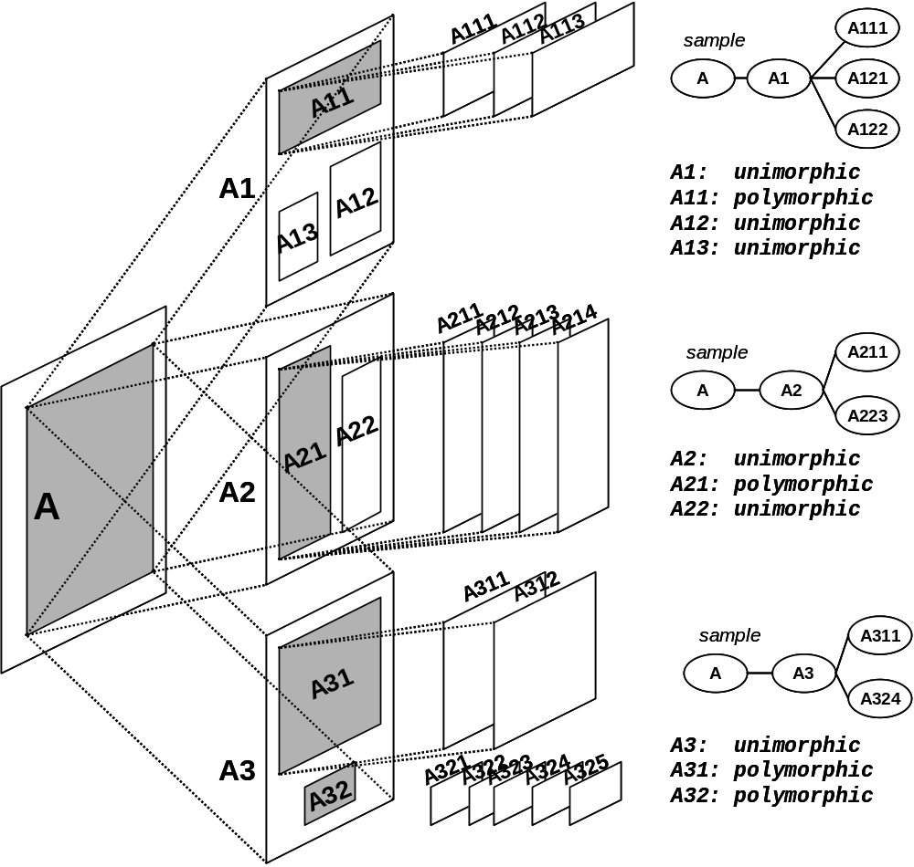
Adaptive composition (3/4)
UI components with multiple versions may impose mutually-exclusive runtime presence of their alternatives
Those are called polymorphic - the rest are unimorphic
Once UI containers are polymorphic, adaptive composition applies to the UI layout as well

Slide 13
Adaptive composition (4/4)
Generally, all reviewed adaptive architectures and systems tend to embody three fundamental features:
  User-interface component alternatives
  Rationale runtime component selection
  Adaptive activation or replacement

Slide 14
Process overview
Identify roles and requirements
preparatory
information gained from the user requirements analysis
Model profiles and define stereotypes
preparatory
information gained from the adaptation design rationale
Identify the adaptation decision logic
Encapsulate adaptation alternatives
Abstract containment and deployment
transformation
applicable even if none of the adaptation alternatives are designed
Support factories and repositories
Enable adaptive dynamic replacement

Slide 15
Identify roles and requirements (1/3)
role
  responsibility-based notion of UI components
    thus abstracting over UI operations
  alternative implementations of roles are possible
    role implementations are actual UI components
  r(α) denotes the role of the UI component α
requirements
  denote functional requirements on roles

Slide 16
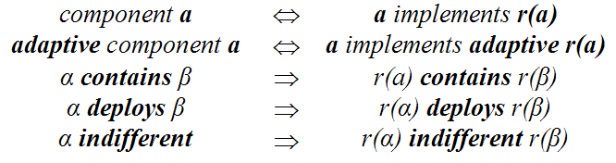
Identify roles and requirements (2/3)
Relationships among components emerge by respective relationships among their roles
contains and deploys concern aggregation and deployment at the functional level, not the UI layout

Slide 17
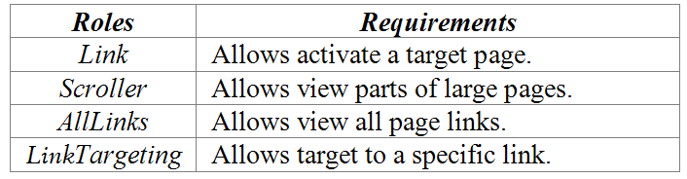
Identify roles and requirements (3/3)
To refactor for adaptivity we should map roles to all UI components and also identify their respective requirements
The example table says that “Link is a UI role whose primary functional requirement is to facilitate activation of a target web page”

Slide 18
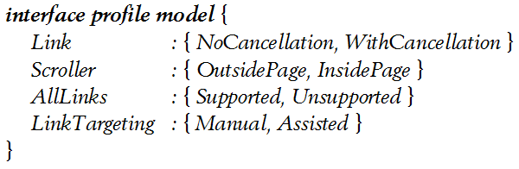
Model profiles and define stereotypes (1/4)
interface profile model - record
  expresses the domain of adaptive variations of UI behavior
  enumerates all viable alternatives for adaptive roles
  designates the set of adaptive user-interface composition possibilities in an application
    UIcomps = Link × Scroller × AllLinks × LinkTargeting
  every instance of the interface profile model represents a plausible adaptive UI setup
    UIsetup ∈ UIcomps

Slide 19
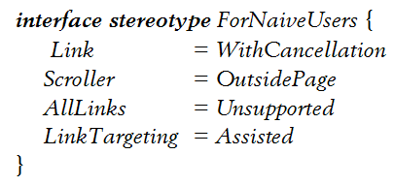
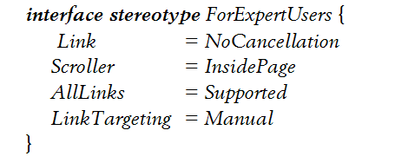
Model profiles and define stereotypes (2/4)
interface stereotypes - instances
  Specific UI setups identified as appropriate for a set of deployment profile instances
  Their identification is an optional step

Slide 20
Model profiles and define stereotypes (3/4)
deployment profile model - record
  expresses the domain of users and contexts of use of an adaptive application
  reflects information about the actual user population and the real environments of use
  involves only computable or known attributes
deployment profile - instance
  an instance of the model data structure
deployment stereotype - set of instances
  set of instances resulting by assigning value predicates to model attributes

Slide 21
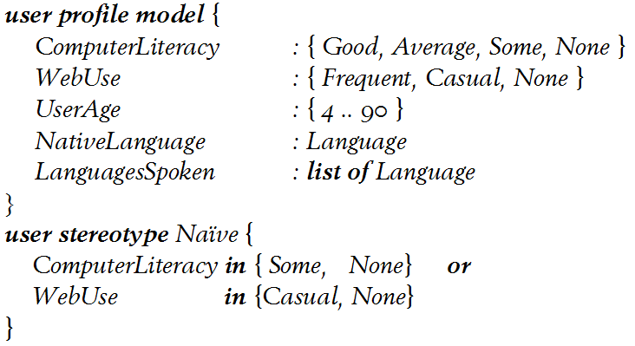
Model profiles and define stereotypes (4/4)
Profiles attributes not important to the adaptation goals of an application are simply skipped, not being part of the model
Predicates involve the attributes important for the stereotype - the rest are assumed to unconditionally match the stereotype

Slide 22
Identify the adaptation decision logic (1/3)
Conditions regulating the delivery and presence of an adaptive component during interaction
  when adaptive activation of components should be performed
  which of the available alternatives of adaptive components should be chosen
Rationally links the deployment profile with designed UI component alternatives being fundamentally user and context dependent

Slide 23
Identify the adaptation decision logic (2/3)
The adaptation decision logic links deployment profile attributes to interface profile attributes
It can be expressed in numerous forms and in various languages
  as a starting point it can be hardcoded in the language the application is programmed
  or may choose an existing decision language
  or may import an entire AI subsystem for deciding adaptation
  we use DMSL (decision blocks, predicated decisions, stateless rules with an imperative syntactic illusion)

Slide 24
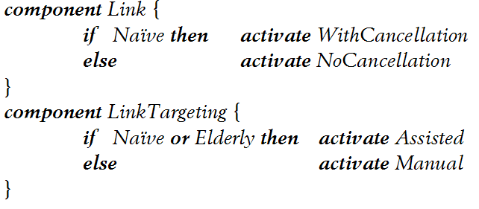
Identify the adaptation decision logic (3/3)
Deployment profile predicates (conditions)
Adaptive alternatives
(attribute values in the interface profile model)

Slide 25
Encapsulate adaptation alternatives (1/4)
At runtime, for adaptive components, only the contextually appropriate versions are activated
Once activated they should be indistinguishable to UI system from its alternatives
Thus, related adaptation alternatives should comply with a common API, like a superclass

Slide 26
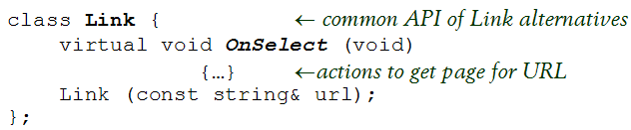


Encapsulate adaptation alternatives (2/4)
Further adaptation alternatives for link may be defined as subclasses of the Link superclass

Slide 27
Encapsulate adaptation alternatives (3/4)
unimorphic
polymorphic
non-adaptive
component A
adaptive
component A
implements
class A₁
class A
superclass A
class A_{N}
adaptation alternatives

Slide 28
Encapsulate adaptation alternatives (4/4)
Refactorings
  Extract Hierarchy
  Create Abstract Super Class
Extra refactorings to turn the UI implementation from procedural to object-oriented
  Convert Procedural Design to Objects
  Extract Class

Slide 29
Abstract containment and deployment (1/2)
An adaptive component, appearing as one of its alternatives, may be contained or deployed
We apply the exclusive use of superclass references to handle contained or deployed adaptive components due to:
  reduced dependencies: decoupling clients of adaptive components from adaptation alternatives
  flexibility and extensibility: one may drop, change or add adaptation alternatives without affecting respective clients

Slide 30
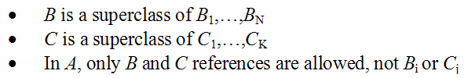
Abstract containment and deployment (2/2)
comp A
contains
adaptive
role B
deploys
adaptive
role C
decoupling A from B_{i} alternatives
decoupling A from C_{j} alternatives
comp B₁
comp B_{N}
comp C₁
comp C_{K}
Adaptation alternatives for the B adaptive contained role
Adaptation alternatives for the C adaptive deployed role

Slide 31
Support factories and repositories (1/4)
We also seek for an optimal decoupling of the decision rules from the rest of the UI source code
Ideally, decision rules refer to component alternatives only by their design name, independently of their implementation name
For instance, we must be able to adopt the adaptive component names from the interface profile model
This requires name-based component instantiation, where adaptive components can dispatch the instantiation requests of the decision engine
This way containers may instantiate adaptive components without dependencies on the concrete class of the actually instantiated component

Slide 32
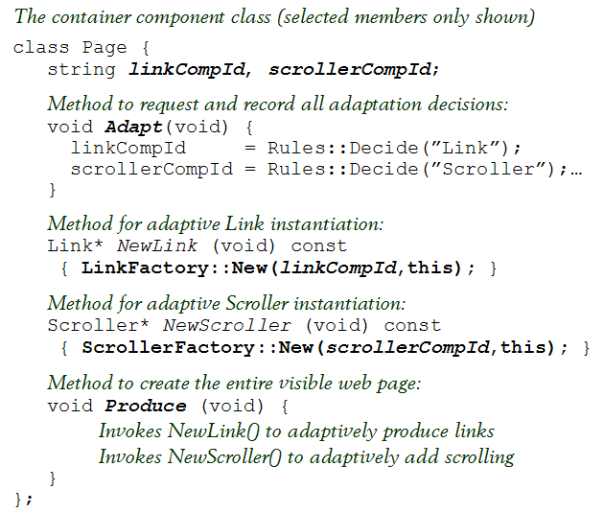
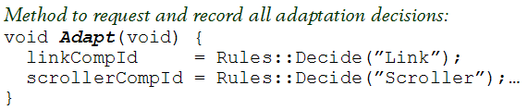


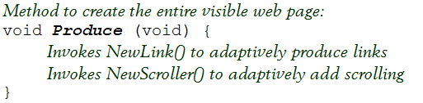
Support factories and repositories (2/4)
assume two adaptive contained components
choosing the correct version is an adaptation decision
instantiation of adaptive contained components is performed through factories
containers use factories to create instances of the adaptive contained components

Slide 33
Support factories and repositories (3/4)
unimorphic
client
component A
non-adaptive
component B
contains
client class A
class B
contains objects of class C
polymorphic
client
component A
adaptive
component B
contains
class B₁
client class A
superclass B
class BFactory
contains objects via superclass B
class B_{N}
uses to adaptively produce instances of class B

Slide 34
Support factories and repositories (4/4)
Refactorings
  Factory Design Pattern
  Virtual Constructor Pattern
  Refactoring To Patterns

Slide 35
Enable dynamic adaptive replacement (1/7)
an adaptive role (an adaptive component) with some alternatives
adaptive role A
3. terminate A₃
1. activate A₂
component A₃
component A₃
component A₂
component A₃
component A₂
component A₁
component A₂
2. replace A₂ by A₃

Slide 36
Enable dynamic adaptive replacement (2/7)
A replaced component may possess state that should be transferred to its substitute
  thus state copy and transfer is needed
Clients of a replaced component are suddenly faced with dangling references
  thus they should refer via proxies to replaceable components

Slide 37
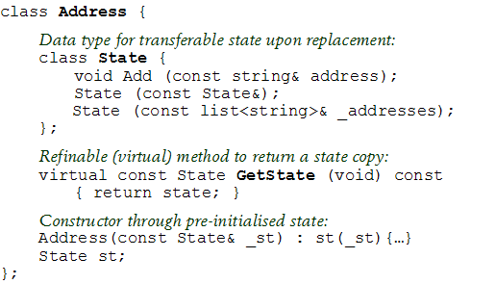
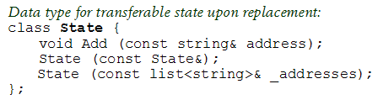




Enable dynamic adaptive replacement (3/7)
State copy and state transfer
assume an adaptive replaceable UI component for the web-page address bar
we model its state at the level of the superclass; this item carries enough information ot transfer state
subclasses may refine the way state is constructed but not the state type itself
instance initialization from a state copy is supported
subclasses support construction from a state copy, while the refine as needed the state extraction virtual method GetState

Slide 38
Enable dynamic adaptive replacement (4/7)
It is possible to have dangling references within referrers of replaceable components when replacement occurs
We rectify this issue using proxies of replaceable components as opposed to directly using the components references

Slide 39
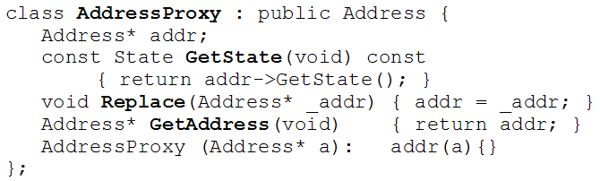
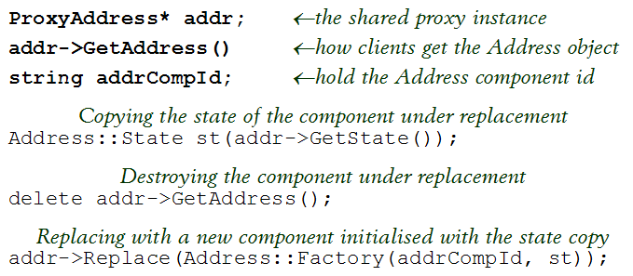
Enable dynamic adaptive replacement (5/7)
we define proxies for replaceable components, where Get<item> is used to extract the actual reference when needed (referrers never stored the real reference)
the actual replacement sequence using directly the proxy instance: copy state, destroy old, create new with the copied state

Slide 40
Enable dynamic adaptive replacement (6/7)
client
component A
replaceable adaptive
component A
deploys
class ProxyA
access through
class A₁
client class A
superclass A
class AFactory
deploys
class A_{N}
copy and transfer
class A::State

Slide 41
Enable dynamic adaptive replacement (7/7)
Refactorings
  Proxy Design Pattern
  Adapter Design Pattern
  Refactoring To Patterns

Slide 42
Some wishful thinking (1/2)
Easy to apply
  Well-defined, prescriptive, guaranteed to achieve its target due to use of standard refactorings, aspect oriented
  Involves diverse disciplines, is software intensive, applies at source level only (no automations defined), adaptivity code is scattered (is this unconditionally bad?)

Slide 43
Some wishful thinking (2/2)
Can be generalized to other UI aspects
  Paradigm shift from macro to micro architectures, features defined as stepwise source transformations, methods expressed as transformation cookbooks
    e.g., context sensitive help, interaction monitoring, universal access, multiple views, animated feedback, etc.
  Backup methodological propositions with software processes enabling vendors easily uptake your idea
  We made no investigation on this, we have no evidence it is feasible, we cannot tell how independent updates from different features compose well

Slide 44
Conclusions (1/2)
This work is not for achieving an enhanced adaptive interaction behavior or for structuring adaptive interfaces in a better way
It provides strong evidence for setting a methodological path to apply UI research propositions into existing applications with minimal intrusion
adaptive interface engineering research
adaptive interface process research
industrial interactive applications
adaptive applications
technology transfer path

Slide 45
Conclusions (2/2)
Overall two primary requirements:
  compatible with prevalent development practices
  respecting the application domain architectures
Not pure research targets in terms of:
  software engineering
  user-interface engineering
Essentially they are meta goals no matter what the research problem is:
  solve the original research problem
  solve the problem of optimally applying the solution
  they are both elements of a real solution

