Slide 1
Leaderboard probing
Types of LB probing
Categories tightly connected with ‘id’ are vulnerable to LB probing
- Company of user in RedHat competition
- Year, Month, Week in WestNile competition
Notes:
Now I will tell you about a competition-specific technique tightly connected with data leaks. Leaderboard probing.
There are actually 2 types of LB probing. The first one is simply extracting all ground truth from public part of the leaderboard. It’s usually pretty harmless: only a little more of training data. It’s also relatively easy to do: in every submission change only a small set of rows so that you can unambiguously calculate ground truth for those rows from leaderboard score. I suggest checking out the link to Oleg Trotts post in additional materials. He thoroughly explains how to do it very efficiently, with minimum amount of submissions.
Our main focus will be on another type of LB probing. Remember the purpose of public/private split: it supposed to protect private part of test set from information extraction. It turns out, that it’s still vulnerable. Sometimes it’s possible to submit predictions in such a way that will give out information about private data.

Slide 2


Leaderboard probing
id | … | y
1 | … | 0
1 | … | 0
1 | … | 0
2 | … | 1
2 | … | 1
2 | … | 1
Private
Public
Notes:
It’s all about consistent categories. Imagine a chunk of data with the same target for every row. Like in the example - rows with same ids have the same target. Organizers split it into public and private parts, but we still know that that particular chunk has the same label for every row! After setting all the predictions close to zero in our submission for that particular chunk of data we can expect 2 outcomes:
Score improved. It means that ground truth in public is 0. And it also means that ground truth in private is zero is well. Remember, our chunk has the same labels.
The second outcome is when the score became worse. Similarly, it means that ground truth in both public and private is 1.
Some competitions indeed have that kind of categories. Categories that with high certainty have the same label. You could have encountered those type of categories in RedHat and WestNile competitions. It was a key for winning.
With a lot of submissions, one can explore a good part of private test set. It’s probably the most annoying type of data leak. It’s mostly technical and even if it’s revealed close to the competition deadline, you won’t have enough submissions to properly exploit it.

Slide 3
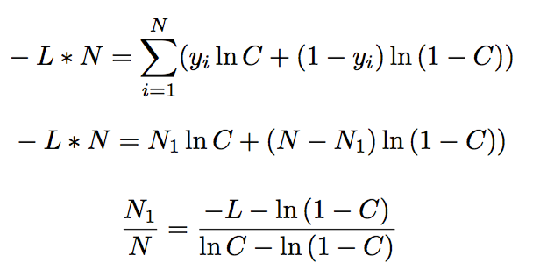

Leaderboard probing
Adapting global mean via LB probing:
Notes:
Furthermore, this is only a tip of the iceberg. When I say ‘consistent category’, it does not necessarily mean that this category has THE same target, it could be consistent in different ways, the definition is quite broad. For example, target variable could simply have the same distribution for public and private parts of data.
It was the case in Quora question pairs competition. In that competition there was a binary classification task being evaluated by logloss metric. Whats important, target variable had different distributions in train and test, but allegedly the same in private and public parts of test set. Because of that, we could benefit a lot via leaderboard probing, treating the whole test set as a ‘consistent category’. Take a look at the formula on the slide. This is logarithmic loss for a submission with constant prediction C, where N is the total number of rows, N1 is the number of rows with target 1 and L is the leaderboard score given by that constant prediction. From this equation, we can calculate N1/N, in other words, the true ratio of ones in the test set! That knowledge was very beneficial, we could use it to rebalance training data points to have the same distribution of target variable as in the test set. This little trick gave a huge boost in leaderboard score.
As you can see, leaderboard probing is a very serious problem that could occur under a lot of different circumstances. I hope that someday it would be completely eradicated from competitive machine learning.

Slide 4


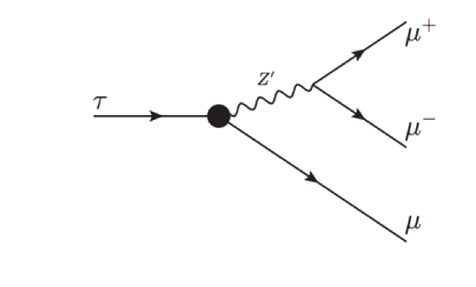
Peculiar examples
Notes:
Finally, I’d like to briefly walk through the most peculiar and interesting competitions with data leakage.

Slide 5
Truly Native
Predict whether the content in an HTML file is sponsored or not
Data leak in archive dates. But is it all?
- Data collection
- Date proxies
Notes:
At first, lets take a look at Truly Native competition form different point of view. In that competition participants were asked to predict whether the content in an HTML file is sponsored or not. As we’ve already discussed in previous video, there was data leak in archive dates. We can assume that sponsored and non-sponsored HTML files were gathered during different periods of time. So do we really get rid of data leak after erasing archive dates? The answer is ‘no’. Texts in HTML files may be connected to dates in a lot of ways: from explicit timestamps to much more subtle things like news contents. As you’ve probably already realized, the real problem was not meta data leak, but rather data collection. Even without meta information ML algorithms will focus on actually useless features, the features that only act as proxies for the date.

Slide 6
Expedia
Predict hotel group a user is going to book
Data leak in distance feature
Reverse engineering true coordinates
Notes:
The next example is Expedia Hotel Recommendations. In that competition participants worked with logs of customer behavior. These include what customers searched for, how they interacted with search results (click/book), whether or not the search result was a travel package. Expedia was interested in predicting which hotel group a user is going to book.
Within the logs of customer behavior there was a very tricky feature: a distance from user’s city to a hotel. It turned out that this feature is actually a huge data leak. Using this distance, it was possible to reverse engineer true coordinates and simply map ground truth from train set to test set. I strongly suggest you to check out the special video dedicated to this competition. I hope that you will find it very useful, because the process and methods of exploiting that data leak were extremely non-trivial and you will find a lot interesting tricks in it.

Slide 7
Flavours of physics
Machine learning problem for something that has never been observed
Signal events were simulated
Special statistical tests in order to punish the models that
exploit simulation flaws
However, one could by-pass the tests, fully exploit
simulation flaws and get a perfect
score on the leaderboard
Notes:
The next example is from Flavours of physics competition.
It was a pretty complicated problem dealing with the physics at Large Hadron Collider (LHC). The special thing about that competition was artificially simulated signal. Organizers wanted a machine learning solution for something that has never been observed, thats why the signal was simulated.
But simulation can not be perfect and it’s possible to reverse engineer it. Organizers created special statistical tests in order to punish the models that exploit simulation flaws. However, it was in vain, one could by-pass the tests, fully exploit simulation flaws, and get a perfect score on the leaderboard.

Slide 8
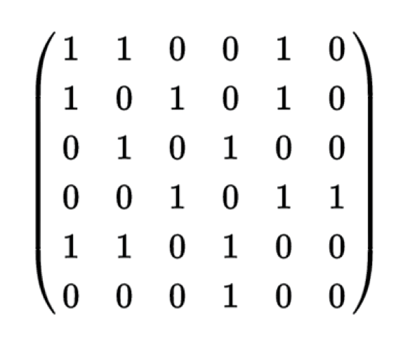
Pairwise tasks
Data leakage in item frequencies
Similarities from connectivity matrix
Notes:
The last example is going to cover pairwise tasks, where one needs to predict whether the given pair of items are duplicates or not. Like in Quora question pairs competition.
There is one thing common to all the competitions with pairwise tasks. Participants aren’t asked to evaluate all possible pairs. There is always some non-random subsampling. And this subsampling is the cause of data leakage. Usually organizers sample mostly hard-to-distinguish pairs, because of that occurs imbalance in item frequencies. It results in more frequent items having the higher possibility of being duplicates.
But thats not all. We can create a connectivity matrix NxN where N is the total number of items. If item i and item j appeared in a pair, then we place 1 in i,j and j,i positions. Now we can treat the rows in connectivity matrix as vector representations for every item. This means that we can compute similarities between those vectors.
It works for a very simple reason: when 2 items have similar set of neighbors, they have a high probability of being duplicates.

Slide 9
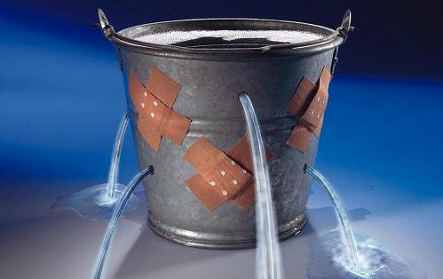
Endcard
Notes:
This is it with data leaks. I hope you gasped the concept and found a lot of interesting examples.

