Slide 1

Expedia Kaggle Competition
Notes:
Hi everyone! In this video I will tell you how I and my teammate Stanislav Semenov solved Kaggle Expedia hotel recommendations competition. Personally, one of my favorites, probably among top5 most interesting competitions I’ve ever participated in. I’ll state the problem now, so if you came here right after data leaks lesson, it should already be familiar to you. Anyway, in that competition we worked with logs of customer behavior. These include what customers searched for, how they interacted with search results (click/book), whether or not the search result was a travel package. And Expedia was interested in predicting which hotel group a user is going to book. Important thing here is prediction target - a hotel group, in other words, characteristic of actual hotel. Remember it.

Slide 2
Data leakage
destination_distance - user_city pair is a leak to true hotel location. A lot of matches between train and test.
How to improve on that?
Features based on counts on corteges of such nature
Try to find the true coordinates
Notes:
As it turned out, this competition had a very nontrivial and extremely hard-to-explore data leak. From the first glance, data leak was pretty straightforward: we had a destination_distance among the features. It’s a distance from users city to an actual hotel he clicked/booked. And as I said earlier, our prediction target is a characteristic of an actual hotel. Furthermore, destination_distance was very precise, so unique user_city and destination_distance pair corresponded to unique hotels. Putting two and two together, we can threat user_city and destination_distance pair as a proxy to our target! When in test set we encountered such pair already present in train set, we could simply take label from there as our prediction. It worked nearly perfect for the pairs present in both train and test. However, nearly half of test set consisted from new pairs, without a match from train set. Thats why we had to go deeper. But how exactly can we improve our solution?
Well, there are two different ways:
First one is to create count features on corteges similar to user_city and destination_distance pair. Like how many hotels of each group there are for (user_city, hotel_country, hotel_city) triplet. Then we could train some ML model on such features.
Another way is to somehow find more matches. For that purpose we tried to find true coordinates of user cities and hotel cities. From that, together with destination_distance feature, it was possible to find good approximation for the coordinates of actual hotels! Lets find out how to do it.

Slide 3
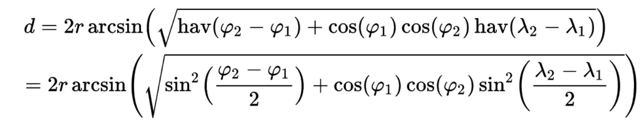
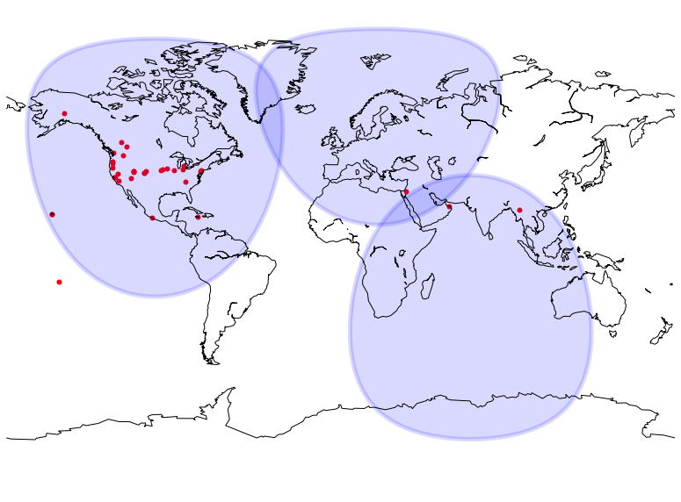
Spherical geometry
Notes:
First of all, we need to understand, how to calculate the distance. Here we work with geographical coordinates so the distances are geodesic. It’s done via Haversine formula. Not a pleasant one!

Slide 4
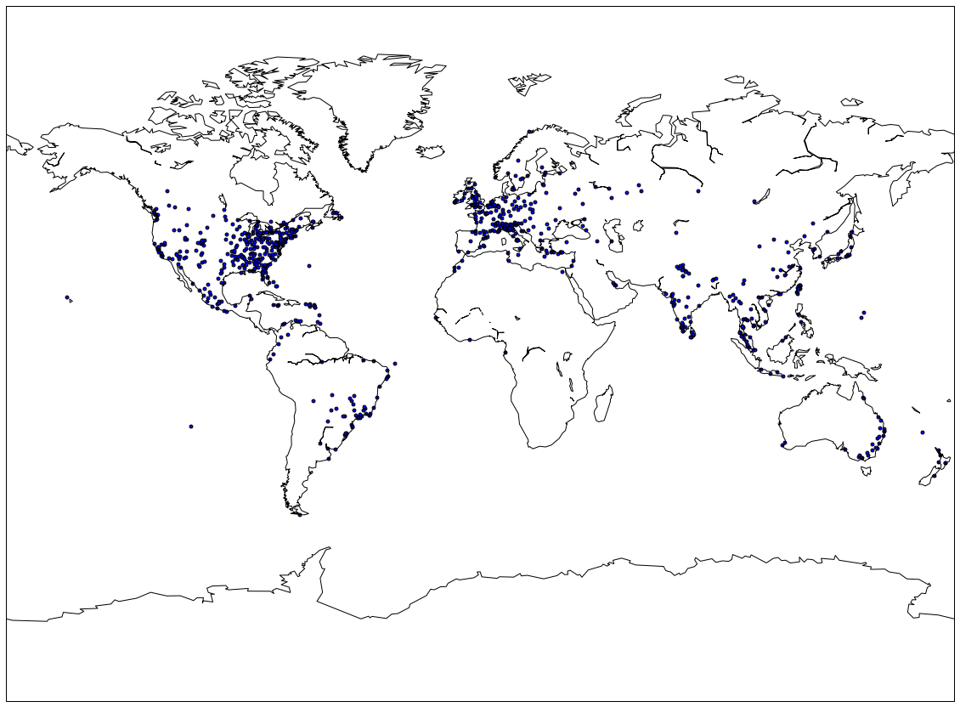
Hotel cities. Old version
Notes:
Now, suppose that we know true coordinates of 3 points and distances from 4th point with unknown coordinates to each of them. If we write down a system of 3 three equations, 1 for each distance, we can unambiguously solve it and get true coordinates for 4th point. Now we have 4 points with known coordinates. I think you get the idea.
So at first, by hook or by crook, we reverse engineered true coordinates of 3 big cities. After that we can iteratively find coordinates of more and more cities. But as you can see from the picture, some cities ended up in oceans. It means that our algorithm is not very precise, rounding error accumulates after every iteration and everything starts to fall apart. We need some different method!

Slide 5
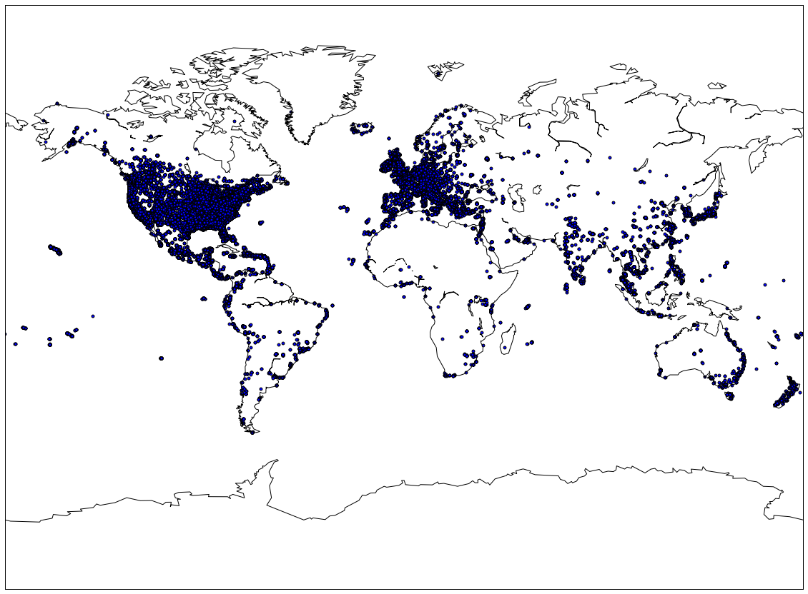
Hotels cities. New version
Notes:
And indeed, we can do better. Just compare this picture with the previous one. It’s obviously much more accurate. Remember how in iterative method we solved a system of 3 equations to unambiguously find coordinates of 4th unknown point. But why limit ourselves with 3 equations? Lets create a giant system of equations from all known distances, with true coordinates being the unknown variables. We end up with literally hundreds of thousands of equations and tens of thousands of unknown variables. Good thing it’s very sparse: we can apply special methods from scipy to efficiently solve such a system.

Slide 6
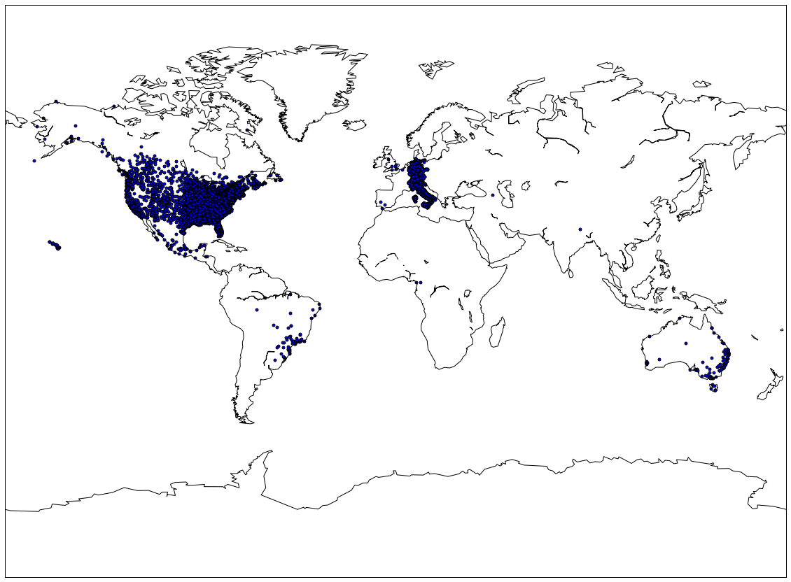
User cities. New version
Notes:
In the end, after solving that system of equations we end up with a very precise coordinates for both hotel cities and user cities.

Slide 7
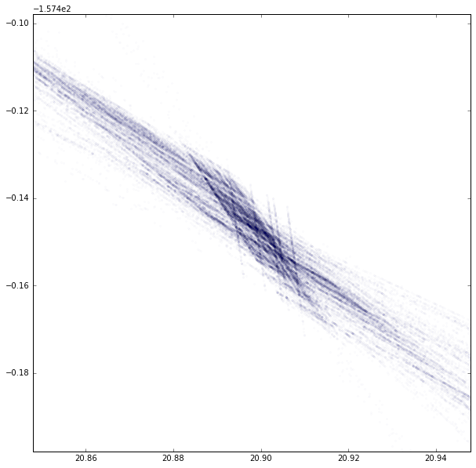
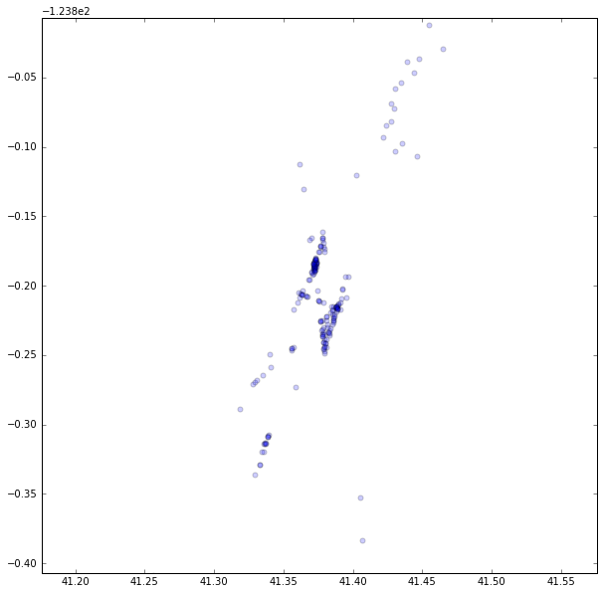
Trying to find the true coordinates of hotels (fail?)
Notes:
But as you remember, we are predicting a type of a hotel. Using city coordinates and destination_distance it’s possible to find an approximation of true coordinates of an actual hotel.
When we fix user city and draw a circumference around it with the radius of destination_distance, it’s obvious that true hotel location must be somewhere on that circumference.
Now lets fix some hotel city and draw such circumferences from all user cities to that fixed hotel city for every given destination_distance. After doing so we end up with pictures like the ones on the slide. A city contains a limited number of hotels, so the intuition here is that hotels actually are on the intersection points. And the more circumferences intersect in such point, the higher the probability of a hotel being in that point.

Slide 8
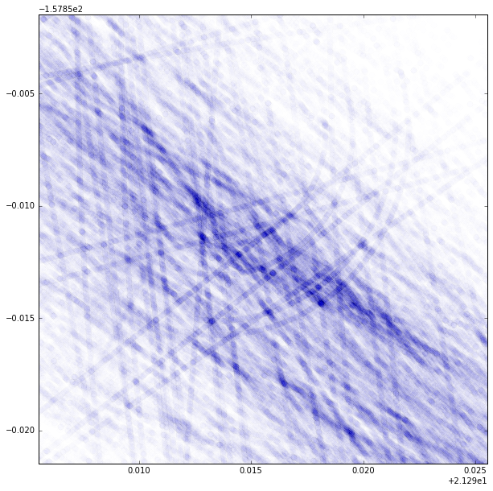
Trying to find the true coordinates of hotels (fail?)
Notes:
As you can see, the pictures are beautiful, but pretty messy, it’s impossible operate in terms of singular points. However, there are explicit clusters of points and this information can be of use. We can do some kind of integration. For every city lets create a grid around it’s center, something like 10km x 10km with step size of 100m.

Slide 9
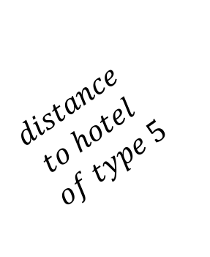
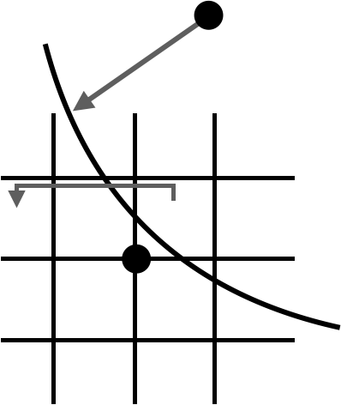
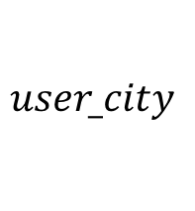

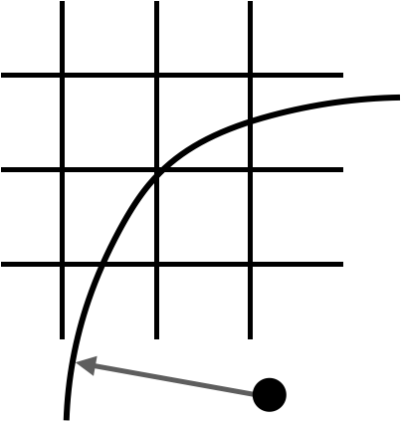













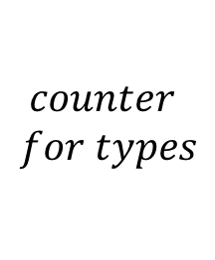


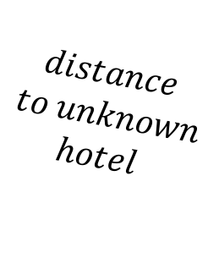
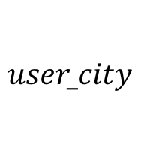
Counters in grid cells
⇒
TRAIN
INFERENCE
Notes:
Now, using training data, for every cell in a grid we can count how many hotels of each type are present there: if a circumference goes through a cell, we give +1 to the hotel type corresponding to that circumference.
During inference, we also draw a circumference based on destination_distance feature. We see though what grid cells in went through and use information from those cells to create features. Like a sum of all counters, average of all counters, maximum of all counters and so on.

Slide 10
Final model
Out-of-fold feature generation. 2013<->2014
Xgboost
16 hours of training
Notes:
Great, we have coved the part of feature engineering. Note that all the features directly you target variable: we can’t use them as is in training. We should generate them in out-of-fold fashion for train data. So, we had training data for years 2013 and 2014.To generate features for year 2014 we used labeled data from year 2013. And vice versa, used year 2014 to generate features for year 2013. For the test set features, which was from year 2015, we naturally used all training data.
In the end, we calculated a lot of features and just shoved them into xgboost model. After 16 hours of training on 40 cores, we got our results.

Slide 11
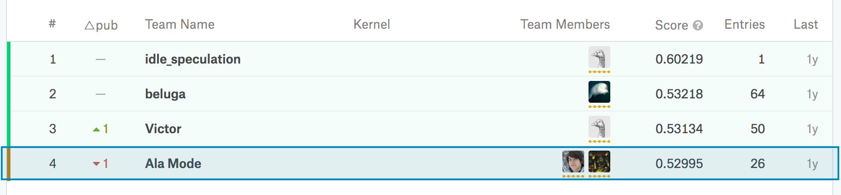
Results
Public – 3rd
Private - 4th
Notes:
We ended up on 3rd position on public LB and 4th on private. We did good, but we still did not fully exploit data leakage. If you check the leaderboard, you’ll notice the difference in scores between 1st place and rest. Idle_speculation, the winner, did extraordinary! Although in general his methods were similar to ours, he was able to extract way more signal.
Finally, I hope you enjoyed my story. As you can see, sometimes working with data leakage could be very interesting and challenging; you may develop some unusual skills and broaden your horizons. Thank you for your attention!

