Slide 1
Using target to generate features
Notes:
Hi everyone! In this section we will cover a very powerful technique: mean encoding. It actually has a number of names: some call it likelihood encoding, some target encoding, but in this course we will stick with plain mean encoding. The general idea of this technique is to add new variables based on some feature together with target; in simplest case we encode each level of categorical variable with corresponding target mean.

Slide 2
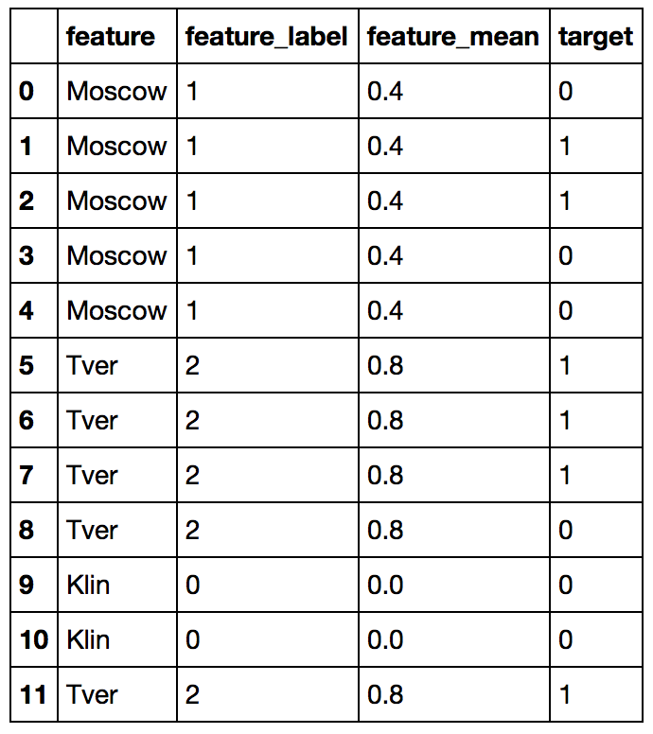
Simple example
Categorical feature
- some city
Binary classification
Notes:
Lets take a look at the following example. Here we have some binary classification task, in which we have a categorical variable, some ‘city’. And, of course, we want to numerically encode it. The most obvious way, and what people usually use - is label encoding (it’s what we have in second column). Mean encoding is done differently, via encoding every city with corresponding mean target. For example, for Moscow we have 5 rows with 3 zeros and 2 ones, so we encode it with 2/5=0.4. Similarly, we deal we the rest of cities.
Pretty straightforward. What I've described here is a very high-level idea. There are a huge number of pitfalls one should overcome in actual competition. We won’t dig into details for now, just keep it mind.

Slide 3
Why does it work?
Label encoding gives random order. No correlation with target
Mean encoding helps to separate zeros from ones
Notes:
At first, let me explain, why does it even work. Imagine that our dataset is much bigger and contains hundreds of different cities. Lets try to compare, of course very abstractly, mean encoding with label encoding. We plot feature histograms for class 0 and class 1. In case of label encoding we’ll always get totally random picture, because there is no logical order. But when we use mean target to encode the feature, classes look way more separable. The plot looks kind of sorted.

Slide 4
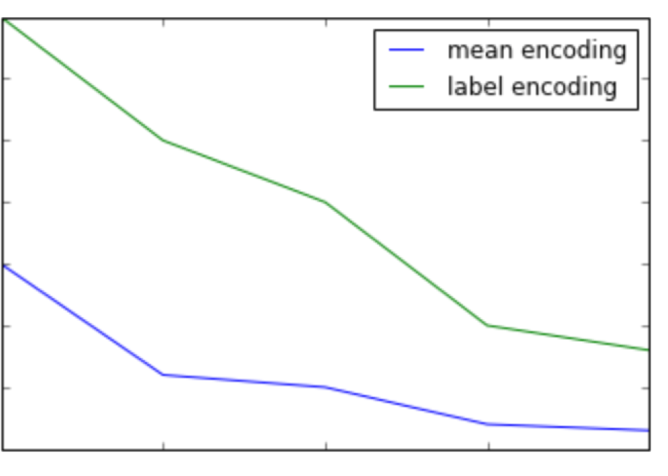
Why does it work?
Reaching a better loss with shorter trees
0.65
0.60
0.55
loss
0.50
0.45
0.40
0.35
1
2
3
4
5
tree depth
Notes:
In turns out that this ‘sorting’ quality of mean encodings is quite helpful. Remember what is the most popular and effective way to solve ML problem - it’s GBT. XGBoost or LighGBM.
One of their few downsides is an inability to handle high-cardinality categorical variables: trees have limited depth. With mean encoding we can compensate it. In general, we can reach better loss with shorter trees. Cross validation logs might even look like this.
In general, the more complicated and non-linear feature-target dependency, the more effective is mean encoding.

Slide 5
What will you learn?
Construct encodings
Correctly validate them
Extend them
Notes:
Further in this section you will learn how to construct mean encodings. There are actually a lot of ways, also keep in mind that we used classification task only as an example, we can use this method on other tasks as well, the main idea remains the same.
Despite the simplicity of the idea you need to be very careful with validation. It’s got to be impeccable. It’s probably the most important part, understanding the correct leak-less validation is also a basis for stacking.
The last, but not least, are extensions. There are countless possibilities to derive new features from target variable. Sometimes they produce significant improvements for your models.

Slide 6
Indicators of usefulness

Slide 7
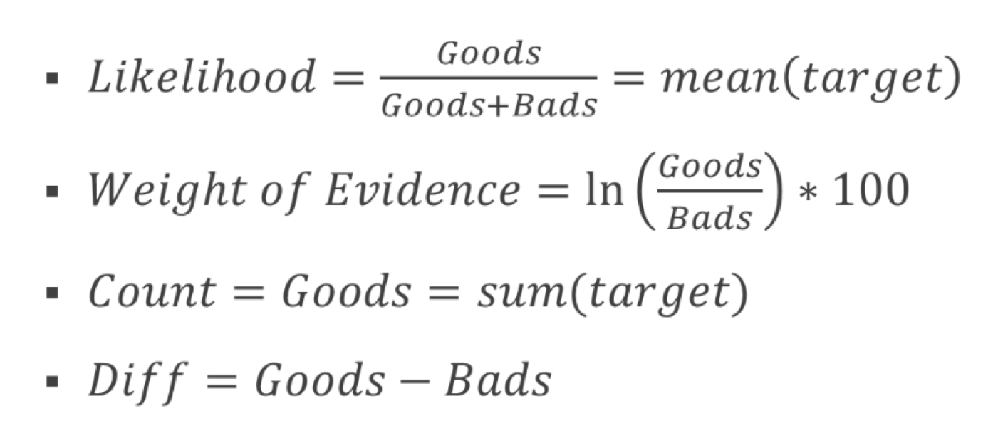
Ways to use target variable
Goods - number of ones in a group,
Bads - number of zeros

Slide 8
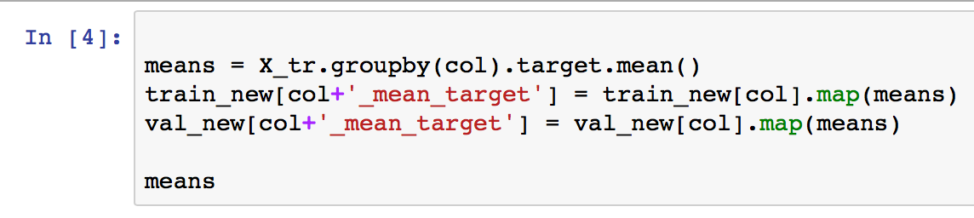
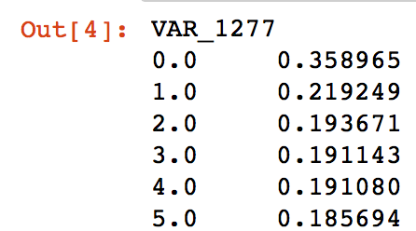
Springleaf example

Slide 9
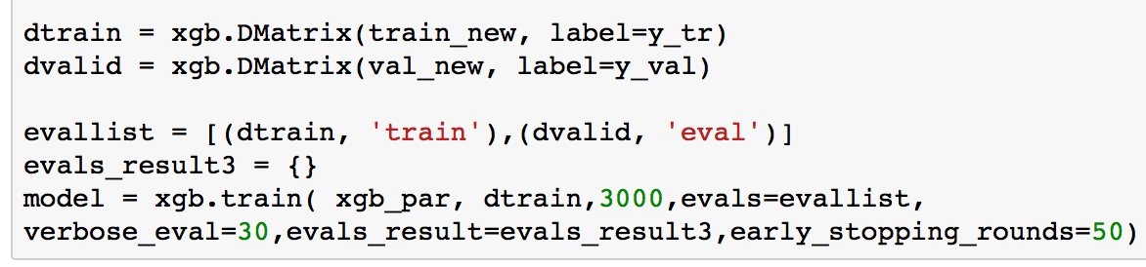
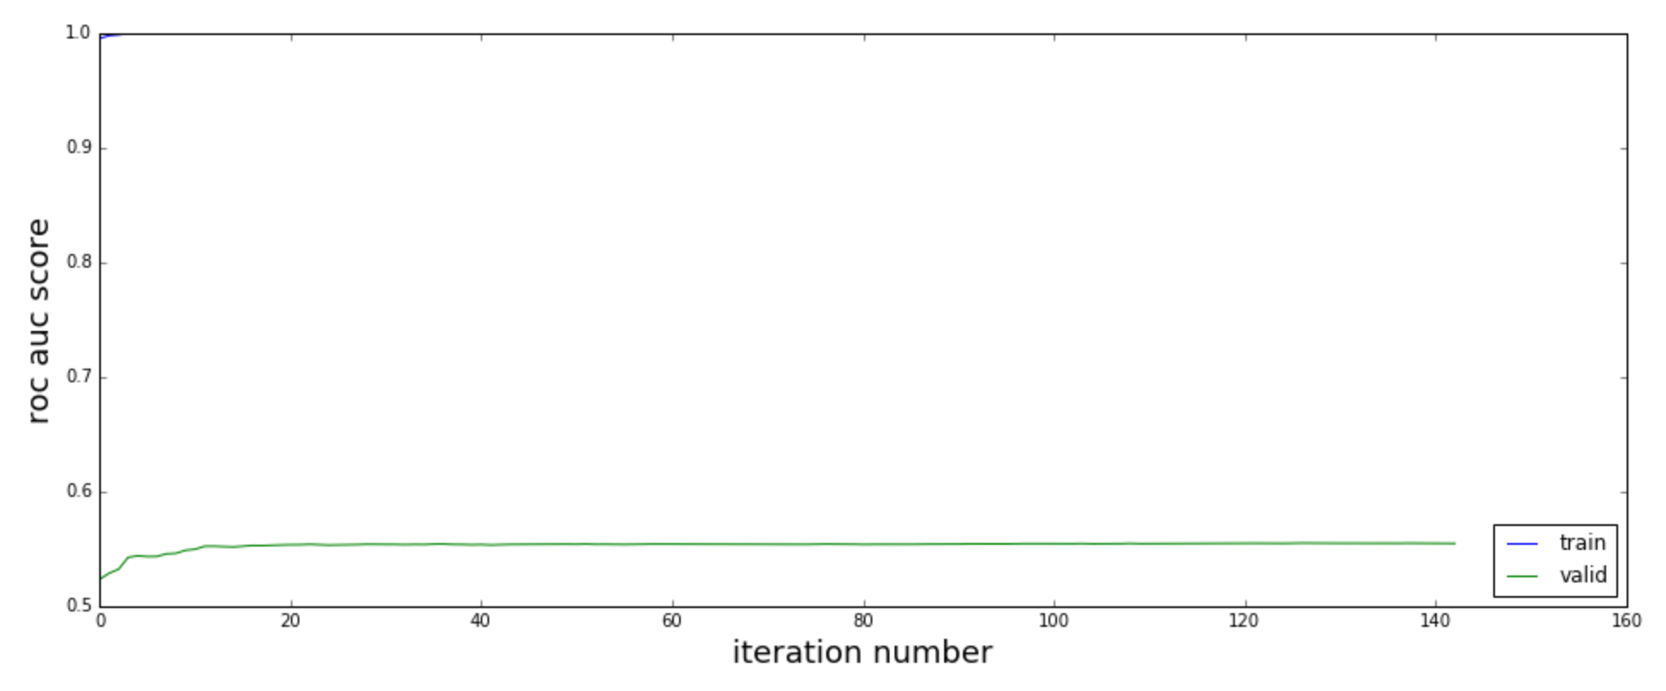
Springleaf example

Slide 10
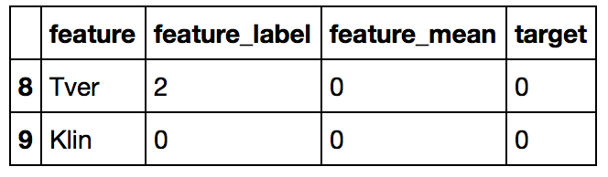
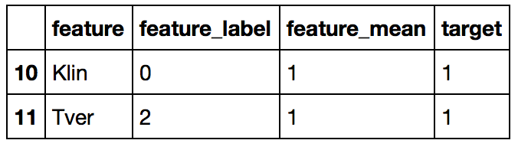
Overfit
Train
Validation

