Slide 1
Generalizations and extensions
Using target variable in different tasks. Regression, multiclass
Domains with many-to-many relations
Timeseries
Encoding interactions and numerical features
Notes:
In the final video we will cover various generalizations and extensions of mean encodings. Namely, how to do mean encoding in regression and muticlass tasks. How can we apply encodings to domains with many-to-many relations. What features can we build based on target variable in time series. And finally, how to encode numerical features and interactions of features.

Slide 2
Regression and multiclass
More statistics for regression tasks. Percentiles, std, distribution bins.
Introducing new information for one vs all classifiers in multi class tasks
Notes:
Lets start with regression tasks. They are actually more flexible for feature encoding. Unlike binary classification, where mean is frankly the only meaningful statistic we can extract from target variable, in regression tasks we can try a variety of statistics. Like median, percentiles, standard deviation of target variable. We can even calculate some distribution bins. For example, if target variable is distributed between 1 and 100, we can create 10 bin features. In the first feature we will count how many data points have target between 1 and 10, in the second between 10 and 20 and so on. Of course, we need to regularize all of these features. In a nutshell, regression tasks are like classification, just more flexible in terms of feature engineering.
Mean encoding for multiclass tasks is also pretty straightforward: for every feature we want to encode we will have N different encodings, where N is the number of classes. It actually has non obvious advantage: tree models, for example, usually solve multi class tasks in one vs all fashion. So every class has a different model, and when we fit that model, it doesn’t have any information about structure of other classes, because they are merged into one entity. Therefore, together with mean encodings, we introduce some additional information about the structure of other classes.

Slide 3
Many-to-many relations
Cross product of entities
Statistics from vectors
LONG REPRESENTATION
User_id | APPS | Target
10 | APP1; APP2; APP3 | 0
11 | APP4; APP1 | 1
12 | APP2 | 1
100 | APP3; APP9 | 0
User_id | APP_id | Target
10 | APP1 | 0
10 | APP2 | 0
10 | APP3 | 0
11 | APP4 | 1
11 | APP1 | 1
Notes:
Domains with many-to-many relations are usually very complex and require special approaches to create mean encodings. I will give you only a very high-level idea.
Consider an example. Binary classification task for users based on apps installed on their smartphones. Each user may have multiple apps and each app is used by multiple users. Hence many-to-many relation.
We want to mean encode apps. The hard part we need to deal with is that user may have a lot of apps.
Lets take a cross product of user and app entities. It will result in a so called ‘long’ representation of data. We will have a row for each user-app pair. Using this table, we can naturally calculate mean encodings for apps.
So now every app is encoded with target mean. But how to map it back to users? Every user has a number of apps, so instead of apps (App1, App2, App3) we will now have a vector like (0.1,0.2,0.1). The answer is pretty simple: we can collect various statistics from those vectors. Mean, minimum, maximum, standard deviation and so on.

Slide 4
Time series
Time structure allows us to make a lot of complicated features.
Rolling statistics of target variable
Day | User | Spend | Amount | Prev_user | Prev_spend_avg
1 | 101 | FOOD | 2.0 | 0.0 | 0.0
1 | 101 | GAS | 4.0 | 0.0 | 0.0
1 | 102 | FOOD | 3.0 | 0.0 | 0.0
2 | 101 | GAS | 4.0 | 6.0 | 4.0
2 | 101 | TV | 8.0 | 6.0 | 0.0
2 | 102 | FOOD | 2.0 | 3.0 | 2.5
Notes:
So far we assumed that our data has no inner structure. But with time series we obviously can’t use future information. On the one hand, it’s a limitation. On the other hand, it actually allows us to make some complicated features. In datasets without time component, when encoding a category, we are forced to use all the rows to calculate the statistic, it makes no sense to choose some subsets of rows. Presence of time changes it: for a given category we can, for example, calculate the mean from previous day, previous 2 days, previous week, etc.
Consider an example. We need to predict on which categories user spends money. In this toy example we have a period of 2 days, 2 users and 3 spending categories. Some good features would be a total amount of money user spent on previous day and average amount of money spent by all users in given category. So, in day 1 user 101 spent 6 dollars, user 102 3 dollars. Therefore we fill those numbers as feature values for day 2. Similarly with average amount per category. The more data we have, the more complicated features we can create.

Slide 5
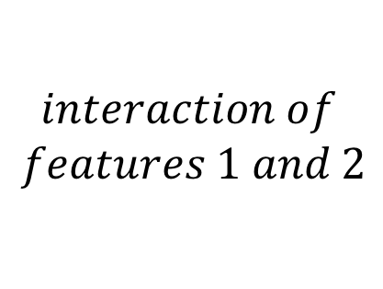
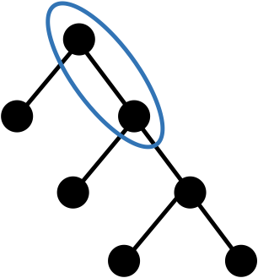




Interactions and numerical features
Analyzing fitted model
Binning numeric and selecting interactions
Notes:
In practice, it is often beneficial to mean encode numeric features and some combination of features. To encode a numeric feature we only need to bin it and then treat as categorical.
Now, we need to answer two questions: how to bin numeric features and how to select useful combinations of features? Well, we can find it out from fitted model, by analyzing tree structure.
So at first, we fit, for example, xgboost model on raw features, without any encodings.
Lets start with numeric features. If numeric feature has a lot of split points, it means that it has some complicated dependency with target and it’s worth trying to mean encode it. Furthermore, these exact split points may be used to bin the feature! So by analyzing model structure we both identified suspicious numeric features and found a good way to bin them.
It’s going to be a little harder with selecting interactions, but nothing extraordinary. First, lets define how to extract 2-way interaction from decision tree. The process will be similar for 3-way, 4-way, arbitrary-way interactions. So, two features interact in a tree if they are in two neighboring nodes.
With that in mind, we can iterate through all the trees in a model and calculate how many times each feature interaction appeared. The most frequent interactions are probably worthy of mean encoding. For example, if we found that feature1 and feature2 pair is most frequent, then we can concatenate those features values in our data and mean encode resulting interaction.
Now, let me illustrate how important interaction encoding may be.

Slide 6
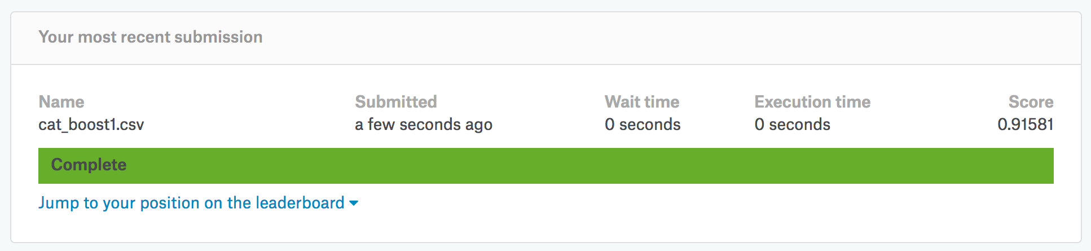
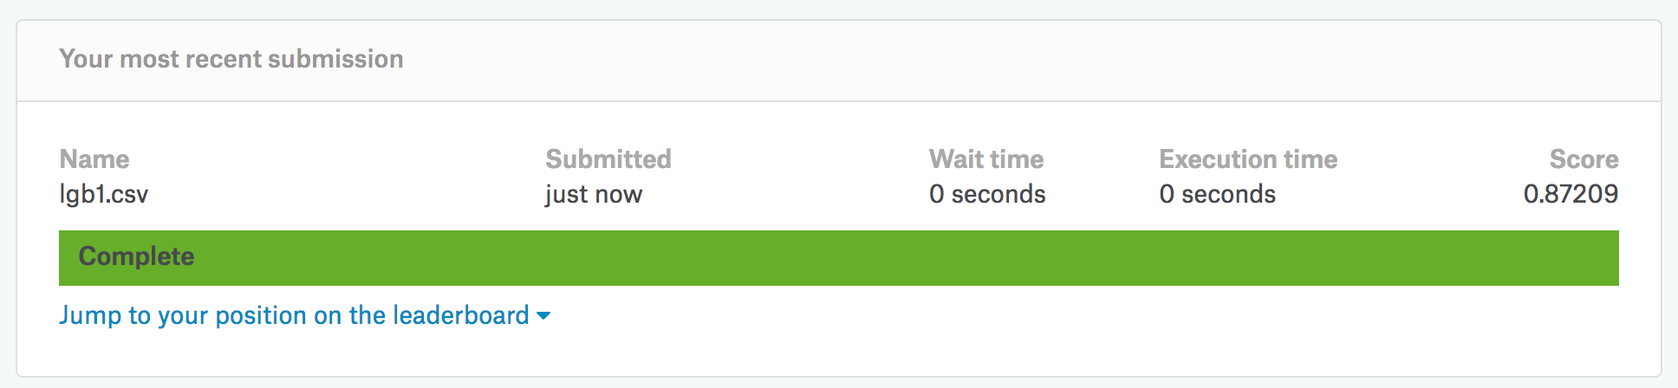
Amazon.com
Amazon.com - Employee Access Challenge Competition
Notes:
Amazon employee access challenge competition has a very specific dataset. There are only 9 categorical features. If we blindly fit, say, LighGtBM model on raw features than, no matter how good we tune the parameters, we will score in 0.87 auc range, which will place ~700 on the leaderboard. Furthermore, even if we mean encode all the variables, we won’t have any progress.
But, if we fit cat boost model, which internally mean encodes some feature interactions, we will immediately score in 0.915 range, which will place on 20th position! The difference in both absolute auc values and relative leaderboard positions is tremendous!
Also note that cat boost is no silver bullet, in order to get even higher on the leaderboard, we’d still need to manually add more mean encoded interactions.
In general, if you participate in a competition with a lot of categorical variables, it’s always worth trying to work with interactions and mean encodings.

Slide 7


Correct validation reminder
Local experiments:
Estimate encodings on X_tr
Map them to X_tr and X_val
Regularize on X_tr
Validate model on X_tr/ X_val split
Submission:
Estimate encodings on whole Train data
Map them to Train and Test
Regularize on Train
Fit on Train
TRAIN
TEST
Notes:
I also want to remind you about correct validation process. During all local experiments, you should at first split the data in X_tr and X_val parts. Estimate encodings on X_tr, map them to X_tr and X_val. Then regularize them on X_tr and only after that validate your model on X_tr/ X_val split. Don’t even think about estimating encodings before splitting the data!
At submission stage, you can estimate encodings on whole Train data, map them to Train and Test. Then apply regularization on Train data and finally fit a model. Note that you should have already decided on regularization method and it;s strength in local experiments!

Slide 8
End
Main advantages:
Compact transformation of categorical variables
Powerful basis for feature engineering
Disadvantages:
Need careful validation, there a lot of ways to overfit
Significant improvements only on specific datasets
Notes:
At the end of this section, lets summarize main advantages and disadvantages of mean encoding.
First of all, mean encoding allows us to make a compact transformation of categorical variables. It is also a powerful basis for feature engineering.
The main disadvantage is target variable leakage, we need to be very careful with validation and regularization. It also works only on specific datasets, it definitely won’t help in every competition.
But keep in mind, when this method works, it may produce significant improvements!
Thank you for your attention!

