Slide 1
Statistics and distance based features
Notes:
Hi everyone! This video is dedicated to the following advanced feature engineering techniques:
Calculating various statistics of one feature grouped by another and features derived from neighborhood analysis of given point. To make it a little bit clearer lets consider a simple example:

Slide 2
Some data for CTR task
 | User_id | Page_id | Ad_price | Ad_position
0 | 4 | 6 | 165.977125 | Bottom_right
1 | 4 | 6 | 34.5395640 | Bottom_right
2 | 4 | 6 | 29.1963786 | Bottom_left
3 | 4 | 6 | 79.4373729 | Bottom_left
4 | 4 | 6 | 290.534595 | Bottom_right
5 | 4 | 6 | 314.412660 | Bottom_right
6 | 4 | 6 | 138.9007639 | Bottom_right
7 | 4 | 6 | 107.4711914 | Bottom_right
8 | 4 | 6 | 242.1089786 | Bottom_left
9 | 4 | 7 | 27.16719836 | Bottom_left
10 | 4 | 7 | 413.5421978 | Bottom_right
Notes:
Here we have a chunk of data for some CTR task. Lets forget about target variable and focus on given features. Namely, user_id - unique identifier of a user, page_id - an identifier of a page user visited, ad_price - item price in the ad, ad_position - relative position of an ad on the web page.
The most straightforward way to solve this problem is to label encode ad_position and fit some classifier. It could be a very good classifier that could take into account all the hidden relations between variables. But no matter how good it is, it still treats all the data points independently. And this is where we can apply feature engineering.

Slide 3
Useful features
 | User_id | Page_id | Ad_price | Ad_position | Max_price | min_price | Min_price _position
0 | 4 | 6 | 95.874252 | Bottom_right | 474.63772 | 73.711548 | Bottom_left
1 | 4 | 6 | 215.751007 | Bottom_right | 474.63772 | 73.711548 | Bottom_left
2 | 4 | 6 | 474.637726 | Bottom_left | 474.63772 | 73.711548 | Bottom_left
3 | 4 | 6 | 73.711548 | Bottom_left | 474.63772 | 73.711548 | Bottom_left
4 | 4 | 6 | 79.288841 | Bottom_right | 474.63772 | 73.711548 | Bottom_left
5 | 4 | 6 | 271.391785 | Bottom_right | 474.63772 | 73.711548 | Bottom_left
6 | 4 | 6 | 296.529053 | Bottom_right | 474.63772 | 73.711548 | Bottom_left
7 | 4 | 6 | 96.030029 | Bottom_right | 474.63772 | 73.711548 | Bottom_left
8 | 4 | 6 | 130.175064 | Bottom_left | 474.63772 | 73.711548 | Bottom_left
9 | 4 | 7 | 35.465202 | Bottom_left | 121.54219 | 35.465202 | Bottom_left
10 | 4 | 7 | 121.542191 | Bottom_right | 121.54219 | 35.465202 | Bottom_left
Notes:
We can imply that an ad with the lowest price on the page will catch the most of attention. The rest of the ads on that page won’t be very attractive.
It’s pretty easy to calculate the features relevant to such an implication: we can add lowest and highest prices for every (user and page) pair; position of an ad with lowest price could also be of use.

Slide 4
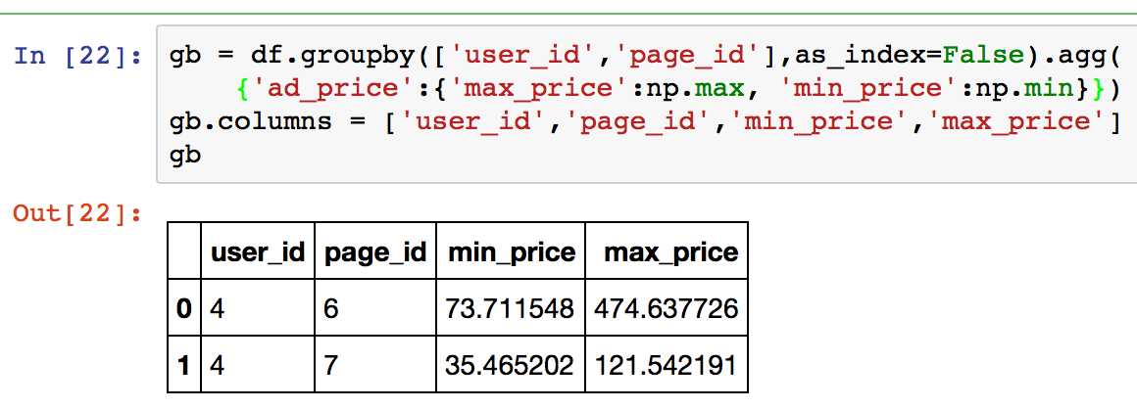
Useful features: implementation
Notes:
Heres one of the ways to implement statistical features with pandas. If our data is stored in DataFrame ‘df’, we call ‘groupby’ method like this to get maximum and minimum price values, store this object in ‘gb’ variable and then join it back to DataFrame ‘df’.

Slide 5
More features
How many pages user visited
Standard deviation of prices
Most visited page
Many, many more
Notes:
I want to emphasize, that you should not stop at this point, it’s possible to add other useful features, not necessarily calculated within user, page pair. It could be how many pages user has visited, how many pages user has visited during the given session, an id of the most visited page, how many users have visited the page and many, many more featuews.
The main idea is to introduce new information, by that means we can drastically increase the quality of the models.

Slide 6
Neighbors
Explicit group is not needed
More flexible
Much harder to implement
Notes:
But what if there is no feature to use groupby on? Well, in such case we can replace grouping operations with finding the nearest neighbors. On the one hand, it’s much harder to implement and collect useful information. On the other hand, the method is more flexible: we can fine tune things like the size of relevant neighborhood or metric.

Slide 7
Neighbors
Number of houses in 500m, 1000m,..
Average price per square meter in 500m, 1000m,..
Number of schools/supermarkets/parking lots in 500m,
1000m,..
Distance to closest subway station
Notes:
The most common and natural example of neighborhood analysis arises from property pricing. Imagine that you need to predict rental prices. You would probably have some characteristics like floor space, number of rooms, presence of a bathtub, but you’d need something more than that to create a really good model.
It could be the number of other houses in different neighborhoods like 500m, 1000m, 1500m; Average price per square meter in such neighborhoods; The number of schools/supermarkets/parking lots in such neighborhoods;
Distances to the closest objects of interest like subway stations or gyms could also be of use.
I think you got the idea!

Slide 8
Neighbors
Explicit group is not needed
More flexible
Much harder to implement
Notes:
In the example, we reviewed a very simple case, where neighborhoods were calculated in geographical space. But don’t be afraid to apply this method to some abstract or even anonymized feature spaces, it still could be very useful. My team and I used this method in Springleaf competition. Furthermore, we did in supervised fashion.

Slide 9
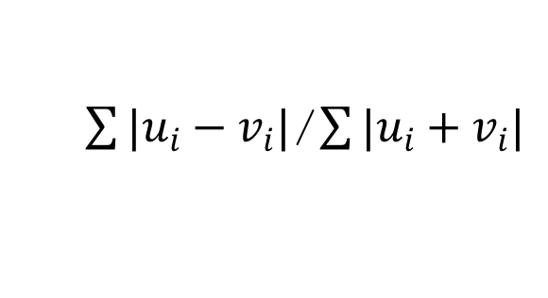
KNN features in Springleaf
Mean encode all the variables
For every point, find 2000 nearest neighbors using
Bray-Curtis metric
Calculate various features from those 2000 neighbors
Notes:
Here is how we’ve done it. First of all, we applied mean encoding to all variables. By doing so, we created homogeneous feature space, so we did not worry about scaling and importance of each particular feature. After that we calculated 2000 nearest neighbors with Bray-Curtis metric.

Slide 10
KNN features in Springleaf
Mean target of nearest 5,10,15,500, 2000 neighbors
Mean distance to 10 closest neighbors
Mean distance to 10 closest neighbors with target 1
Mean distance to 10 closest neighbors with target 0
Notes:
Then we extracted various features from those neighbors, like mean target of nearest 5,10,15,500, 2000 neighbors; mean distance to 10 closest neighbors; mean distance to 10 closest neighbors with target 1; mean distance to 10 closest neighbors with target 0.
It worked great!
Anyway, I hope you embraced the main ideas of both ‘groupby’ and nearest neighbor methods, and you would be able to apply them in practice.

Slide 11
Thank you
Notes:
Thank you for your attention!

