Slide 1
Zero-Hallucination Audit Agent
TUM.AI × CARTHAGENTS · 18 OCTOBER 2026
AS PRINTED · PAGE 1
19.425,96
Field
zugang (additions)
Asset
210004
Reads a client’s fixed-asset schedules, fills the auditor’s Arbeitsversion, traces every figure to its source and checks its own work.
Value
1,942,596 cents
Source
page 1, box around the digits
3.5 Carth
Asians
Notes:
We built an agent for the CarthAgents challenge. It reads the fixed-asset schedules a client hands to its auditor and fills the auditor’s working file, the Arbeitsversion. The card on the right is the whole idea in one value: the figure exactly as printed, the field it fills, the asset it belongs to, the number in cents, and where on the page it came from.

Slide 2
Auditors copy every number by hand
THE PROBLEM
Clients send their asset lists as PDFs, scans or Excel files, each in its own format. Someone on the audit team types every number into the auditor’s spreadsheet.
In the client’s PDF
In the spreadsheet
19.425,96
19.452,96
A typo like this is easy to make and hard to find later.
3.5 CarthAsians · Zero-Hallucination Audit Agent
02
Notes:
Every audit looks at a company’s fixed assets. The client sends its asset list as a PDF, a scan or an Excel file, and every client’s format is different. Today someone on the audit team types every number into the auditor’s spreadsheet by hand. Two digits swapped, like here, and nobody notices, because nothing links the number back to the page it came from.

Slide 3





From unfamiliar reports to traceable values
THE SOLUTION
The model interprets layout. Code reads the amounts.
JSON
PDF / Excel
Source evidence
Arbeitsversion
LLM plan
Code executor
text · cells · OCR
layout → meaning
retrieve + parse
Review + evidence
original values
Source evidence stays attached through JSON, workbook and review.
3.5 CarthAsians · Zero-Hallucination Audit Agent
03
Notes:
This is the whole architecture. A PDF or Excel file becomes source evidence: text with positions, cells, or OCR words. The LLM only plans: it maps the layout to meaning. The code executor then retrieves and parses every amount from the original evidence, shown by the dashed line, never from the model. The same evidence stays attached all the way into the JSON, the Arbeitsversion workbook and the review app.

Slide 4

Capture evidence before assigning meaning
STEP 1 · EVIDENCE
One Excel cell, three linked facts.
Excel source
Source token
Exact pointer
Assets!B2
id: t3
sheet: Assets
cell: B2
123.45
text: 123.45
value: 123.45
Stable handle · untouched source value · exact location
Selected fields from the implemented ExcelToken contract.
3.5 CarthAsians · Zero-Hallucination Audit Agent
04
Notes:
Before anything decides what a number means, we capture it as evidence. Take one Excel cell, Assets B2, holding 123.45. It becomes a source token with a stable id, t3, that later steps refer to; its text and stored value exactly as in the file; and an exact pointer, sheet and cell. A stable handle, the untouched source value, and its exact location. PDFs and OCR work the same way, with a page and a box instead of a cell.

Slide 5

Map the meaning. Retrieve the amount.
STEP 2 · MAPPING
A section rule maps column B across matching asset rows.
Section rule · 2025 asset rows
B → ahk_open
Deterministic code
Asset 001 · ahk_open
read 123.45 EUR
12345 cents
parse 12345 cents
source: Assets!B2
Source evidence
Assets!B2
Preserve printed discrepancies. Abstain when evidence is missing.
Selected fields from the implemented plan and ObservedValue contracts.
3.5 CarthAsians · Zero-Hallucination Audit Agent
05
Notes:
The model’s job is the mapping. It reads the page with amounts masked and returns a section rule: for the 2025 asset rows, column B is ahk_open, the opening cost. It never supplies the figure. Deterministic code applies that rule across the whole table: it reads 123.45 euros from the evidence at Assets B2 and parses it into 12,345 cents. The result is an observed value for asset 001 that still carries its source. A client’s printed discrepancy is preserved, not corrected, and where evidence is missing the value stays blank with a reason.

Slide 6
How we tested it
EVALUATION
We generated fake client documents, with answer keys, in layouts the agent has never seen.
144
~25,900
synthetic documents, half held out
values right on the 72 samples (local score)
3.5 CarthAsians · Zero-Hallucination Audit Agent
06
Notes:
The final test uses layouts nobody has seen, so we built our own fake client documents: 144 of them, each in a new randomised layout, with answer keys, and half held out so we never tuned on them. On the organisers’ 72 samples our local scorer counts about 25,900 values right, against about 1,300 wrong; that is our local number, not the official leaderboard. And for the workbook step we injected 713 known mistakes, wrong units, flipped signs, shifted columns and rows, and every one was caught.

Slide 7
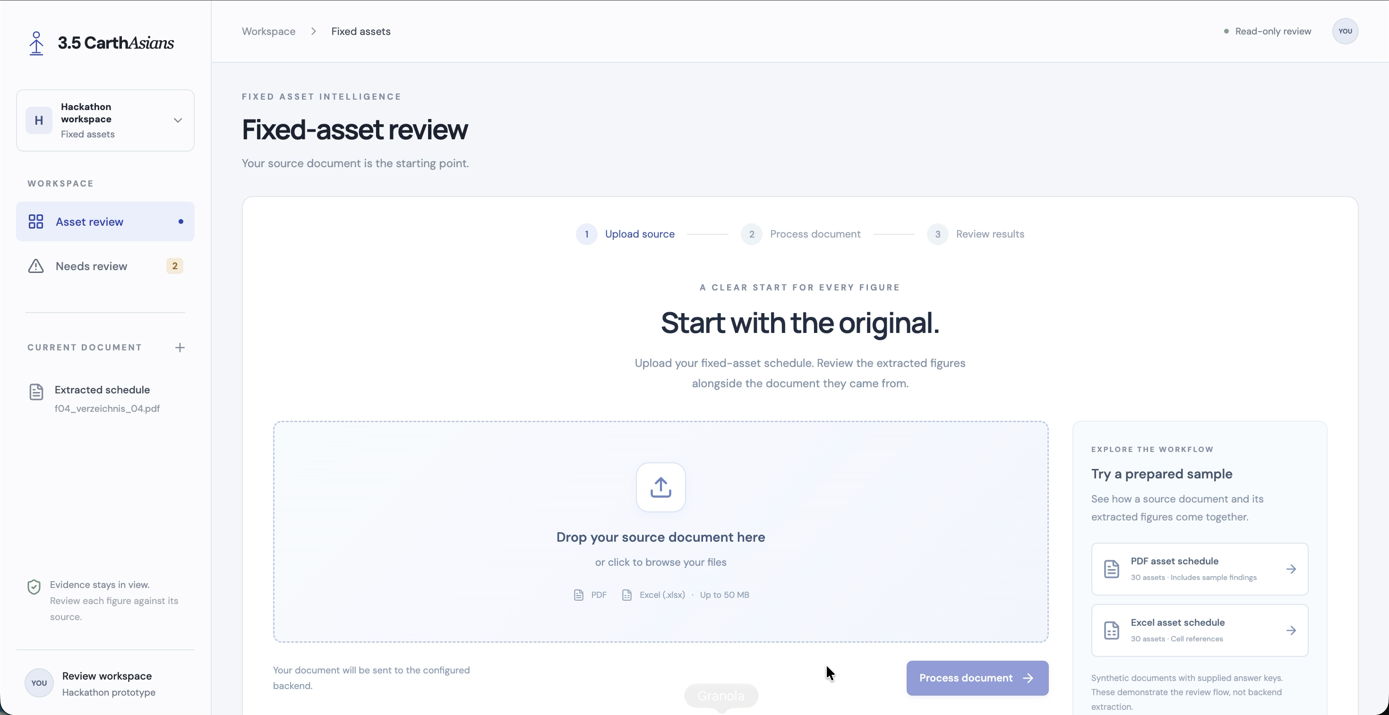
See it run
DEMO
3.5 CarthAsians · Zero-Hallucination Audit Agent
07
Notes:
Now the whole thing running on one document. We upload a client PDF, the agent processes it, and the review app opens with every extracted value. Clicking a value highlights the exact characters on the page it came from, and flagged values explain why. At the end we download the filled Arbeitsversion.

Slide 8
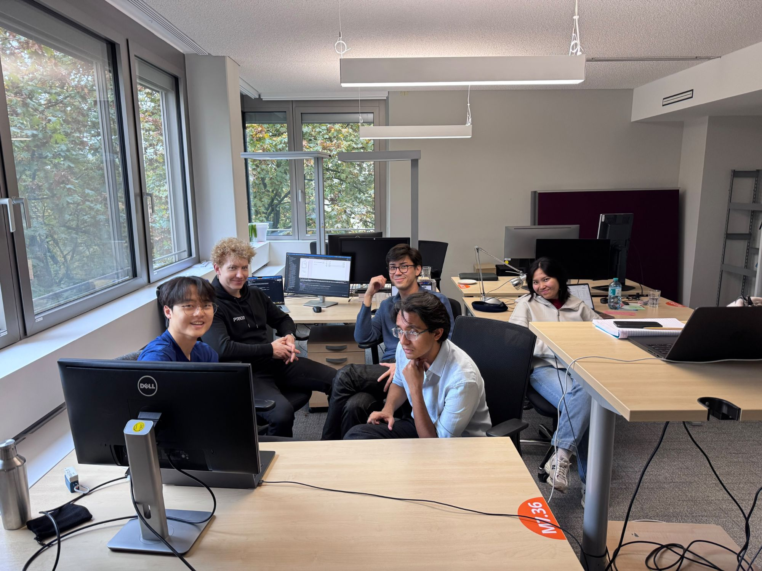
Thank you
TUM.AI × CARTHAGENTS
3.5 Carth
Asians
Questions welcome.
Notes:
Thank you. This is our team, mid-hackathon. Happy to take questions about the pipeline, the evaluation or the test data.

