Slide 1
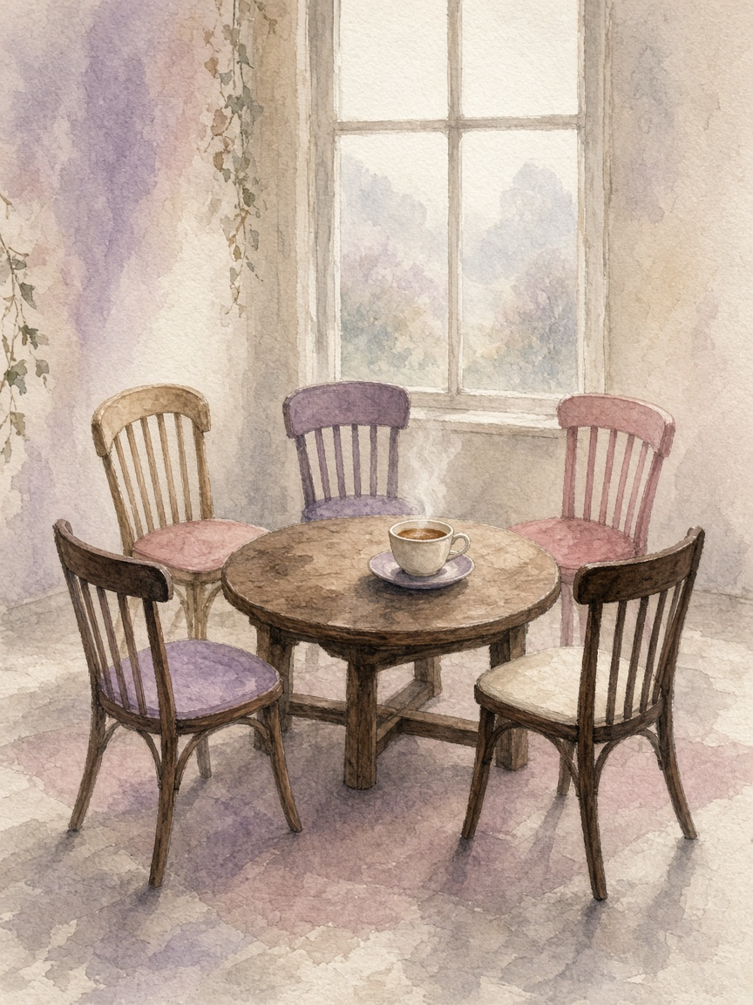
Krąg
A care circle for one ageing parent.
People and agents, working toward one shared goal.
A prototype
A 1-minute pitch • Multiplayer AI / Multi-agent Systems
not an alarm
Notes:
Krąg — a care circle for one ageing parent. People and agents work toward one shared goal.
Prototype of the experience, not an alarm or a medical service. The demo family is invented.
Illustration: generated watercolor (no real or invented person depicted).

Slide 2
37.5%
of Wrocław residents
find care hard to get
What families pay today
Alarm wristband: about 20–55 zł a month, plus 299–999 zł for the device.
Voice check-in service: listed at 149 zł a month.
National 2026 budget for remote care devices: 20 million zł.
We pitch Krąg as an experience, not yet as a business.
Wrocław Social Diagnosis 2025
7.9M
people in Poland
are 65 or over
Statistics Poland, 2025
Large need,
low price point
1.9M
of them
live alone
Estimate, EU labour survey 2020
Notes:
Sources:
37.5% of Wrocław residents report difficulty getting care — Wrocław Social Diagnosis 2025.
~7.9 million people 65+ — Statistics Poland (GUS) 2025, via spidersweb.pl/2026/04/polska-sie-starzeje-gus-mediana-wieku-44-lata.html
~1.9 million live alone — estimate from 2020 European labour survey (33% of women, 13% of men).
Prices — vendor price guide, June 2026: eopiekun.pl/wpis/ile-kosztuje-teleopieka-dla-seniora
20 million zł — national 2026 budget line for remote care devices, Senior Support Corps programme 2026.
Reading: large need, low price point; pitched as an experience, not yet as a business.

Slide 3
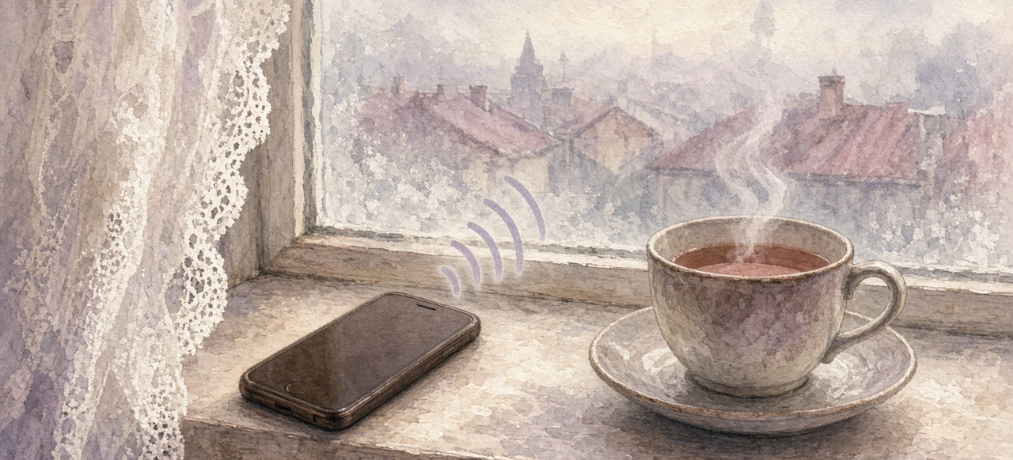
She talks to
one person
What she sees
Behind the conversation
She talks only to Krąg, by voice or a simple tap. She can start voice mode herself in the 1:1 chat and speak as she would to a neighbour.
A companion, not a dashboard.
Five more agents work quietly behind Krąg.
Family stays outside the app.
A prototype of the experience, not an alarm or medical service.
Notes:
She talks only to Krąg, by voice or a simple tap; she can start voice mode herself in the 1:1 chat.
Five more agents work behind that conversation. Family stays outside the app.
Prototype of the experience, not an alarm or medical service. Demo family is invented.
Illustration: generated watercolor of a phone and teacup on a foggy windowsill.

Slide 4

What she hears this morning
Weather: 2°C and fog in Wrocław (IMGW).
Name day: today is Marek’s.
Morning tablet: biała, jedna, as on the prescription.
A family photo may arrive from Ania or Marek.
For later: “Jak wyglądała Pani droga do szkoły?”
Demo morning · DemoTablet · invented family, simulated photo
One check-in
Voice mode
One warm conversation, not a dashboard of alerts.
She can say it out loud, in the same 1:1 chat.
A morning in her chair
Notes:
One concrete morning in the 1:1 chat with Krąg.
Weather: 2°C and fog in Wrocław — IMGW (Polish Institute of Meteorology and Water Management) public data.
Name day: Marek. Morning tablet: biała, jedna, as on the prescription (DemoTablet, demo data).
A family photo can arrive from Ania or Marek — simulated; the family is outside the app and invented for the demo.
Memory question for later: “Jak wyglądała Pani droga do szkoły?”
Point: one warm check-in, not a dashboard of alerts. Voice mode works for the conversation.
Illustration: generated watercolor of an armchair, tea, phone, notebook, blister pack and an empty photo frame by a foggy window. No person depicted.

Slide 5
01
02
03
Six agents,
one goal
Krąg
The only bot she talks to: companion voice and care.
Informator
Morning brief: weather, air, name days, public facts.
Rodzina
Links relatives outside the app (simulated sends in the demo).
People and agents, working toward one shared goal: her day going well.
She only ever sees Krąg.
04
05
06
Kronika
One memoir question a day. Never invents her past.
Apteczka
Tablet times and stock. Never advises on medicine.
Strażnik
Every outbound message needs approval before it reaches her or the family.
Notes:
Six agents, one goal: her day going well.
1 Krąg — the only bot she talks to; companion voice and care.
2 Informator — morning brief (weather, air, name days, public facts).
3 Rodzina — link to relatives outside the app (simulated sends for the demo).
4 Kronika — one memoir question a day; never invents her past.
5 Apteczka — tablet times and stock; never advises medicine.
6 Strażnik — every outbound message needs approval before it reaches her or the family.
People and agents work toward one shared goal. She only sees Krąg.

Slide 6

Prototype,
not an alarm
Working prototype on Grok Bot: six agents and a care-team group. She only sees Krąg.
Theme fit: Multiplayer AI / Multi-agent Systems — people plus AI toward a shared goal.
Covers the brief: a working demo; Grok Bot integrated with public Polish APIs (IMGW, air quality); the care-circle pattern; real impact for ageing in place.
github.com/vlad-ovsyannikov/Kr-g-grok-bot-hackathon
A care circle you can talk to — not another alarm on the wrist.
Notes:
Close of the 1-minute pitch.
Working prototype on Grok Bot: six agents plus a care-team group; she only sees Krąg.
Theme fit: Multiplayer AI / Multi-agent Systems — people plus AI toward a shared goal.
Deliverables: working demo; technical integration of Grok Bot and public Polish APIs (IMGW, air quality); innovation in the care-circle pattern; real-world impact for ageing in place.
Repo: https://github.com/vlad-ovsyannikov/Kr-g-grok-bot-hackathon
Closing line: A care circle you can talk to — not another alarm on the wrist.
Prototype of the experience, not an alarm or medical service. Demo family invented.
Illustration: generated watercolor of six teacups around a teapot, with a phone and laptop. No person depicted.

