Slide 1
MacroPru analytical toolkit at Central Bank of Armenia (CBA)
Financial Stability Department
Central Bank of Armenia

Slide 2
Growth at Risk (GaR)
Background
The Transformation Agenda
At the end of 2022 the Financial Stability team of the CBA presented its transformation plan which, among other things, intends:
To connect MacroPru with a measure of Welfare, such as GDP.
To quantify the uncertainty around the MacroPru effects.
To provide better transparency between macro-prudential policymakers, society at large, and the state bodies.
Financial Stability Department
1 /

Slide 3
Growth at Risk (GaR)
Background
MacroPru and GDP
External communication of the policy measures through GDP.
The idea is to demonstrate that even though MacroPru may create immediate costs in the short-run, they will be more than compensated in the long-run in the form of stable and sustainable GDP growth.
Financial Stability Department
1 /

Slide 4
Growth at Risk (GaR)
Background
Uncertainty around MacroPru
Quantifying uncertainty around MacroPru aims to capture the effects of the policy on the entire distribution of GDP and not only its mean.
From the policy perspective it is of first-order importance to ascertain the effect of MacroPru on the probability of crisis.
Financial Stability Department
1 /

Slide 5
Growth at Risk (GaR)
What is GaR?
How GaR fits into this agenda?
Growth at Risk (GaR) is a framework based on quantile regression methodology allowing to accomplish the above objectives.
Measure of welfare
Quantifies uncertainty
Communication
Financial Stability Department
1 /

Slide 6

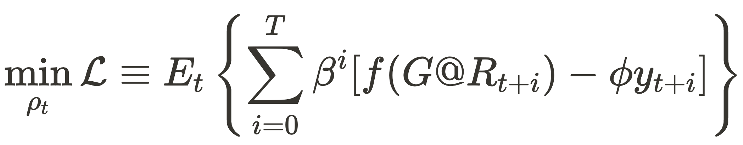
Growth at Risk (GaR)
What is GaR?
GaR Formulas
Welfare function by Suarez (2022):
Loss function in general form:
Financial Stability Department
1 /

Slide 7
Growth at Risk (GaR)
Application
Practical Implementation
We view the GaR project as being composed of the following tasks:
Data Transformation
Modelling
Policy Simulations
On the modelling side we try to combine traditional econometrics with statistical learning methods, such as model selection via forward stepwise selection.
Financial Stability Department
1 /

Slide 8
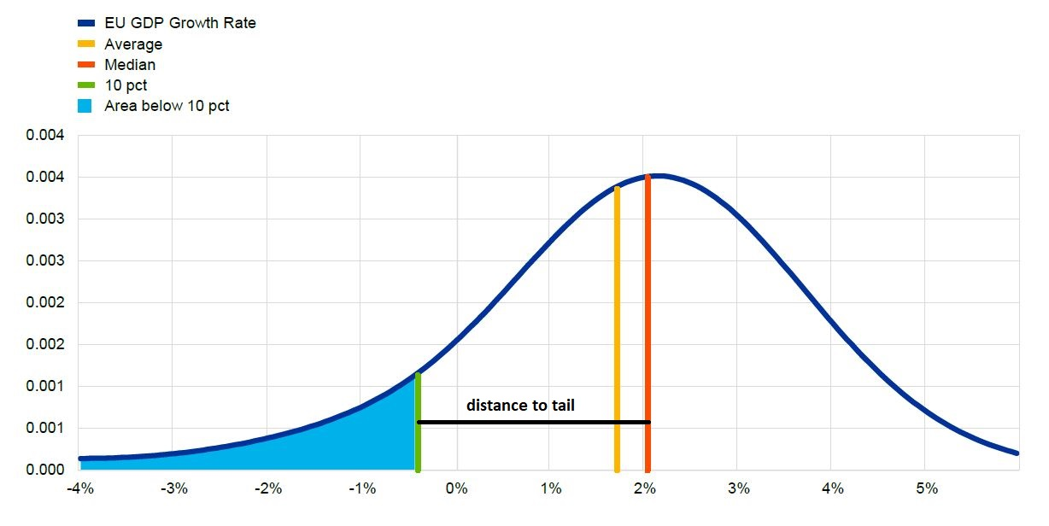

Growth at Risk (GaR)
Application
Expected results
Financial Stability Department
1 /

Slide 9
Thank You!

