Slide 1
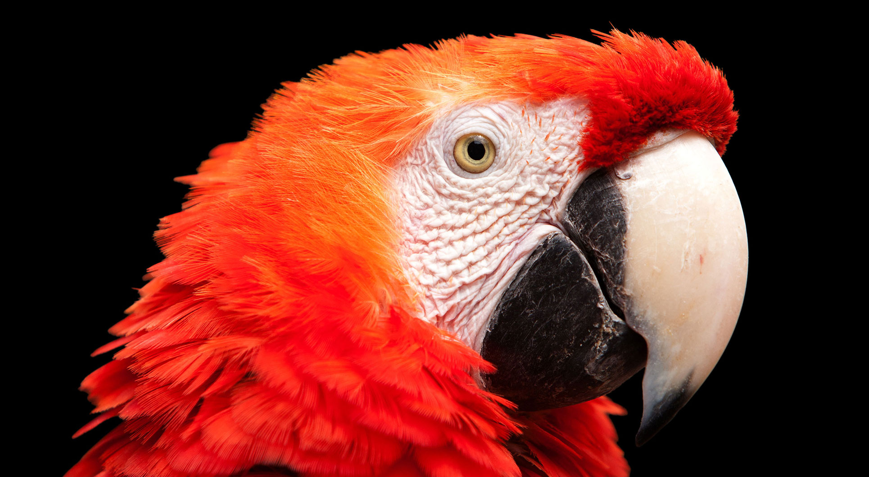
Parrot Project
Nikolaos Stekas, Vladimir Mikovski, Angel Montana, Cong Chen, (Vera Matei)

Slide 2


Speech
Text
Entities
Definition
Terms
Glossary

Slide 3




Web
NLP
Bucket

Slide 4
Demo Time!

