Slide 1



AWS Big Data platform
Vadym Kovalenko
AWS Architect
AWS Big Data Platform

Slide 2
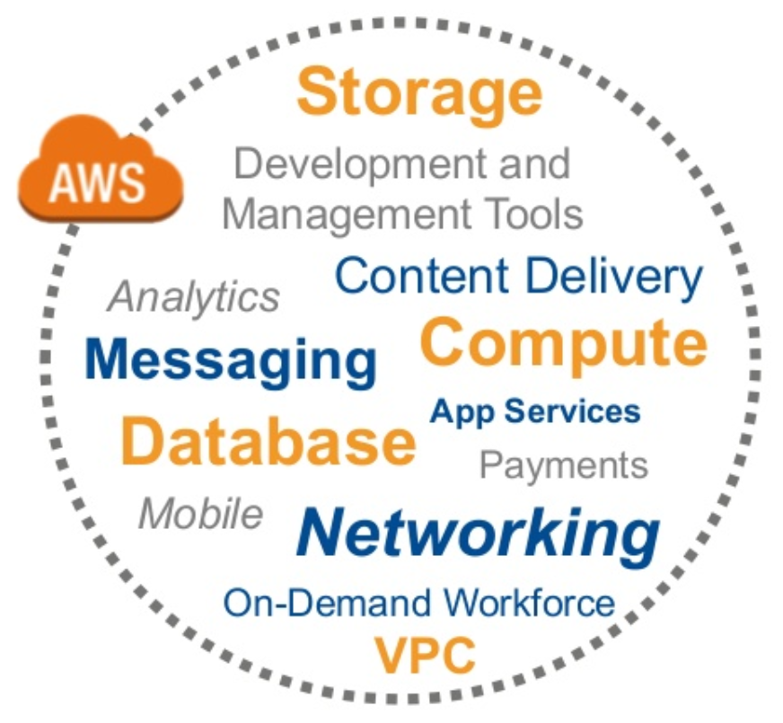
Why do customers use AWS
Agility & Elasticity
Platform Breadth and Depth
Innovation at Scale
Cost Savings and Flexibility
Go Global in minutes
AWS Big Data Platform

Slide 3

AWS Starting point
Sign up for an AWS account at aws.amazon.com
Take advantage of the Free Tier
Start experimenting!
AWS Big Data Platform

Slide 4
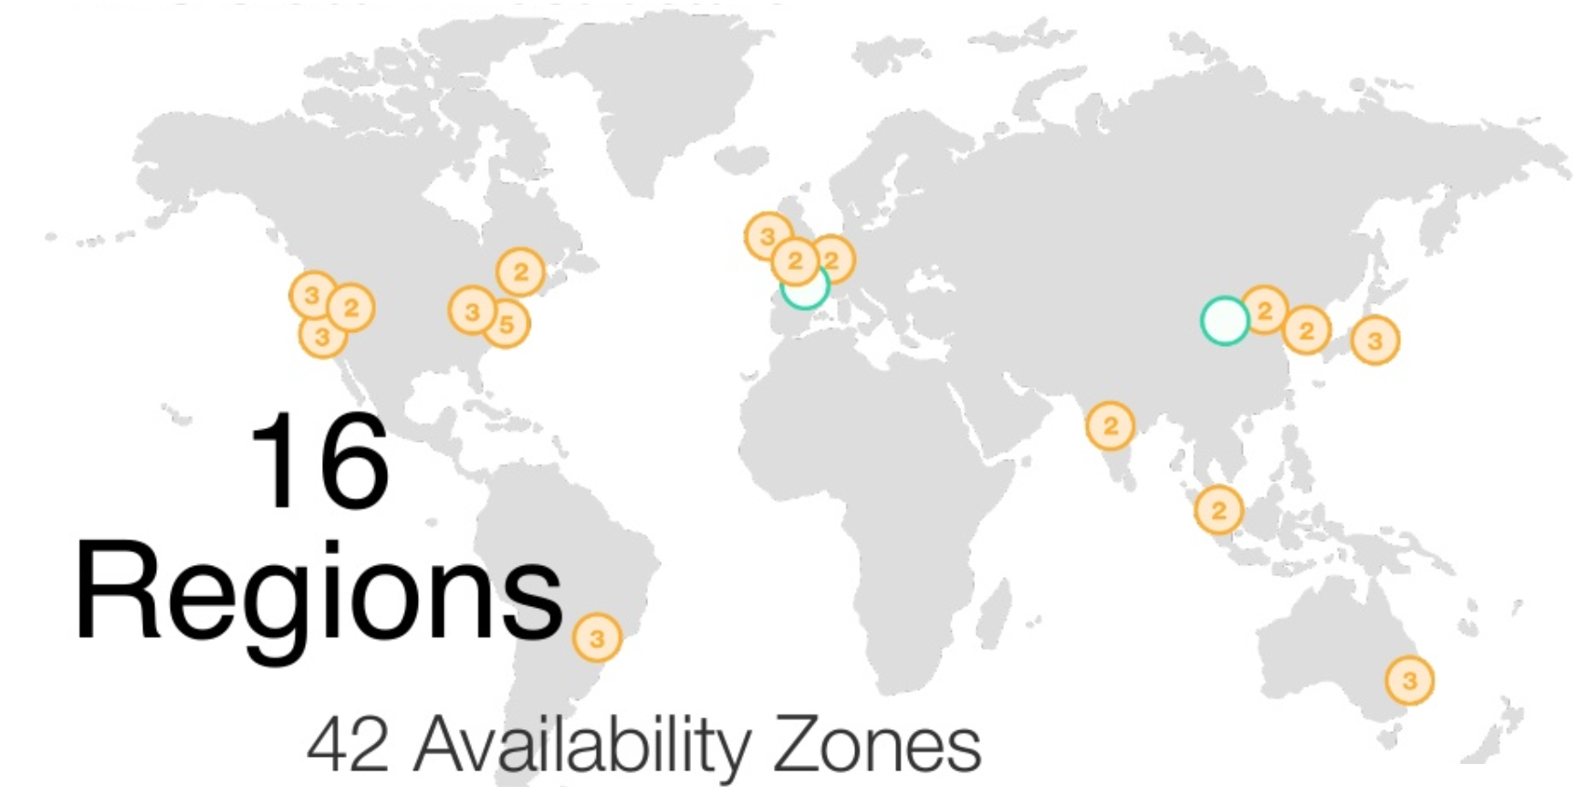
AWS Global Footprint
AWS Global Footprint

Slide 5
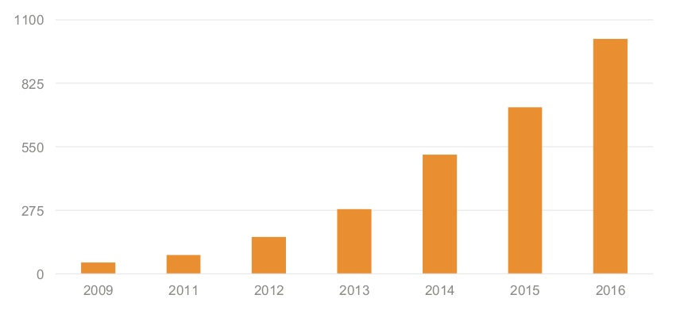
AWS Rapid pace of Innovation
AWS Global Footprint

Slide 6
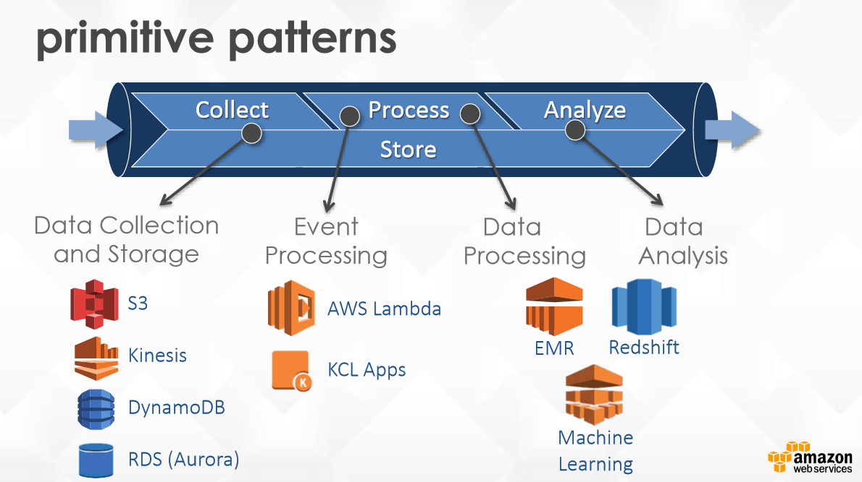
AWS Rapid pace of Innovation
AWS Global Footprint

Slide 7
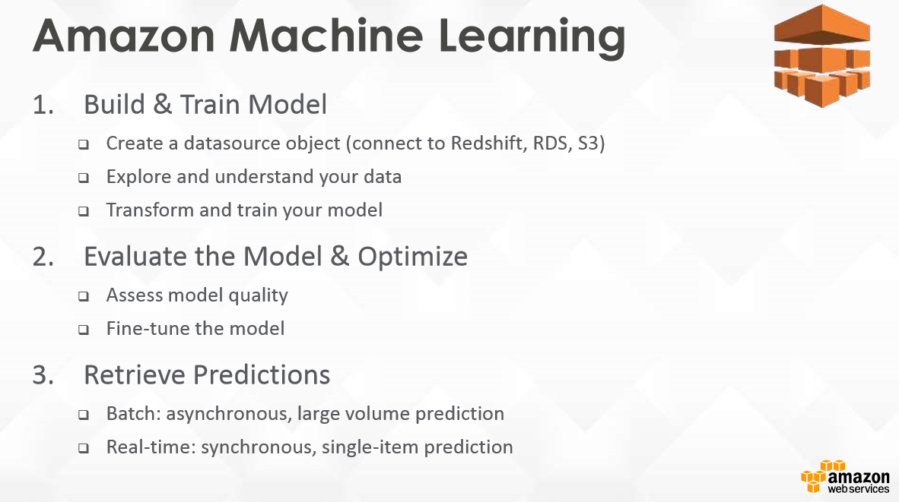
AWS Rapid pace of Innovation
AWS Global Footprint

Slide 8
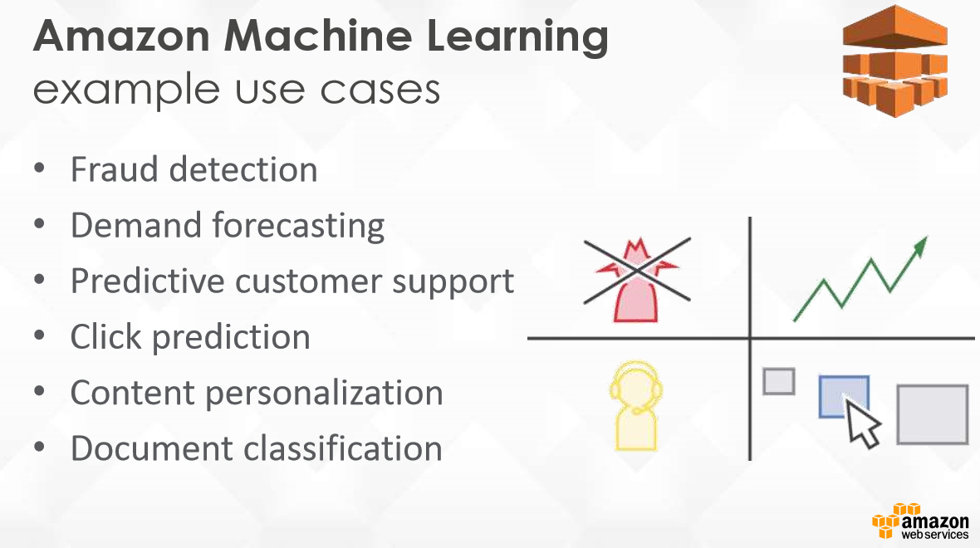
AWS Rapid pace of Innovation
AWS Global Footprint

Slide 9
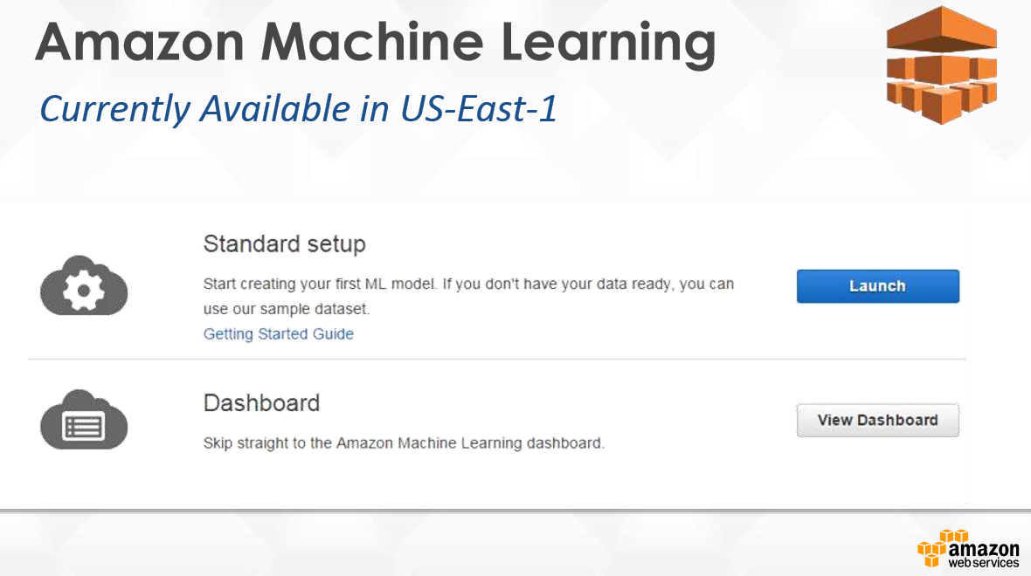
AWS Rapid pace of Innovation
and EU-WEST-1
AWS Global Footprint

Slide 10
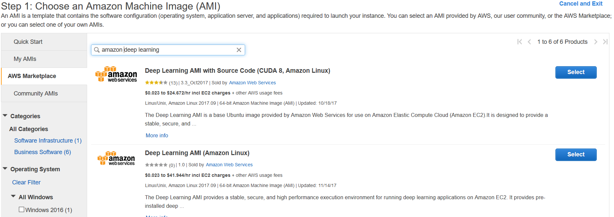
AWS Deep Learning AMI
AWS Global Footprint

Slide 11
AWS Deep Learning AMI cont.
Framework upgrades for Caffe1 (compiled with NCCL 2.0 support), PyTorch, Keras 2.0.
Used Amazon Linux 2017.09 (ami-8c1be5f6) as the base AMI with CUDA 8 and NVidia Driver 375.66. Please note the AMI is NOT compatible with EC2 p3 instance type. Use Deep Learning AMI CUDA 9 version for p3 instances.
8 Deep Learning Frameworks - contains the most popular Deep Learning Frameworks: MXNet, Caffe, Caffe2, TensorFlow, Theano, PyTorch, Torch and CNTK
AWS Global Footprint

Slide 12
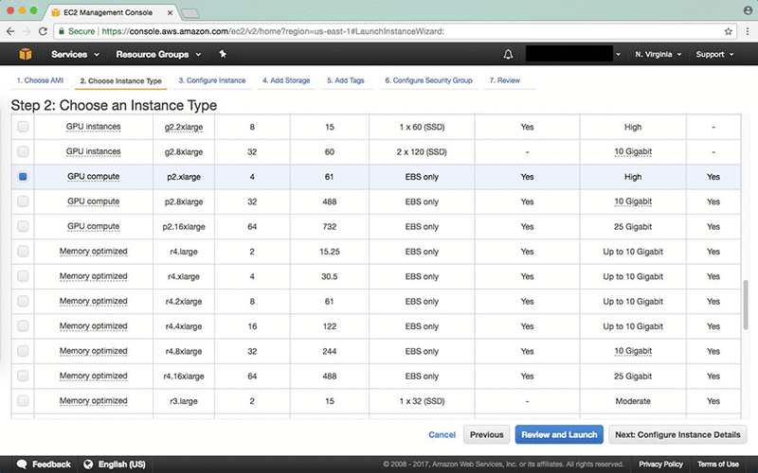
AWS Deep Learning AMI cont.
AWS Global Footprint

Slide 13
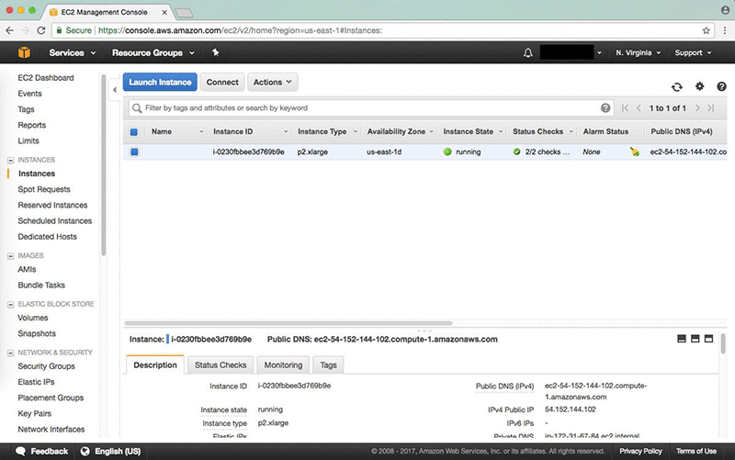
AWS Deep Learning AMI cont.
AWS Global Footprint

Slide 14
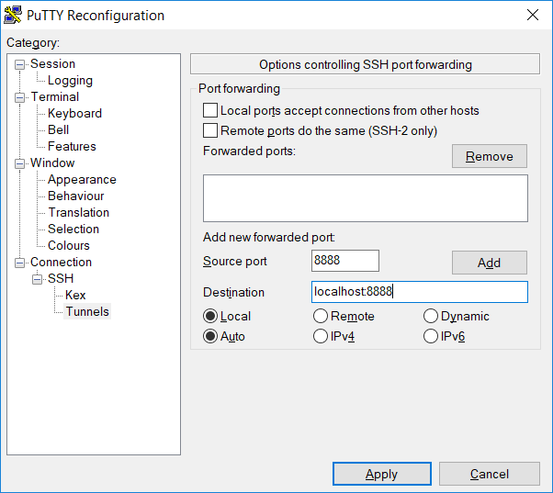
AWS Deep Learning AMI cont.
ssh -L localhost:8888:localhost:8888 -i <your .pem file name> \ ubuntu@<Your instance DNS>
AWS Global Footprint

Slide 15
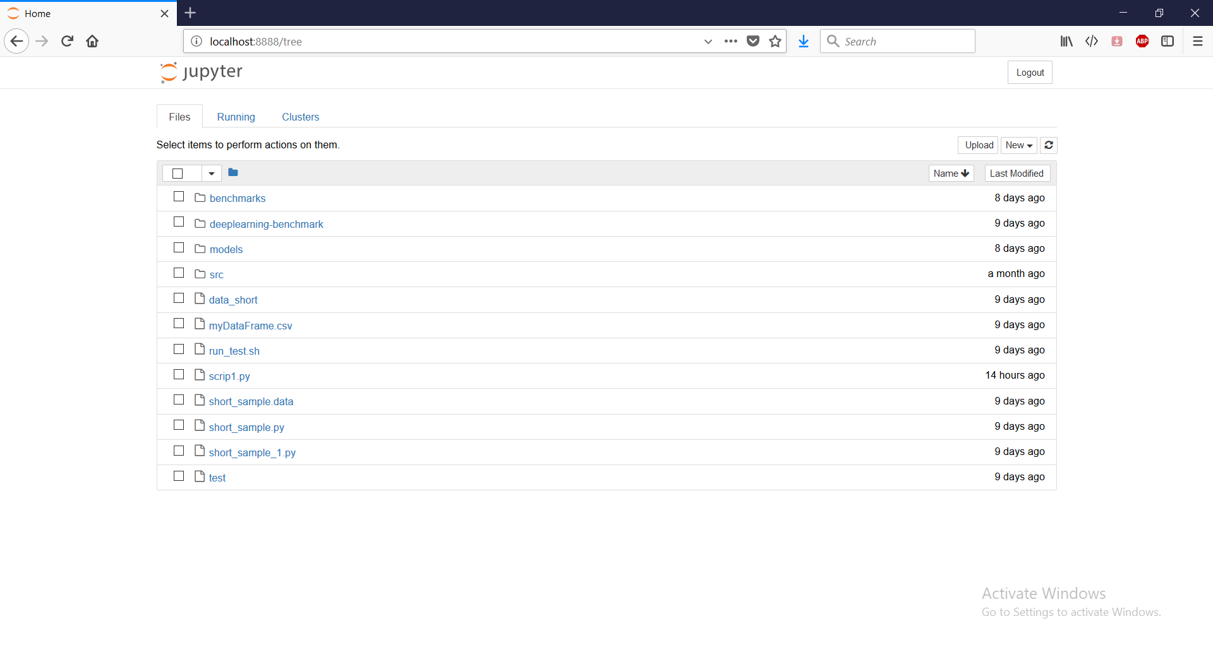
AWS Deep Learning AMI
AWS Global Footprint

Slide 16
Thank you Questions?
AWS Global Footprint

