Slide 1
Devops BASE
What continuous integration is

Slide 2
Devops BASE
Continuous integration is a practice supported by people and software

Slide 3


Devops BASE
10 people writing one book

Slide 4



Devops BASE
App v1.0
App v1.1
App v1.2

Slide 5
Devops BASE
CI help to verify that the code is one step closer to production quality code

Slide 6

Devops BASE
Creating OS installer package

Slide 7
Devops BASE
The CI process is important first step

Slide 8
Devops BASE
CI is a process

Slide 9
Devops BASE
It's only continuous integration, if developers are continuously integrating their code

Slide 10
Devops BASE
Why mirroring production
reduces bugs

Slide 11

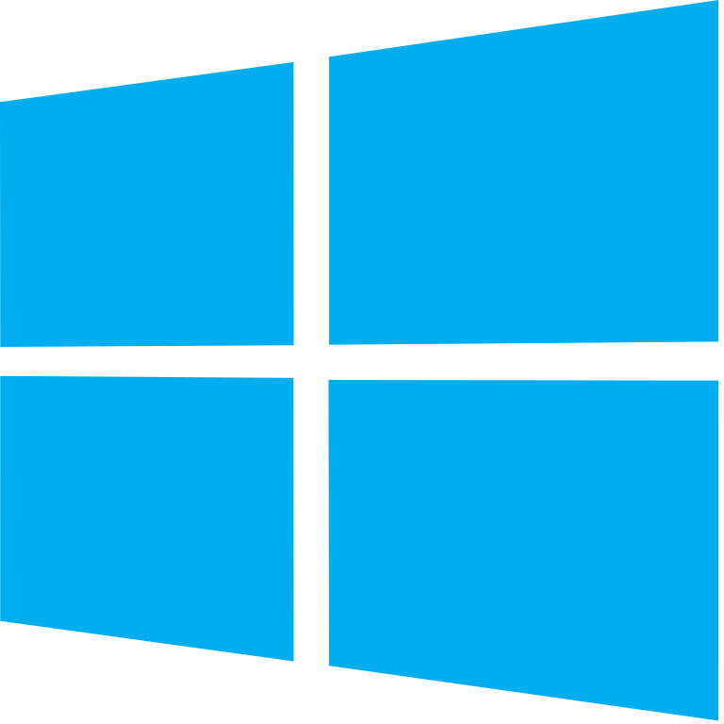
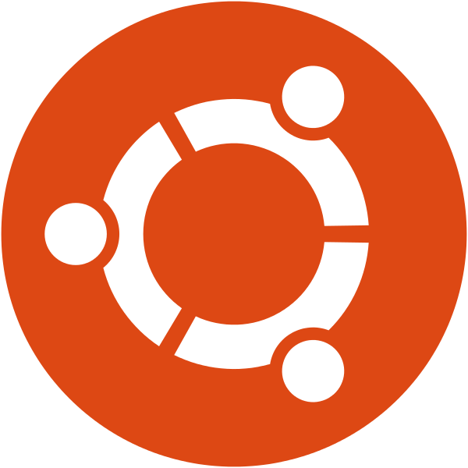

Devops BASE
This Photo by Unknown Author is licensed under CC BY-SA

Slide 12

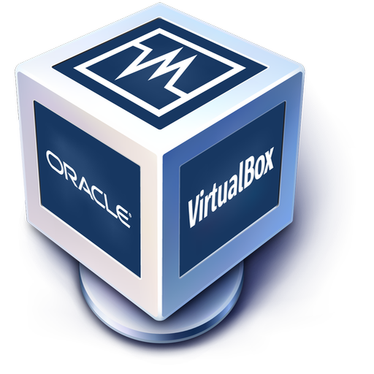
Devops BASE
Vagrant + Virtualbox

Slide 13
Devops BASE
Vagrant demo

Slide 14
Devops BASE
What is version control?

Slide 15
Devops BASE
Version control is about tracking changes to one or more files over time

Slide 16
Devops BASE
Files can be anything

Slide 17
Devops BASE
There are different types of Version Control Systems

Slide 18
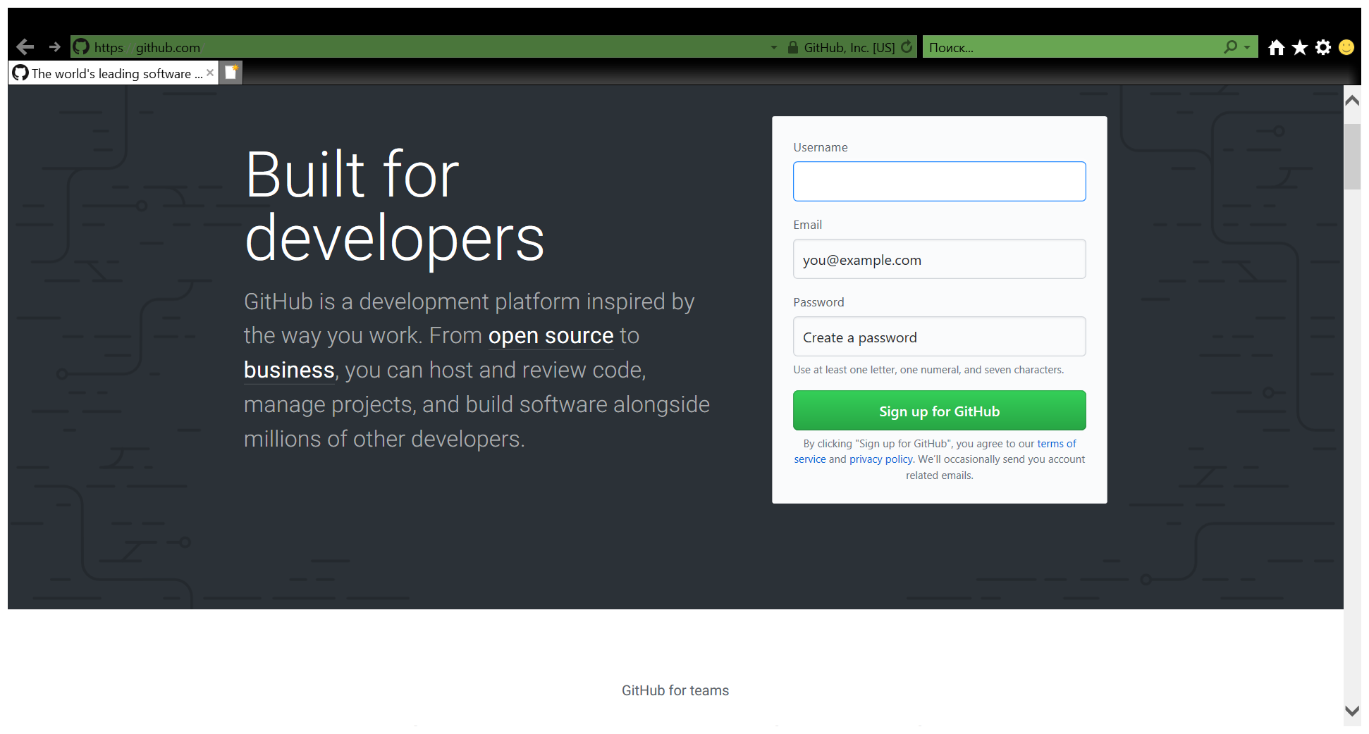
Devops BASE

Slide 19
Devops BASE
What tests to include in your CI process

Slide 20
Devops BASE
Why testing is important

Slide 21
Devops BASE
“Sure, testing is great, but we’re on a tight deadline, so we don’t have time to write tests” -People, all the time

Slide 22

Devops BASE
Would you fly on a plane with an untested OS?

Slide 23
Devops BASE
All code should be considered broken, until it has been proven otherwise

Slide 24
Devops BASE
Because we can’t just assume that code works correctly

Slide 25
Devops BASE
What kind of tests should we be running?

Slide 26
Devops BASE
Unit tests

Slide 27
Devops BASE
Unit tests need to be fast

Slide 28
Devops BASE
Typically unit tests don’t interact with external resources

Slide 29
Devops BASE
Linters

Slide 30
Devops BASE
Code coverage tools

Slide 31
Devops BASE
Source Code Analysis Tools

Slide 32
Devops BASE
Testing is important because it catches problems early

Slide 33
Devops BASE
Sometimes you need to make DB changes during CI phase

Slide 34
Devops BASE
The problem that we’re trying to solve…

Slide 35
Devops BASE
Use an ORM and schema migration tools

Slide 36
Devops BASE
.NET: Entity Framework + Code First Migration

Slide 37
Devops BASE
Java: Hibernate + Flyway

Slide 38
Devops BASE
Ruby: Active Record

Slide 39
Devops BASE
Python(Django): Built-in ORM + Migrations

Slide 40
Devops BASE
Python: SQLAlchemy + Alembic

Slide 41
Devops BASE
Etc…

Slide 42
Devops BASE
Your database should be versioned

Slide 43
Devops BASE
One schema change per migration

Slide 44
Devops BASE
Changes should be non-destructive

Slide 45
Devops BASE
New columns require sane defaults

