Slide 1

Configuration management

Slide 2
Agenda:
What is Ansible?
Ansible Concepts
Installation
Inventory
What are modules?
Playbooks

Slide 3
What is ansible

Slide 4
What is ansible
Ansible is an automation engine
It allows you to run tasks on multiple servers
It uses the YAML syntax

Slide 5
Common Use cases
Provisioning environments
Configuring operating systems
Deploying application
Performing compliance checks

Slide 6



Provisioning Environments
Ansible can automate setting up and tearing down environments
Specify the desired architecture of the environment and Ansible will create it

Slide 7
Configuring OS
Install and remove software
Ensure Services are in the desired state
Running
Stopped
Apply OS patches

Slide 8
Deploying Applications
Specify the individual tasks required to deploy an application
Deploy to multiple hosts / environments
Perform Blue/Green deployments

Slide 9
Perform compliance checks
Create tasks for the desired state of a host / service
Run the task to enforce that state
Report on any changes

Slide 10
What Other Options Exist?
There are a lot of similar tools
Two popular options are
Chef
Puppet

Slide 11
How Does Ansible Compare?
Ansible doesn’t require an agent to be installed on the host
Ansible does require Python on Linux hosts
Ansible does require PowerShell 3 on Windows hosts
Ansible uses YAML
Chef and Puppet use a Ruby DSL(Domain Specific Language)
None of these makes one better than another

Slide 12

Which One Should You Use?
It depends on the features you need
It also depends on the skill set of the team using it

Slide 13
What Other Options Exist?
There are a lot of similar tools
Two popular options are
Chef
Puppet

Slide 14
ansible Concepts

Slide 15


Modules?
Playbooks?
Roles?
TASKS?

Slide 16

Running Tasks
Ad-hoc commands
Playbooks

Slide 17
Ad-hoc Commands:
Use the ansible executable to run code on hosts
$ ansible lamp –m ping
Run one-off commands
Examples include:
Shutting down a server
$ ansible lamp –m command –a “/sbin/shutdown”
Restarting a service:
$ ansible lamp –m service –a “name=apache2 state=restarted”

Slide 18
A simple ad-hoc command:
$ ansible lamp –m service –a “name=apache2 state=restarted”
The name of the group of servers to run on
The name of the module to run
The parameters to pass to the module in key-value format

Slide 19
Playbooks
Playbook allow you to run multiple tasks, on multiple hosts
Playbooks are a YAML file with zero or more plays

Slide 20
Modules
Modules are wrappers around specific code
Copy module
- name: example copying file with owner and permissions
copy:
src: /srv/myfiles/foo.conf
dest: /etc/foo.conf
owner: foo
group: foo
mode: 0644
Git module
# Example git checkout from Ansible Playbooks
- git:
repo: 'https://foosball.example.org/path/to/repo.git'
dest: /srv/checkout
version: release-0.22
Ping module
# ansible webservers -m ping
# Example from an Ansible Playbook
- ping:
# Induce an exception to see what happens
- ping:
data: crash

Slide 21
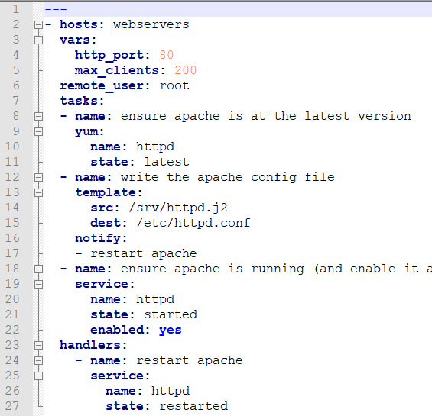
Tasks
Tasks consist of a module and some metadata
Metadata for a task includes:
Name
Handler notification
Ignore Errors
Conditionals
Loops
Etcetera

Slide 22
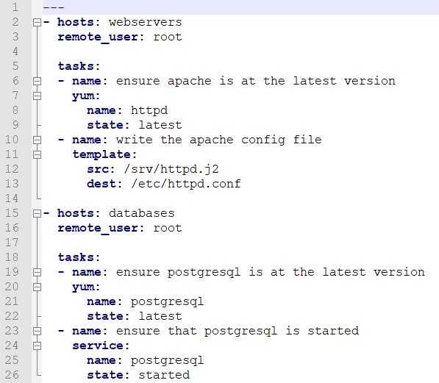
Plays / Playbook
Plays consist of tasks, hosts, variables and additional settings
Playbook can have multiple plays
Playbooks are the most common way to interact with Ansible

Slide 23
InSTAlling ansible

Slide 24
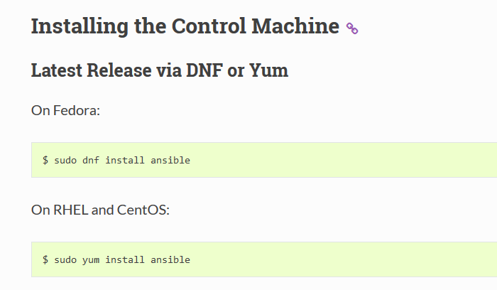
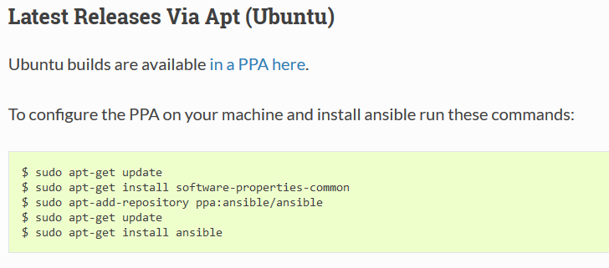

Slide 25
Inventory

Slide 26
Inventory
Ansible need to know which servers you want to manage
Because Ansible doesn’t use an agent, you need to specify the servers
Ansible keeps this info into in an inventory file

Slide 27
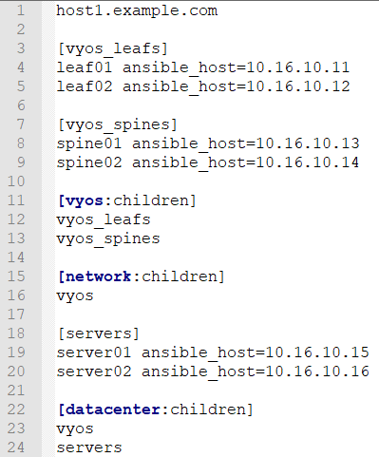
Inventory file

Slide 28
Variable files
It’s a best practice to store host and group specific variables in their own files
Hosts belong in the /etc/ansible/host_vars folder
Groups belong in the /etc/ansible/group_vars folder
The name of the variable file should match the host or group name

Slide 29
Connecting to remote hosts
The default connection method is
SSH for Linux
WinRM(Windows Remote Management) for Windows
Ansible allows per hosts and per group connection settings
If all hosts share connection settings you can use ansible.cfg file

Slide 30

Thanks

