Slide 1
Introduction to CD
DevOps Base

Slide 2
Continuous Delivery
What is Continuous Delivery
Architecting for Continuous Delivery
Mutable vs. Immutable servers
Deployment Methods

Slide 3
What is Continuous Delivery

Slide 4
CD is a way of building software such that it can be deployed to a specified environment, whenever you want to
DevOps-CD

Slide 5
CI is responsible for code level testing...

Slide 6
When the acceptance tests are passing, then any non-functional automated tests can be run

Slide 7
I like to have load testing performed here

Slide 8
As well as more in depth security audits

Slide 9
Developers, ops and security engineers should collaborate on a testing plan for these automated tests

Slide 10
Circling back to initial descriptin

Slide 11
CD is a way of building software such that it can be deployed to a specified environment, whenever you want to…
DevOps-CD

Slide 12
In particular, you should be able to deploy to production

Slide 13
…it’s about more than just deploying software

Slide 14
it’s about deploying the highest quality software possible

Slide 15
Your end goal should to be attempt to make a deployment process that is so boring and predictable that it can be done by the least technical person that you know

Slide 16
continuous delivery is a way of building software, such that it can be deployed to a specified environment

Slide 17
And deploy only the highest quality versions to production

Slide 18
Why is all this valuable?

Slide 19
Increased Quality

Slide 20
Improved cycle time

Slide 21
Better resource management

Slide 22
Reduced deployment risk

Slide 23
Better customer feedback loops

Slide 24
continuous delivery/
continuous deployment

Slide 25
Architecting for Continuous Delivery
Monoliths
Microservices

Slide 26
It's not uncommon for web applications to start out as monoliths

Slide 27
Amazon started out as a monolith, so did Netflix and Etsy

Slide 28
Amazon and Netflix have moved towards microservices, Etsy remains a monolith

Slide 29
What is the difference?

Slide 30
A monolith is a singular application that contains all of the modules needed to perform its job

Slide 31
Microservices are discreet services that serve a specific purpose

Slide 32
A monolith can grow to a certain point where testing and deployments become very time consuming

Slide 33
monoliths can cause a technology lock in

Slide 34
When should you use a monolith, and when does it make sense for microservices?

Slide 35
it depends…

Slide 36
For greenfield development, which is a term that basically means a new project

Slide 37
For greenfield development, which is a term that basically means a new project

Slide 38
Better
search
APP
Payment
processor

Slide 39
There is no perfect architecture

Slide 40
Microservices and monoliths are developed, deployed, and operated in similar, yet different ways

Slide 41
Servers
Mutable
Immutable

Slide 42
Years ago, servers were setup and configured one at a time by people

Slide 43
Over time things started to get scripted out

Slide 44
Eventually, configuration management tools became the ideal way to manage server setups

Slide 45

Snowflake server

Slide 46
Phoenix servers

Slide 47
…immutable servers are the next step in that evolution

Slide 48
Mutable and Immutable

Slide 49
Pros
There are some fantastic tools out there for handling CM

Slide 50
Pros
It can be useful for small projects or small teams that don't want the extra overhead of managing virtual machine images

Slide 51
Pros
Ad hoc commands for things like security patches are really rather simple

Slide 52
Pros
Having CM scripts under version control allows shared ownership

Slide 53
Cons
When an upgrade or deployment fails, the server can be left in a broken state

Slide 54
Cons
Because we're making changes over time, we're not starting with a known working configuration each time we deploy

Slide 55
Cons
Depending on how we implement our configuration, we may have to use our CM tool to handle scaling

Slide 56
Cons
Any change to the OS needs to be tested separately to ensure that nothing breaks

Slide 57
Deployment Methods
Deployment Strategies

Slide 58
blue/green deployment

Slide 59
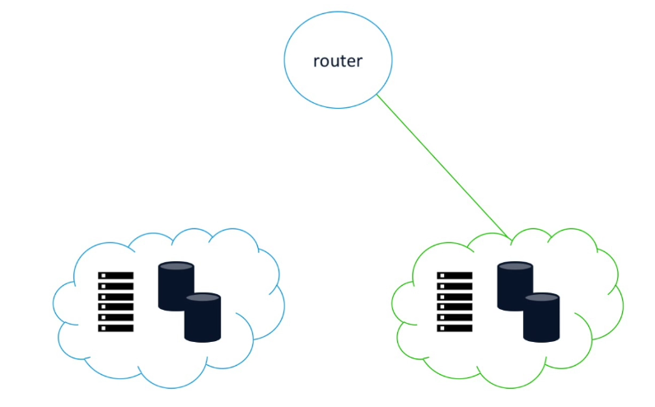

Slide 60
Canary deployments

Slide 61
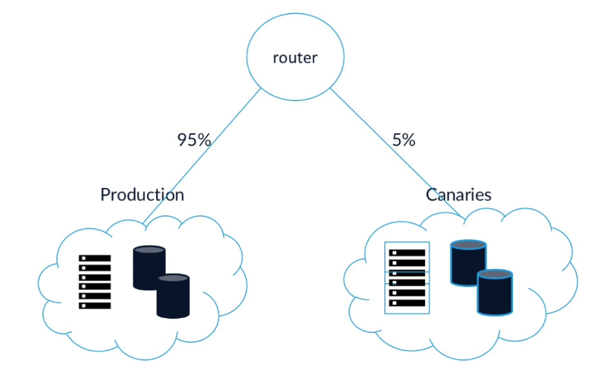

Slide 62
Canary deployments get its name from the practice of coalminers bringing canaries into the mines with them

