Slide 1
BR41N.IO
Patient-Stratified
Motor Imagery Classification
for Stroke Rehabilitation
Vlada Misici
Solo Entry · Spring School 2026
Beating both organizer baselines on the hardest stroke patients

Slide 2
The headline
BR41N.IO
3 of 6
conditions where I beat BOTH organizer baselines
(CSP+LDA and PCA+TVLDA)
+11.7 pp
100.0 %
+32 pp
average gain over CSP+LDA (5 of 6 conditions)
P2_post · FBCSP+LDA
P2_pre vs original window (52 → 84 %)
BR41N.IO Spring School 2026 | Stroke Rehab Data Analysis | Vlada Misici
2 / 9

Slide 3
Clinical Challenge
BR41N.IO
Why standard BCI struggles on stroke
Lateralization Index — clinical biomarker
Weaker, more diffuse signals
LI = (ERD_contra − ERD_ipsi) ⁄ (ERD_contra + ERD_ipsi)
Stroke patients produce smaller and less lateralized ERD than healthy subjects.
Only ~46 % show clear contralateral ERD
Many recruit ipsilateral or compensatory regions.
LI > 0 bilateral / healthy pattern LI ≈ 0 diffuse activation LI < 0 ipsilesional dominance (compensatory)
CSP+LDA gets 68–77 % on pre-data
Insufficient for closed-loop BCI control.
Clinical anchor: LI correlates with Fugl-Meyer motor scores (r = 0.57–0.61). We use it both as a biomarker and to interpret why one pipeline beats another per patient.
GOAL — beat both baselines, with clinical interpretation
BR41N.IO Spring School 2026 | Stroke Rehab Data Analysis | Vlada Misici
3 / 9

Slide 4
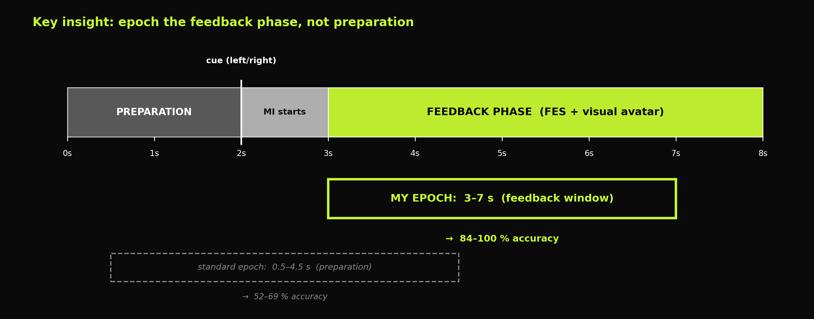
Method · the key insight
BR41N.IO
Preprocessing
Pipelines tested
Why this wins
0.5–30 Hz bandpass
No artifact rejection
16-ch sensorimotor
FBCSP+LDA (primary)
ACM(3,7) (secondary)
+ 6 Riemannian variants
Feedback phase carries
the FES-evoked SMR
— stronger and stabler
BR41N.IO Spring School 2026 | Stroke Rehab Data Analysis | Vlada Misici
4 / 9

Slide 5
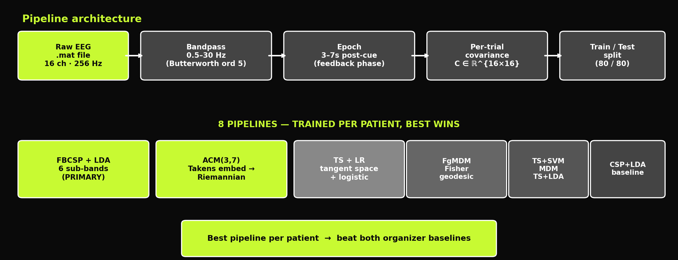
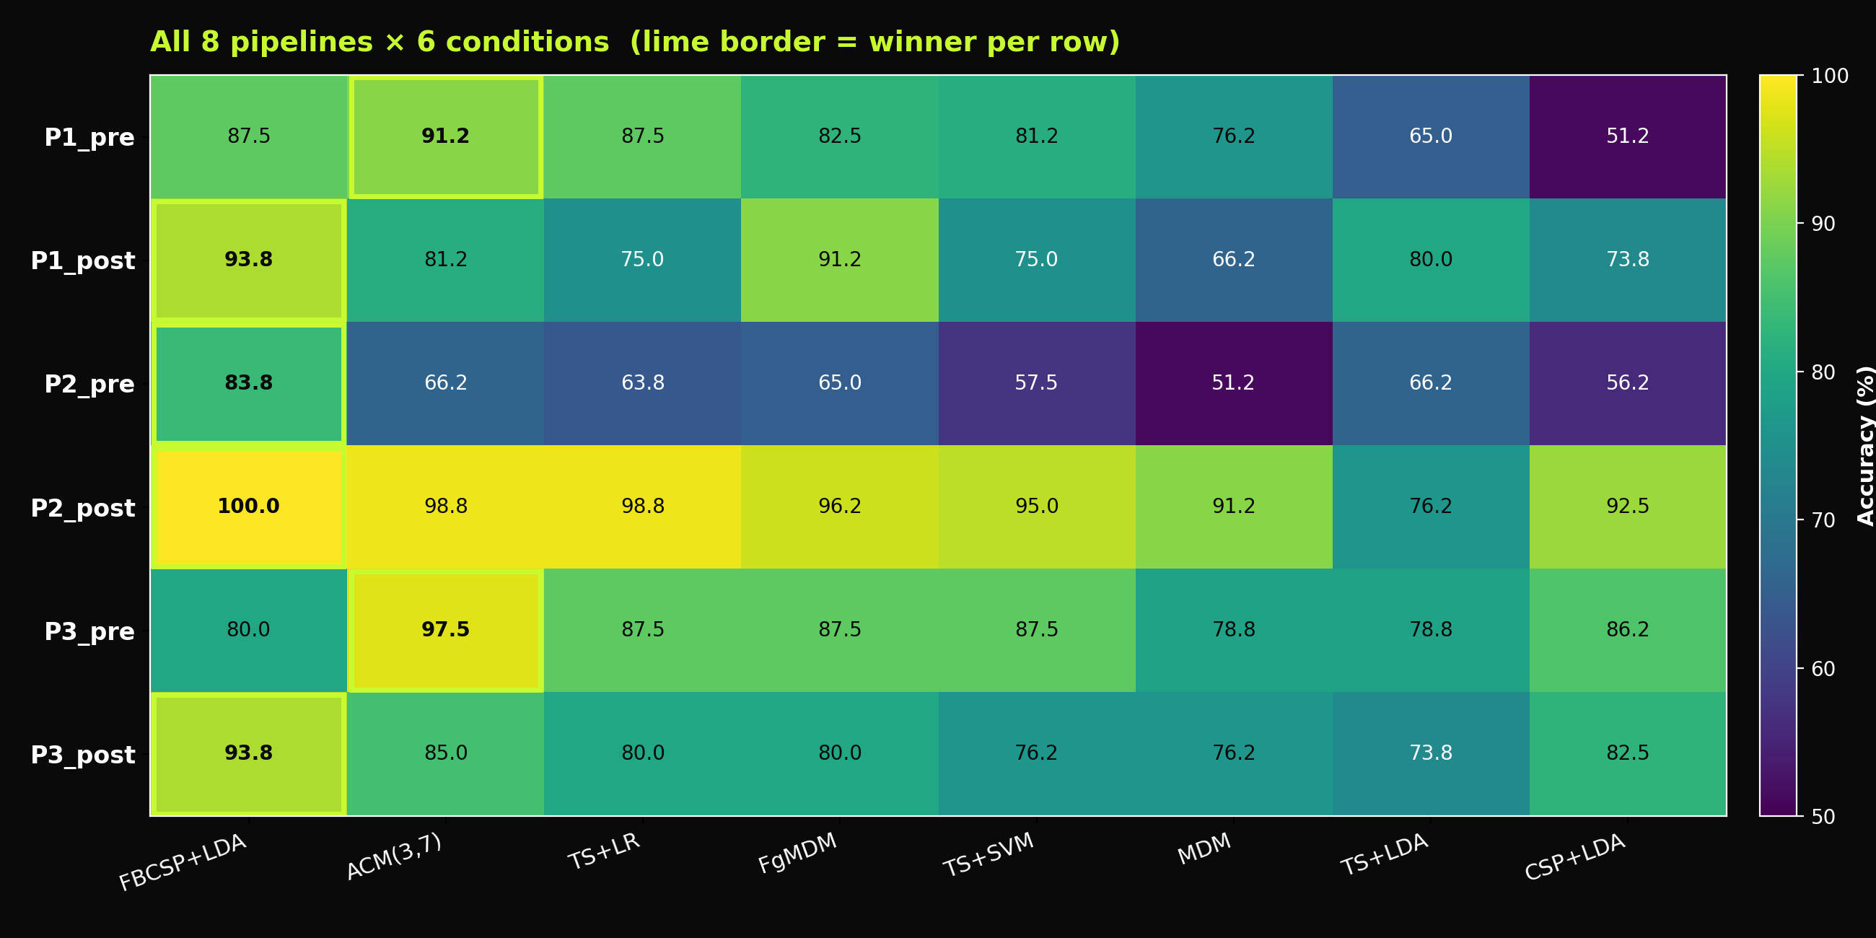
Implementation · systematic comparison
BR41N.IO
Statistical validation
Permutation test
→ p = 0.001 (n=1000)
Cohen's κ ≥ 0.825
→ almost perfect
Binomial threshold
→ 58.8 % (n=80)
Train/test + 5-fold CV
BR41N.IO Spring School 2026 | Stroke Rehab Data Analysis | Vlada Misici
5 / 9

Slide 6
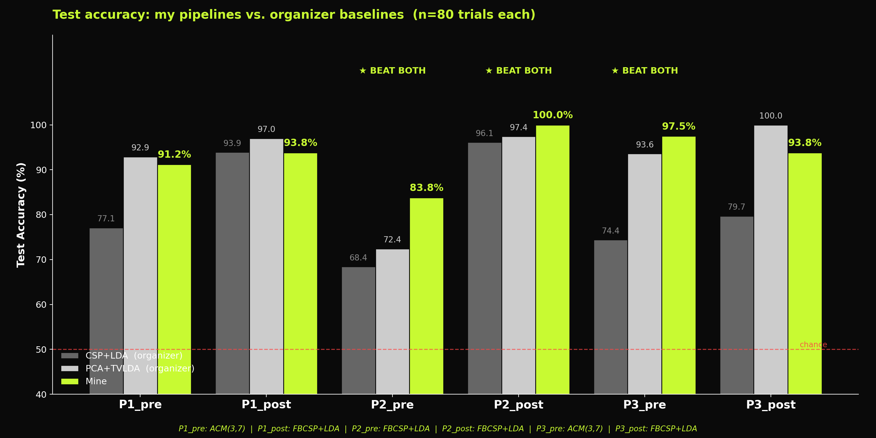
Results
BR41N.IO
5 / 6
3 / 6
+15.3 pp
conditions beat CSP+LDA
conditions beat BOTH baselines
biggest gain on the hardest patient
+11.7 pp average
P2_pre, P2_post, P3_pre
P2_pre · FBCSP+LDA · 68 → 84 %
BR41N.IO Spring School 2026 | Stroke Rehab Data Analysis | Vlada Misici
6 / 9

Slide 7
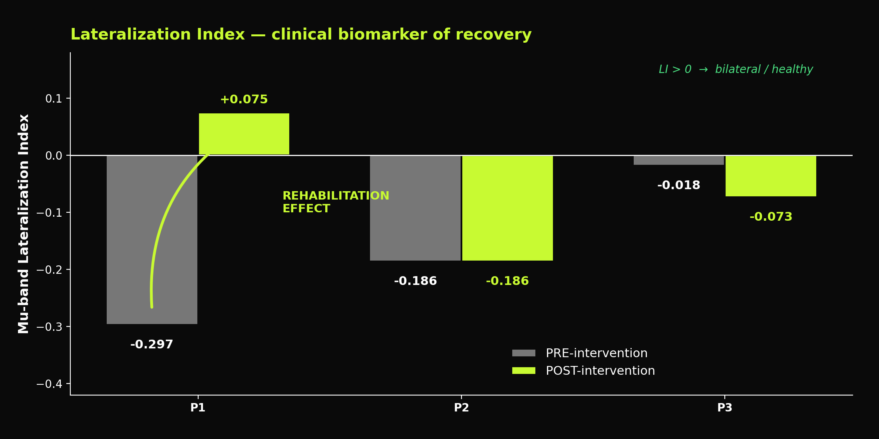
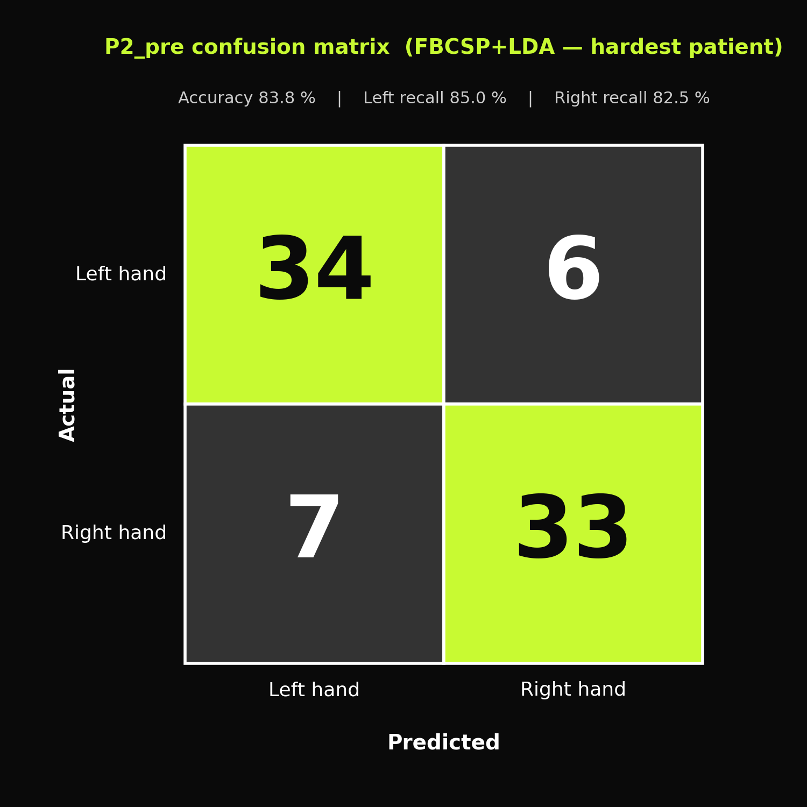
Clinical insights
BR41N.IO
Patient 1 · rehabilitation effect
P2_pre · hardest case
Mu-band LI shifted from −0.297 to +0.075 after 25 sessions of recoveriX therapy. Right-dominant compensation → bilateral healthy pattern. Accuracy also rose 91 → 94 %.
FBCSP+LDA reached 83.8 %
where CSP+LDA gets only 56 %.
Per-class balance is preserved (L 85 %, R 82.5 %)
BR41N.IO Spring School 2026 | Stroke Rehab Data Analysis | Vlada Misici
7 / 9

Slide 8
Reflection · why this matters
BR41N.IO
No single pipeline dominates
Why FBCSP works on stroke
FBCSP+LDA wins 4/6, ACM wins 2/6. Stratifying per patient is essential — single-method recoveriX deployment leaves accuracy on the table.
Stroke shifts ERD into theta (4–8 Hz) and broadens the spectrum. Six sub-band CSP captures these patient-specific frequency shifts that single-band CSP misses.
Why ACM works on diffuse cases
Limitations · honest
Takens delay embedding turns temporal dynamics into spatial structure inside the covariance matrix — useful exactly when spatial contrast is weak (bilateral patients).
Solo, 24h scope. Within-session split (no cross-session test). 3 patients only. Window choice motivated by paradigm, validated by permutation test, but worth replication.
BR41N.IO Spring School 2026 | Stroke Rehab Data Analysis | Vlada Misici
8 / 9

Slide 9
BR41N.IO
Thank you
Patient-stratified MI classification
for stroke rehabilitation
5 / 6
3 / 6
+11.7 pp
beat CSP+LDA
beat both baselines
average gain
Vlada Misici
Solo Entry · Spring School 2026

