Slide 1

Moonrise Movies
Drive-In movie theatre
By Vladislav Epelboym, Matthew Rao, and Mitchell Fridman
HTTPS://MOONRISEMOVIES.AZUREWEBSITES.NET/

Slide 2
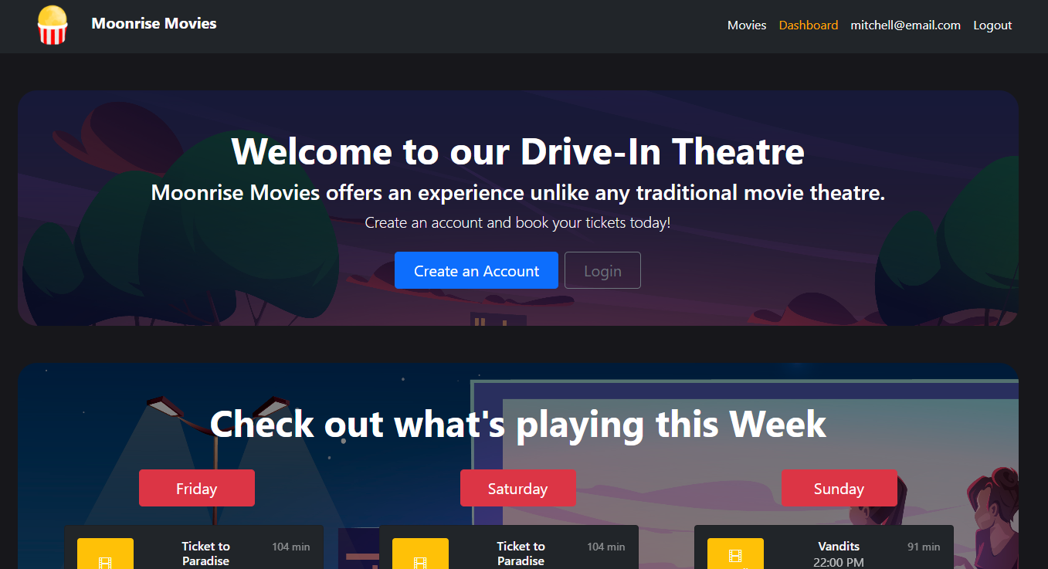
Drive-In Movie Theatre Website
This project aims to provide a website where customers can see what movies are playing at the drive-in, when they are playing, purchase a ticket in advance if they so wish, and then leave ratings and reviews of the movies.

Slide 3
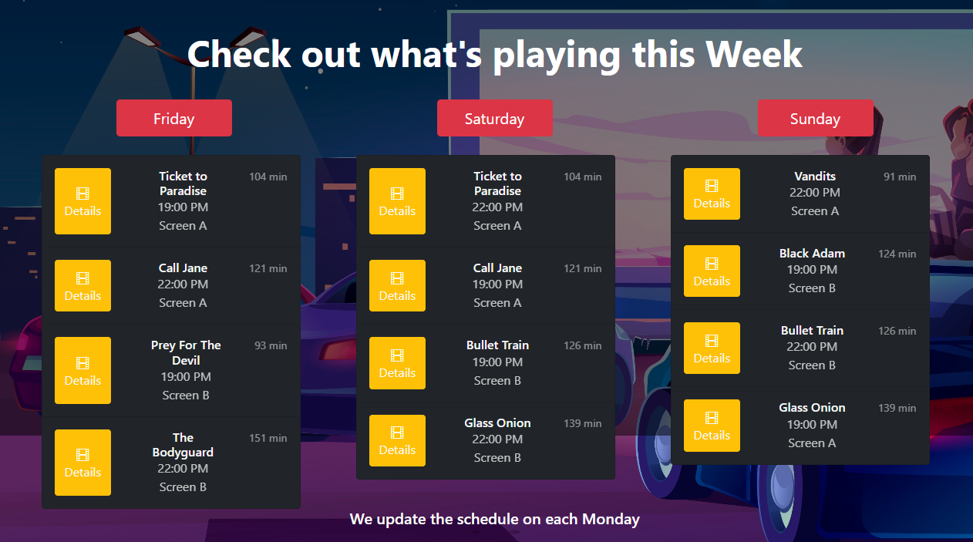
Weekly Schedule
Weekly schedule updated every Monday
Shows which two movies are playing each night on both of our screens
You can click on “Details” for more information.

Slide 4
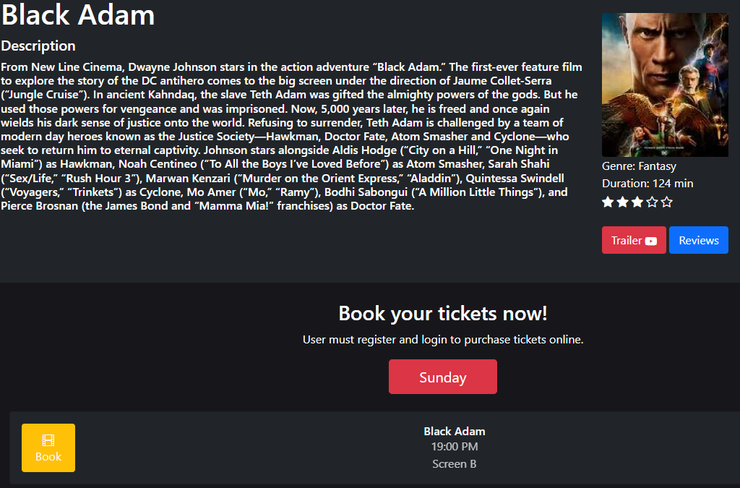
Details
Here you can see a description of the movie and the official movie poster as well as all of our scheduled screenings of it this week.
You can click to book any of those screening.
You can also click to see a trailer or to see or leave a review.

Slide 5
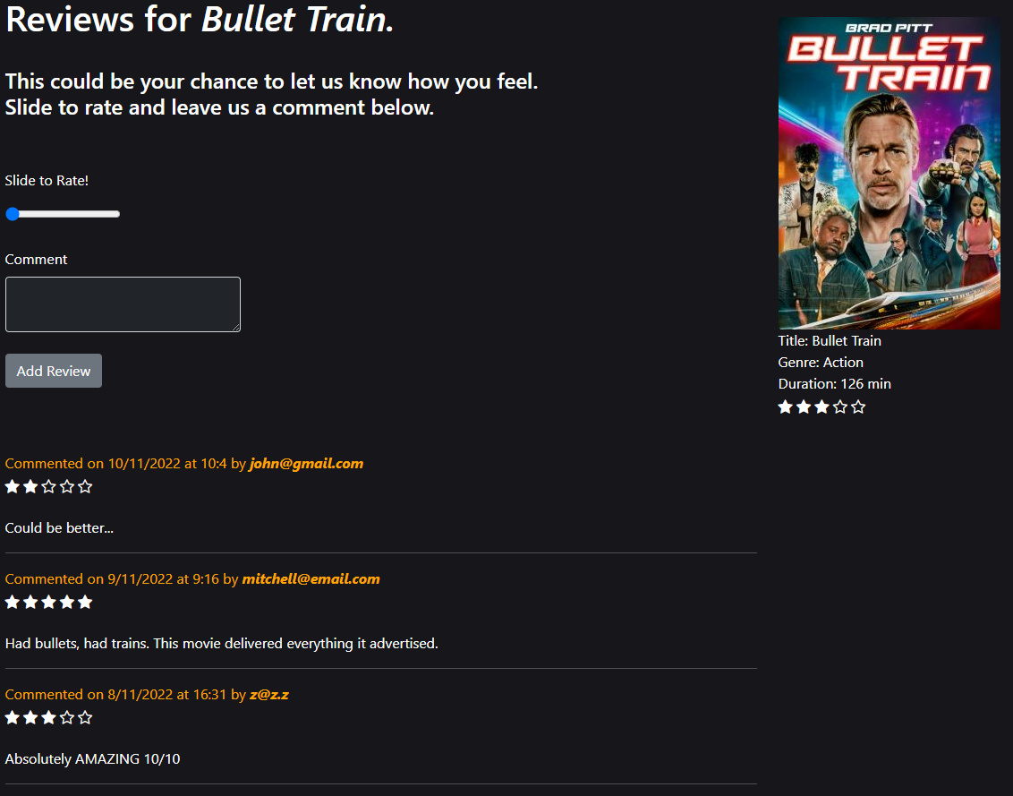
Reviews
Here you can select a star rating from 0-5 for movies you have seen as well as leave a review about them.
The website will aggregate all of the ratings and display the average submitted rating for movies on our website.

Slide 6
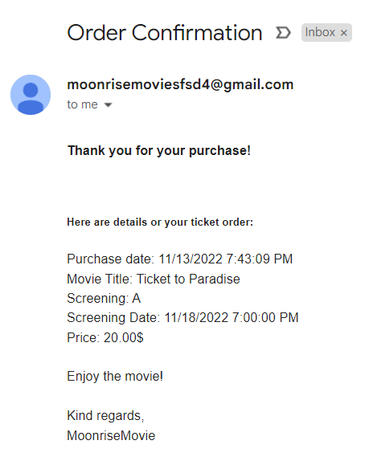
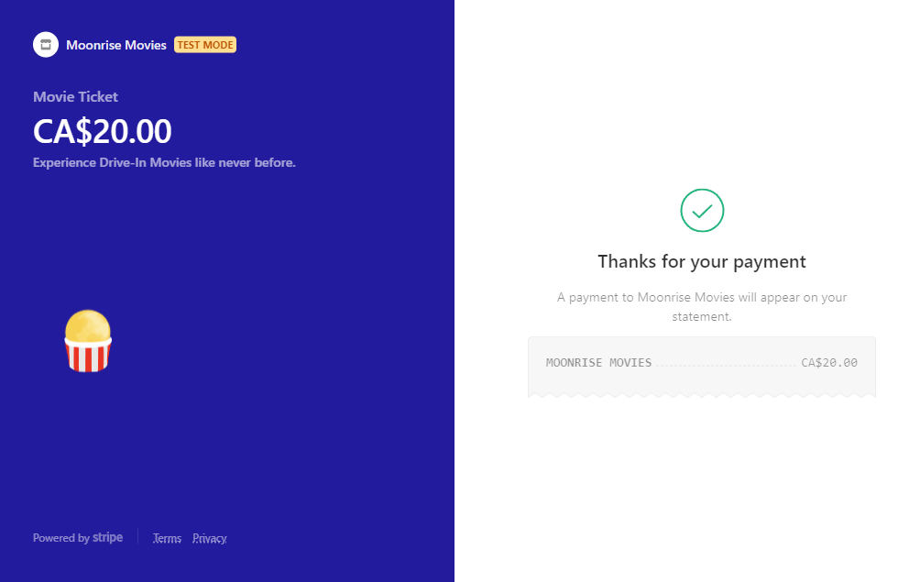
Order Page
You can pay for your ticket online to skip the line with Stripe.
When you book a ticket, a confirmation email will be sent to you with relevant order details.

Slide 7
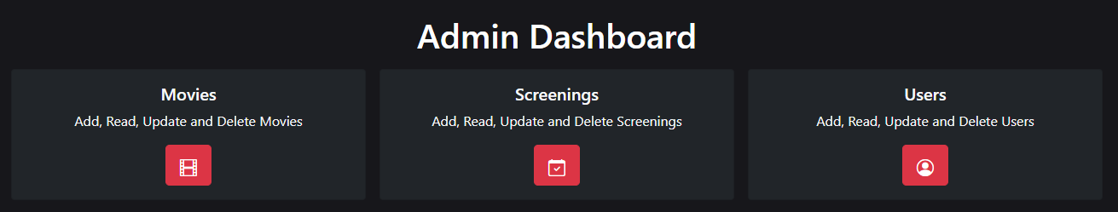
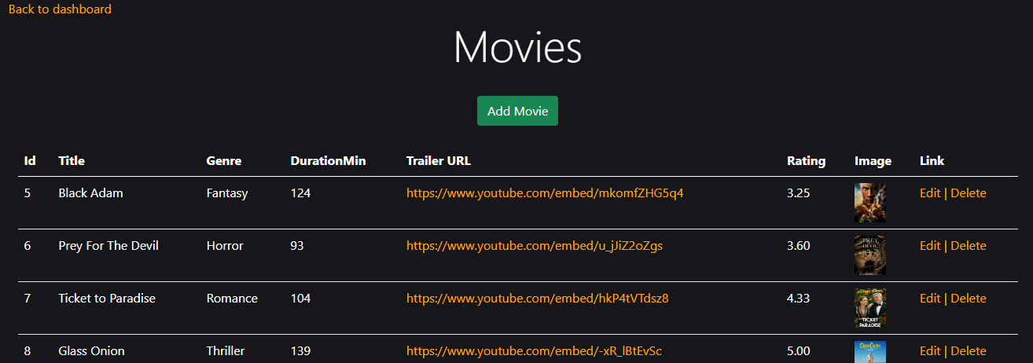
Admin Dashboard
CRUD with tables for Movies, Screenings, and Users.

Slide 8
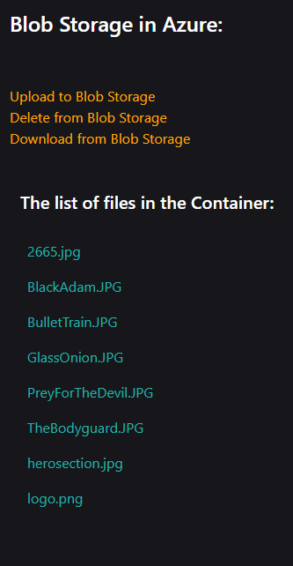
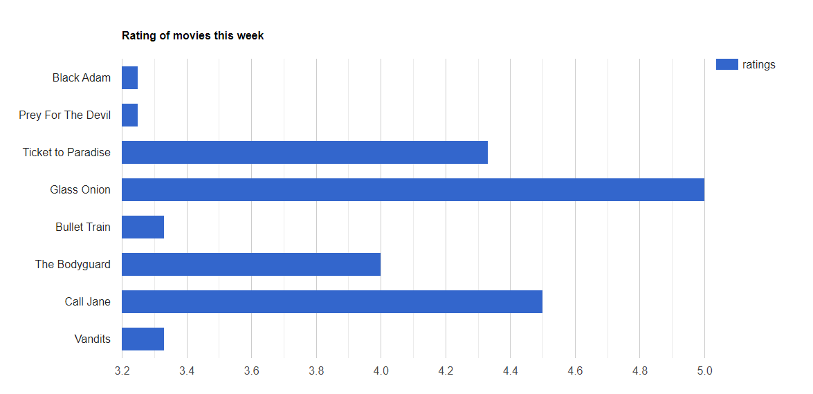
Charts & Blob Storage
Charts with average ratings from this week.
Blob Storage in Azure

Slide 9
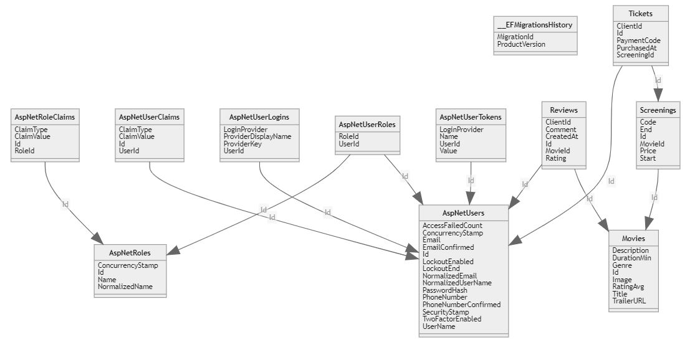
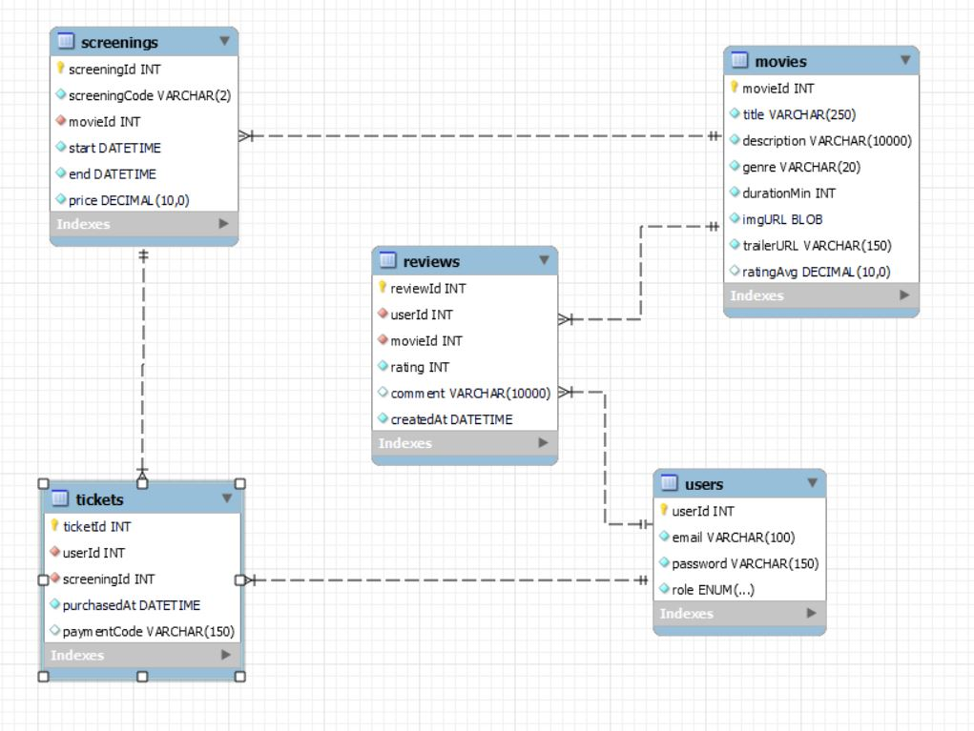
Database Design
Schema Visualization Extension in Azure Data Studio

Slide 10
Technologies Used
ASP.NET Core
ASP.NET Identity
Entity Framework
Google Charts API
Stripe - No code approach
Microsoft SQL Server
Azure Storage Blobs
Azure Application
Microsoft Azure Storage Explorer

Slide 11
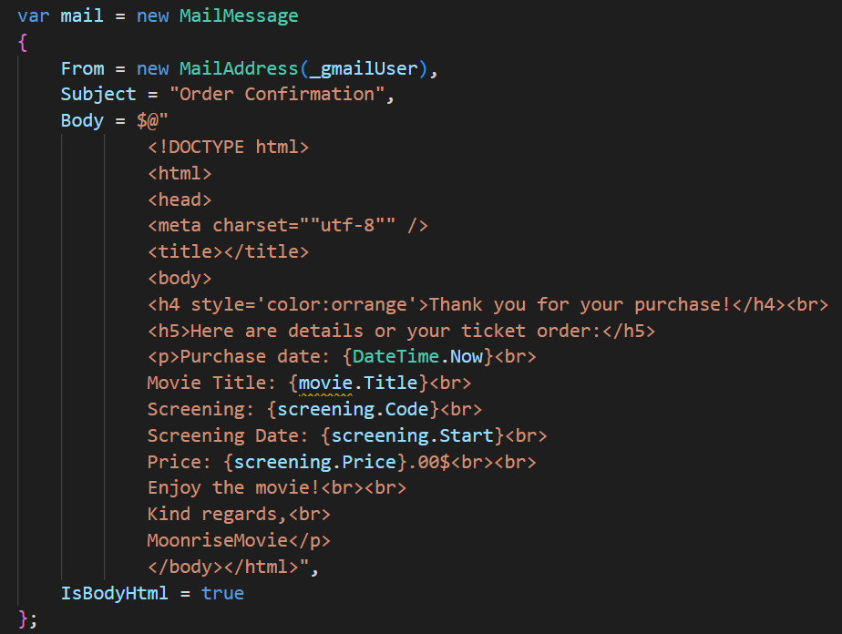
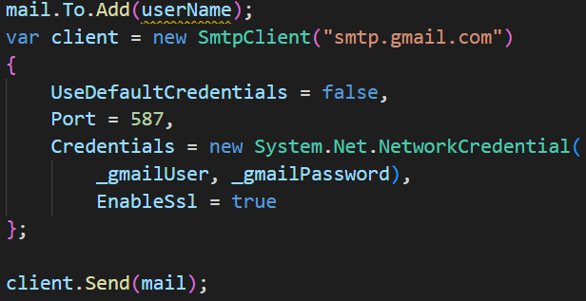
Auto-Emailing our Clients

Slide 12
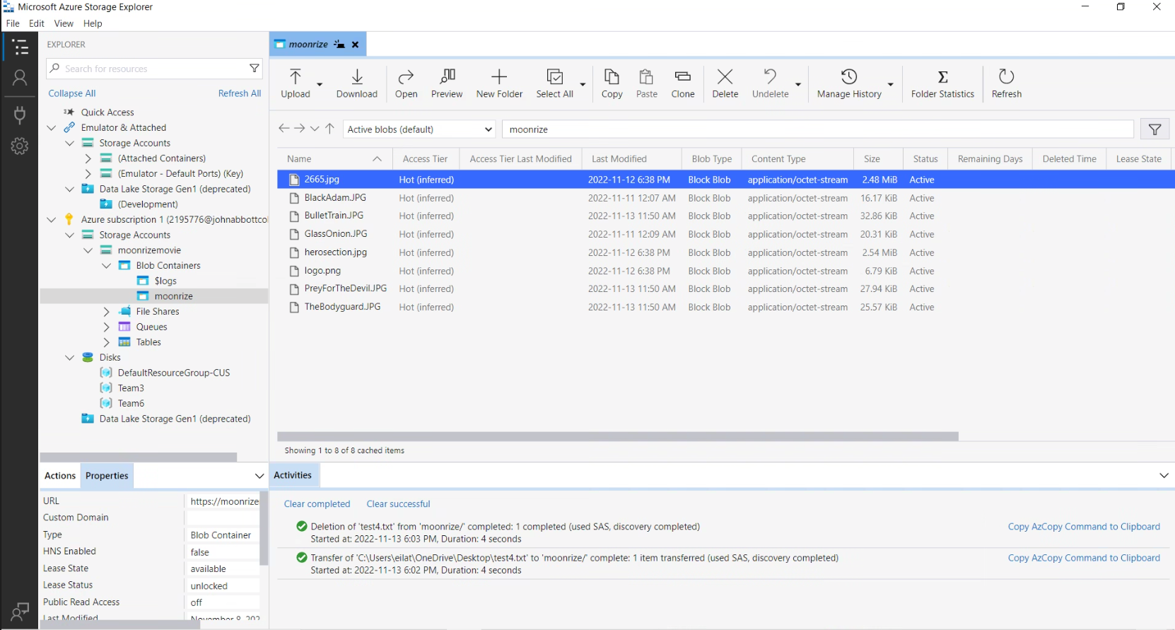
Microsoft Azure Storage Explorer

Slide 13
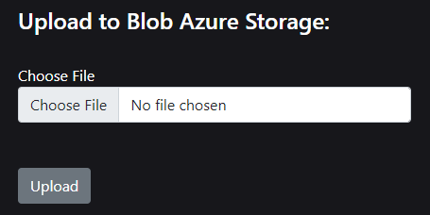
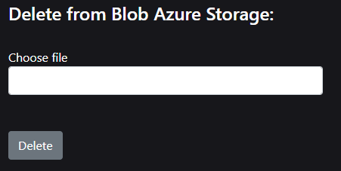
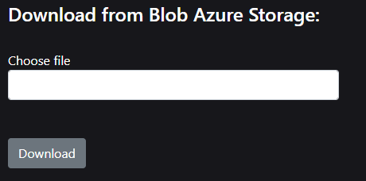
Azure Blob Storage

Slide 14
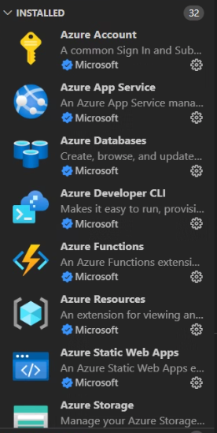
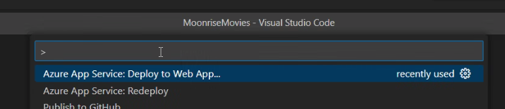
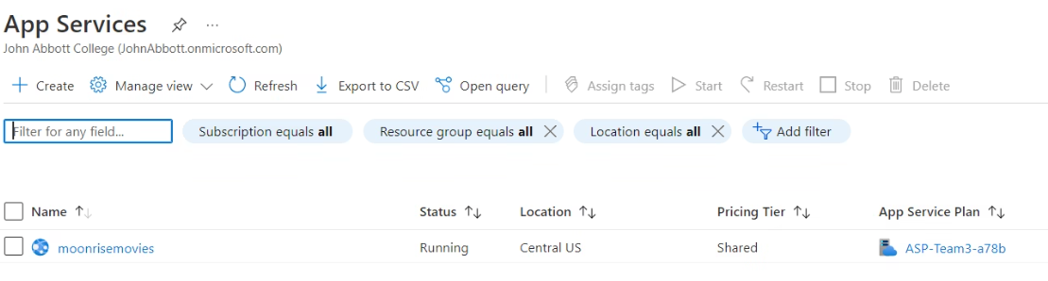
Deployment on Azure Application

Slide 15
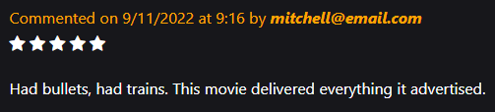
Easily Edit Your Data with Azure Data Studio

Slide 16
Future Work
Stripe No-Code Solution, fully implement Stripe

Slide 17
Summary
We started with a database-first approach.
Easily created webpages with Razor Pages and it’s annotations.
Decided on a calendar display.
Selected Movies, added showtimes, added Ratings & Reviews.
Order Tickets
Deployed the project
Our final result was a great drive-in experience. Thank you for coming to Moonrise Movies

