Slide 1

Moonrise Movies
DRIVE-IN MOVIE THEATRE
By:
Vladislav Epelboym, Matthew Rao, and Mitchell Fridman

Slide 2
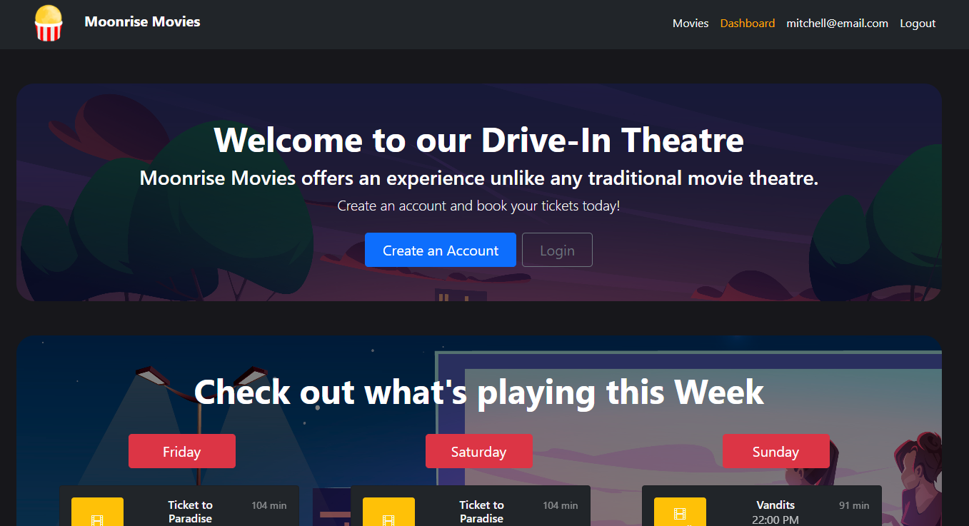
Drive-In Movie Theatre Website
This project aims to provide a website where customers can see what movies are playing at the drive-in, when they are playing, purchase a ticket in advance if they so wish, and then leave ratings and reviews of the movies.

Slide 3
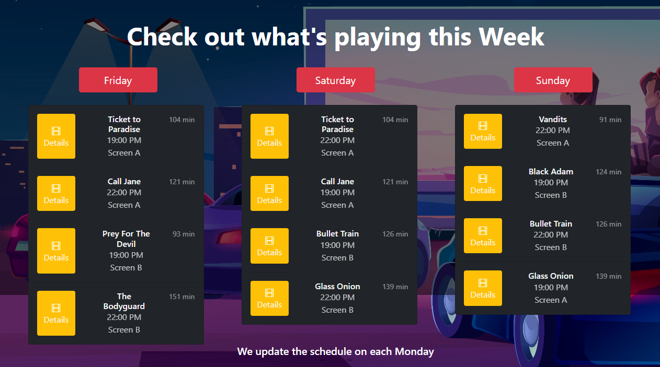
Weekly Schedule
Weekly schedule updated every Monday
Shows which two movies are playing each night on both of our screens
You can click on “Details” for more information.

Slide 4
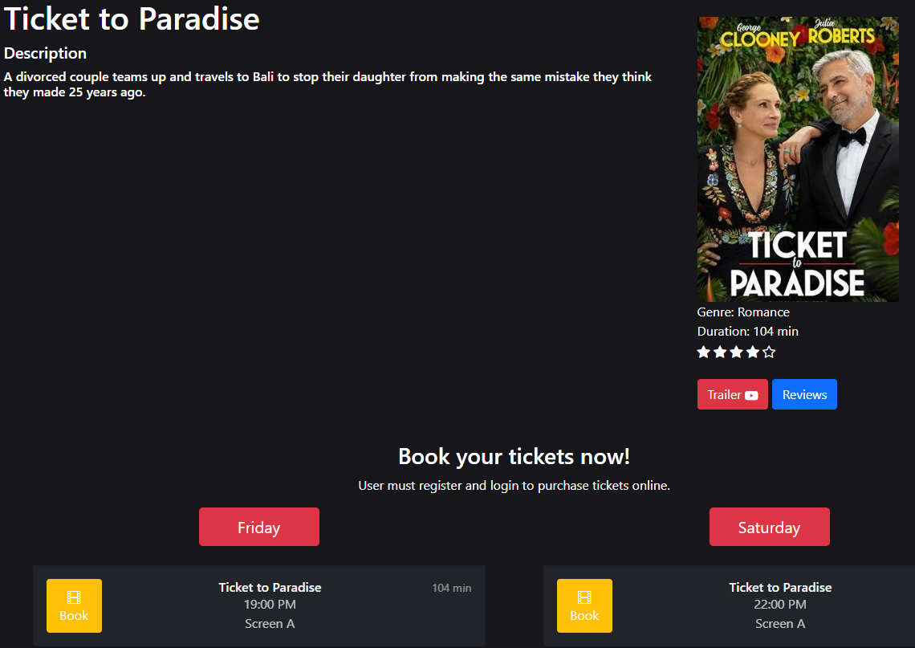
Details
Here you can see a description of the movie and the official movie poster as well as all of our scheduled screenings of it this week.
You can click to book any of those screening.
You can also click to see a trailer or to see or leave a review.

