Slide 1

Moonrise Movies
Drive-In movie theatre
By Vladislav Epelboym, Matthew Rao, and Mitchell Fridman

Slide 2
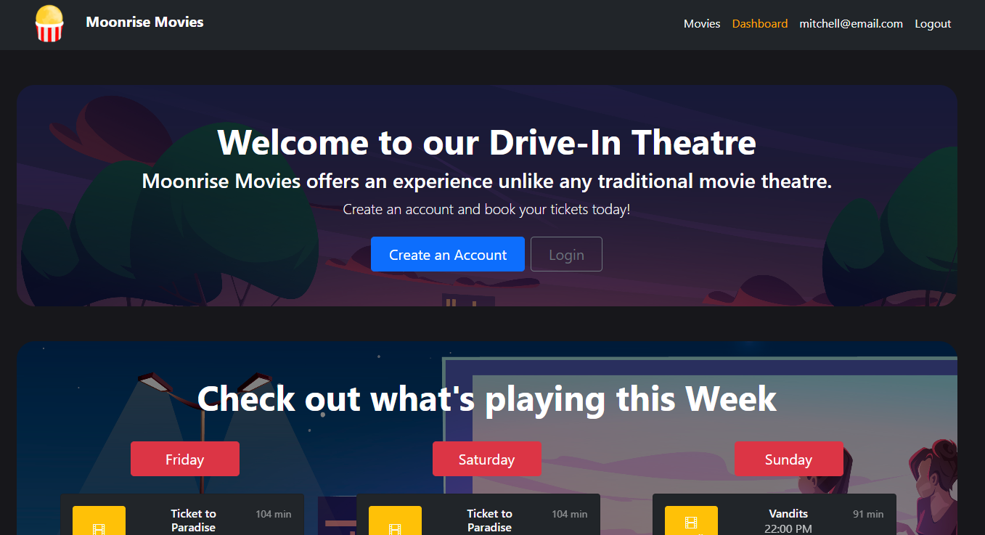
Drive-In Movie Theatre Website
This project aims to provide a website where customers can see what movies are playing at the drive-in, when they are playing, purchase a ticket in advance if they so wish, and then leave ratings and reviews of the movies.

Slide 3
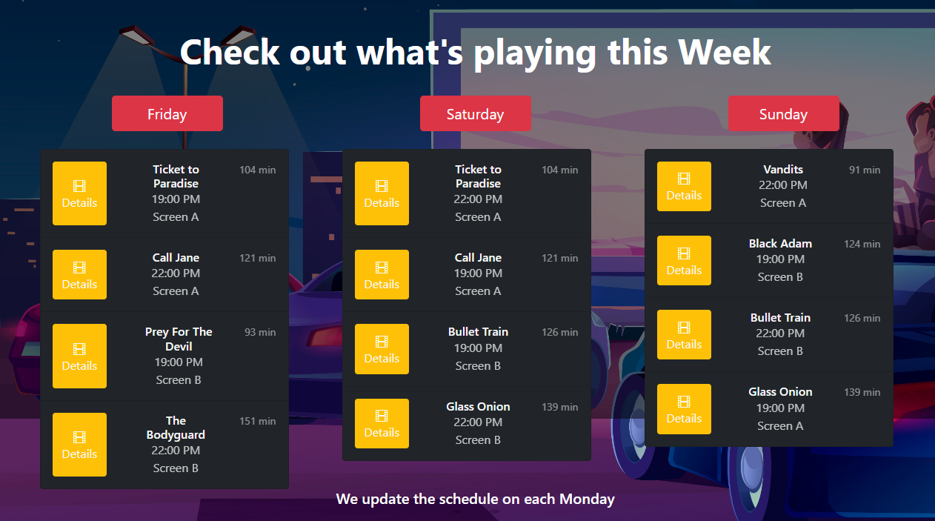
Weekly Schedule
Weekly schedule updated every Monday
Shows which two movies are playing each night on both of our screens
You can click on “Details” for more information.

Slide 4
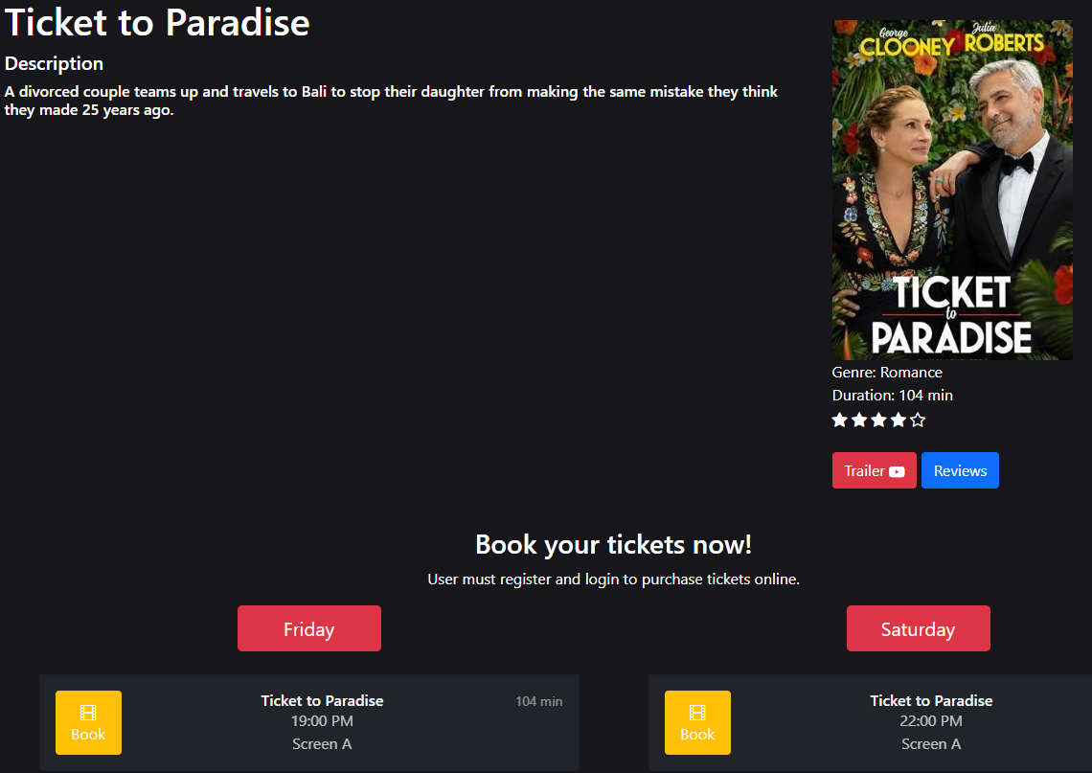
Details
Here you can see a description of the movie and the official movie poster as well as all of our scheduled screenings of it this week.
You can click to book any of those screening.
You can also click to see a trailer or to see or leave a review.

Slide 5
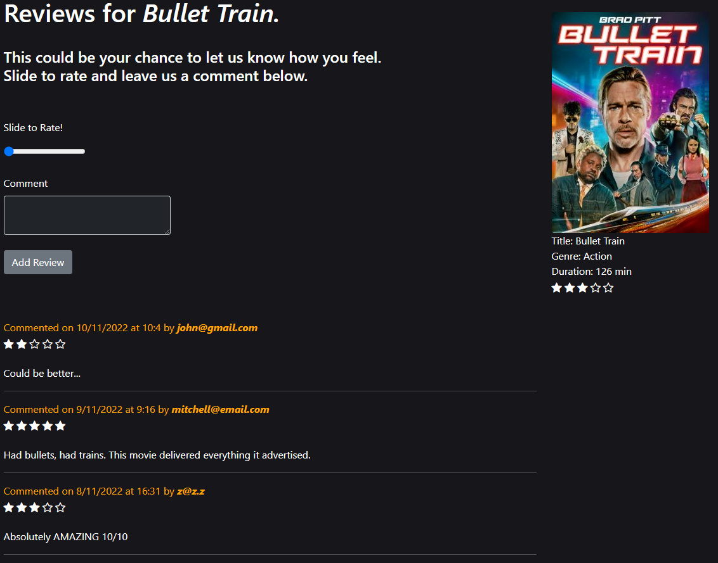
Reviews
Here you can select a star rating from 0-5 for movies you have seen as well as leave a review about them.
The website will aggregate all of the ratings and display the average submitted rating for movies on our website.

Slide 6
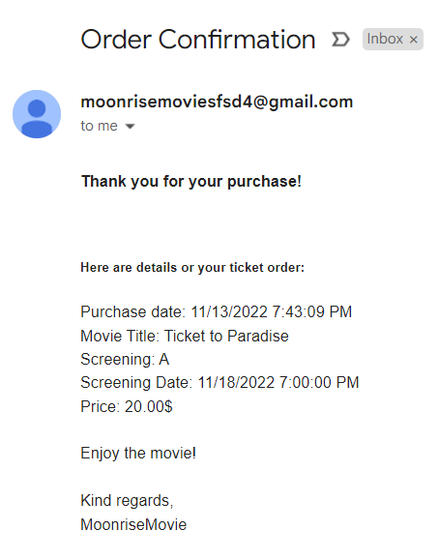
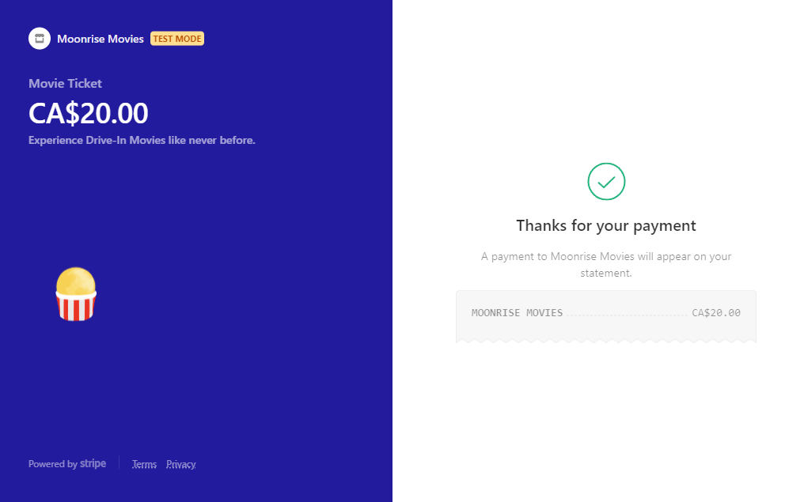
Stripe Payment
You can pay for your ticket online to skip the line with Stripe.
When you order with Stripe, a confirmation email will be sent to you with relevant order details.

Slide 7
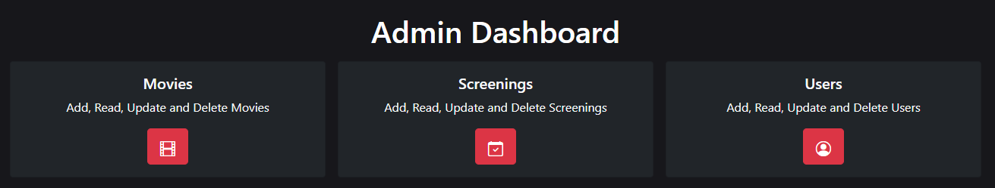
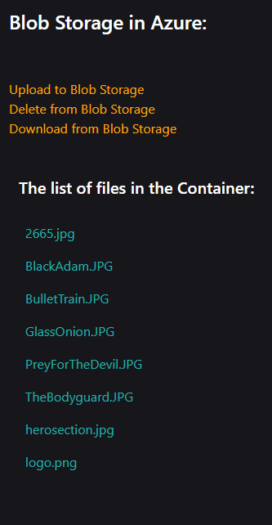
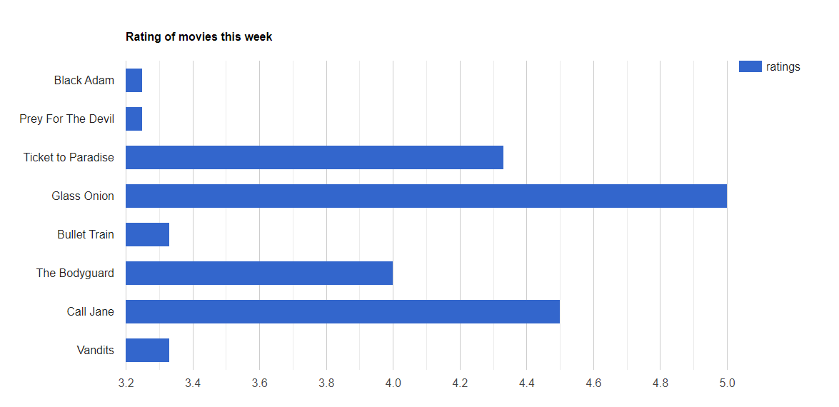
Admin Dashboard
CRUD with tables for Movies, Screenings, and Users.
Charts with average ratings from this week.
Blob Storage in Azure

Slide 8
Challenges and Solutions 1

Slide 9
Challenges and Solutions 2

Slide 10
Challenges and Solutions 3

Slide 11
Challenges and Solutions 4

Slide 12
What we Learned 1

Slide 13
What we Learned 2

Slide 14
What we Learned 3

Slide 15
What we Learned 4

Slide 16
Future Work

Slide 17
Summary

