Slide 1
Docker
04.02.2016
vlad.balmos@code932.com

Slide 2
Introduction to virtualization
What is Docker?
Use cases
What is a Docker Image
What is a Docker container
Docker as a local development environment
Docker in production
Questions?
Further reading
Notes:
Slideurile sunt in engleza iar limbajul meu va fi romglezesc (spre dezamagirea Danei si a lui Bogdan – care prefera ori engleza ori romana)
Pentru a intelege ce este Docker, intai trebuie sa intelegem ce este Operating System Level Virtualization

Slide 3
Introduction to virtualization
Hardware Virtualization
(VirtualBox, VMWare, VirtualPC. etc)
Notes:
Software

Slide 4
Hardware Virtualization
Control program (hypervisor) that simulates computer hardware
Allows an entire OS (guest OS) to run on virtual hardware
Examples:
VirtualBox
VMWare
Parallels Desktop
User software depends on a guest OS
Notes:
Aici vorbim despre virtualizarea “obisnuita” folosita in web development.
Benefits:
Run different & multiple OSes on a single real computer

Slide 5

Hardware Virtualization

Slide 6
Introduction to virtualization
Operating-system-level virtualization
(chroot, Docker, LXC, OpenVZ, Virtuozzo, etc)

Slide 7
Operating-system-level virtualization
No hardware simulation involved!
The kernel creates a sandbox environment (software container) in which an application can run
Each container has its own resources (cpu & mem), filesystem, network stack and any other sub-system which allows a user application to run
Applications running inside container A are not aware of any other active containers B, C and D or their hosted applications
Notes:
The kernel is shared between containers.
You cannot run a different OS (Linux cannot run Windows)

Slide 8
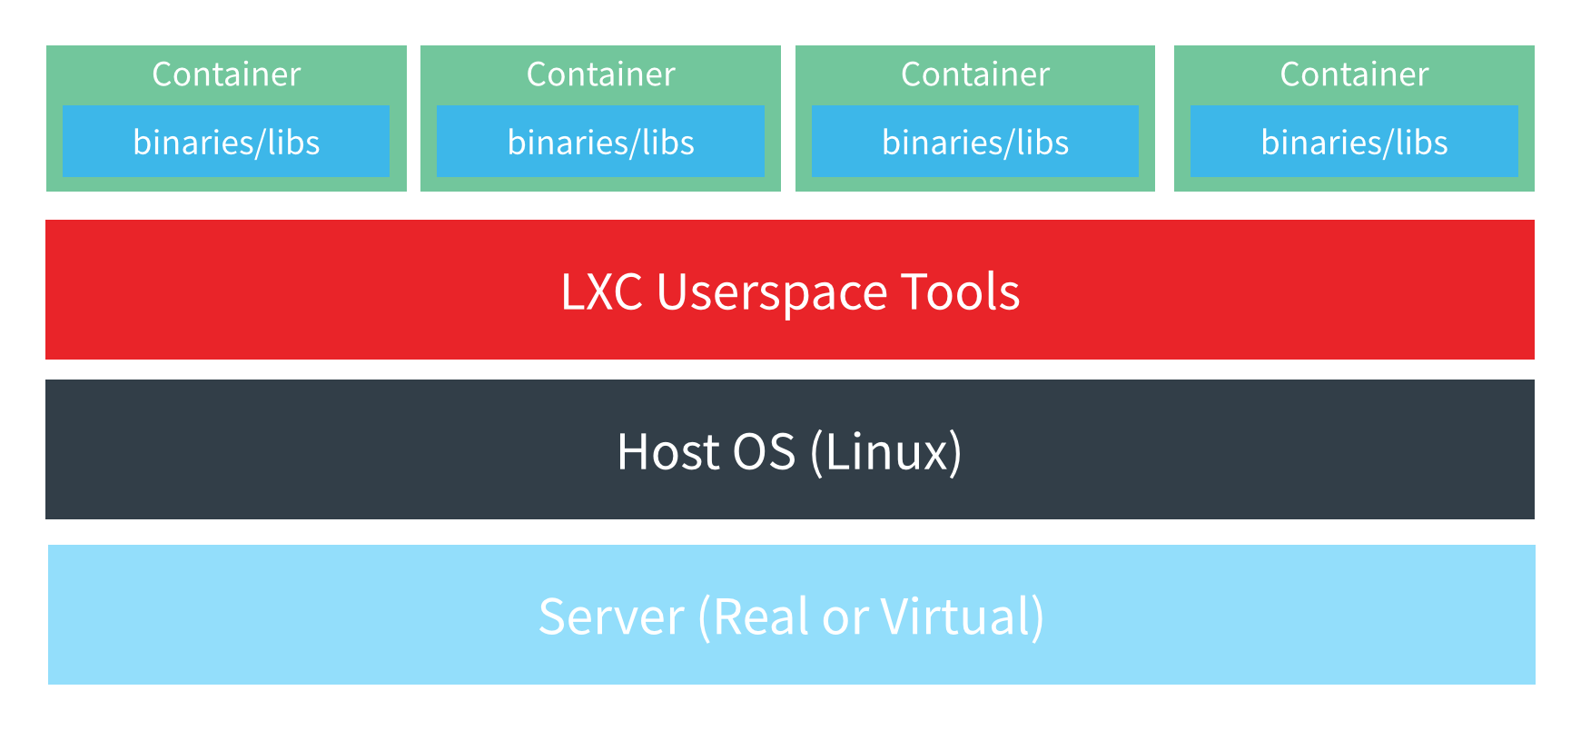
Operating-system-level virtualization

Slide 9
What is Docker

Slide 10
Docker
Makes use of Operating-system-level virtualization
Implements a High Level API to manage the creation and deployment of containers (sandbox environments)
A thin extra layer between your application and a native software container
Open source
Notes:
Software

Slide 11
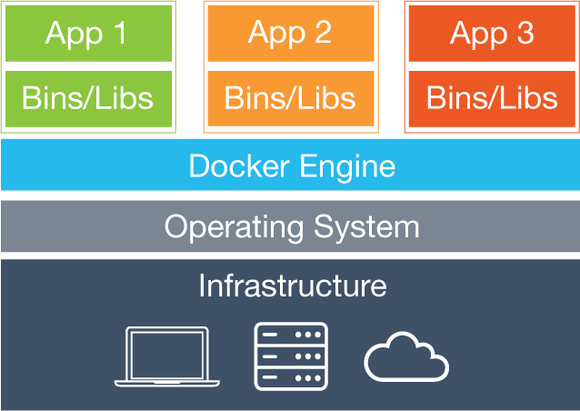
Docker

Slide 12
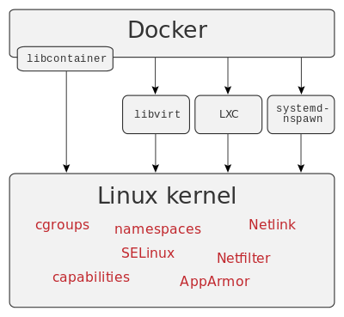
Docker

