Slide 1
C4 Architecture Model
Level Reference + KnowledgeForge Extraction
Context · Container · Component
KnowledgeForge Thesis Reference · March 2026

Slide 2
Three Levels of Abstraction
Each level zooms deeper, serving a different audience and answering a different question.
L1: Context
L2: Container
L3: Component
Question
What does the system do and who uses it?
Question
What are the major deployable / runnable units?
Question
What are the key building blocks inside a container?
Audience
C-level, product, external stakeholders
Audience
Engineering leadership + architects + devs/ops
Audience
Developers working inside a specific container
Shows
System as a black box + users + external systems
Shows
Apps, databases, message brokers, APIs
Shows
Services, controllers, repos, modules

Slide 3
Level 1: System Context
Purpose
The big picture: system as a single box, surrounded by its users and external systems.
Must Include
• Your system (single named box)
• People / user roles
• External systems (email, payment, SSO)
• Labeled relationship arrows
Do NOT Include
• Internal containers, databases, queues
• Technology choices or protocols
Example: Context Diagram
Developer
KnowledgeForge
[Software System]
Clones
Enriches
Git Repository
[External System]
LLM API
[External System]

Slide 4
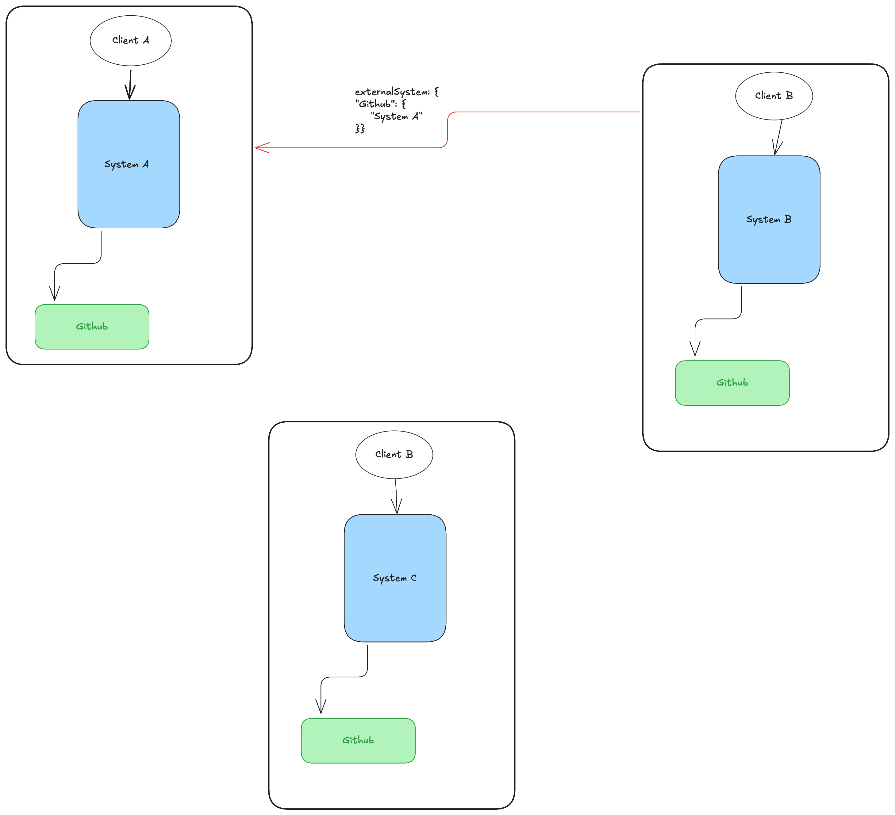
Discussion:
How to label external systems?
Idea:
- Dictionary + llms + hitl
Notes:
This is a core design problem for KnowledgeForge. Let me think through the approaches.
Your DependencyDetector already has the right instinct with NUGET_DEPENDENCY_MAP (60+ entries) and the SaaS mappings for Python/npm. But the question is: what's the general, deterministic rule that makes this work across any ecosystem?
There are really only a few signals you can check without an LLM:
1. Curated SDK mapping (what you already do)
A maintained dictionary: library name → external system. This is the most reliable. stripe → Stripe, boto3 → AWS, @sendgrid/mail → SendGrid. The problem is coverage: there are thousands of SDK libraries and you'll never map them all. But in practice, the long tail doesn't matter much because the top 200 or so SDKs cover the vast majority of real-world integrations.
2. Library metadata inspection
This is where it gets interesting for a deterministic approach. Package registries (PyPI, npm, Maven Central) expose metadata you can check:
Package description/keywords. If the PyPI description says "client for" or "SDK for" or "API wrapper", it's almost certainly wrapping an external service. You can regex for patterns like client for *, SDK for *, wrapper for *, interface to *.
Homepage URL. If the package homepage points to stripe.com, aws.amazon.com, twilio.com, it's an SDK for that service. You could maintain a domain → service mapping rather than a package → service mapping, which scales better.
Package name conventions. Many SDKs follow naming patterns: azure-*, aws-cdk-*, google-cloud-*, @slack/*, twilio, sentry-sdk. Prefix/suffix matching catches a lot.
3. Import pattern analysis in code
Instead of just scanning requirements.txt, scan the actual source code for how the library is used:
If code constructs an HTTP client, URL, or connection string using the library → it's talking to something external.
If code only does in-process computation (data transforms, parsing, math) → it's not.
But this crosses from "deterministic" into "heuristic" territory and gets expensive.
4. Network-level classification
The most principled deterministic rule: does this library, by definition, require a network connection to function?
You can classify libraries into categories:
CategoryExternal system?DetectionCloud provider SDKsYesPrefix match: boto3, azure-*, google-cloud-*, @aws-sdk/*SaaS API clientsYesCurated map + "client/SDK/wrapper" in package descriptionDatabase driversProduces a Container, not external systemCurated list: psycopg2, pymongo, mysql-connector, redisMessage broker clientsProduces a Containerkafka-python, pika (RabbitMQ), celeryComputation/utilityNoEverything else (default)Dev/test toolingNoIn devDependencies or [tool.pytest] or known list
The cleanest deterministic pipeline would be:
For each dependency in manifest:
1. Is it in dev-only section? → skip
2. Match against curated SDK map → emit external system
3. Match against DB driver list → emit L2 container (not L1 external)
4. Match against broker client list → emit L2 container
5. Match cloud provider prefix (aws-*, azure-*, google-cloud-*) → emit external system with inferred service
6. (Optional) Fetch package metadata from registry, check description for "client/SDK/API" patterns → emit candidate
7. Everything else → tech stack label, not an external system
Steps 1 through 5 are fully deterministic. Step 6 is deterministic too but requires network access to the package registry, which you may or may not want.
The key insight for your thesis: the mapping is finite and maintainable because the number of external services people actually integrate with is much smaller than the number of libraries. There are maybe 500 distinct external services in common use (cloud providers, payment, email, auth, monitoring, analytics, CRM, etc.), and each has 1 to 3 SDK libraries per language. A curated map of ~1500 entries across Python/npm/NuGet/Maven covers the vast majority of real-world projects. The long tail of obscure integrations is where LLM enrichment picks up the slack, which is why your pipeline already has LLM as an optional second pass.
The one genuinely hard edge case: generic HTTP client libraries like requests, axios, httpx. These imply the code talks to something external, but you can't know what from the dependency alone. That's where your env file / URL scanning in DependencyDetector comes in. The library itself isn't the signal. The URLs in config are.

Slide 5
KnowledgeForge: Context Extraction (L1)
Orchestrator: ContextManager (runs after L2 containers are extracted)
SystemDetector
System name (package.json, pyproject, README, sln, LLM fallback)
purpose from README, languages by file count, frameworks from indicators
actors from README, git metadata (commits, contributors, DORA)
regulatory frameworks (PCI, GDPR, HIPAA)
DependencyDetector
External deps from requirements/package.json/NuGet (60+ mappings)
docker-compose image → service type
env files for URLs
deployment deps from IaC (Helm, Terraform)
freshness alerts for pinned versions
MetadataDetector
Owner (CODEOWNERS → README → git log → LLM)
domain inference from paths + tech stack
status lifecycle (ACTIVE/MAINTENANCE/DEPRECATED/ARCHIVED from commit velocity)
tier (1/2/3 from keywords + dependency count)
data_class (PII/Credit-Card/Legal/General)
bus factor (experts covering 80% of commits)
compliance risk score (composite of all signals)

Slide 6
Level 2: Container Diagram
Purpose
Zoom into the system boundary. Show high-level tech choices and how responsibilities are distributed across deployable units.
Must Include
• Web apps, APIs, workers, CLIs
• Shared databases and caches
• Message brokers / queues / topics
• Technology labels + relationship protocols
Do NOT Include
• Internal classes, modules, functions
• K8s pods, load balancers (infra details)
Example: Container Diagram
KnowledgeForge [System Boundary]
Web Frontend
[React SPA]
REST
API Server
[Python / FastAPI]
C4 Pipeline
[Python / tree-sitter]
SQL
Cypher
PostgreSQL
[Database]
Neo4j
[Graph DB]

Slide 7
L2 Practical: What Belongs at Container Level?
Sources: c4model.com official guidance, Blewitt (2024) practitioner recommendations
YES — Model as Container
NO — Push Down to L3 or Omit
Shared databases
Used by multiple services → first-class citizen at L2
Message brokers (Kafka, RabbitMQ)
c4model.com: model individual queues/topics as containers, not the broker itself. Or simplify by putting queue names on arrows.
Backend APIs, web apps, mobile apps
Separately deployable → always a container
Serverless functions, workers, cron jobs
If independently deployed/invoked
Shared blob/object storage
S3 buckets used by multiple services
Private databases
"If a team uses MongoDB internally, that's an implementation concern" → push to L3 component
The broker itself (e.g. "Kafka cluster")
Model queues/topics, not the infrastructure running them. Broker = deployment detail.
Load balancers, service mesh, K8s pods
Infrastructure plumbing, not architectural containers. Use deployment diagrams instead.
Internal classes/modules
That's L3 Component territory.
Private caches (in-process Redis)
Only model at L2 if shared across containers

Slide 8
KnowledgeForge: Container Extraction (L2)
Orchestrator: ContainerManager — runs first, feeds results to L1 ContextManager
StructureDetector
Base layer
Walks repo, finds framework manifests (Dockerfile, package.json, pom.xml, go.mod, Cargo.toml...)
Infers container_type, technology, protocol
GitOps detection for ArgoCD. Root suppression when sub-services exist.
ComposeDetector
Parses docker-compose.yml services
Extracts image → type (postgres → DB, redis → Cache), depends_on → relationships with inferred protocol, healthcheck endpoints, shared volumes.
HelmDetector
Scans Chart.yaml files
Extracts subchart deps, ingress endpoints, liveness probes. values.yaml env scan for service URLs
Always overrides runtime/deployment fields to Kubernetes/Helm.
TerraformDetector
Parses *.tf resource blocks for passive infra:
aws_db_instance → Database
aws_sqs_queue → Message Queue
aws_s3_bucket → Object Storage
lambda → Serverless.
Merge: slug-based identity matching, fill-missing-only (no overwrite), Helm always overrides runtime fields. Then optional LLM enrichment pass for descriptions + missing relationships.

Slide 9
Level 3: Component Diagram
Example: Components of API Server
Purpose
Zoom into a single container. Show key structural building blocks and their interactions.
Must Include
• Components: logical groupings with clear responsibility
• Technology/pattern (Service, Repository, Controller)
• Inter-component interactions
• Connections to other containers + external systems
• Private DBs demoted from L2 live here
Do NOT Include
• Every class/function (that's L4 Code)
• Private methods, field types
API Server [Container]
API Router
[Controller]
C4 Context
Service
[Service]
C4 Container
Service
[Service]
C4 Component
Service
[Service]
Graph Repo
[Repository]
LLM Enricher
[Service]
→ Neo4j
→ LLM API

Slide 10
KnowledgeForge: Component Extraction (L3)
Orchestrator: ComponentExtractor — chains A → B → C → D per container
A
Parse
tree-sitter AST parsing with language-specific visitors (Python, Java, TypeScript, Go)
Extracts CodeElements: classes, functions, decorators, imports, framework roles (controller / service / repository).
▼
B
Graph
Build weighted dependency graph (NetworkX)
Three edge types: structural (imports, inheritance, calls), directory proximity (same dir = 0.3, parent/child = 0.15), semantic (TF-IDF cosine similarity on tokenized names > 0.5).
▼
C
Group
Two-tier strategy:
(1) Framework detection (Spring/Django/FastAPI/NestJS matchers, confidence > 0.5) groups by domain prefix.
(2) Louvain community detection on remainder with post-processing (merge singletons, split clusters > 15).
▼
D
Enrich
Optional LLM pass: improve component names, generate descriptions, infer responsibility and layer. Graceful fallback to static-analysis names if LLM unavailable.
Confidence: framework = 0.9, community = 0.6, singleton = 0.3.

Slide 11
C4 Rules to Remember
Every element is named + described
No anonymous boxes. Name, description, technology label (L2+).
Every relationship is labeled
"Reads events from" not just a bare line. Direction matters.
Each level has a single parent scope
L2 inside one system. L3 inside one container.
Show external deps at every level
People and external systems from L1 reappear in L2/L3.
Abstractions, not implementation
L2: "PostgreSQL" not "pg_hba.conf". L3: "UserService" not every method.
Model queues/topics, not the broker
c4model.com: individual queues as containers, or queue names on arrows.

Slide 12
References & Resources
Primary Source
Brown, S. (2018). The C4 Model. https://c4model.com | Queues & Topics: c4model.com/abstractions/queues-and-topics
Brown, S. (2026). The C4 Model. O'Reilly Media (forthcoming).
Practitioner Guidance
Blewitt, J. (2024). The C4 Model in Practice. https://jamesblewitt.net/the-c4-model-in-practice/
Tournois, A. (2021). C4 model and agility: documenting architecture at ADEO. Medium / ADEO Tech Blog
Tooling
Structurizr DSL & Lite — https://structurizr.com | Architecture as Code — https://aac.geon.se/06_structurizr/
Research (C4 + LLM)
Szczepanik & Chudziak (2025). Collaborative LLM Agents for C4 Architecture Design Automation. arXiv:2510.22787
Amalfitano et al. (ECSA 2025). Automated SA Design Recovery from Source Code Using LLMs. Springer LNCS 15929
Research (Architecture Recovery)
Bucaioni et al. (2025). AI for Software Architecture: Lit Review and the Road Ahead. arXiv:2504.04334
Savidis & Savaki (2022). SA Mining from Source Code with Dep Graph Clustering. VISIGRAPP

Slide 13
Notite:
Context:
Where should you look?
Configs, dockerfiles: images, cmds? Project files, scripts.
- Diff languages, what about shell scripts?
To not forget? Competency questions with llms during the process. We use llms mostly for enhancement, does it make sense to integrate them in the code more -> more decisions, more realiability?
TODO: Common CLAUDE.MD with the whole architecture
Decisions:
NO CODE level anymore
Create a project simulation for testing

Slide 14
1. Core Ledger Service (omnipay-ledger) - Iulia
Language/Framework: Java / Spring Boot.
Purpose: The source of truth for user balances and transaction processing.
Key Files: pom.xml, Dockerfile, CODEOWNERS (assigned to multiple developers).
What KnowledgeForge will show off: * Level 3: Your Phase A Spring framework matcher beautifully identifying @RestController, @Service, and @Repository layers.
Level 2: StructureDetector pulling the pom.xml and Dockerfile.
2. Fraud Detection Engine (omnipay-fraud-ml) - Vlas
Language/Framework: Python / FastAPI.
Purpose: Analyzes transactions in real-time for suspicious patterns.
Key Files: requirements.txt, Dockerfile, .env.example (containing fake OpenAI/DataDog API keys), git log (manipulated so only one dev ever commits).
What KnowledgeForge will show off:
Level 1: Your MetadataDetector flagging this as "Critical" tier, "High Data Sensitivity," and—crucially—a Bus Factor of 1 based on the Git log.
Level 3: The Louvain community detection separating the data-science/pandas functions from the FastAPI routing logic.
3. Client API Gateway (omnipay-gateway) - Vlad
Language/Framework: TypeScript / NestJS.
Purpose: The Backend-For-Frontend serving the mobile apps.
Key Files: package.json, docker-compose.yml (spinning up this service alongside a Redis cache container).
What KnowledgeForge will show off:
Level 2: The ComposeDetector parsing the docker-compose.yml to automatically draw the dependency between the Gateway and Redis.
Level 3: NestJS AST framework matchers grabbing modules and controllers.
4. Webhook & Notification Worker (omnipay-notifier) - Iulia
Language/Framework: Go.
Purpose: Listens to message queues and dispatches SMS/email receipts.
Key Files: go.mod, Dockerfile.
What KnowledgeForge will show off:
Level 1: DependencyDetector mapping known Go SDKs (e.g., Twilio, SendGrid) to external SaaS boundaries.
Level 3: Go AST visitor checking structural edges and imports.
5. Infrastructure & Orchestration (omnipay-infra) -Iulia
Tech Stack: Terraform & Helm.
Purpose: Provisions the AWS environment and Kubernetes clusters.
Key Files: main.tf, variables.tf, Chart.yaml, values.yaml.
What KnowledgeForge will show off:
Level 2: TerraformDetector finding the RDS Postgres database and S3 buckets. HelmDetector mapping the deployments. Your slug-based identity matching will seamlessly link the GitHub repos to this infrastructure.
6. Card Network Integration (omnipay-card-router). - Vlad
Language/Framework: C# / ASP.NET Core (.NET 8) with Entity Framework Core.
Purpose: The highly secure service that actually talks to external credit card networks (like Visa, Mastercard, or a dummy "GlobalBank API") to authorize holds and captures.
Key Files to Include: OmniPay.CardRouter.csproj, appsettings.json, Dockerfile, and a tightly controlled CODEOWNERS file.
What KnowledgeForge will show off:
Level 2 (Container): Your StructureDetector will walk the filesystem, spot the .csproj file as the framework manifest, and parse the Dockerfile to establish it as a core container.
Level 1 (Context): * MetadataDetector: Because this handles raw credit card data, this service should be tagged with the highest "Criticality Tier," an extreme "Data Sensitivity Class" (PCI-DSS level), and a severe "Compliance Risk Score."
DependencyDetector: It will parse the appsettings.json or environment files to find the external URLs for the banking networks, mapping a clear boundary to external SaaS/Banking systems.
Level 3 (Component): * Phase A: Your tree-sitter AST visitor for C# will parse the source code to find framework roles.
Phase C: Your framework pattern matchers will specifically hunt for ASP.NET Core and Entity Framework signatures—such as classes decorated with [ApiController], [Route(...)], and classes inheriting from DbContext or implementing
custom repository interfaces.

