Slide 1
Russian History
1st seminar
Senior Lecturer
Aksenova Maria Dmitrievna

Slide 2
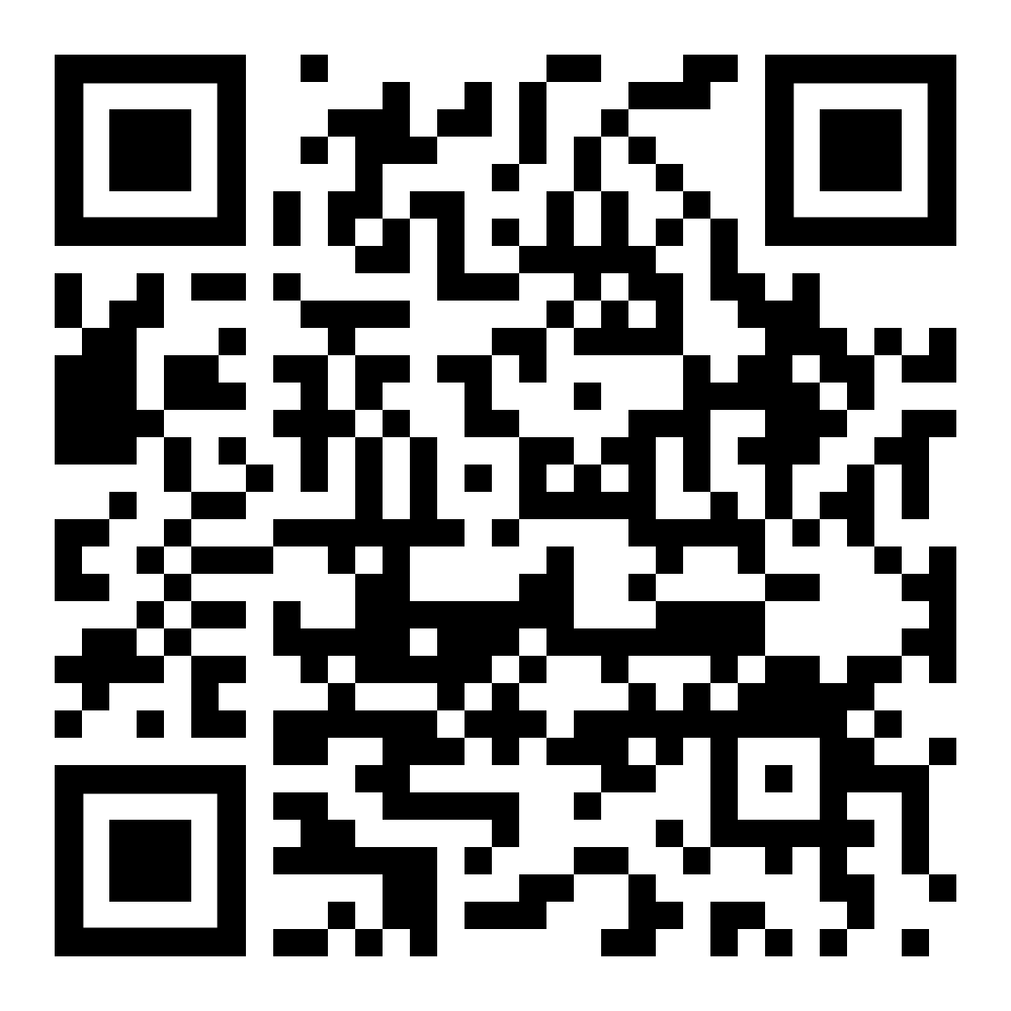
Structure
Homework for 1st module
1-4 module
30 seminars:
6 seminars – 1st module
8 seminars – 2nd module
9 seminars – 3rd module
7 seminars – 4th module
22 lectures:
Online-course in SmartLMS
8 lectures by teacher:
3 lectures – 3rd module
5 lectures – 4th module
https://disk.360.yandex.ru/i/YHk8U5C9g4nFzA

Slide 3
Final mark
1 semester
0,29 seminars (1st module) + 0,29 seminars (2nd module) + 0,21 SmartLMS + 0,21 exam
2 semester
0,25 seminars (3rd module) + 0,25 seminars (4th module) + 0,2 project + 0,15 SmartLMS + 0,15 exam
Both exams block all other received marks!

Slide 4
Some important info (1)
Work in SmartLMS means that you should watch online lectures and do some tasks and tests for each topic
This kind of work will be accounted in accordance with your marks for each task and due to the scale:
0-29 % - 0 points
30 - 39% - 4 points
40-49% - 5 points
50-69% - 6 points
70-79 % - 7 points
80-89% - 8 points
90-95% - 9 points
96-100% - 10 points
Tasks will be available for a limited time!

Slide 5
Some important info (2)
Activity on seminars means activity related to seminar, not just attending and remaining silent
Marks 9-10 are given only for the answers that exceed seminar’s requirements in terms of knowledge of literature
In case of the absence on the seminar: only 1 additional task for one missed seminar per module. You will need to read literature for the seminar and write an answer for 2-3 questions based on the literature. You will need to send this task to our assistant no later than 10 days after missed seminar! After this deadline tasks will not be accepted.
Mostly seminars will be organized in the form of discussion.

Slide 6
Some important info (3)
Project topics and formats will be presented at the beginning of 2nd semester
Exams will take place in SmartLMS without proctoring system
1st exam will be on winter session (2nd half of December)
2nd exam will be on summer session (2nd half of June)
If you will not pass the exam, it will fully block other received parts of mark and you will get unsatisfactory final mark!

Slide 7


Slide 8
What is history?
Teoriya i metodologiya istoricheskoy nauki. Terminologicheskiy slovar' / Otv. red. A. O. Chubar'yan. M.: Akvilon, 2014. S. 191.
HISTORY [Dr.-Greek ioxopia - story about the past] - 1) the process of development of nature and society; 2) a story, an incident, the process of development of something; 3) a complex of social sciences (historical science), which studies the past of mankind in all its concreteness and multifacetedness. Modern historical science consists of separate sections and branches. ... General history is divided primarily into the history of primitive society, the history of the most ancient civilizations (Egypt, China, Sumer, etc.) and ancient history (Ancient Greece and Ancient Rome), united in the history of the ancient world, as well as the history of the Middle Ages, modern history (17th – 19th centuries) and, finally, contemporary history, which includes the 20th – early 21st century.

Slide 9
Historical sources (1)
A historical source is ...
anything from which information about the past can be derived - any object, monument of the past, etc.
a carrier of information on the basis of which the historian reconstructs the social and historical reality he is studying.
objectified result of human creative activity/cultural product used to study/understand a person, society, culture.
documents are traces left by the thoughts and actions of people who once lived.
source can be "everything that, belonging to man, depends on him, serves him, expresses him, signifies his presence, activities, tastes and ways of being human"

Slide 10
Historical sources (2)
types (according to the difference in the principles of information storage and coding): written, material, ethnographic, oral, linguistic, audiovisual
kinds of historical source - a historically formed set of sources, which is characterized by the uniformity of the internal form of the source (structure), resulting from the unity of origin, content, purpose of the source at its creation: memoirs, letters, periodicals, accounting documents, statistics, etc.
criterion of "purposefulness" of the author of the source
subjectivity

Slide 11
Working with sources
Primary sources and secondary sources
How do historians work with sources?
Analysis + synthesis
Analysis: Preparatory measures - Origin analysis - Content analysis
Synthesis: Consideration of the source as a sociocultural phenomenon
Problems:
Accessibility
Preservation

