Slide 1

Vladimir Mikheev
Junior Data Analyst

Slide 2
Working experience
National Research University Higher School of Economics
Vision Modeling Lab
Centre for Computational Educational Sciences
Criteo

Slide 3
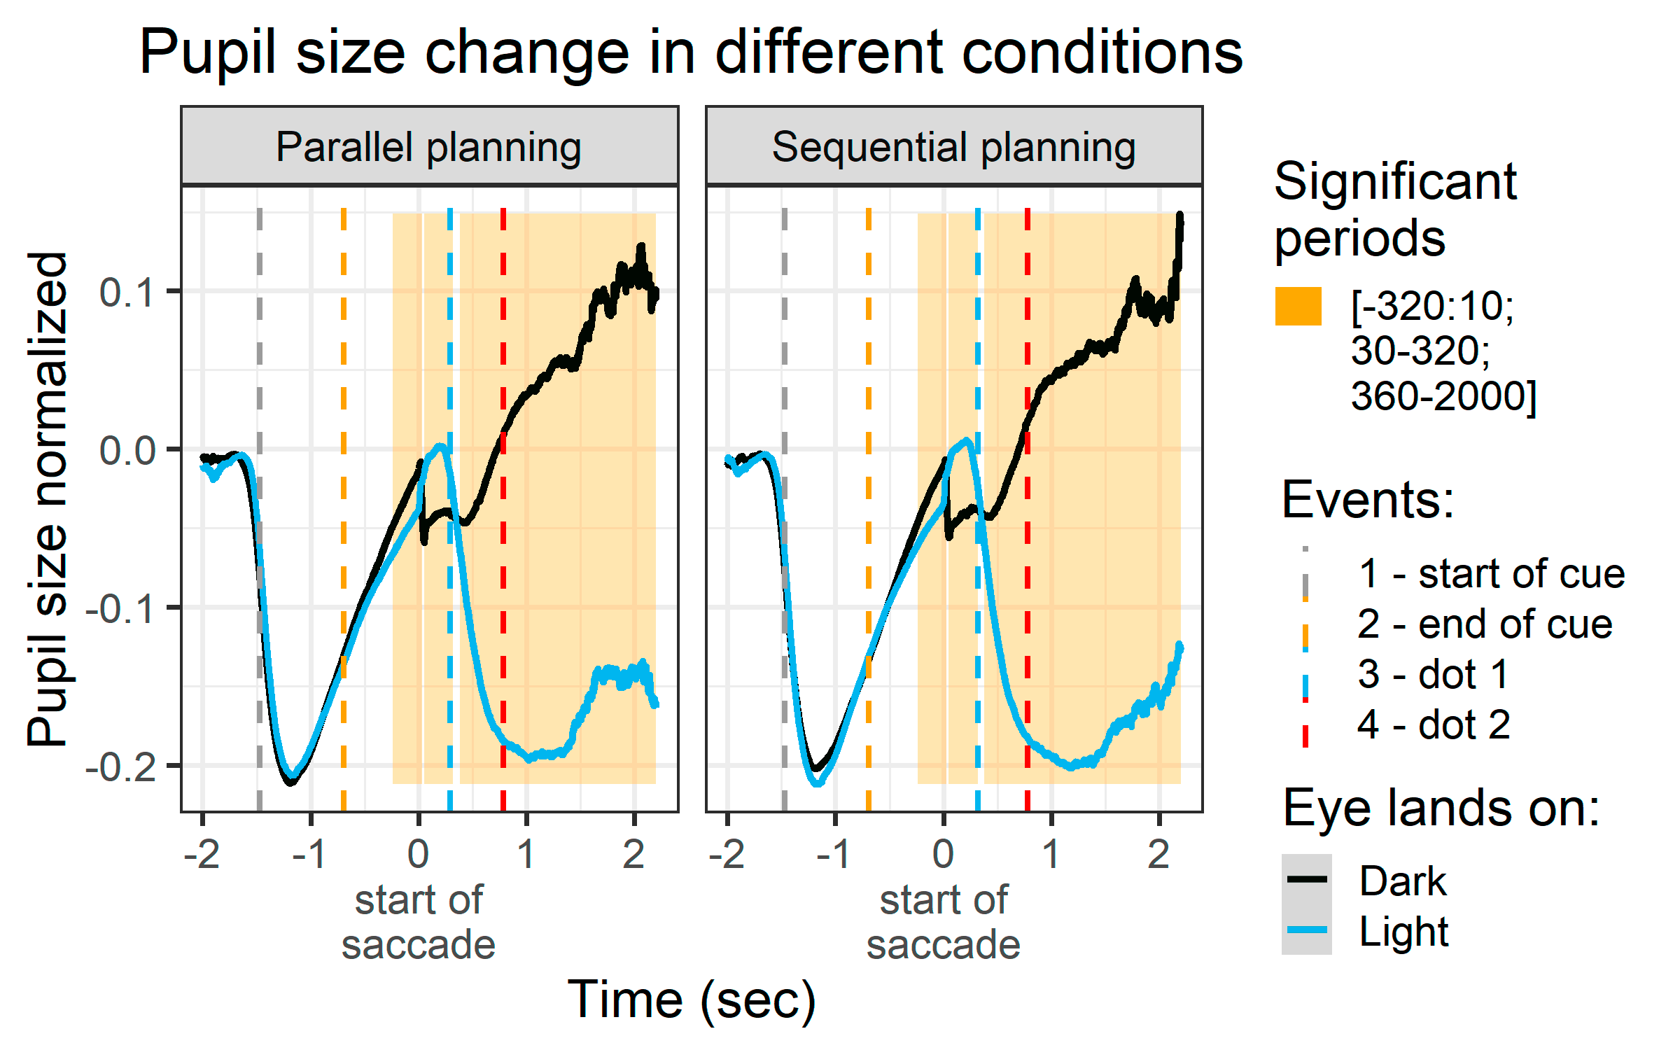
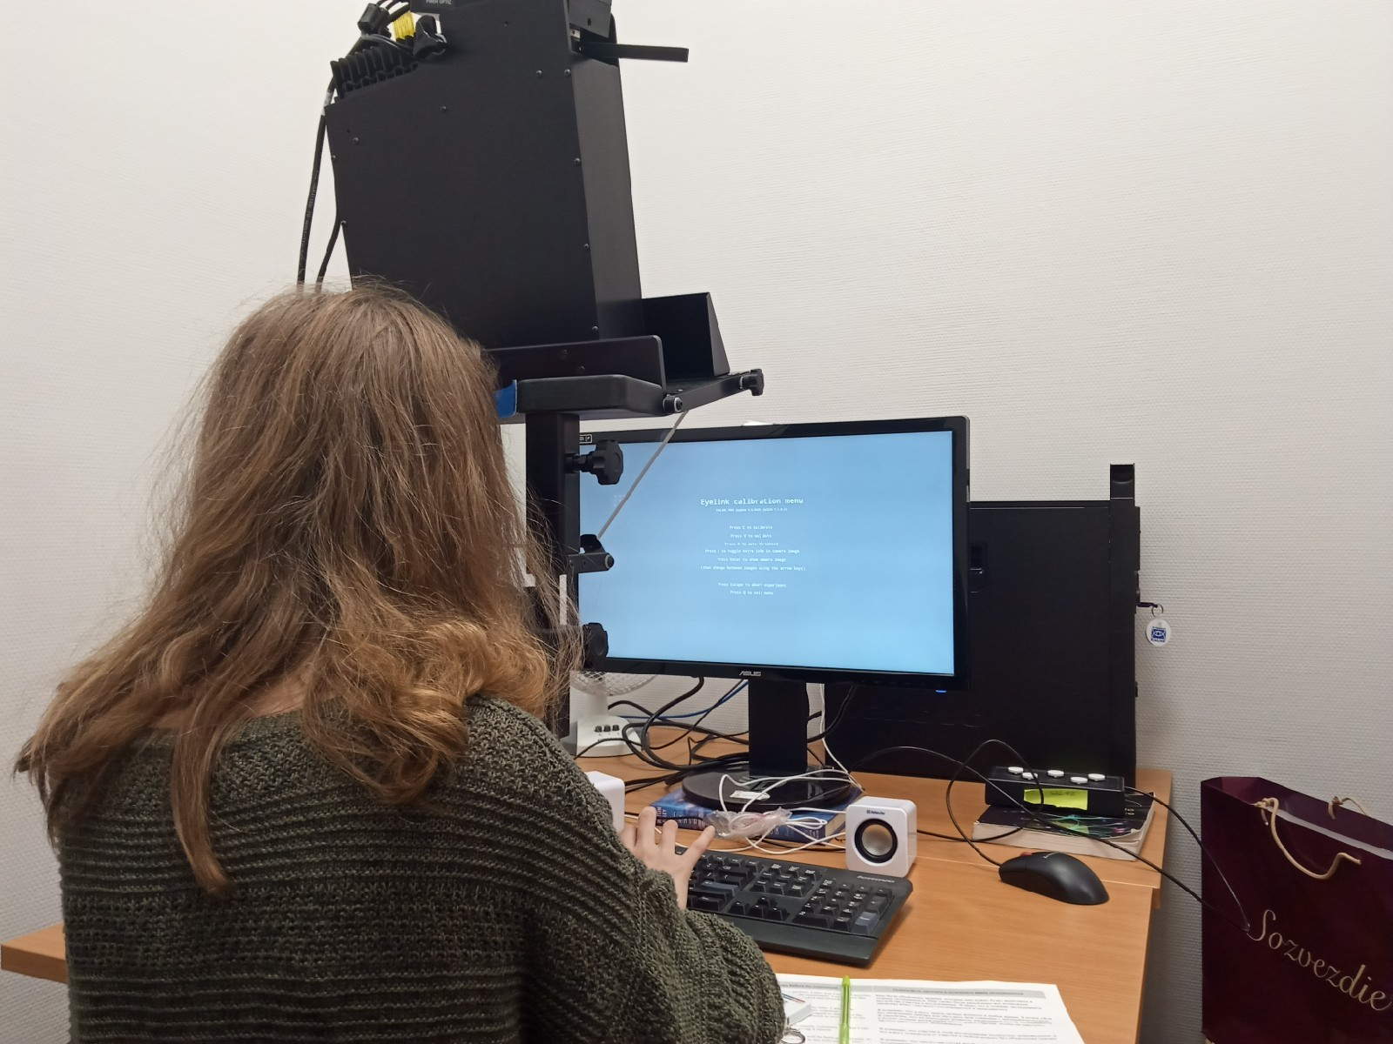
Vision Modeling Lab
design, programming and conduction of eye tracking experiments;
parsing of eye tracker logs and analysis of results.

Slide 4
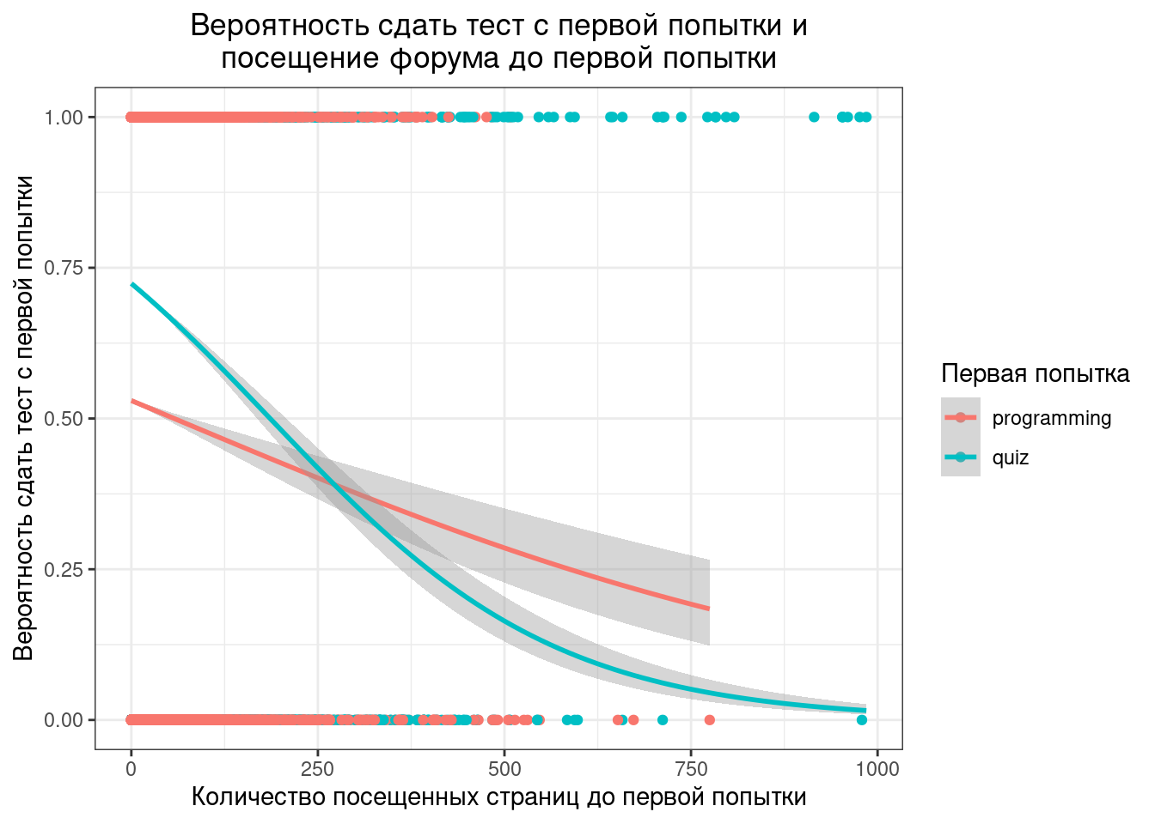
Centre for Computational Educational Sciences
API retrieval, parsing and analysis of students' activity logs on Coursera platform;
analytical reports for Direction of Online Education in HSE;
teaching of statistics on the program of professional retraining in HSE.

Slide 5
Skills: Communication
Russian: Native;
English: C1 (IELTS, 2017 - 7);
English speaking Master program;
4-month Internship in Catholic University of Leuven, Belgium (2016-2017);
Prizewinner of Science Slam HSE (2019, 2020).

Slide 6



Skills: Programming and Analyses
R:
ggplot2, data.table, dplyr, glmer, pscl, aer, Rmarkdown;
Python:
numpy, pandas, matplotlib, requests, Django;
SQL
Tableau
Generalized Linear Mixed Models

