Slide 1
Image Search in Big Database
Coord. Lect.dr. Ignat Anca

Slide 2
Outliner
The problem and requirements
Proposed System
Architecture and technologies used
Diagrams
Optimization

Slide 3
The problem and requirements
The problem: Given a query image, retrieve similar images from a large database of images.
Requirements:
Implement a search system that has the following mandatory characteristics:
scalable
robust
heterogeneous
correctness and efficiency

Slide 4
Proposed system
A system that stores the image database in a distributed manner on different machines so it can execute image queries in parallel way.
Main Components:
File Master
File Slave

Slide 5
Technologies used
JavaEE - servlets, JSF
AspectJ - used for implementing the logging and security component
OpenCV – used for different image processing procedures
JSONSimple – library used for creating and parsing the messages send between modules

Slide 6
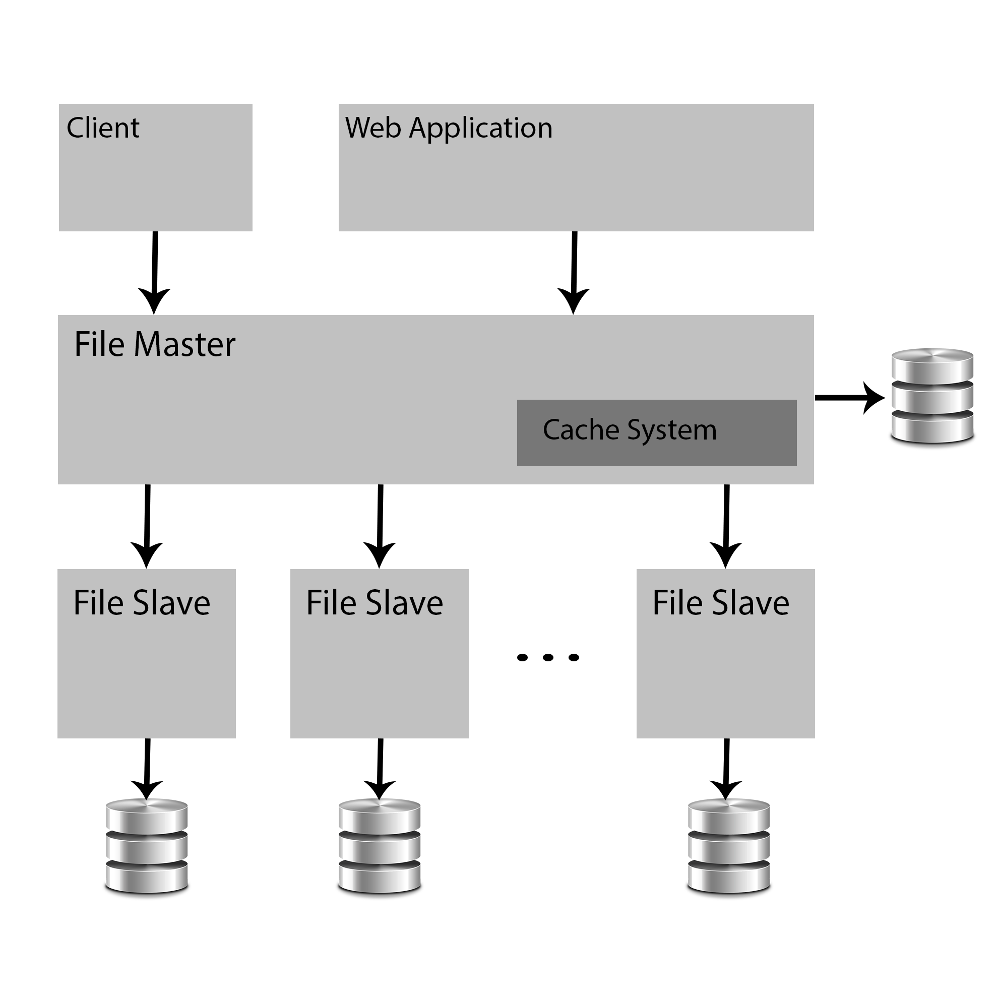
Arhitecture

Slide 7
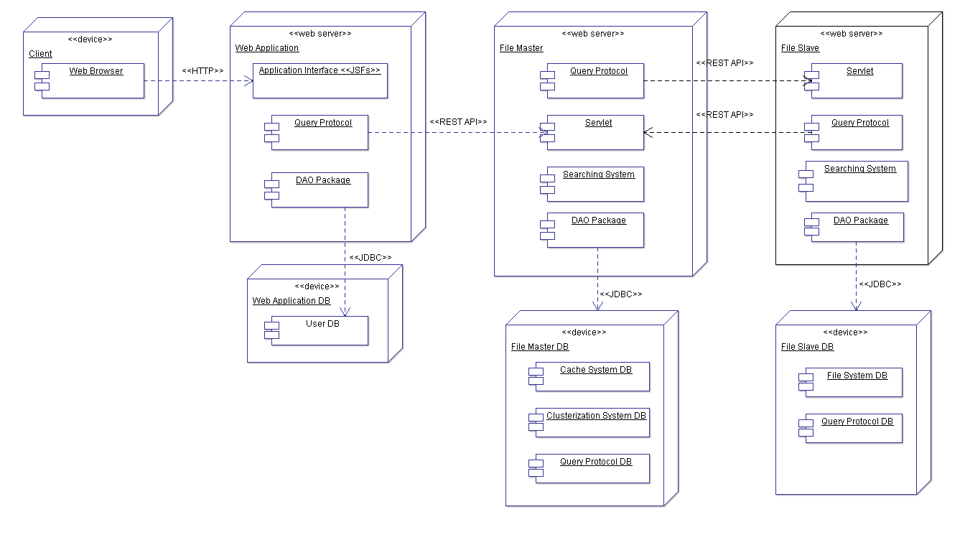
Deployment Diagram

Slide 8
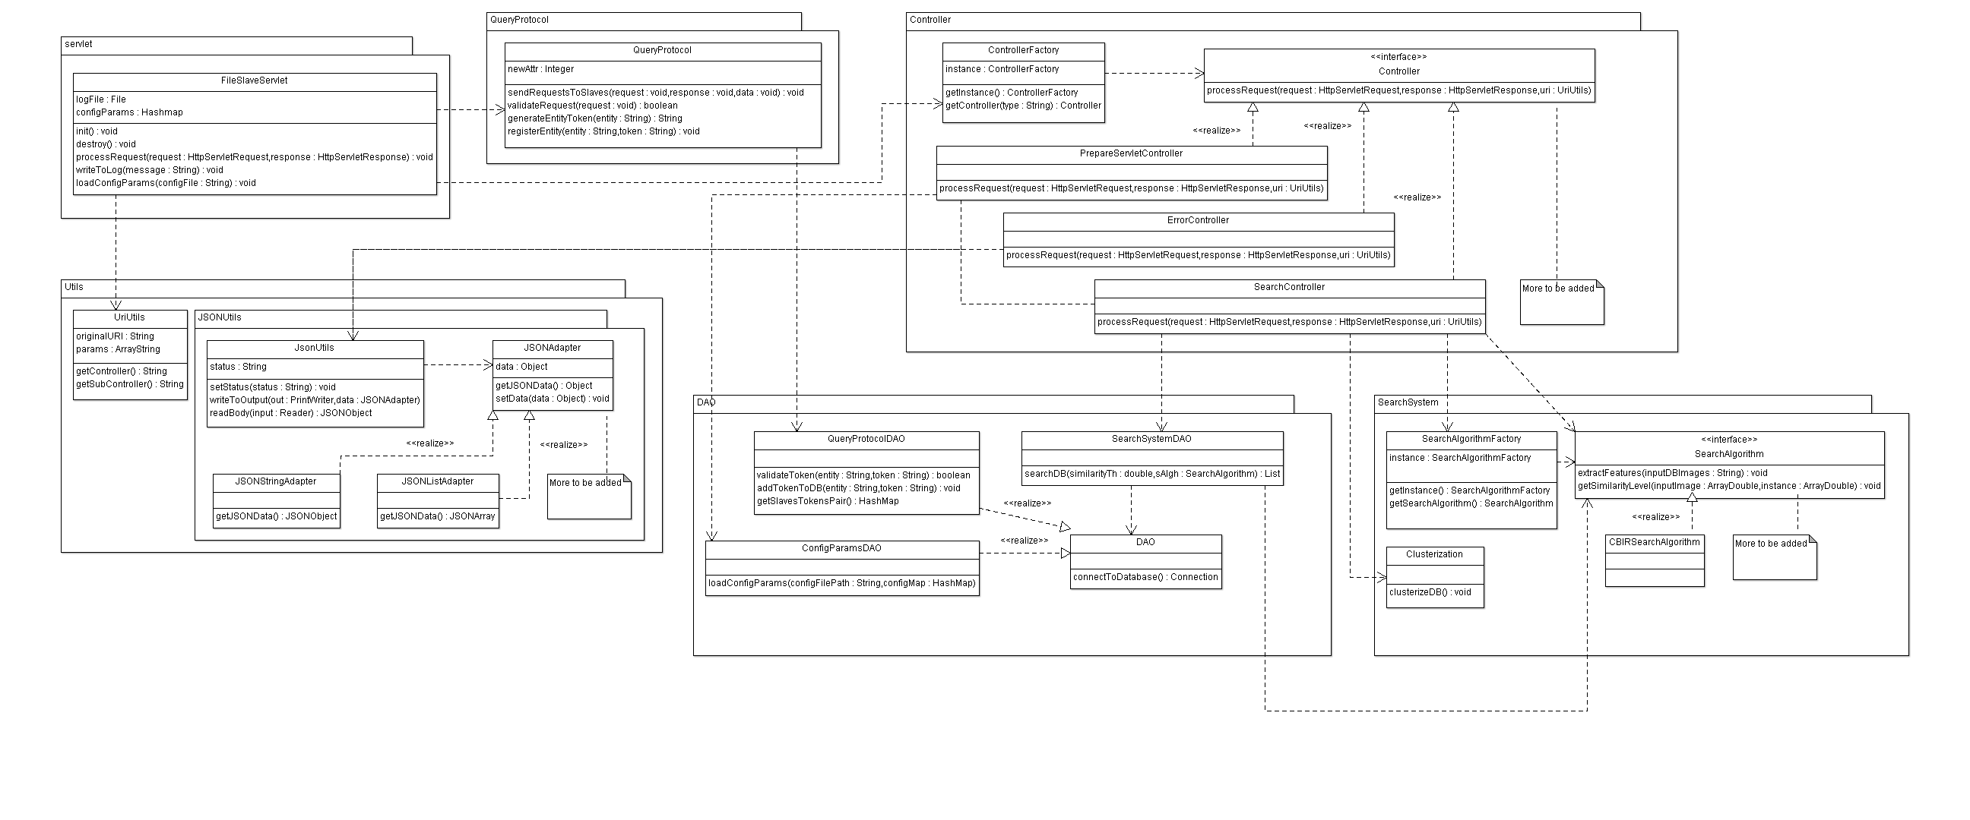
Class Diagram – File Slave

Slide 9
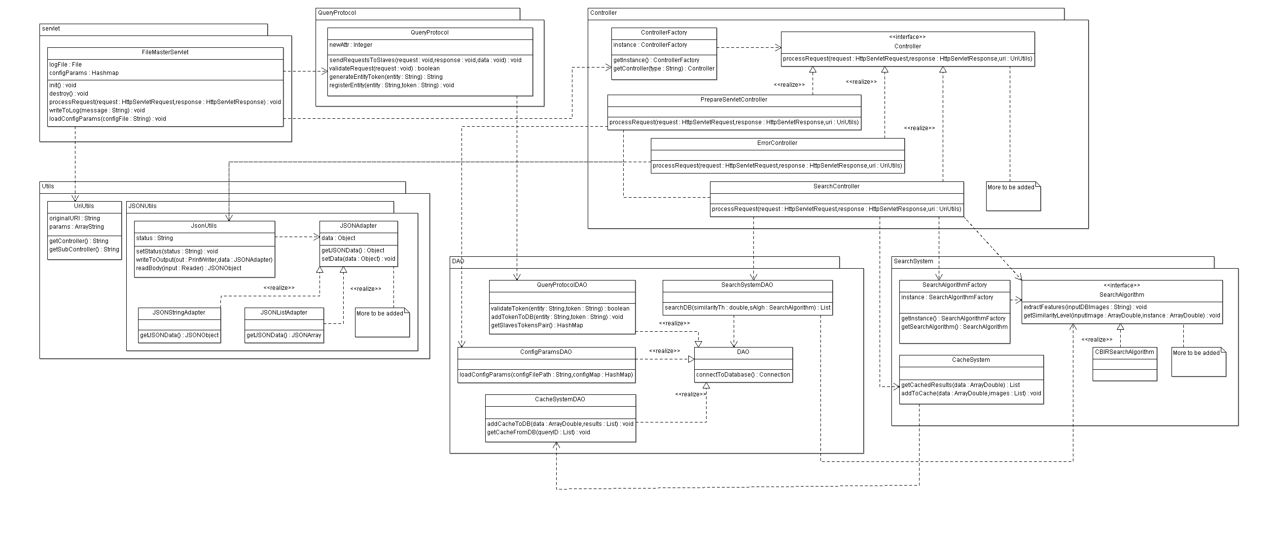
Class Diagram – File Master

Slide 10
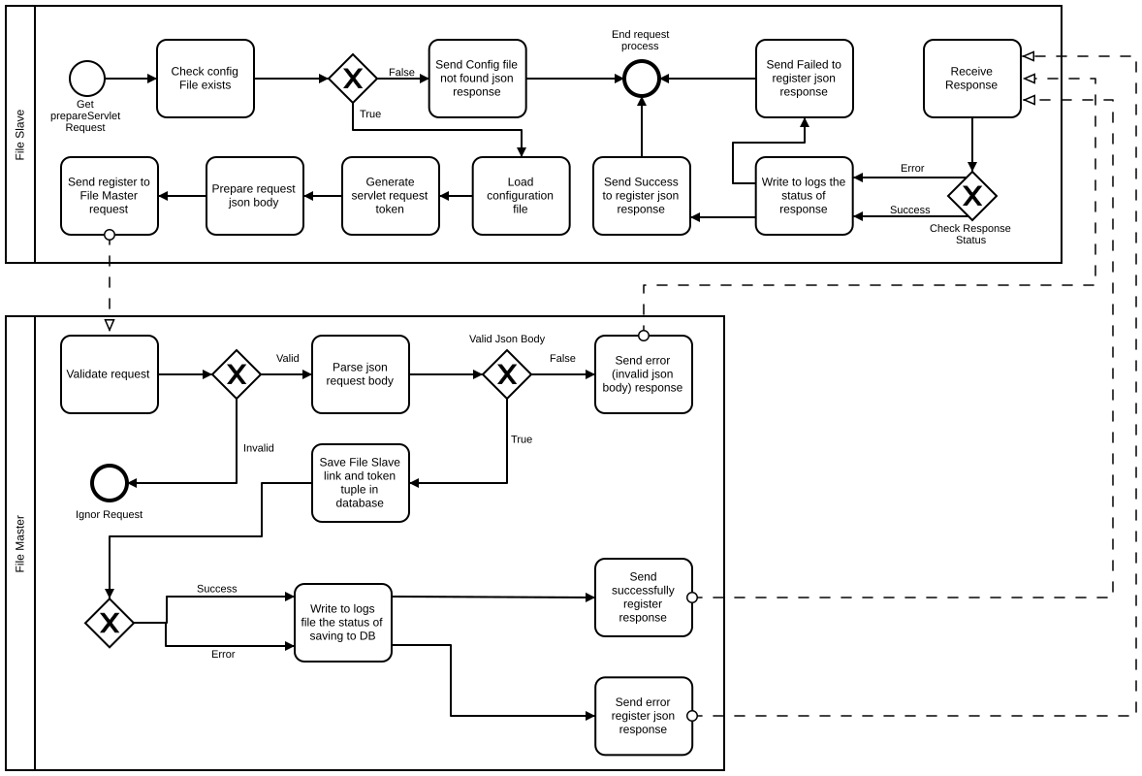
BPMN diagram

Slide 11
Example of JSON message structure used
{
"data":[
{
"similarity":"0.708",
"link":"https://s-media-cache-ak0.pinimg.com/originals/4b/b2/85/4bb2852cb354b0ad89dfa1a97ef2f6fa.jpg"
},
{
"similarity":"0.11",
"link":"http://pop.h-cdn.co/assets/cm/15/05/54cb1d27a519c_-_analog-sports-cars-01-1013-de.jpg"
},
{
"similarity":"0.2689",
"link":"http://pop.h-cdn.co/assets/cm/15/05/54cb1d27a519c_-_analog-sports-cars-01-1013-de.jpg"
},
{
"similarity":"0,0657",
"link":"https://s-media-cache-ak0.pinimg.com/originals/4b/b2/85/4bb2852cb354b0ad89dfa1a97ef2f6fa.jpg"
}
],
"message":"null",
"status":"success"
}

Slide 12
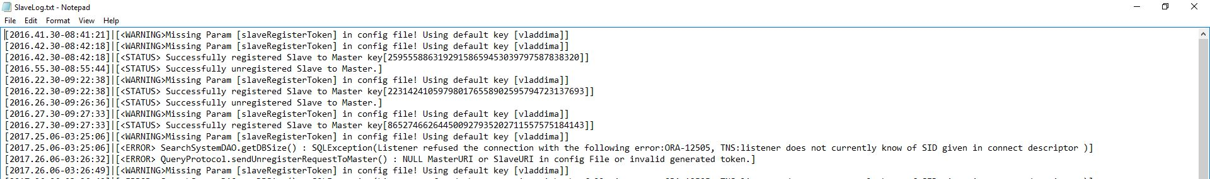
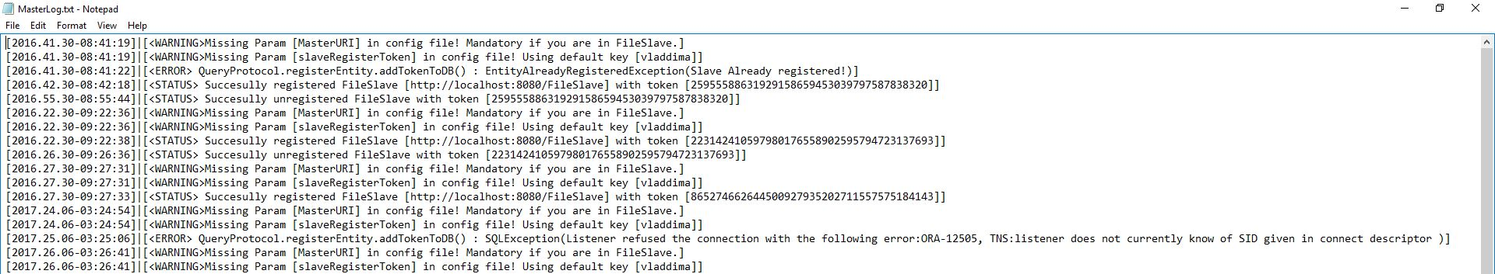
Example of logs

Slide 13
Optimization
Use of a clusterization algorithm (k-means):
Optimization in terms of
Processing : search for corresponding cluster and sort instances of that cluster by similarity level
Memory usage : 8500 * 382 * 8 V.S. 40 * n * 382 * 8 ( n – number of instances from a cluster)
Use of a caching system
Optimization in terms of processing
Use of OpenCV library for image processing and feature vector extraction
Optimization in terms of processing power

