Slide 1
LABLAB.AI HACKATHON · APR 2026
+1.09%
AI Trading Agent
Paper P&L
182
Trades
Autonomous · Verifiable · On-Chain
89/100
Reputation
Multi-agent BTC trading pipeline with ERC-8004 identity,
EIP-712 checkpoints, and Kraken execution — deployed live on Railway.
594
Checkpoints
$55K
Prize Pool
ERC-8004 · EIP-712 · Kraken CLI · Sepolia · Railway · Redis · Svelte · FastAPI

Slide 2



THE CHALLENGE
AI agents are opaque.
No auditability. No trust.
Black-Box Decisions
No On-Chain Identity
Unvalidated Risk
Trades happen without explainability or verifiable reasoning trails.
AI agents lack persistent identity, reputation, or attestation.
No on-chain risk gating before execution — catastrophic in volatile markets.

Slide 3
OUR SOLUTION
A fully autonomous, verifiable AI trading agent
with on-chain identity and live execution.
1
2
3
4
Market Analyst
Trader Agent
Risk Manager
Execute + Attest
Fetches OHLC, orderbook & ticker via Kraken CLI. Computes RSI, MACD, Bollinger, ATR in Python — not by the LLM.
Proposes BUY / SELL / HOLD with position sizing. Structured JSON output via Gemini / Mistral fallback.
APPROVE, RESIZE, or VETO before any execution. Enforces concentration limits and volatility guards.
Kraken CLI executes (paper mode). EIP-712 checkpoint signed and posted to Sepolia via ERC-8004 registry.

Slide 4
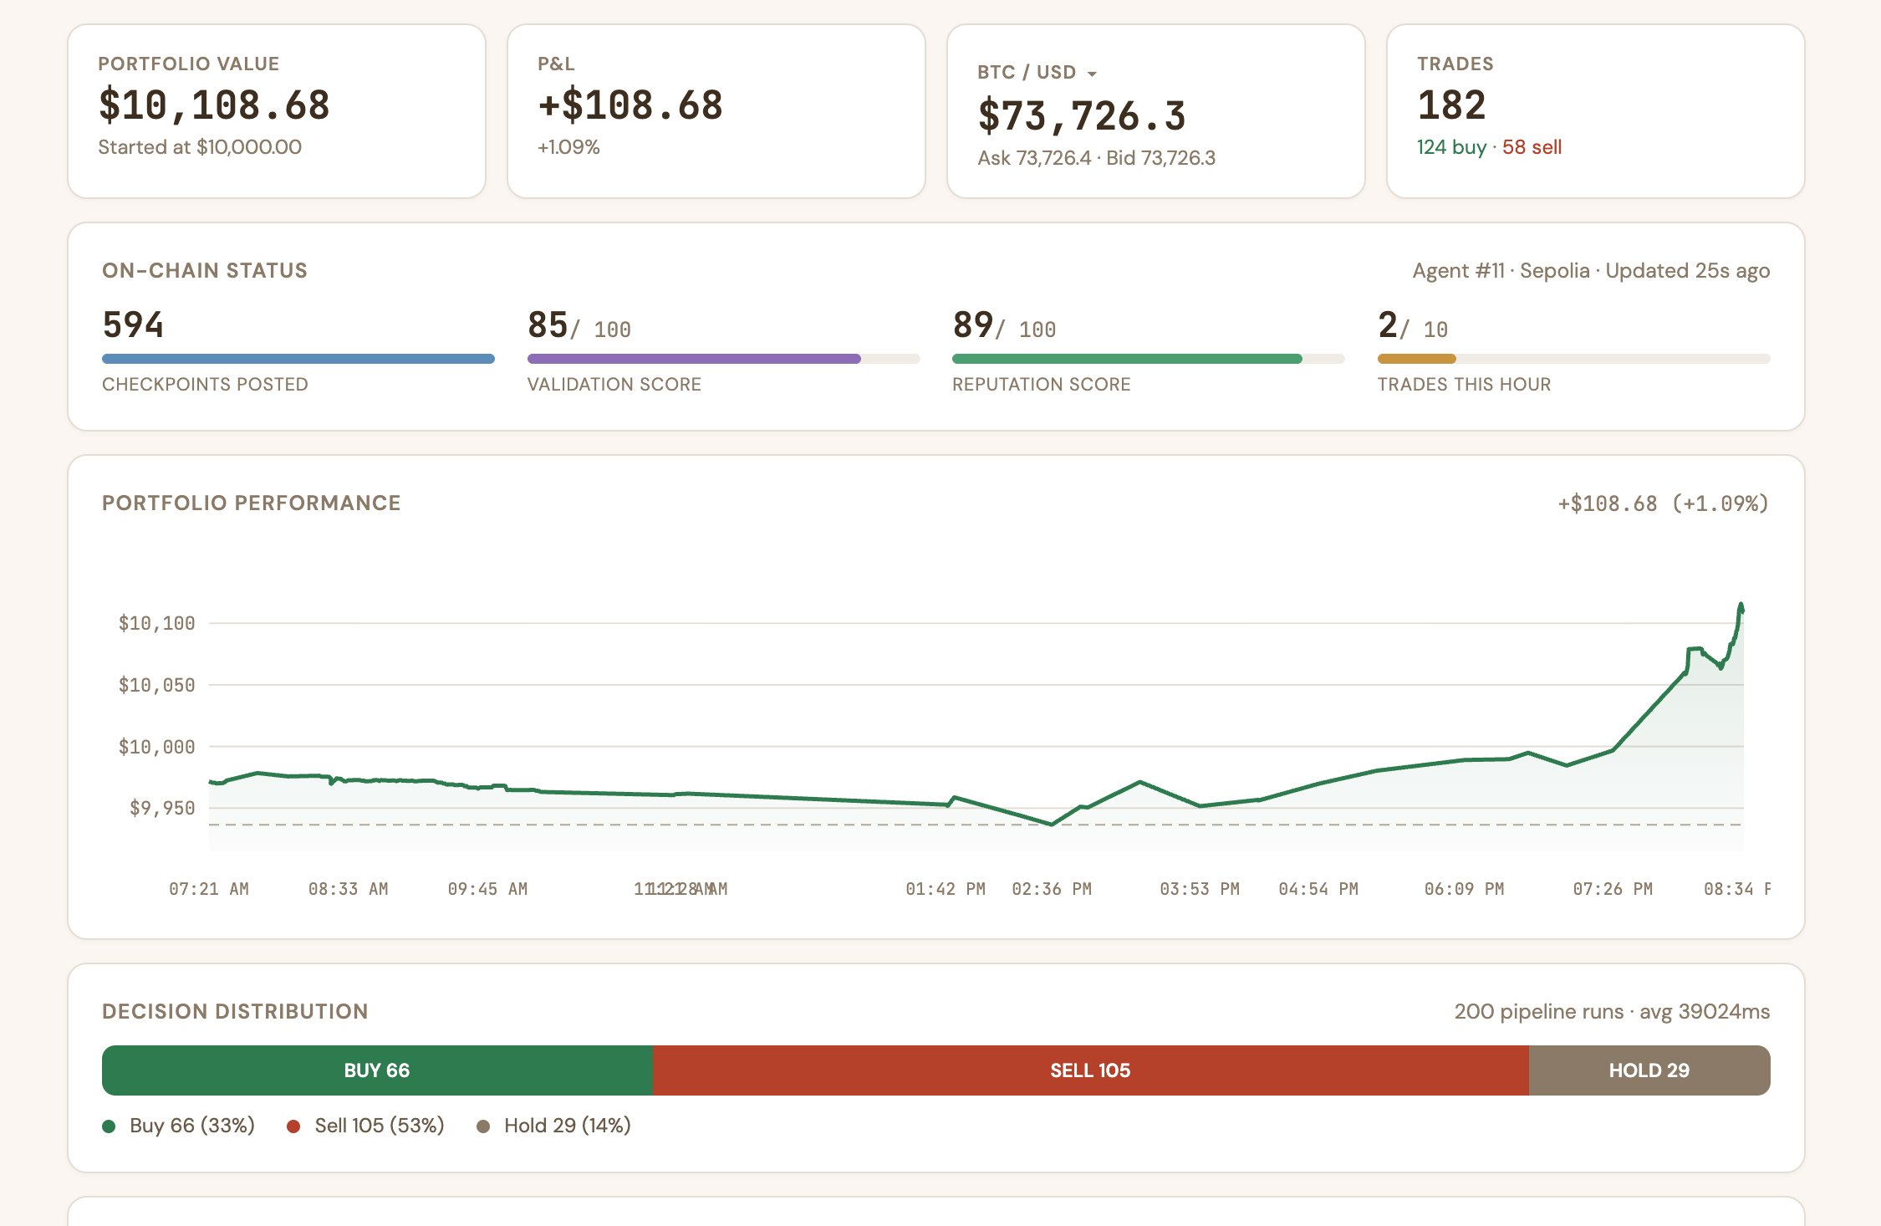
LIVE PERFORMANCE
Real-time dashboard — paper trading on Kraken BTC/USD

Slide 5
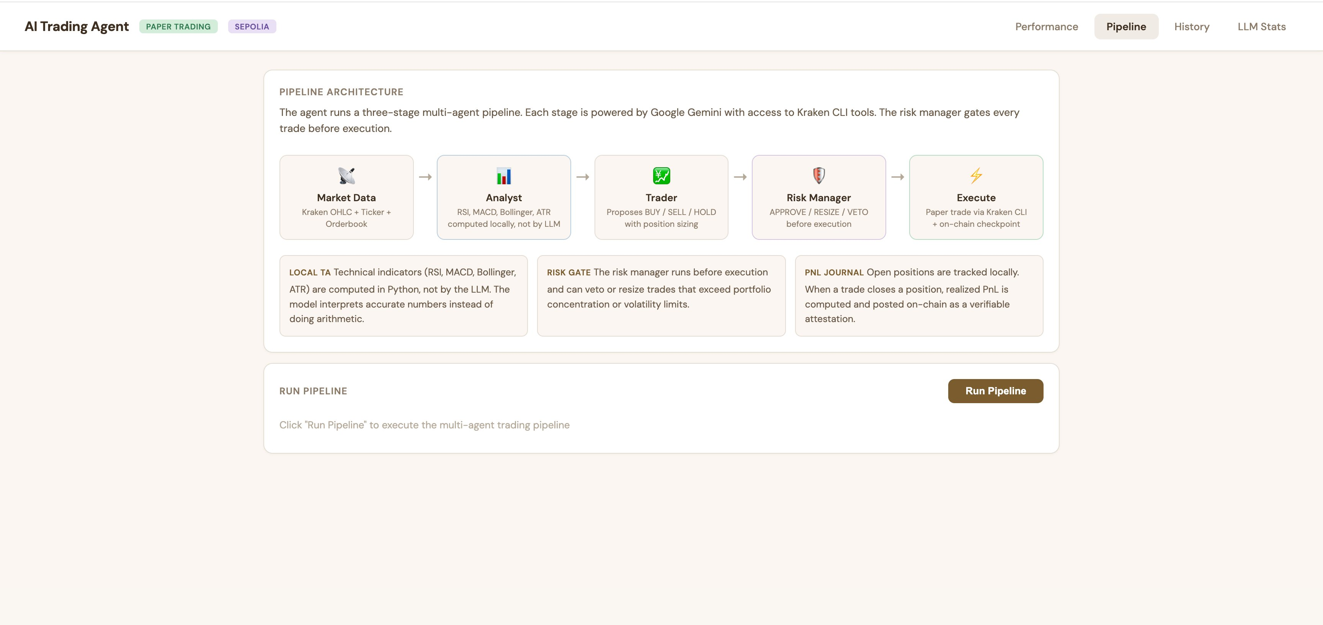
PIPELINE ARCHITECTURE
Three-stage multi-agent pipeline, each powered by Gemini / Mistral

Slide 6





FULL-STACK DEPLOYMENT
Production-grade infrastructure, live on Railway
FRONTEND
Real-time dashboard: performance, pipeline, history, LLM stats
Svelte
BACKEND
Agent pipeline API — structured outputs, Gemini/Mistral LLMs, TA indicators
FastAPI (Python)
AGENT LOOP
npm run agent — polls every 3 min, executes Kraken CLI, posts ERC-8004 on-chain
Node.js / TS
DATA STORE
Persistent checkpoints, trade history, pipeline run log across all services
Redis
ON-CHAIN
ERC-8004 Registry, RiskRouter, EIP-712 checkpoints, ValidationRegistry
Solidity / Sepolia

Slide 7
ON-CHAIN TRUST LAYER
ERC-8004 Agent Identity + EIP-712 Checkpoints
Agent Registry
// Verify a checkpoint
Persistent on-chain identity for the trading agent (Agent #11, Sepolia)
import { verifyCheckpoint }
from './checkpoint.js'
const
valid = verifyCheckpoint(
checkpoint,
AGENT_REGISTRY_ADDRESS,
11155111, // Sepolia
EXPECTED_SIGNER
);
// true ✓
Reputation Score
89/100 reputation, updated per trade — trustless verifier can inspect
Validation Registry
Attestations for every key action: intents, risk checks, PnL realisation
EIP-712 Checkpoints
594 signed checkpoints in checkpoints.jsonl — cryptographically verifiable
Risk Router Contract
On-chain gating: validateTrade() must approve before any execution

Slide 8
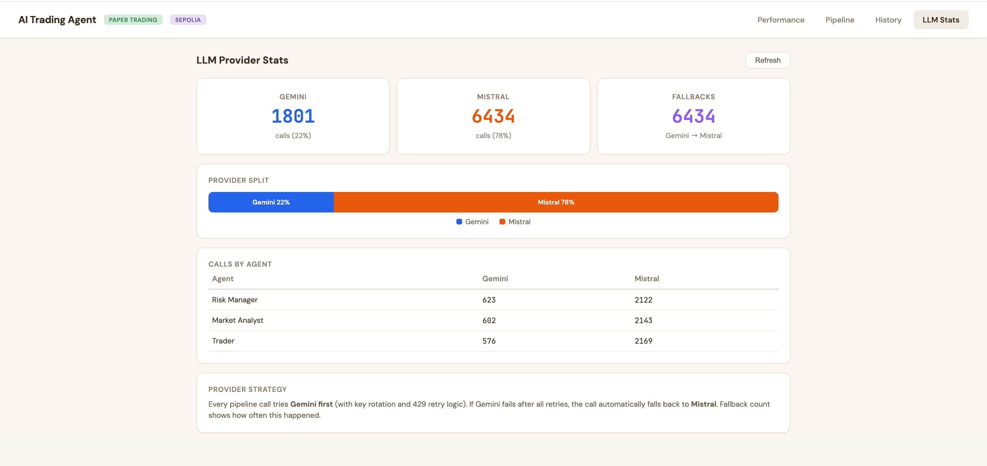
LLM PROVIDER STATS
8,235 total LLM calls · automatic Gemini → Mistral fallback

Slide 9
RESULTS
Everything running live, all day, all hackathon
+1.09%
182
200
Paper P&L
Trades Executed
Pipeline Runs
$10,108 from $10,000
124 buy · 58 sell
avg 39s latency
594
85/100
8,235
Checkpoints
Validation Score
LLM Calls
EIP-712 signed on Sepolia
On-chain quality signal
Gemini 22% · Mistral 78%

Slide 10
WHAT WE BUILT
A production trading agent
that is trustless by design.
✦ Multi-agent AI pipeline (Market Analyst → Trader → Risk Manager)
✦ Live Kraken paper trading, every 3 minutes, around the clock
✦ ERC-8004 on-chain identity + EIP-712 signed decision checkpoints
✦ Full-stack Railway deployment: Svelte · FastAPI · Redis · Node.js
✦ Automatic Gemini → Mistral fallback — zero downtime
Built for the LabLab.ai AI Trading Agents Hackathon · March 30 – April 12, 2026

