Slide 1
Angular. Angular CLI. Components
Information Technology Video Developer Network http://itvdn.com

Slide 2
Angular CLI
The Angular CLI is a command line interface tool that can create a project, add files, and perform a variety of ongoing development tasks such as testing, bundling, and deployment.

Slide 3
Установка Angular CLI
npm install -g @angular/cli
ng new my-app
ng serve --open

Slide 4
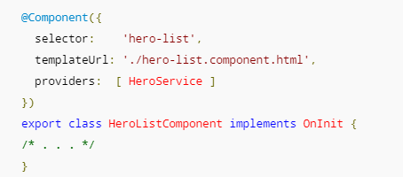
Компоненты
Представление части отображения на странице.
Взаимодействует с отображением.

Slide 5
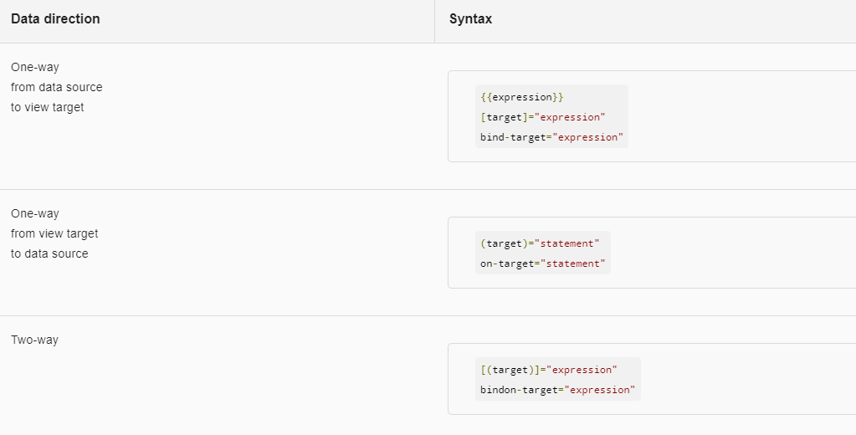
Template expressions

Slide 6
Взаимодействие между компонентами
  import { Component } from '@angular/core';
  @Component({
  selector: 'my-app',
  template: `<child-comp [userName]="name" [userAge]="age"></child-comp>
  <input type="text" [(ngModel)]="name" />`
  })
  export class AppComponent {
  name: string = "Tom";
  age: number = 24;
  }
  import { Component, EventEmitter, Input, Output} from '@angular/core';
  @Component({…})
  class ChildComponent {
  …
  @Input() userName: string;
  @Input() userAge: string;
  …
  }

Slide 7
Привязка к событиям дочернего компонента
  import { Component, EventEmitter, Input, Output} from '@angular/core';
  @Component({…})
  class MyComponent {
  …
  @Output() onChanged = new EventEmitter<boolean>();
  …
  }

Slide 8
Шаблонные переменные
  @Component({
  selector: 'child-comp',
  template: `<p>{{counter}}</p>`
  })
  export class ChildComponent{
  counter: number = 0;
  increment() { this.counter++; }
  decrement() { this.counter--; }
  }
  @Component({
  selector: 'my-app',
  template: `<child-comp #counter></child-comp>
  <button (click)="counter.increment()">+</button>
  <button (click)="counter.decrement()">-</button>`
  })
  export class AppComponent { }

Slide 9
ViewChild
  @Component({
  selector: 'child-comp',
  template: `<p>{{counter}}</p>`
  })
  export class ChildComponent{
  counter: number = 0;
  increment() { this.counter++; }
  decrement() { this.counter--; }
  }
  @Component({
  selector: 'my-app',
  template: `<child-comp></child-comp>
  <button (click)="increment()">+</button>
  <button (click)="decrement()">-</button>`
  })
  export class AppComponent {
  @ViewChild(ChildComponent) private counterComponent: ChildComponent;
  increment() { this.counterComponent.increment(); }
  decrement() { this.counterComponent.decrement(); }
  }

Slide 10
ContentChild
  @Component({
  selector: 'child-comp',
  template: `<ng-content></ng-content>
  <button (click)="change()">Изменить</button>`
  })
  export class ChildComponent{
  @ContentChild("headerContent") header: HTMLElement;
  change() {
  this.header.nativeElement.textContent = "Hell to world!";
  }
  }
  @Component({
  selector: 'my-app',
  template: `<child-comp>
  <h3 #headerContent>Добро пожаловать {{name}}!</h3>
  </child-comp>`
  })
  export class AppComponent {
  name: string = "Tom";
  }

Slide 11
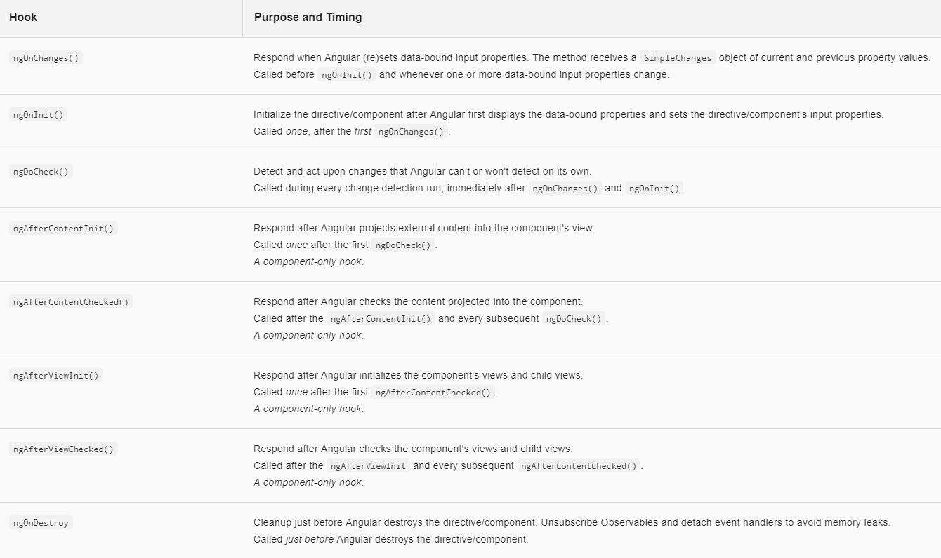
Lifecycle Hooks

Slide 12
Ресурсы
https://angular.io/
https://metanit.com/web/angular2/

Slide 13
Q&A

