Slide 1

Twitter Sentiment Analysis With Various Tools
By Vladislav Dubrovenski

Slide 2
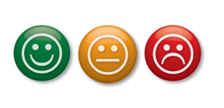
What is Sentiment Analysis
Main goal is to determine authors attitude.
Can be implemented in various ways.
Positive, negative, neutral

Slide 3
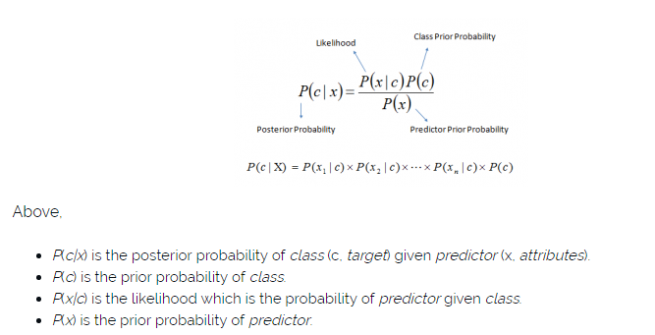
Naive Bayes classifier
My implementation uses NLTK Dictionary for sentiment calculation
Classifier is being trained using positive and negative tweets obtained from NLTK
https://www.analyticsvidhya.com/blog/2015/09/naive-bayes-explained/

Slide 4
Why do we care about sentiments and Naive Bayes?
Finding negative and positive comments about a particular product.
Can be used as a spam filter.
Naive Bayes classifier is superior in terms of CPU and memory consumption[1]
Trend analysis help determine what is more popular on the market or during the elections.
http://citeseerx.ist.psu.edu/viewdoc/download?doi=10.1.1.141.751&rep=rep1&type=pdf

Slide 5
Part 1
Python
Getting real time data in JSON format using Twitter Streaming API
Create dictionaries from positive and negative tweets obtained from NLTK
Since these sample data tweets were classified using smiles, remove them, and create 2 dictionaries.
Combine these two dictionaries and train the Naive Baes Classifier

Slide 6
Part 1
Load the data obtained from twitter API.
Process each tweets
Using regex remove www, http, @, and hashtags.
Classify it as positive or negative(eliminate neutrals)
Put them in a data frames

Slide 7
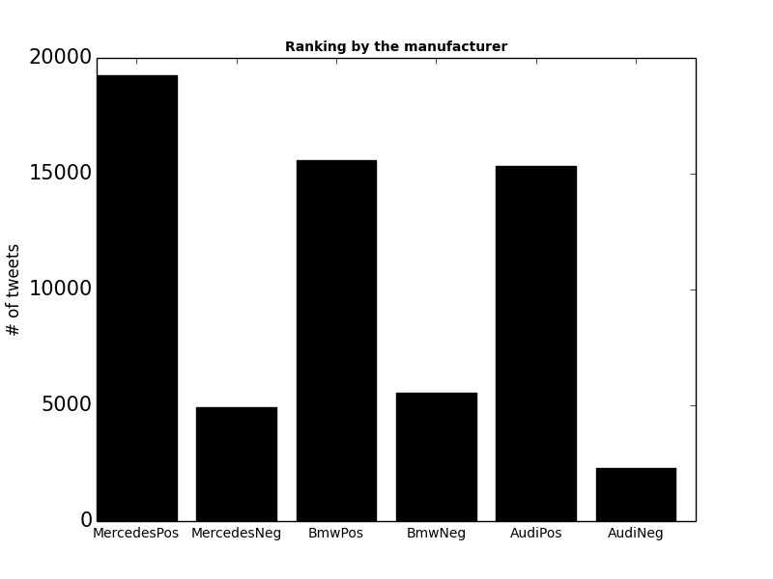
Data obtained

Slide 8
Part 2
Similar implementation using Microsoft software.
Obtaining data from datahub(2012 elections).
Using AFINN dictionary and Hive tables to classify tweets.
Graph using Excel.

Slide 9
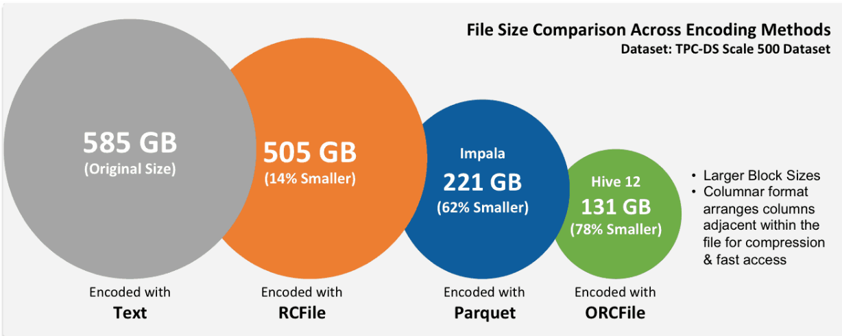
Using ORCFile to store tweet tables

Slide 10
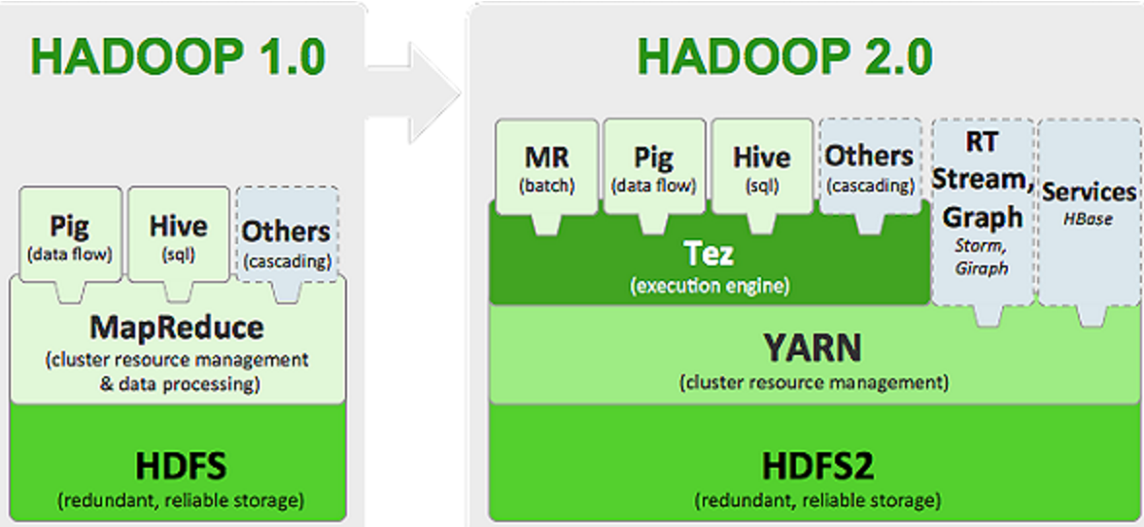
Using Tez as an execution engine

Slide 11
Data obtained for Part 2
*Separate Folder

Slide 12
Questions
What aspect of the project did you find most challenging?
Data Parsing
Difficulties with Microsoft Azure Interface.
Optimization issues

Slide 13
Future implementation
Accomplish and compare the same goals with Decision Trees and Support Vector Machines(SVM).
Gain current data to be able to obtain useful information.

