Slide 1
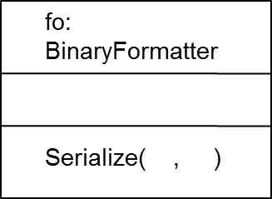
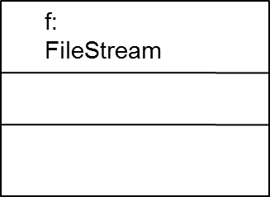
Serialization
Do not forget to add the serializable attribute
to each class whose objects are to be serialize
object structure to be serialized
C
A
B
Since the FileStrem
object is connected
to a file, the stream
is written into the file
The object structure is
serialized and put into
the FileStream object

Slide 2
Deserialization
original
object structure
fo:
BinaryFormatter
C
A
Deserialize( )
B
The FlieStream
object is connected
to a file

