Slide 1
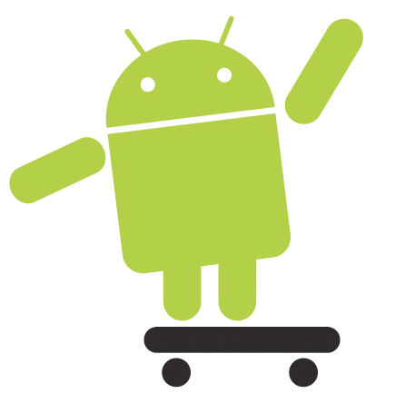
Android
The 9,000 foot Overview
G. Blake Meike
marakana.com

Slide 2
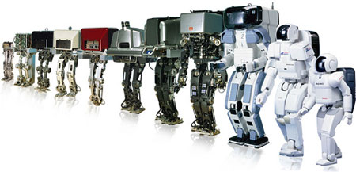
Android Then & Now

Slide 3

History
2005 | Google buys Android, Inc. Work on Dalvik starts
2007 | Open Handset Alliance announced Early Software Development Kit
2008 | HTC G1 Announced SDK 1.0 Released
2009 | G2 + 20 other phones released Cupcake, Donut, Éclair
2010 | Zillion devices FroYo, Gingerbread, JIT
Notes:
History, per Wikipedia
In July 2005, Google acquired Android, Inc., a small startup company based in Palo Alto, California, USA. Android's co-founders who went to work at Google included Andy Rubin (co-founder of Danger),Rich Miner (co-founder of Wildfire Communications, Inc.), Nick Sears (once VP at T-Mobile), and Chris White (headed design and interface development at WebTV). At the time, little was known about the functions of Android, Inc. other than that they made software for mobile phones.[8] This began rumors that Google was planning to enter the mobile phone market, although it was unclear what function it might perform in that market.
At Google, the team led by Rubin developed a mobile device platform powered by the Linux kernel which they marketed to handset makers and carriers on the premise of providing a flexible, upgradeable system.[citation needed] It was reported that Google had already lined up a series of hardware component and software partners and signaled to carriers that it was open to various degrees of cooperation on their part. More speculation that Google would be entering the mobile-phone market came in December 2006. Reports from the BBC and The Wall Street Journal noted that Google wanted its search and applications on mobile phones and it was working hard to deliver that. Print and online media outlets soon reported rumors that Google was developing a Google-branded handset. More speculation followed reporting that as Google was defining technical specifications, it was showing prototypes to cell phone manufacturers and network operators. As many as 30 prototype phones were reported to be operating "in the wild."
In September 2007, InformationWeek covered an Evalueserve study reporting that Google had filed several patent applications in the area of mobile telephony.

Slide 4





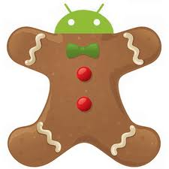

Versions
Version | API Level | Nickname
Android 1.0 | 1
Android 1.1 | 2
Android 1.5 | 3
Android 1.6 | 4
Android 2.1 | 7
Android 2.2 | 8
Android 2.3 | 10
Android 3.2 | 13
Android 4.0.3 | 15

Slide 5
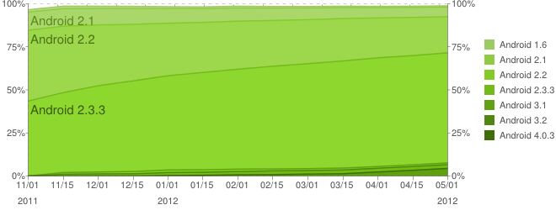
Version Distribution
Source: Android.com

Slide 6

Android Stack

Slide 7
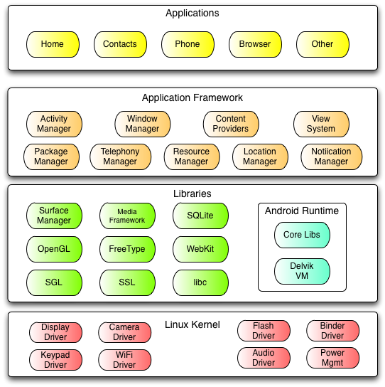
The Stack

Slide 8
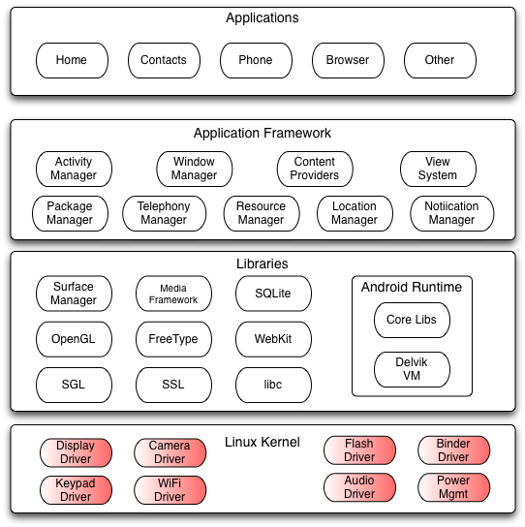
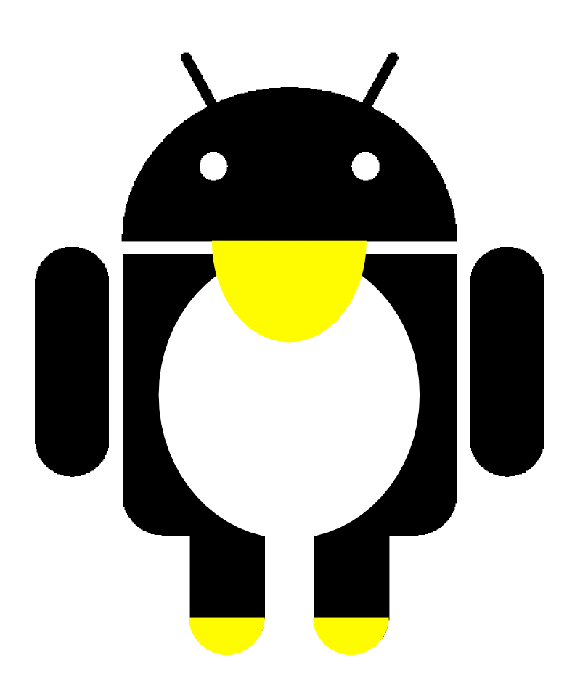
Linux Kernel
Android runs on Linux.
Linux provides:
Hardware abstraction layer
Memory management
Process management
Networking
Users never see Linux sub system
The adb shell command opens Linux shell

Slide 9
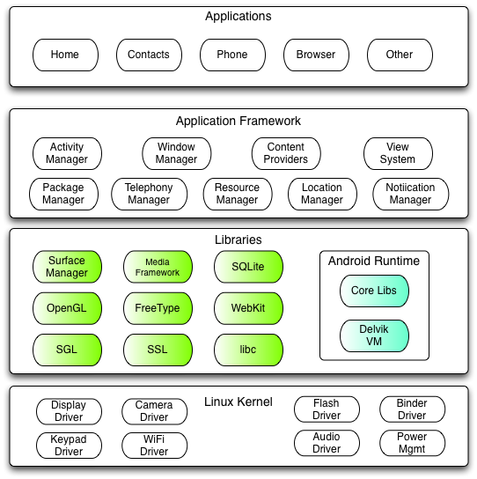
Native Libraries
Pieces borrowed from other open source projects:
Bionic, a super fast and small license-friendly libc library optimized for Android
WebKit library for fast HTML rendering
OpenGL for graphics
Media codecs offer support for major audio/video codecs
SQLite database
Much more…
Notes:
Libraries are written in C/C++ and compiled for the particular hardware.

Slide 10

Dalvik
Now with JIT
Dalvik VM is Android implementation of
Java VM
Dalvik is optimized for mobile devices:
  Battery consumption
  CPU capabilities
Key Dalvik differences:
  Register-based versus stack-based VM
  Dalvik runs .dex files
  More efficient and compact implementation
  Different set of Java libraries than JDK
Notes:
The Dalvik virtual machine is a major piece of Google's Android platform for mobile devices. It runs Java platform applications which have been converted into a compact Dalvik Executable (.dex) format suitable for systems that are constrained in terms of memory and processor speed. It was written by Dan Bornstein, who named it after the fishing village of Dalvík in Eyjafjörður, Iceland, where some of his ancestors lived.
Unlike most virtual machines and true Java VMs which are stack machines, the Dalvik VM is a register-based architecture. Like the CISC vs. RISC debate, the relative merits of these two approaches is a subject of continuous argument but the underlying technology sometimes blurs the ideological boundaries. Moreover, the relative advantages of the two approaches depend on the interpretation/compilation strategy chosen. Generally, however, stack based machines must use instructions to load data on the stack and manipulate that data and thus require more instructions than register machines to implement the same high level code. However, the instructions in a register machine must encode the source and destination registers and therefore tend to be larger. This difference is primarily of importance to VM interpreters for whom opcode dispatch tends to be expensive and other factors are relevant for JIT compilation.
A tool called dx is used to convert Java .class files into the .dex format. Multiple classes are included in a single .dex file. Duplicate strings and other constants used in multiple class files are included only once in the .dex output to conserve space. Java bytecode is also converted into an alternate instruction set used by the Dalvik VM. An uncompressed .dex file is typically a few percent smaller in size than a compressed .jar (Java Archive) derived from the same .class files.
The Dalvik executables may be modified again when they get installed onto a mobile device. In order to gain further optimizations, byte order may be swapped in certain data, simple data structures and functions libraries may be linked inline, and empty class objects may be short-circuited, for example.
Being optimized for low memory requirements, Dalvik has some specific characteristics that differentiate it from other standard VMs[3]:
* The VM was slimmed down to use less space.
* Dalvik has no Just-in-time compiler
* The constant pool has been modified to use only 32-bit indexes to simplify the interpreter.
* It uses its own bytecode, not Java bytecode.

Slide 11
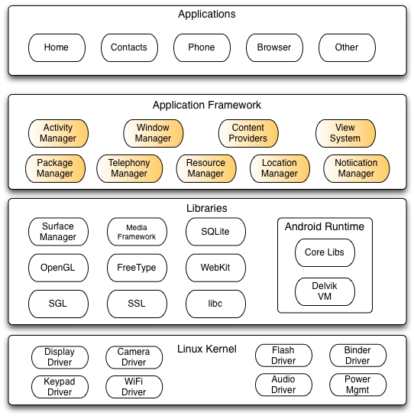
Application Framework
The rich set of system services wrapped in an intuitive Java API.
This ecosystem that developers can easily tap into is what makes writing apps for Android easy.
Location, web, telephony, WiFi, Bluetooth, notifications, media, camera, just to name a few.

Slide 12
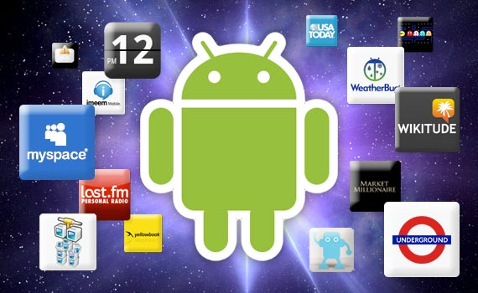
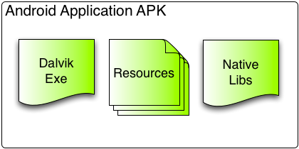
Applications
Dalvik Executable + Resources = APK
Must be signed (but debug key is okay for development)
Many markets with different policies

Slide 13
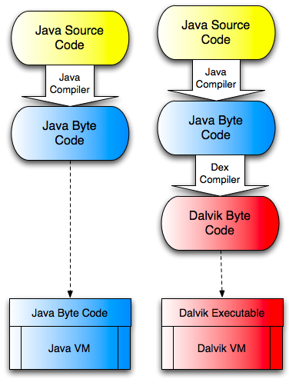
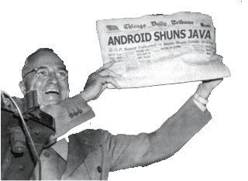
Android and Java
Android Java
=
Java SE
–
AWT/Swing
+
Android API

