Slide 1

Platform Comparisons

Slide 2
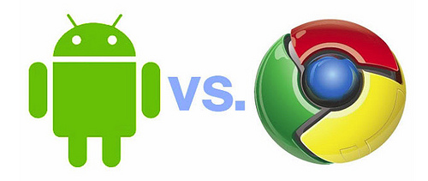
Android Versus Chrome
Android is designed for variety of devices, from phones to set-top boxes. Chrome is web-centric and designed for PCs with keyboards.
While there’s a lot of overlap, Google is hedging bets on the future of innovation. Overlap is good, but confusing.
Android has traction today, Chrome potential tomorrow.

Slide 3
Android Versus iPhone
Pros | Cons
Android is open for developers Android does multitasking, background services Users can customize their phone Carriers and OEMs can customize entire platform Android runs on many devices | iPhone is sexier for users iPhone has better development tools iPhone has more apps iPhone is more intuitive to use iPhone hardware is slicker iPhone appears to run faster

Slide 4
Android Versus BlackBerry
Pros | Cons
Easier to develop for More apps | Larger market share Superb enterprise support, security Faster hardware

Slide 5
Android Versus JavaME
Pros | Cons
Complete platform Pragmatic approach to development Much friendlier license | Incompatible apps across OEMs One VM for all apps, insecure Costs $

Slide 6
Android Versus BREW/Symbian/Etc
Pros | Cons
“Fully” open-sourced platform with no strings attached Many app stores Device-agnostic Mass developer market (Java, not C) | Newcomer with lower adoption Requires higher-end phones Fragmentation Viruses, spyware Unproven model

Slide 7
Competitive Canvas

Slide 8

Summary
Android is open and complete system for mobile development. It is based on Java and augmented with XML.
Android is being adopted very quickly both by users, carriers, and manufacturers.
It takes about 3-5 days of intensive training to learn Android application development for someone who has basic Java (or similar) experience.
Marko Gargenta, Marakana.com
marko@marakana.com
+1-415-647-7000
Licensed under Creative Commons License (cc-by-nc-nd) – non-commercial. Please Share!

