Slide 1

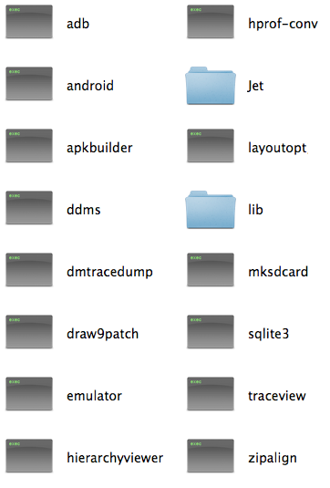
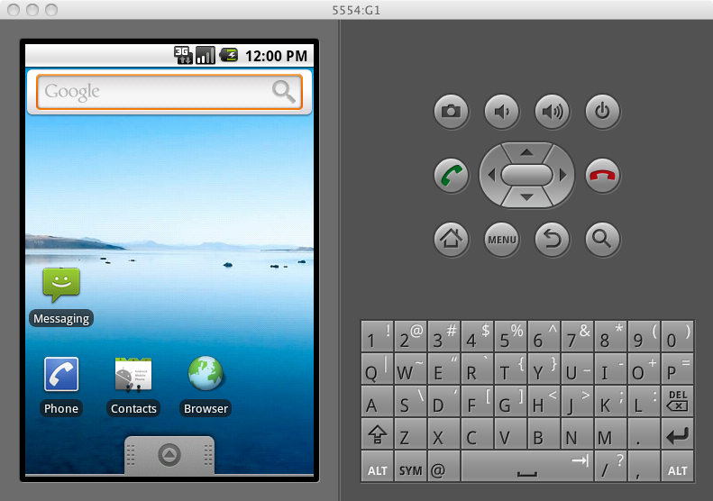
Android SDK - What’s In The Box
SDK
Tools
Docs
Platforms
Data
Skins
Images
Samples
Add-ons
Google

Slide 2
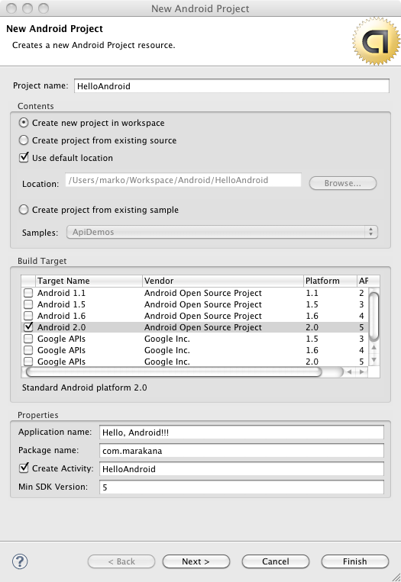
Create New Project
Use the Eclipse tool to create a new Android project.
Here are some key constructs:
Project | Eclipse construct
Target | minimum to run
App name | whatever
Package | Java package
Activity | Java class

Slide 3
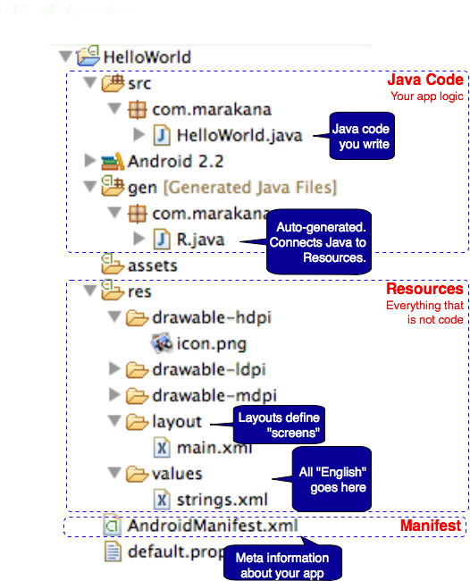
Anatomy of An App
Java Code
+
XML and Other Resources
+
Manifest File
=
Android App

Slide 4

The Manifest File
<?xml version="1.0" encoding="utf-8"?>
<manifest xmlns:android="http://schemas.android.com/apk/res/android"
package="com.marakana"
android:versionCode="1"
android:versionName="1.0">
<application android:icon="@drawable/icon"
android:label="@string/app_name">
<activity android:name=".HelloAndroid"
android:label="@string/app_name">
<intent-filter>
<action android:name="android.intent.action.MAIN" />
<category android:name="android.intent.category.LAUNCHER" />
</intent-filter>
</activity>
</application>
<uses-sdk android:minSdkVersion="5" />
</manifest>

Slide 5
The Layout Resource
<?xml version="1.0" encoding="utf-8"?>
<LinearLayout xmlns:android="http://schemas.android.com/apk/res/android"
android:orientation="vertical"
android:layout_width="fill_parent"
android:layout_height="fill_parent"
>
<TextView
android:layout_width="fill_parent"
android:layout_height="wrap_content"
android:text="@string/hello"
/>
</LinearLayout>

Slide 6

The Java File
package com.marakana;
import android.app.Activity;
import android.os.Bundle;
public class HelloAndroid extends Activity {
/** Called when the activity is first created. */
@Override
public void onCreate(Bundle savedInstanceState) {
super.onCreate(savedInstanceState);
setContentView(R.layout.main);
}
}

Slide 7
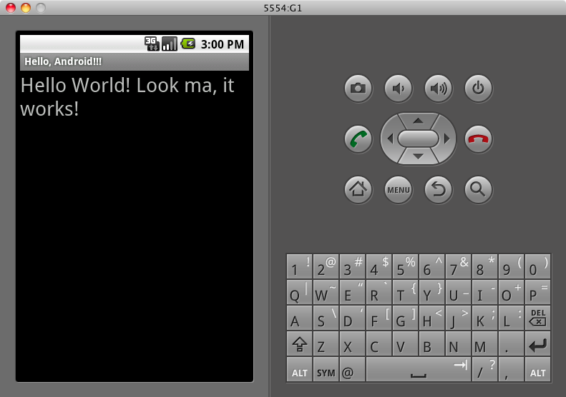
Running on Emulator
Emulator, not a simulator

