Slide 1
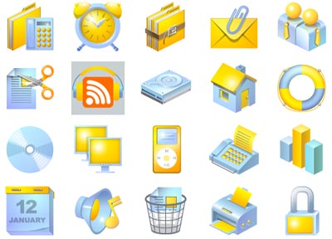
Android User Interface

Slide 2


Two UI Approaches
Procedural | Declarative
You write Java code Similar to Swing or AWT | You write XML code Similar to HTML of a web page
You can mix and match both styles. Best practice:
  Start with XML and declare most of UI
  Switch to Java and implement the UI logic

Slide 3
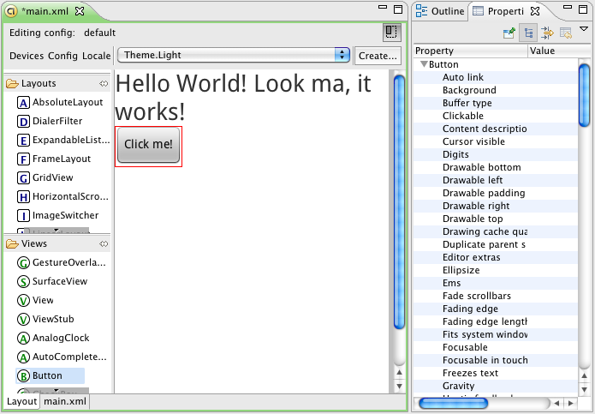
XML-Based User Interface
Use WYSIWYG tools to build powerful XML-based UI.
Easily customize it from Java. Separate concerns.
Notes:
Build UI as if it was a web page
Put your UI XML files in Resources directory
res/layout
Get a handle of your UI in Java
setContentView()
findViewById()
Easy tools for generating UI in XML
Easy separation of concerns

Slide 4
Common View Properties
Layout Width | FILL_PARENT, WRAP_CONTENT or a specific size in units.
Layout Height | FILL_PARENT, WRAP_CONTENT or a specific size in units.
Layout Weight | How greedy or generous a widget is. Value is 0 to 1.
Layout Gravity | How to align widget within parent
Gravity | How to align content of widget within itself
Id | Unique id of this widget, usually @+id/someUniqueId
Text | Text for the content of the component, usually @string/myText

Slide 5
Dips and Sps
px (pixel) | Dots on the screen
in (inches) | Size as measured by a ruler
mm (millimeters) | Size as measured by a ruler
pt (points) | 1/72 of an inch
dp (density-independent pixel) | Abstract unit. On screen with 160dpi, 1dp=1px
dip | synonym for dp and often used by Google
sp | Similar to dp but also scaled by users font size preference

Slide 6
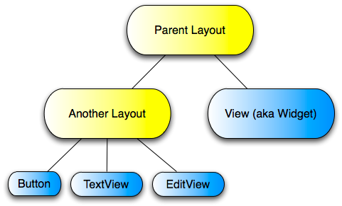
Views and Layouts
Layouts contain widgets and other layouts forming a “composite” pattern.

Slide 7
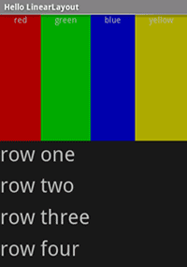
Linear Layout
One of the most commonly used layouts. It lays its children next to each other, either horizontally or vertically.
Notes:
http://d.android.com/resources/tutorials/views/hello-linearlayout.html

Slide 8
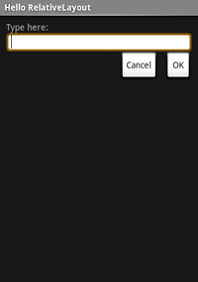
Relative Layout
Children of relative layout are placed in relationship to each other. This layout is efficient.
Notes:
http://d.android.com/resources/tutorials/views/hello-relativelayout.html

Slide 9
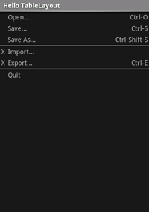
Table Layout
Table layout puts its children into table rows and columns. It is similar to an HTML table.
Notes:
http://d.android.com/resources/tutorials/views/hello-tablelayout.html

Slide 10
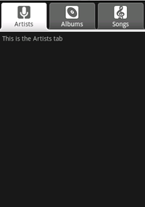
Frame Layout
Frame layout places its children on top of each other, like a deck of cards. It is useful for widgets such as tabs or as a placeholder for views added programmatically.
Notes:
http://d.android.com/resources/tutorials/views/hello-tabwidget.html

Slide 11


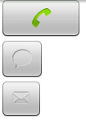
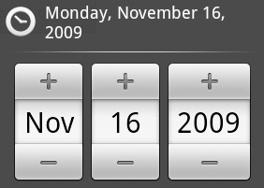
Common UI Components
Android UI includes many common modern UI widgets, such as Buttons, Tabs, Progress Bars, Date and Time Pickers, etc.

Slide 12
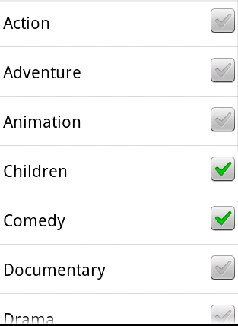
Selection Components
Some UI widgets may be linked to zillion pieces of data. Examples are ListView and Spinners
(pull-downs).

Slide 13
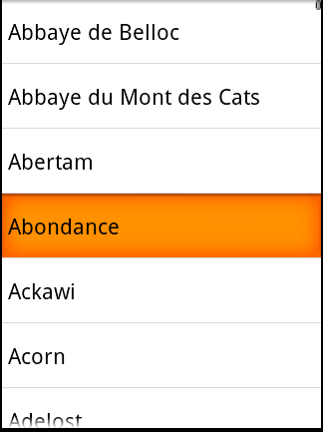
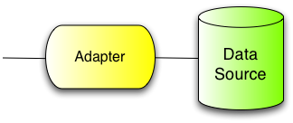
Adapters
To make sure they run smoothly, Android uses Adapters to connect them to their data sources. A typical data source is an Array or a Database.

Slide 14
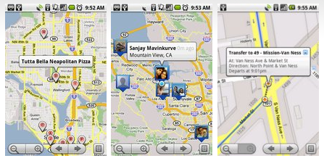
Complex Components
Certain high-level components are simply available just like Views. Adding a Map or a Video to your application is almost like adding a Button or a piece of text.

Slide 15
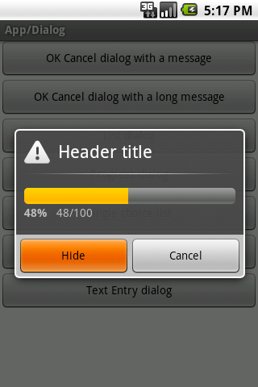
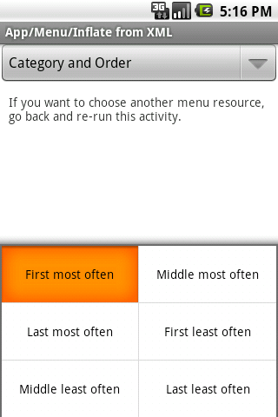
Menus and Dialogs

Slide 16
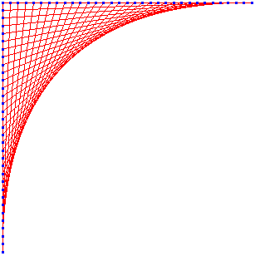
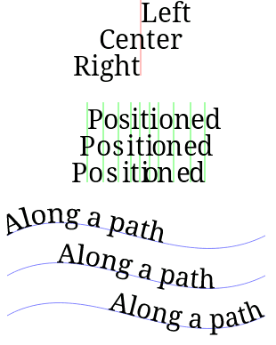
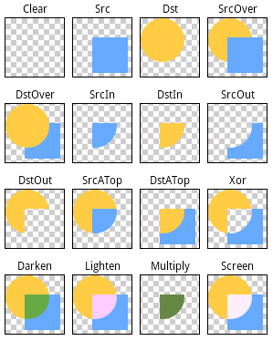
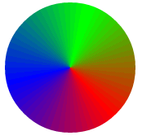
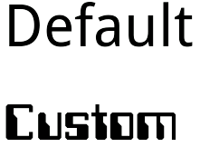

Graphics & Animation
Android has rich support for 2D graphics.
You can draw & animate from XML.
You can use OpenGL for 3D graphics.

Slide 17

Multimedia
AudioPlayer lets you simply specify the audio resource and play it.
VideoView is a View that you can drop anywhere in your activity, point to a video file and play it.
XML:
<VideoView
android:id="@+id/video"
android:layout_width="fill_parent"
android:layout_height="fill_parent"
android:layout_gravity="center” />
Java:
player = (VideoView) findViewById(R.id.video);
player.setVideoPath("/sdcard/samplevideo.3gp");
player.start();

