Slide 1
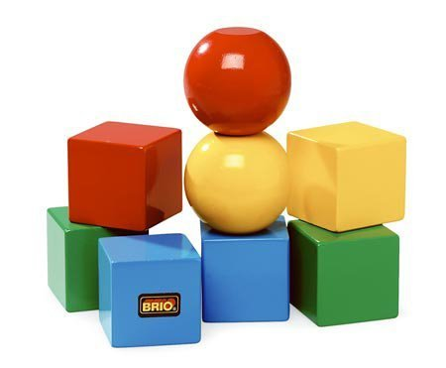
Main Building Blocks

Slide 2
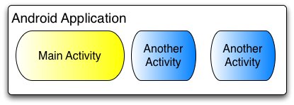
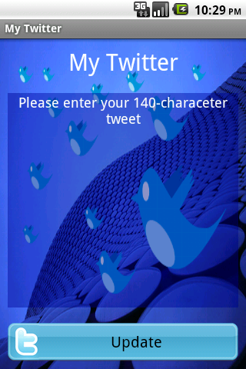
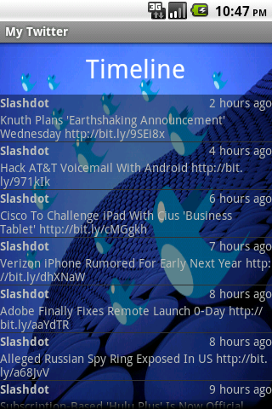
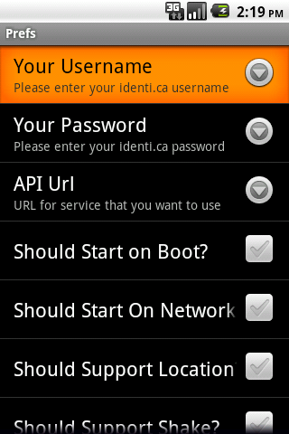
Activities
An Activity represents a screen or a window. Sort of.

Slide 3
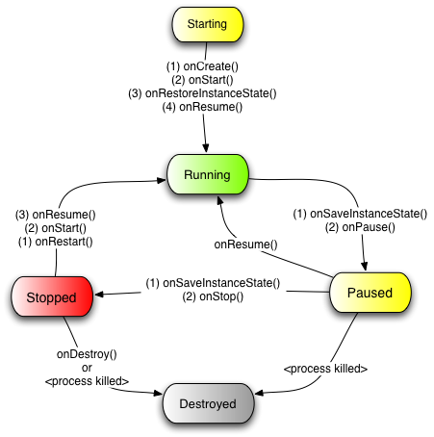
Activity Lifecycle
Activities have a well-defined lifecycle. The Android OS manages your activity by changing its state. You fill in the blanks.

Slide 4
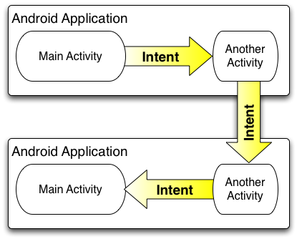
Intents
Intents represent events or actions.
They are to Android apps what hyperlinks are to websites. Sort of.
Intents can be implicit or explicit.

Slide 5
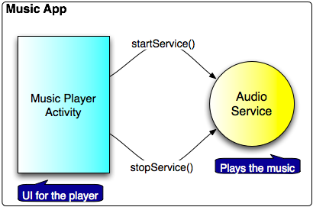
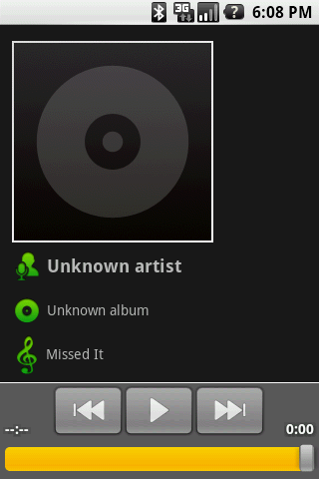
Services
Services are code that runs in the background. They can be started and stopped. Services doesn’t have UI.

Slide 6
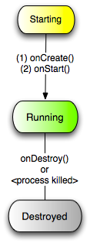
Service Lifecycle
Service also has a lifecycle, but it’s much simpler than activity’s.
An activity typically starts and stops a service to do some work for it in the background, such as play music, check for new tweets, etc.
Services can be bound or unbound.

Slide 7
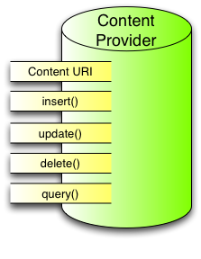
Content Providers
Content Providers share content with applications across application boundaries.
Examples of built-in Content Providers are: Contacts, MediaStore, Settings and more.

Slide 8
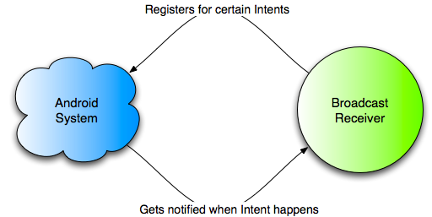
Broadcast Receivers
An Intent-based publish-subscribe mechanism. Great for listening system events such as SMS messages.

