Slide 1
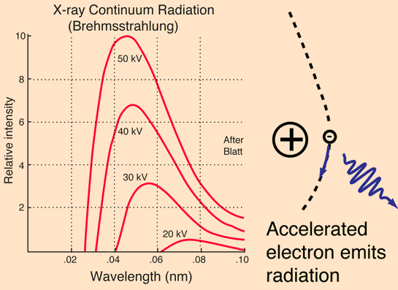
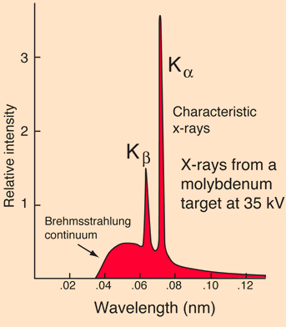
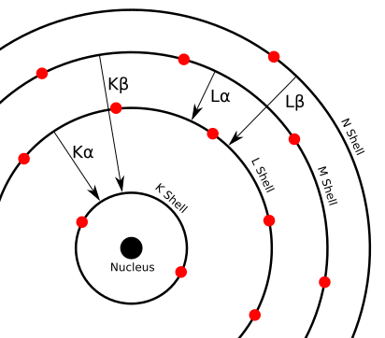
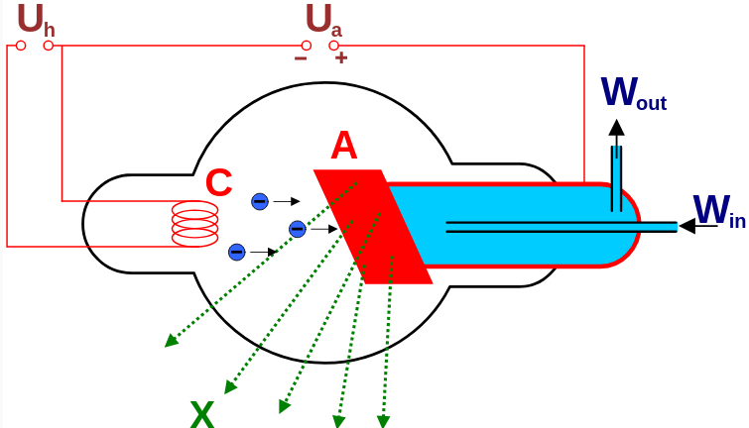
X-ray spectroscopy. Emission spectra of metals

Slide 2
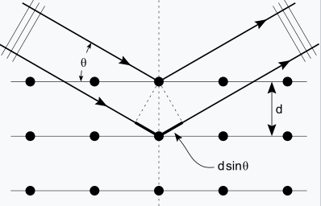
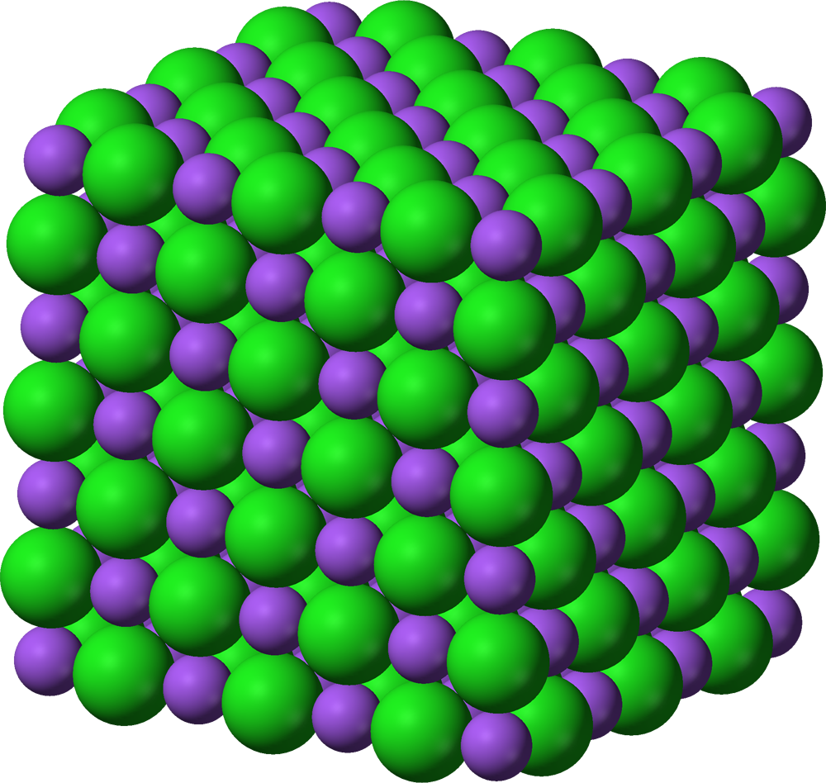
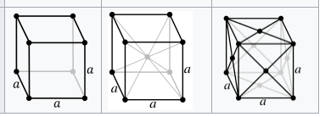

Registration of x-ray spectra
Energy-dispersive X-ray spectroscopy
Wavelength-dispersive X-ray spectroscopy
Semiconductor detectors:
Si(Li)
Silicon Drift Detectors
PiN diodes
+
Multichannel analyzers
Bragg diffraction at single crystal monochromator
+
Scintillation counter
Geiger counter
Extinction rules for cubic lattices:
Primitive: all present
Body-centered: h+k+l=even
Face-centered: all odd or all even
For NaCl-type crystals oriented
Along main axis: (002), (004)...

Slide 3
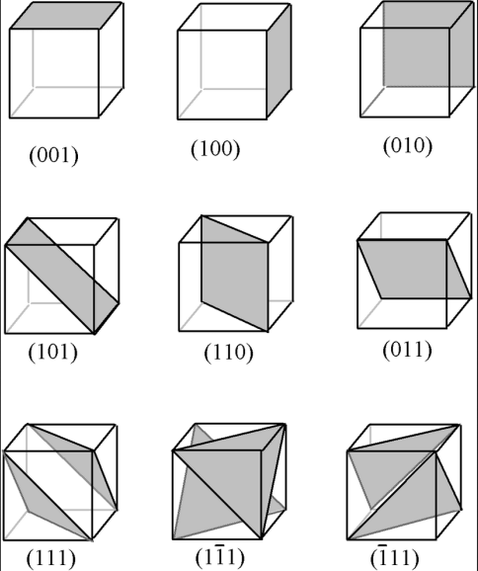
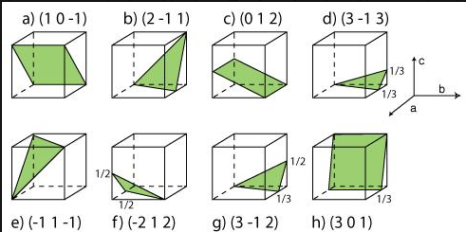
Miller indeces

