Slide 1
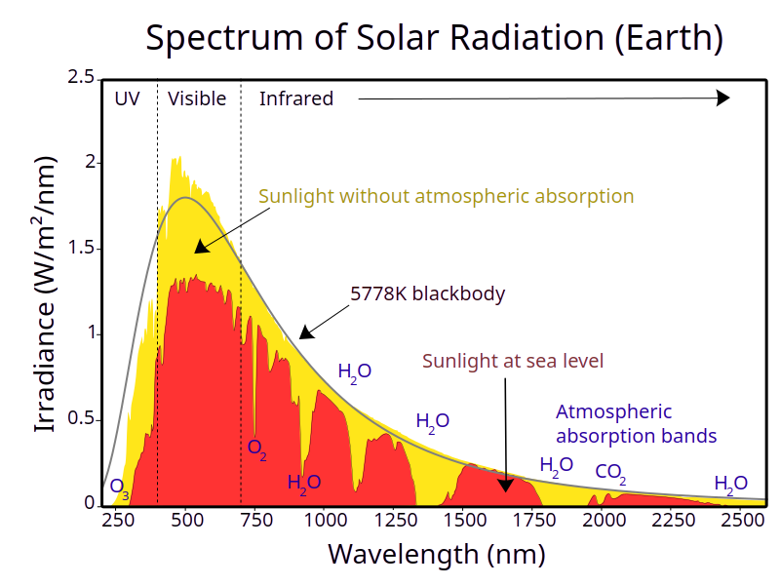
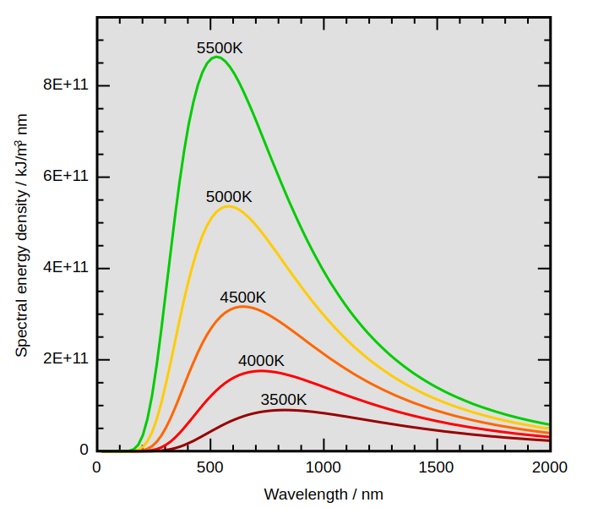
Electromagnetic spectrum
Blackbody radiation

Slide 2
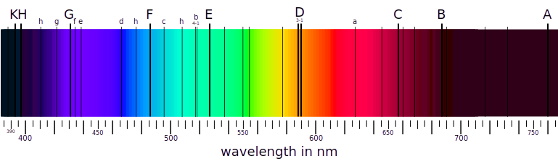

Hydrogen emission spectrum
Solar spectrum
With Fraunhofer lines
Balmer series.
Color | Wave-length | Relative strength
red | 656.27 | 50
cyan | 486.13 | 20
blue | 434.05 | 9
viotel | 410.17 | 7
Balmer formula:
m=2 n=3,4,5,6...7…
h=364.56 nm
Balmer’s prediction: n = 7 gives 397 nm wavelength

Slide 3

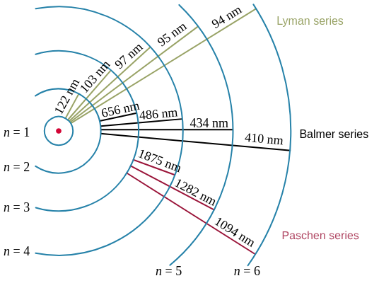
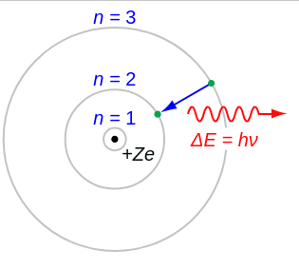
What is the physical meaning
of n_1 and n_2?
Next step – Rydberg formula
For hydrogen-like atoms
Z – atomic number
R=10967758.3
Bohr model of the hydrogen atom:
1. The electron is able to revolve in “stationary” orbits
without radiating electro-magnetic waves
2. The angular momentum of the electron on stationary orbit
is proportional to natural number n – main quantum number
3. Electron can only jump between stationary orbits
absorbing or emitting portions of energy determined by
the difference of orbits energy according to Planck’s relation
The origin of absorption
and emission spectra

Slide 4
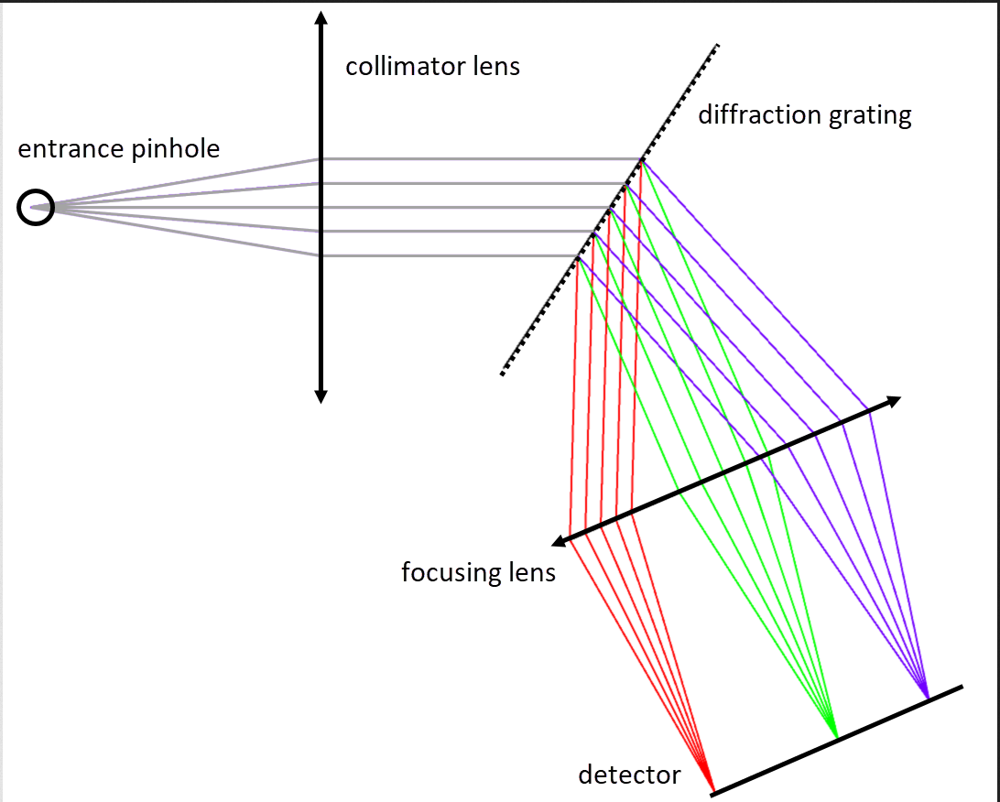
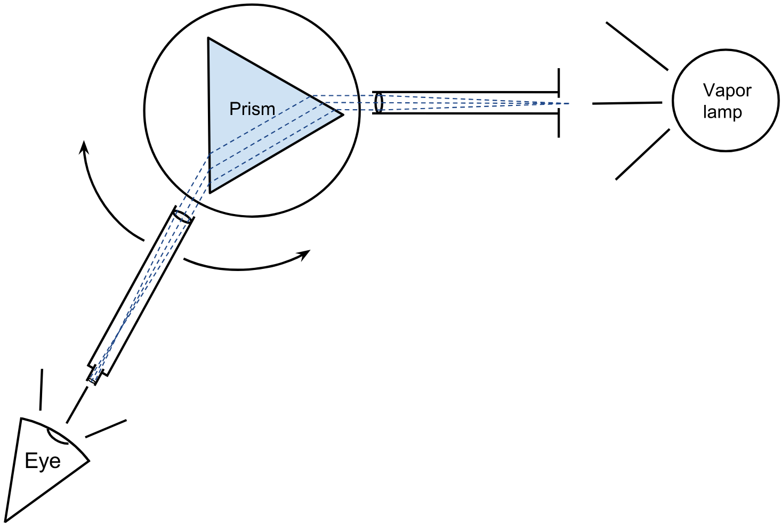
Rydberg constant belongs to the List of Fundamental Physical constants
Measuring it’s value we are touching the very fundamentals of our Univers
Our experiments
Classic spectrometers:
with prism and with diffraction grating as a dispersive element

Slide 5
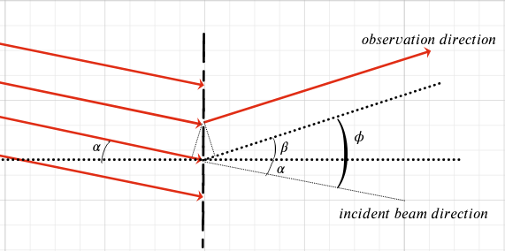
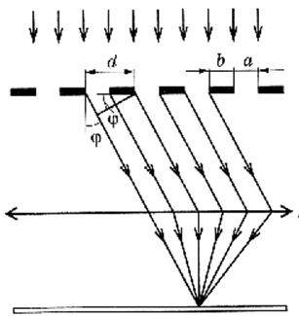
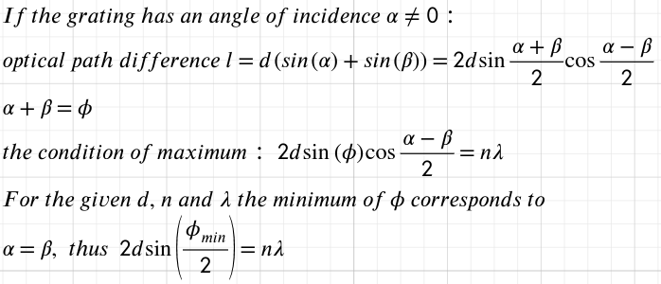


Slide 6
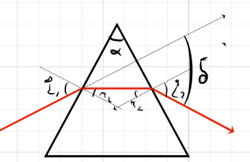
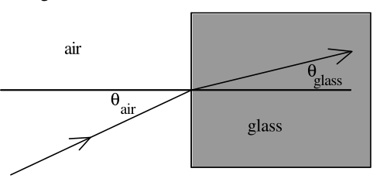
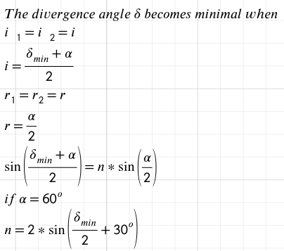
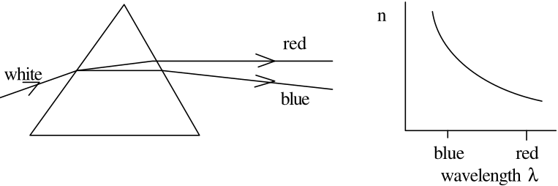

Cauchy formula

Slide 7
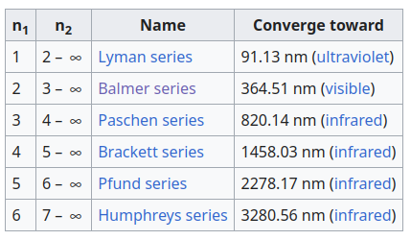

For hydrogen-like atoms
Z – atomic number
Rydberger formula:
R=10967758.3
n2 – principal quantum number of higher energy level
n1- principal quantum number of lower energy level
Moseley’s low

