Slide 1
Social Network
Username
Username
John
John
Password
******
Password
Confirm Password
******
**********
Name
John Parsley
Login
Email
johnny@gmail.com
Gender
Male
Female
Other
Register

Slide 2








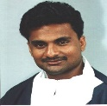




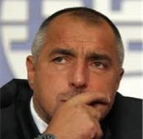
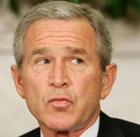



John Parsley
Search…
1
News Feed
Friends – 5 total
Jack Jackson
1 Jan 2015 18:22:35
I challenge John Cena to a deathmatch!
3
Like
1
Comment
Maria
Jack Jackson
George
Cena
1 Jan 2015 19:03:00
What did you just say to me!?
1
Unlike
Bat Boiko
Nakov
Nakov
29 Dec 2014 09:16:58
Oi lamio…
4
Comment
231
Like
Jack Jackson

Slide 3

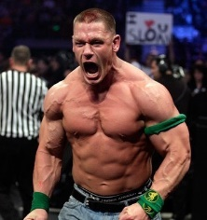

John Parsley
Search…
1
News Feed
Friends – 5 total
Jack Jackson
1 Jan 2015 18:22:35
I challenge John Cena to a deathmatch!
3
Like
1
Comment
Maria
Jack Jackson
George
Cena
1 Jan 2015 19:03:00
What did you just say to me!?
1
Unlike
Bat Boiko
Nakov
Cena
Nakov
Invite
29 Dec 2014 09:16:58
Oi lamio…
4
Comment
231
Like
Jack Jackson

Slide 4


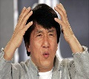
John Parsley
Jack_
1
Jack Jackson
News Feed
Jackie Chan
2 results total
Friends – 5 total
Jack Jackson
1 Jan 2015 18:22:35
I challenge John Cena to a deathmatch!
3
Like
1
Comment
Maria
Jack Jackson
George
Cena
1 Jan 2015 19:03:00
What did you just say to me!?
1
Unlike
Bat Boiko
Nakov
Nakov
29 Dec 2014 09:16:58
Oi lamio…
4
Comment
231
Like

Slide 5

John Parsley
Search…
1
Eddie Murphy
News Feed
Accept
Reject
1 result total
Friends – 5 total
Jack Jackson
1 Jan 2015 18:22:35
I challenge John Cena to a deathmatch!
3
Like
1
Comment
Maria
Jack Jackson
George
Cena
1 Jan 2015 19:03:00
What did you just say to me!?
1
Unlike
Bat Boiko
Nakov
Nakov
29 Dec 2014 09:16:58
Oi lamio…
4
Comment
231
Like
Jack Jackson

Slide 6
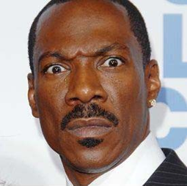
John Parsley
Search…
News Feed
Friends – 6 total
Jack Jackson
1 Jan 2015 18:22:35
I challenge John Cena to a deathmatch!
3
Like
1
Comment
Maria
Jack Jackson
George
Cena
1 Jan 2015 19:03:00
What did you just say to me!?
1
Unlike
Bat Boiko
Nakov
Eddie Murphy
Nakov
29 Dec 2014 09:16:58
Oi lamio…
4
Comment
231
Like

Slide 7
John Parsley
Search…
John Parsley – Friends (6 total)
Name filter:
Search…
 | Maria |  | Bat Boiko
 | Jack Jackson |  | Nakov
 | George |  | Eddie Murphy
Jack Jackson

Slide 8
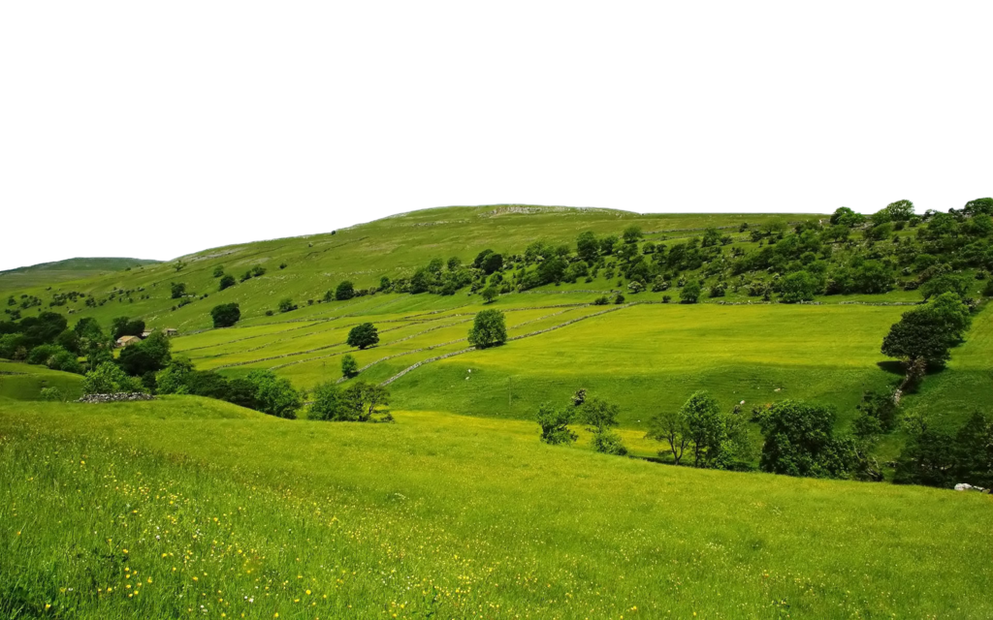




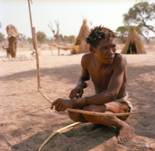
John Parsley
Search…
Jack Jackson
Friend
Message…
John Parsley
1 Jan 2015 22:22:35
as John Parsley
Submit
Happy birthday, Jack!
3
Like
Comment
Friends – 33 total
Jack Jackson
1 Jan 2015 22:25:35
Thanks, buddy!
Like
Maria
Jamal
George
Jack Jackson
1 Jan 2015 22:28:35
Let’s go get some beers?
1
Unlike
Cena
Bat Boiko
Nakov

Slide 9

John Parsley
Search…
Edit Profile
Name
John Parsley
Email
johnny@gmail.com
Gender
Male
Female
Other
Allowed format: .jpg
Limit: 128kb
Upload
Upload
Limit: 1024kb
Save Changes

Slide 10
John Parsley
Search…
Change Password
Old password
****
New password
***********
Confirm password
***********
Save Changes

